Slide 1
Agile Planning: Step-by-Step Guide
Sprint Retrospective

Slide 2
Sprint Retrospective: Why
The sprint retrospective is an inspect-and-adapt activity performed at the end of every sprint.
The sprint retrospective is a continuous improvement opportunity for a Scrum team to review its process (approaches to performing Scrum) and to identify opportunities to improve it.

Slide 3
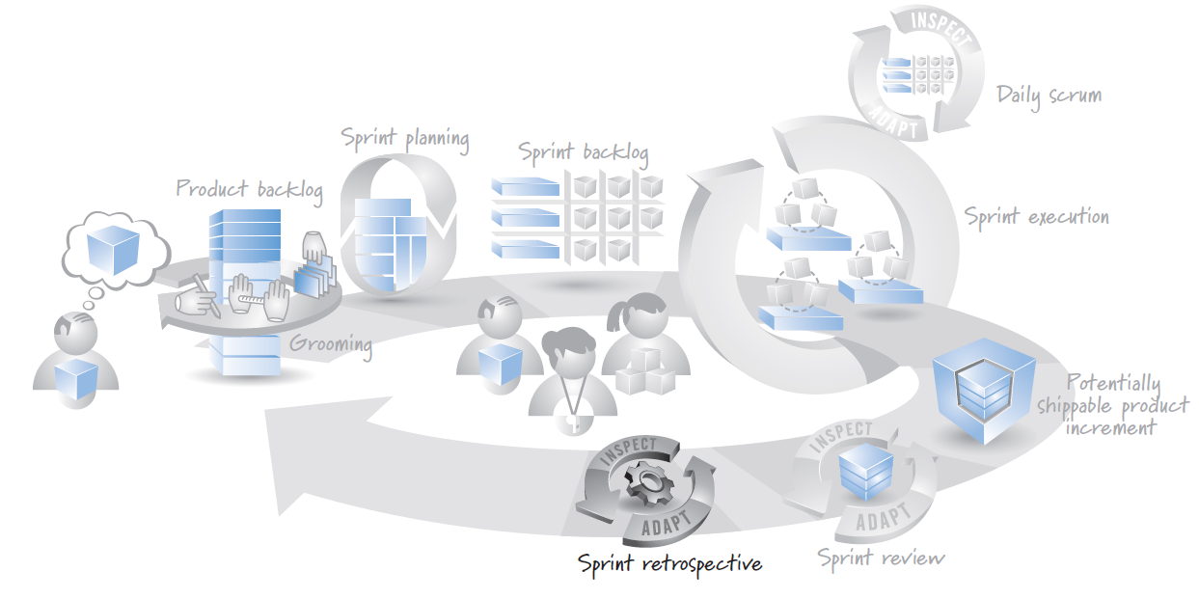
Sprint Retrospective: When

Slide 4
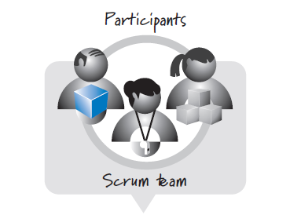
Sprint Retrospective: Who

Slide 5
Sprint Retrospective: How
sprint retrospective can be as simple as the Scrum team members coming together to discuss questions such as
What worked well this sprint that we want to continue doing?
What didn’t work well this sprint that we should stop doing?
What should we start doing or improve?
Based on their discussions, team members determine a few actionable changes to make and then get on with the next sprint with an incrementally improved process.

Slide 6
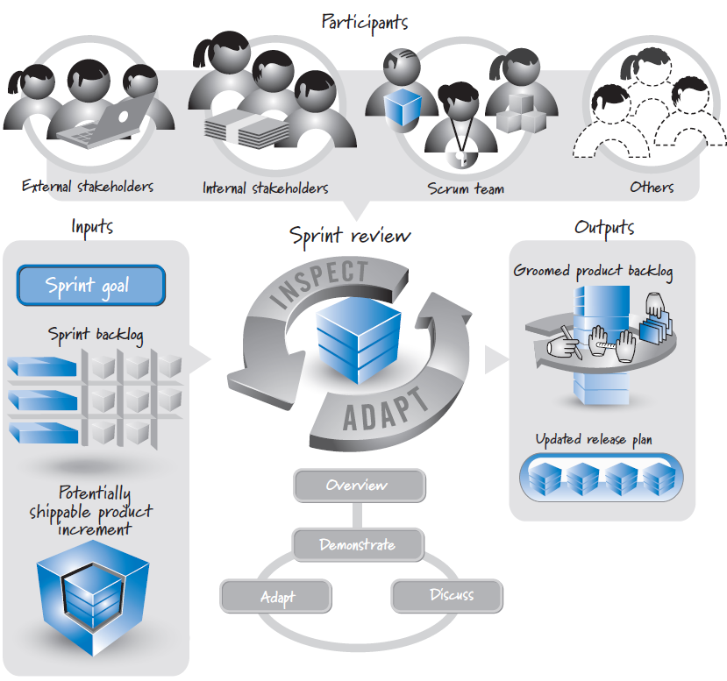
Sprint Retrospective: Overview

Slide 7

References
Kenneth S. Rubin, Essential Scrum: A Practical Guide to the Most Popular Agile Process, 2012, Addison-Wesley

