Slide 1
Categorizing the content of GitHub README Files
A project for ENSF-612, Fall-2021
Presented by
Bhavyai Gupta, Kayode Awe, and Michael Man Yin Lee
16-November-2021

Slide 2
Data Collection Breakdown
Cat# | Section Type | Section Count for Original Files | Section Count for new Files | Total
Category 1: | What | 707 | 216 | 923
Category 2: | Why | 116 | 0 | 116
Category 3: | How | 2467 | 540 | 3007
Category 4: | When | 180 | 30 | 210
Category 5: | Who | 322 | 73 | 395
Category 6: | References | 858 | 179 | 1037
Category 7: | Contribution | 122 | 26 | 148
Category 8: | Other | 58 | 5 | 63
Note: Section Count for new Files are not finalized and may subject to changes in the future.

Slide 3
The quality of data labeling.
Categories used in classifying data
Agreement between data labelers
Resolution of disagreements

Slide 4
Categories used in classifying each README sections
Code# | Category | Example section headings
1 | What | Introduction, project background
2 | Why | Advantages of the project, comparison with related work
3 | How | Getting started/quick start, how to run, installation, how to update, configuration,setup, requirements, dependencies, languages, platforms, demo, downloads, errors and bugs
4 | When | Project status, versions, project plans, roadmap
5 | Who | Project team, community, mailing list, contact, acknowledgement, license, code of conduct
6 | References | API documentation, getting support, feedback, more information, translations, related projects
7 | Contributions | Contributing guidelines
8 | other

Slide 5

Agreement between data labelers
Percent agreement and Cohen kappa were used to determine the agreement between two data labelers.
The results show that both metric were very close with over 90% agreement between the labelers.
Table 1: Result from the percentage agreement computation

Slide 6
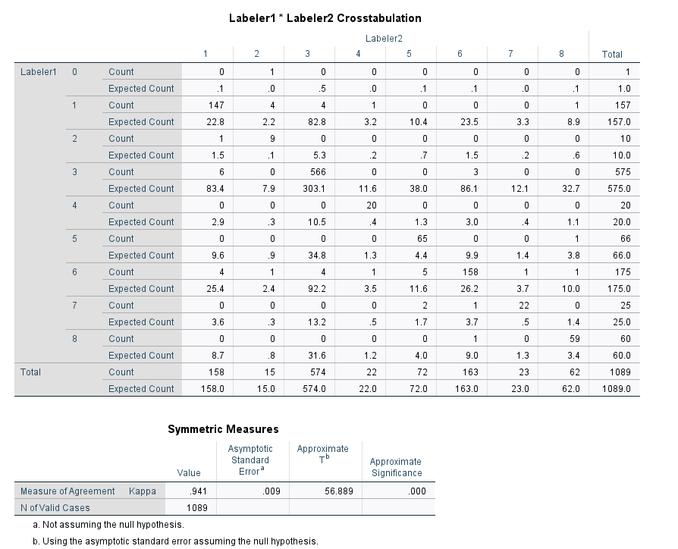
Table 2: Result of Cohen kappa analysis with agreement 0f 94.1%

Slide 7
Disagreement resolution.
The instances where the labelers disagreed were re-examined to arrive at the final code for the sections.
Some of the most common area of disagreement are in the “Title” sections and some other sections that are ambiguous.
For example ,in the “Question and answer” section of ashgadala.WordPress-Skeleton.md , one labeler categorized it as 1 & 3, while the other labeler categorized as 3.

Slide 8
Disagreement resolution contd
The reasoning from the first labeler was that while the section was gave a breif explanation of the project, there is also some instructions being given at the same time, making thie section to be categorized as ”what” by the labeler.
The second labeler was convinced that the section was only giving explanation about the project which explained the reason for the choice of 3.

Slide 9
Collecting data
Developed "readme_downloader.py"
It downloads README.md files from GitHub using GitHub API
Files downloaded are randomly chosen but unique
Files downloaded belong only to the Software Development repository and have size greater than 2 KB.

Slide 10
Pre-processing of data
Content Abstraction
It abstracts contents to their types
The below table summarizes the content abstraction
Type | Abstracted text
Code snippets | @abstr_code_section
Numbers | @abstr_number
Images | @abstr_image
Hyperlinks | @abstr_hyperlink
mailto links | @abstr_hyperlink

Slide 11
Pre-processing of data
Tokenization and Stop Word removal
Tokenization and stop word removal done using "sklearn" instead of "nltk"
Both are done when instantiating TfidfVectorizer
tfidf = TfidfVectorizer(ngram_range=(1,1), analyzer='word', stop_words='English')

Slide 12
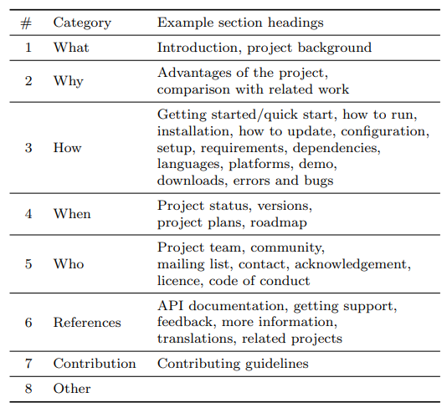
Pre-processing of data
Encoding
README sections are classified based on what they answer about the project
These classifications are numbered from 1 to 8 respectively during manual classification and predictions
As part of pre-processing, MultiLabelBinarizer is used to encode these numbers

Slide 13
Data Features - Statistical
TF-IDF
TF means Term Frequency
Number of times a word appears in each section
IDF means Inverse Document Frequency
Reciprocal of the number of sections in which the word appears
TF-IDF means TF * IDF

Slide 14
Data Features - Heuristic
Heuristic features are categorized into 4 types –
Linguistic Patterns
Single-Word Non-English Heading
Repository Name
Non-ASCII Content Text
Total 55 binary heuristic features derived from the headings and content separately.

Slide 15
Machine Learning Model and its Features
Data Input (Readme Files)
Feature Extraction
(Statistical and Heuristic)
Modelling
Validation

Slide 16
Modelling and Validation
Author’s original models:
RandomForestClassifier
LinearSVC
GaussianNB
LogisticRegression
KNeighborsClassifier
Additional Models used:
BaggingClassifier
ExtraTreesClassifier
DecisionTreeClassifier
AdaBoostClassifier
HistGradientBoostingClassifier
Notes:
As for the target vector, we will use the section labelling that we did manually as well as the ones defined by the authors.
Now for the model, we will test out the performance of the original models that were experiemented by the author, which are:
RandomForestClassifier
LinearSVC
GaussianNB
LogisticRegression
KNeighborsClassifier
As well as additional models that were not experimented before:
BaggingClassifier
ExtraTreesClassifier
DecisionTreeClassifier
AdaBoostClassifier
HistGradientBoostingClassifier
The data will be split where 25% is used for training and the 75% is for validating the model using a 10-fold cross validation.
The score will then be calculated in terms of its overall performance, from then on we can evaluate and optimize the model as part of this project.

Slide 17
Thank you for listening and see you in our next presentation!

