Slide 1
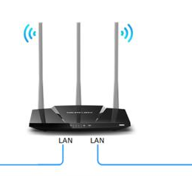
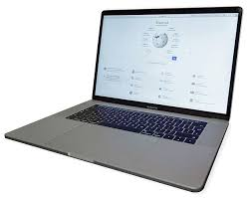
4
典型DDS数据分发演示
Video stream
PC1 obtains camera information and publishes video stream
PC2 receives the video stream and displays it

Slide 2
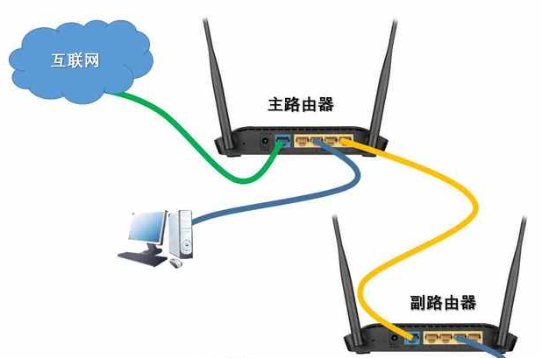
internet
router1
router2
PC1 obtains camera information and publishes video stream
Video stream
PC2 receives the video stream and displays it

