Slide 1

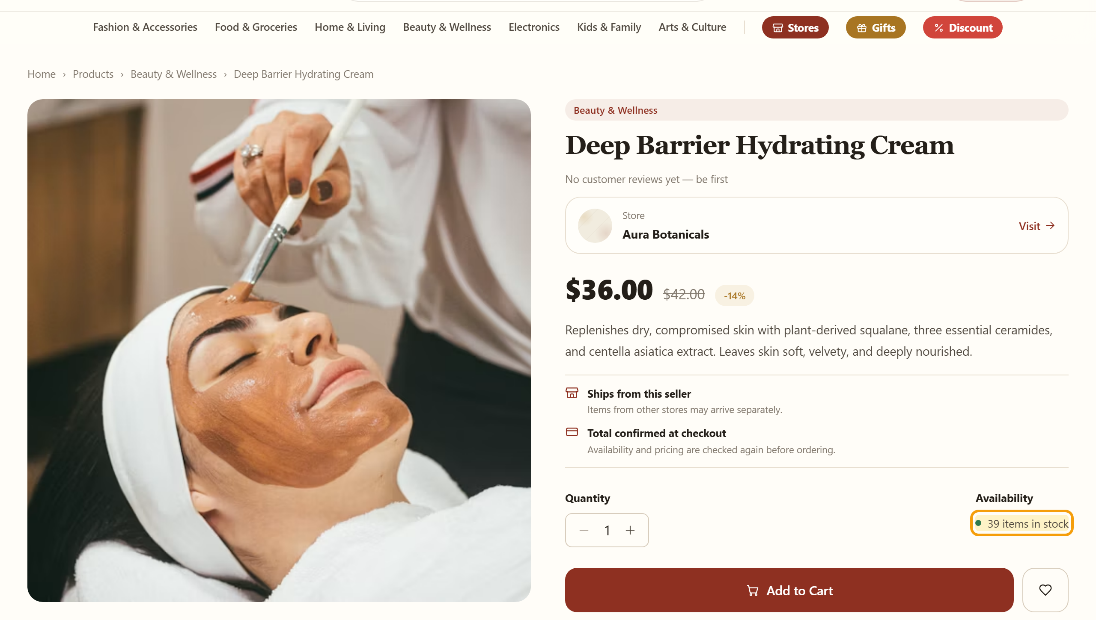
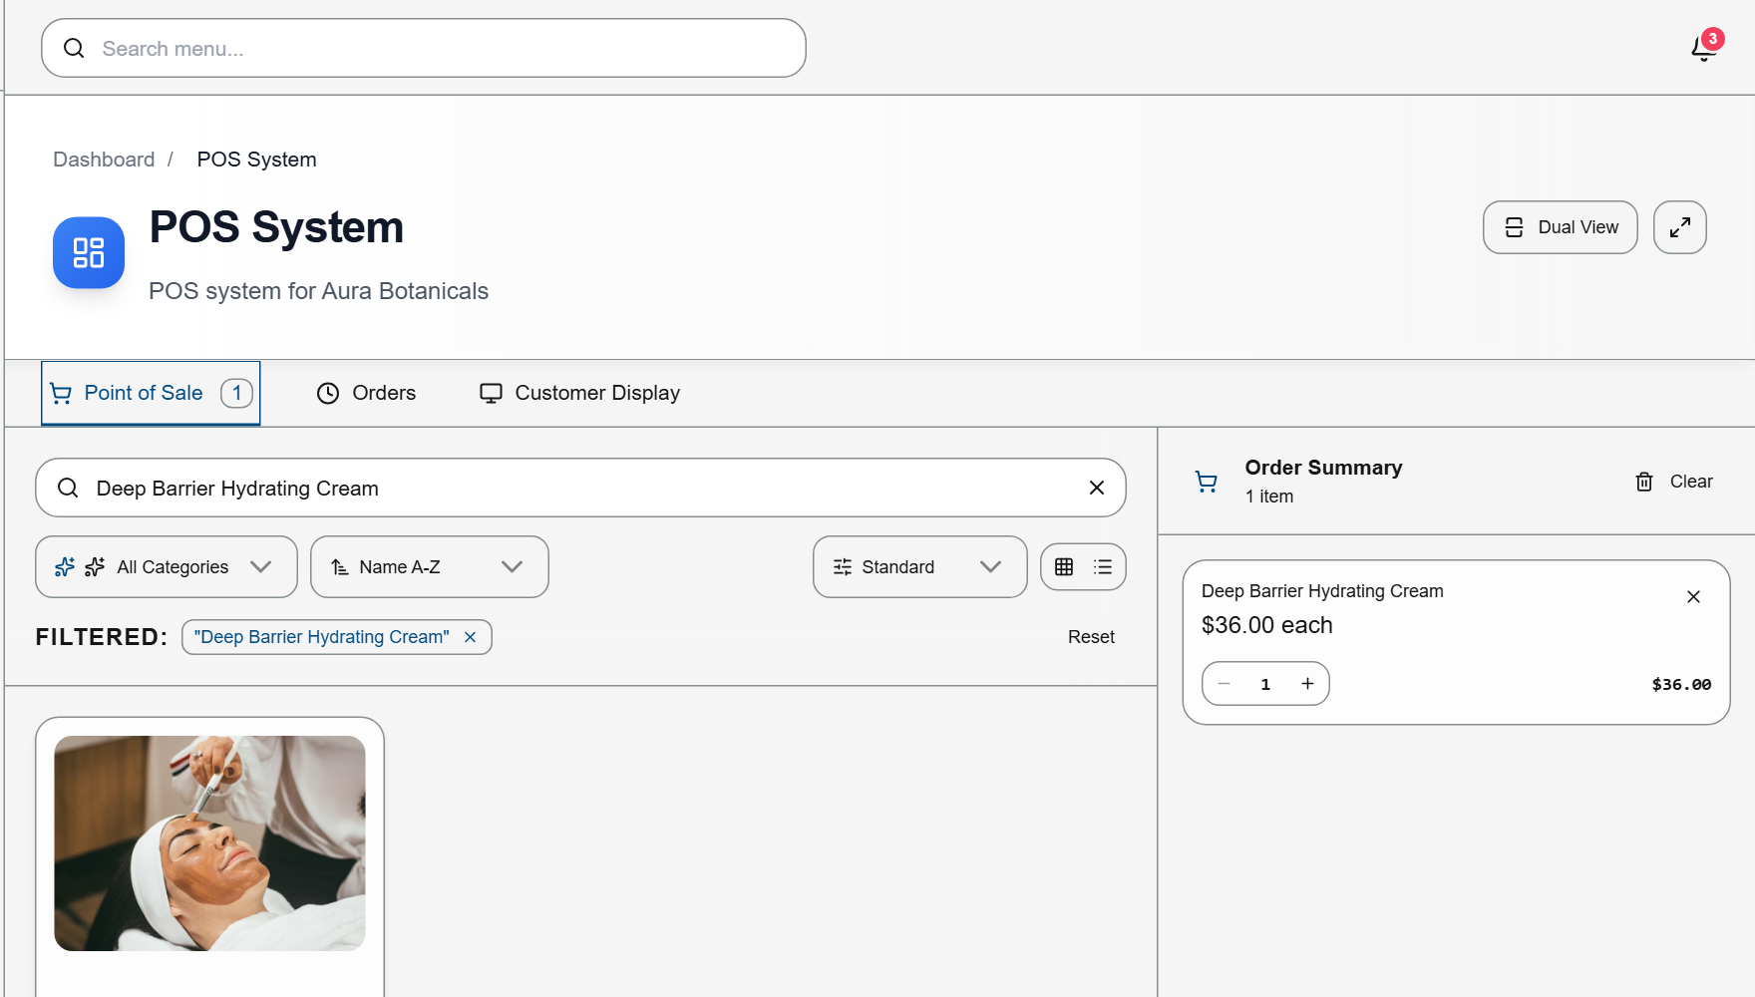



Rentify
Sell everywhere.
Manage once.
One store behind your own website, a shared marketplace and your shop counter — built for Cambodian merchants.
Own storefront
Shared marketplace
In-store POS
Notes:
[0:00–0:15]
Cambodian merchants sell in many places — Facebook, marketplaces and their own shop counter. Rentify lets them sell everywhere and manage once.

Slide 2






Merchants have tools. None of them connect.
Facebook page
posts, Live and inbox
Telegram
customer orders
Marketplace listing
a second copy of products
Notebook or Excel
the “real” stock count
Cash box or POS app
counter sales
The last item sells at the counter.
Facebook still says “in stock”.
Every new channel adds another list to update by hand.
Result: an apology, a refund, a lost customer.
Illustrative scenario and AI-generated image. How often this happens will be measured in our first merchant pilots.
02
Notes:
[0:15–0:40]
But their tools don't connect. Orders arrive on Telegram, stock lives in a notebook, and cash sits at the counter. So when the last item sells in the shop, Facebook still says it's in stock. The result is an apology, a refund and a lost customer.
(Evidence: illustrative scenario. Replace with real merchant quotes once pilot conversations happen.)

Slide 3


Every option today solves one piece
We are not the first. We aim to be the one merchants don’t have to stitch together.
Marketplaces
Global store builders
Local all-in-one
Khmer24 · Smile Shop · VTENH
Shopify
Khmum eShop
What works
What works
What works
Bring buyers to listings.
Online store and POS in sync.
Marketplace, merchant tools and POS.
What’s missing
What’s missing
Our angle
Listings live on their platform, separate from the merchant’s own brand and counter.
No shared Cambodian buyer marketplace; setup and plans are built for global merchants.
Closest to our idea. We compete on setup speed, brand-first storefronts and fairer pricing.
Public product descriptions checked 24–25 Sep 2026 (khmer24.com, vtenh.com, shopify.com/pos, Khmum on startupcambodia.gov.kh). Detailed comparison in appendix.
03
Notes:
[0:40–1:05]
Existing options each solve one piece. Marketplaces bring buyers but live apart from the merchant's shop. Shopify syncs a store and POS but has no Cambodian marketplace. Khmum is closest to us, and we respect it. Tesla wasn't the first electric car. We aim to be the platform merchants don't have to stitch together.

Slide 4


Rentify: one store behind every channel
ONE MERCHANT STORE
Products · Prices · Stock · Orders
Entered once. Always the same everywhere.
Own storefront
Shared marketplace
In-store POS
The merchant’s brand, template and link to share on Facebook and Telegram.
Buyers discover products from many Cambodian stores in one place.
Counter sales, cash and receipts, using the same stock count.
Start with any channel. Add the others later without re-listing a single product.
04
Notes:
[1:05–1:25]
Rentify puts one store at the centre. Products, prices, stock and orders are entered once, then sold through the merchant's own storefront, our shared marketplace and our POS.

Slide 5



What makes Rentify different
Three ideas we build on and will prove with merchants
01
Start anywhere, grow without re-listing
Begin as a marketplace seller with no website. Add a branded storefront or POS later — the same products and stock move with you.
02
One sale updates everywhere
A sale at the counter, on the storefront or in the marketplace changes one stock count, so no channel oversells.
03
Fair channel pricing
A subscription pays for the tools. Commission applies only to orders our marketplace brings — never to the merchant’s own storefront or counter sales.
Idea 02 is already working in our development build (next slide). Ideas 01 and 03 are designed into the platform; merchant acceptance is tested in pilots.
05
Notes:
[1:25–1:50]
Three ideas make us different. Start anywhere: sell on the marketplace first and add a storefront later without re-listing. One sale updates everywhere. And fair pricing: commission only on sales our marketplace brings, never on the merchant's own sales.

Slide 6
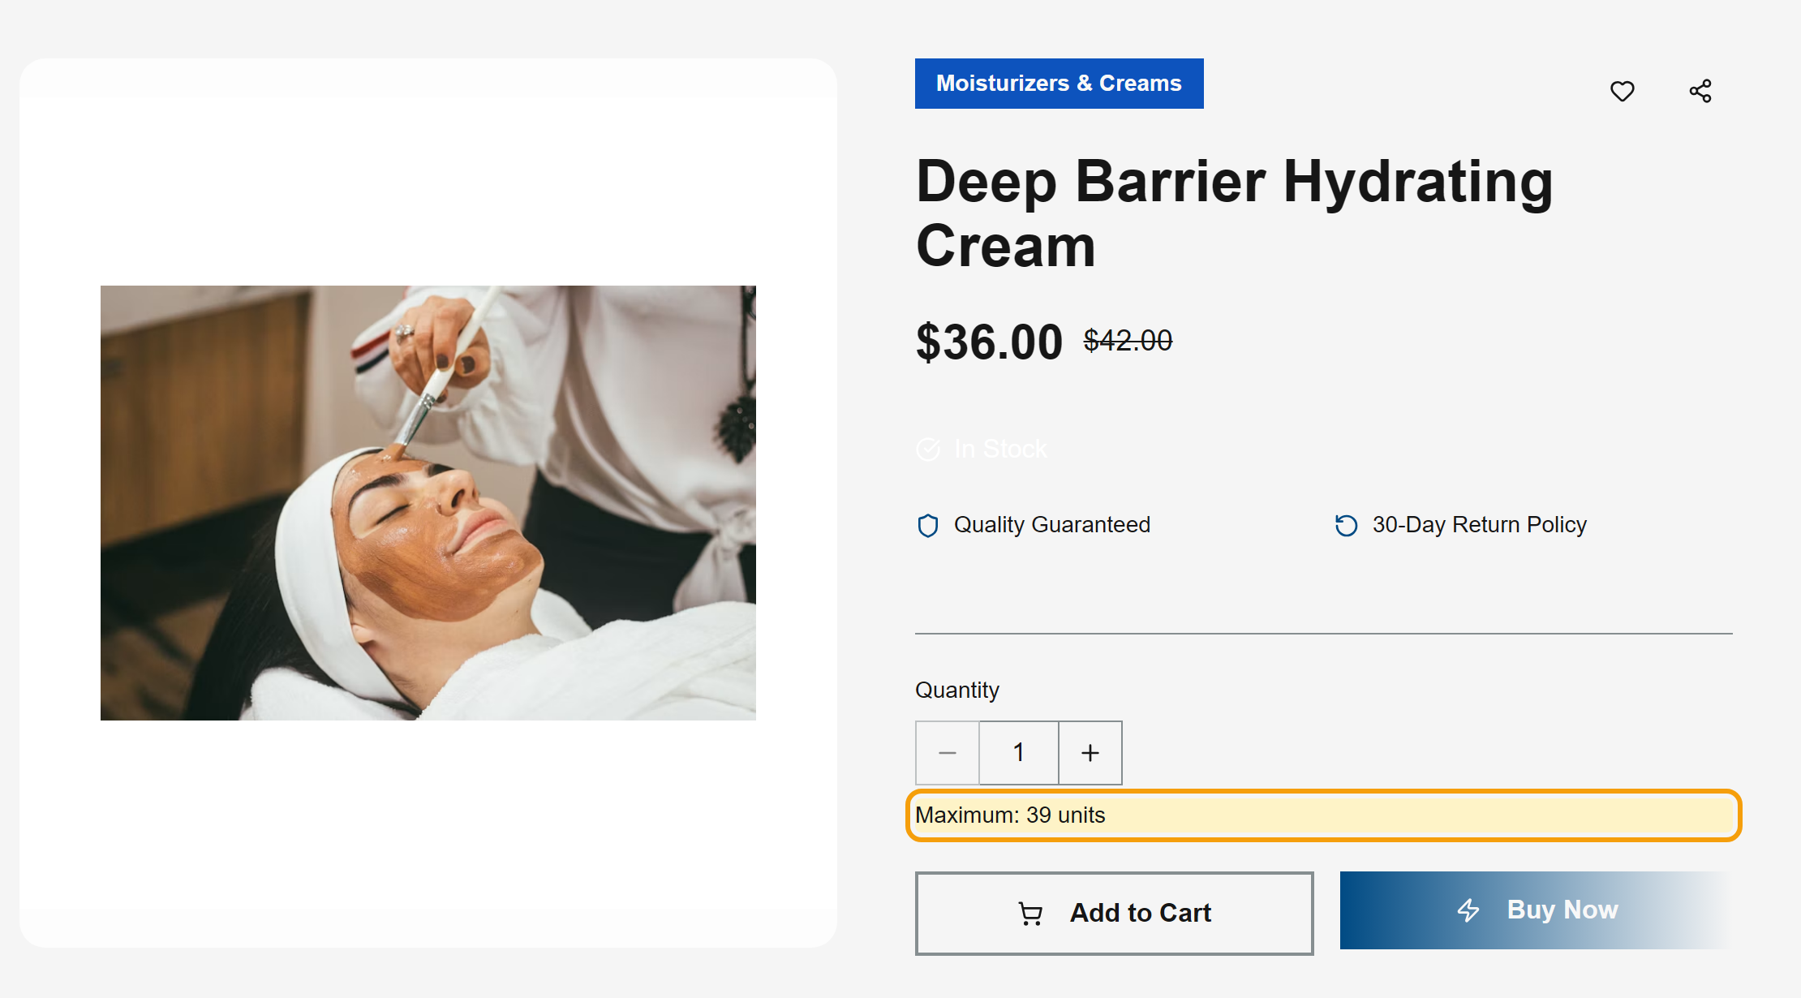

Working today: one sale, updated everywhere
Aura Botanicals demo store · Deep Barrier Hydrating Cream · starting stock 40
1
Sold at the counter
2
Own storefront
3
Shared marketplace
POS sale: 1 unit, paid in cash
Now shows “Maximum: 39 units”
Now shows “39 items in stock”
40 → 39 on every channel, from one counter sale. No second update.
Captured 25 Sep 2026 from Rentify’s working development build with seeded demo data (not customer orders). Live demo available in Q&A.
06
Notes:
[1:50–2:15]
This already works. Our demo store had forty units of this cream. We sold one at the counter. Seconds later, the storefront and the marketplace both showed thirty-nine. One sale, updated everywhere.
(Q&A: seeded demo data in the development build, captured 25 Sep 2026 — not customer orders.)

Slide 7



Who we serve first
The Facebook seller
The small retail shop
BEACHHEAD
Phnom Penh retailers who sell online and at a counter
Sells through posts, Live and inbox. No shop, or a small one.
Sells at a counter and increasingly online.
Fashion · Beauty · Electronics · Home goods
HOW THEY START
HOW THEY START
They already have customers, physical stock and a daily sales routine we can observe and improve.
Starts on the marketplace plus a shareable storefront link.
Starts with POS plus a storefront, joins the marketplace in one click.
Persona photos are illustrative. Phnom Penh holds 20% of Cambodia’s establishments (Economic Census 2022).
07
Notes:
[2:15–2:35]
We start with two merchants: the Facebook seller, who begins on our marketplace, and the small shop, which begins with POS and a storefront. Our beachhead is Phnom Penh retailers in fashion, beauty, electronics and home goods.

Slide 8
A bottom-up market we can reach
Counted from Cambodia’s 2022 Economic Census × US$60 a year (US$5 average monthly plan)
TAM
410,600
US$24.6M / year
ON TOP
retail shops in Cambodia
Marketplace commission
SAM
US$3.9M / year
Not counted here. Cambodia’s e-commerce market was US$1.51B in 2024.
65,400
specialized non-food stores: fashion, beauty, electronics, home and more
SOM
US$67.7K / year
Facebook-only sellers are largely outside the census — also upside.
≈1,130
avg. paying merchants in Year 3 (1.7% of SAM)
Sources: NIS Economic Census 2022, Table 2.10 (ISIC 47 excl. fuel; ISIC 4741–4774); Ministry of Commerce 2024. SOM from the team’s 3-year model (slide 12).
08
Notes:
[2:35–2:58]
Counting from the 2022 Economic Census, Cambodia has about 410,000 retail shops — a 24.6 million dollar subscription market. We focus on 65,000 specialised stores, worth 3.9 million a year, and aim for about 1,100 paying merchants by Year 3. Commission is on top.
(Q&A: US$1.51B is total 2024 e-commerce value — context, not our revenue.)

Slide 9
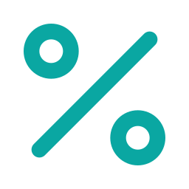


How Rentify makes money
A subscription for the tools, plus commission only where our marketplace creates the sale
MOST MERCHANTS
Starter
Growth
Pro
Marketplace commission
$3 /month
$5 /month
$10 /month
A small share of orders the marketplace brings in, deducted when buyers pay online.
Storefront (Khmer / English)
Everything in Starter
Everything in Growth
0% on the merchant’s own storefront and counter sales
Marketplace listing
Up to 500 products
Unlimited products
POS for one counter
Sales analytics
Marketing tools
Starts with online payments (2027). Rate set after pilot testing.
Up to 100 products
Up to 3 staff accounts
Up to 10 staff accounts
Launch revenue = subscriptions only
Proposed prices, to be tested with pilot merchants. Commission rate not yet set.
09
Notes:
[2:58–3:20]
Merchants pay three, five or ten dollars a month for storefront, marketplace listing and POS. We add a commission only on marketplace orders, once buyers pay online in 2027. Their own storefront and counter sales stay commission-free.
(Q&A: prices are proposals to test; commission cannot be deducted from cash on delivery.)

Slide 10



Go-to-market: merchants first, buyers follow
Merchants join for the tools. Their customers bring the first marketplace traffic.
PILOT PASSES IF
7 of 10
Phase 1 · Q4 2026
Phase 2 · 2027
Phase 3 · 2027+
merchants still active after 30 days
10 pilot merchants
Merchant-led buyers
Partners at scale
Shop visits in Phnom Penh markets
Facebook seller groups
UniPreneur introductions
Merchants share storefront links
Referral credit for merchants
Cross-store discovery in the marketplace
SME associations and business desks
Delivery partner bundles
Category campaigns (e.g. festivals)
≥99%
stock accuracy across channels
6 of 10
willing to pay a subscription
Proposed targets, set before the pilot starts. Marketplace-discovered orders are measured separately from merchants’ own customers.
10
Notes:
[3:20–3:45]
We go merchants first. We recruit ten pilot shops through market visits, Facebook seller groups and UniPreneur introductions; their customers bring the first buyers. The pilot passes if seven of ten stay active, stock stays 99% accurate, and six of ten will pay.

Slide 11

Roadmap
Built · 2026
Q4 2026
H1 2027
H2 2027
2028+
Working build
Pilot
Public launch
Marketplace revenue
Scale
Storefront templates
Shared marketplace
POS and invoices
One store catalog and stock
10 merchants in Phnom Penh
Measure setup time and stock accuracy
Test prices
Seller approval and buyer support
Delivery partner options
KHQR online payments
Commission on marketplace orders
Merchant analytics
Multi-staff roles
Multi-branch stock
Deeper delivery integrations
Explore nearby ASEAN markets
Built items run in our development build; production launch, payments and commission are planned.
11
Notes:
[3:45–4:00]
The platform works in development today. We pilot this quarter, launch publicly with KHQR payments in 2027, then add marketplace commission and multi-branch stock.

Slide 12
Three-year projection
Lean scenario · subscriptions only · marketplace commission not included
US$67.7K
Year 3 revenue
–US$26.1K
Year 3 net result; losses narrow after Year 2
1,895
paying merchants to break even
US$5
average plan per merchant each month
Team 36-month model (lean cost base). Price, conversion, churn and cost inputs are assumptions to validate in the pilot. Full table in appendix.
12
Notes:
[4:00–4:18]
Our lean model counts subscriptions only. Revenue grows to 68,000 dollars in Year 3 and we break even at about 1,900 paying merchants. Commission is upside.
(Q&A: all inputs are assumptions to validate in the pilot.)

Slide 13







The team behind Rentify
OUR ASK
10 retailer introductions
shops that sell online and at a counter
Long Mengchheng
Hong Thanbrathna
Khemrak Pasey
Mom Sothireak
Vy Seoul
Team Lead
Idea Founder
Business Lead
Pitch Lead
Developer
Mentors
Developer · Management
Developer
Advisor outreach · Strategy
Presenter · Brand story
UX/UI design
in retail, payments and marketplaces
Sell everywhere. Manage once.
Pilot support
to run and measure the Q4 pilot
Rentify — one store behind every way a Cambodian merchant sells.
Thank you.
13
Notes:
[4:18–4:45]
We are five students who have already built this platform. We ask UniPreneur for introductions to ten retailers, mentors in retail and payments, and support for our pilot. Rentify: sell everywhere, manage once. Thank you.
[Stop here. Keep this slide up for Q&A.]

Slide 14
Appendix
Competitors · Market math · Financial detail · Business model canvas · Delivery partners · Build status
Notes:
Use appendix slides only when a question calls for them.

Slide 15
Competitor evidence
Alternative | Publicly described offer | What we compare in pilots
Khmer24 | Broad listings across goods, property, jobs and services | Seller workflow for stock and orders
Smile Shop | Multi-merchant app with delivery, payment and returns | Merchant brand and storefront control
VTENH | Marketplace with nationwide delivery, card and ABA payments | Seller terms and total cost
Shopify | Online store and POS with synced inventory | Local fit, setup effort and cost
Khmum eShop | Marketplace, merchant tools, POS and white-label (closest) | Setup time, storefront, stock accuracy
Public descriptions checked 24–25 Sep 2026: khmer24.com, khsmileshop.com, vtenh.com, shopify.com/pos, startupcambodia.gov.kh (Khmum). Not a hands-on feature audit.
15
Notes:
Khmum overlaps with our concept. Our advantage must be proven through merchant tasks: setup time, stock accuracy and total cost. Do not claim we are cheaper or better until pilots measure it.

Slide 16
Market sizing: how we counted
 | Merchants | Basis | × US$60 / year
TAM | 410,623 | All retail establishments, ISIC division 47, excluding fuel stations (4730) | US$24.6M
SAM | 65,433 | Specialized non-food retail, ISIC 4741–4774: electronics, clothing, cosmetics, household, books, toys, sports, second-hand | US$3.9M
SOM | ≈1,129 | Year 3 subscription revenue (US$67,744) ÷ US$60 — average paying merchants in the team model | US$67.7K
Why not US$1.51B? That is the 2024 value of all Cambodian e-commerce (Ministry of Commerce). It is market context, not revenue Rentify can capture.
Not counted: marketplace commission, and home-based Facebook sellers, which the census barely captures (only 162 establishments list internet retail as their main activity).
Source: NIS, National Report on Final Census Results, Economic Census of Cambodia 2022, Table 2.10. US$60 = US$5 average plan × 12.
16
Notes:
Recalculate if the average plan price changes after pilot testing.

Slide 17
Financial detail (team model, lean scenario)
US$ | Year 1 | Year 2 | Year 3 | Assumption
Subscription revenue | 3,456 | 25,131 | 67,744 | US$5 average plan across tiers
Commission revenue | 0 | 0 | 0 | Excluded from this scenario (upside)
Cost of service | 1,543 | 8,939 | 21,669 | $0.30 per active + $0.75 per paying merchant / month
Gross profit | 1,913 | 16,193 | 46,074
Team | 20,250 | 35,300 | 46,000 | Founders, lean hiring path
Sales & marketing | 4,110 | 10,450 | 16,450 | Field onboarding, referrals, paid ads
Software, office, legal | 4,355 | 7,190 | 9,700 | Fixed lean overhead
Net result | –26,802 | –36,747 | –26,076 | No tax while loss-making
Break-even: about 1,895 paying merchants (Month-36 operating cost ÷ contribution per merchant). All inputs are assumptions to validate.
17
Notes:
Figures reproduced from the team’s 36-month model (Rentify_36_Month_Financial_Model.xlsx, Base-Lean sheet) as shown in the v2 deck. Totals were checked: gross profit and net result add up within US$1 rounding.

Slide 18
Business model canvas
Key partners
Key activities
Value proposition
Relationships
Customer segments
Pilot merchants
Delivery carriers
Payment provider (online payments, 2027)
SME associations
Build and run the platform
Onboard and approve sellers
Buyer support and moderation
Merchants: sell on their own storefront, the marketplace and at the counter from one store.
Buyers: products from many Cambodian stores with clear seller and delivery details.
Assisted onboarding
Khmer and English support
Facebook sellers
Small retail shops selling online and at a counter
Buyers in Cambodia
Key resources
Channels
One-store catalog and stock
Storefront templates, marketplace, POS
Shop visits, Facebook seller groups
Merchant storefront links, referrals
Cost structure
Revenue streams
Engineering and hosting · Seller onboarding and moderation · Buyer support · Sales and marketing
Subscriptions: Starter $3, Growth $5, Pro $10 per month (proposed)
Marketplace commission on marketplace-sourced online orders (from 2027, rate to be set)
Update each block with what the pilot shows.
18
Notes:
Consistent with slides 9–11: subscription revenue at launch; commission starts only with online payments.

Slide 19
Cambodia delivery partner options
Carrier | Publicly described offer | Confirm before pilot
Vireak Buntham | Parcels, tracking, COD, insurance | Routes, prices, remittance
J&T Express | Cambodia parcel booking and tracking | Local COD, returns, insurance
ZTO Cambodia | Domestic parcels; business inquiry | Quotes, COD and data link
Grab for Business | Urban parcel booking and tracking | Area, size limit and COD
All candidates are prospective. Compare identical parcels; no carrier terms are signed.
19
Notes:
Merchants fulfil their own orders at launch. Delivery partnerships are options to evaluate, not agreements.

Slide 20


What is built and what comes next
Working in development
Next
Merchant sign-up and one store per merchant
Store catalog with shared price and stock
Two storefront templates
Shared marketplace with seller approval
POS with cash sales and receipts
Marketplace checkout with cash on delivery
Admin console for sellers, products and reviews
10-merchant pilot and real usage data
Production hosting, backups and rollback drills
Merchant custom domains
KHQR and online payments
Marketplace commission and seller payouts
Restricted-product and returns policies
Status as of 25 Sep 2026 from the Rentify repository. Demo data is seeded; there are no customer orders yet.
20
Notes:
Answer "what is built today?" precisely from this slide. Do not call seeded demo orders customer orders.

