Slide 1

Rentify
Unified selling for Cambodian merchants
One catalog.
Three ways to sell.
Personal storefront
Shared marketplace
In-store POS
01
Notes:
SLIDE 1 | 20 seconds
SAY
Rentify gives Cambodian merchants one place to manage their selling, with three ways to reach customers: their own storefront, our shared marketplace, and a point of sale at the counter. One catalog connects the business behind all three.
EVIDENCE AND Q&A
Full product direction confirmed by the user. Do not imply that all shared transaction behavior is production ready.

Slide 2

One sale can leave three records out of step
The last item sells
at the counter.
Online still says
“in stock.”
Extra work. Missed orders.
Customer frustration.
Illustrative scenario. AI-generated image.
02
Notes:
SLIDE 2 | 35 seconds
SAY
Imagine a small shop that also sells online. The last item sells at the counter, but the online listing still says it is available. Now the owner has to update stock, find the order, and explain the mistake to a customer. This is the problem we want to solve: selling in more places should not mean maintaining more separate records. We will test how often this happens with our first merchant pilots.
EVIDENCE AND Q&A
Illustrative scenario. The shopkeeper image is AI-generated, not an interviewed merchant. No interviews or measured problem frequency are verified.

Slide 3
One catalog connects every sale
ONE MERCHANT WORKSPACE
Products Prices Stock Orders
PERSONAL STOREFRONT
SHARED MARKETPLACE
IN-STORE POS
Build their brand
Reach shared buyers
Sell at the counter
Full product workflow
03
Notes:
SLIDE 3 | 40 seconds
SAY
Our full product puts the merchant at the center. They manage products, prices, stock, and orders once. Their personal storefront carries their brand. The shared marketplace gives buyers a place to discover different stores. The POS handles sales in the physical shop. The intended result is simple: when an item sells in one channel, its availability changes across the others. A merchant can begin with the marketplace and add a storefront as their business grows.
EVIDENCE AND Q&A
Target product workflow. Marketplace-only stores and optional storefronts follow docs/platform-architecture.md. Cross-channel stock behavior remains a release validation task. Sources: C:/Users/User/rentify/README.md; C:/Users/User/rentify/docs/migration-plan.md.

Slide 4
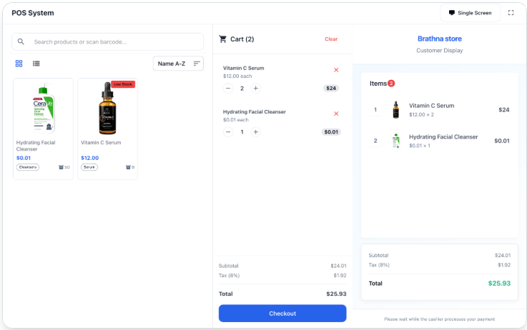
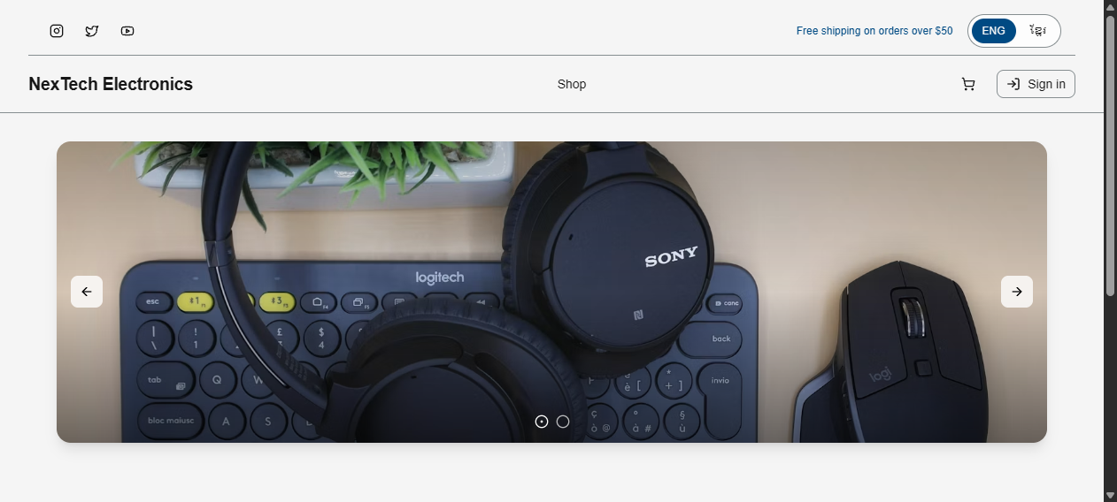
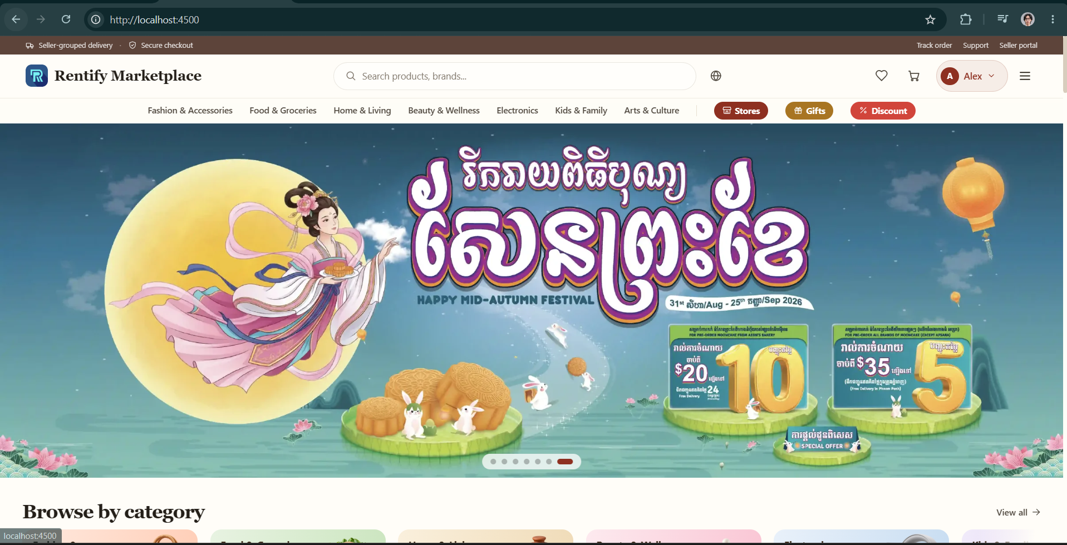
The storefront, marketplace and POS experience
PERSONAL STOREFRONT
SHARED MARKETPLACE
IN-STORE POS
Their own online shop
A place to find more buyers
Products, cart and checkout
Development storefront and marketplace screens. POS product preview.
04
Notes:
SLIDE 4 | 35 seconds
SAY
Here are the three interfaces. On the left is a merchant storefront. In the middle is Rentify Marketplace, where buyers can browse across sellers. On the right is our POS product preview, showing products, a cart, and a customer display. We have development interfaces running today. The next product milestone is to demonstrate a complete sale with consistent stock across all three channels.
EVIDENCE AND Q&A
Storefront: local NexTech template at http://localhost:4600/. Marketplace: user-provided screenshot of http://localhost:4500/. POS: user-selected image from marketing site http://localhost:4200/; this is a product preview. Actual POS route is http://localhost:4400/pos. Prior browser review added a seeded product to a temporary POS cart; no sale was submitted. The hosted storefront product section was empty during that review. Do not claim that these images prove stock synchronization.

Slide 5
Target retailers sell online and in person
Small Cambodian retailers
US$1.51B
Online
and at the counter
Cambodian e-commerce
market value in 2024
Existing customers.
Physical stock.
A daily sales workflow.
First milestone: 10 pilot retailers
Market context. Sources: Cambodia Ministry of Commerce and U.S. ITA.
05
Notes:
SLIDE 5 | 25 seconds
SAY
We will start with small Cambodian retailers who sell both online and at a physical counter. They already have customers and a stock management task we can observe. Cambodia's e-commerce market was reported at 1.51 billion US dollars in 2024. That gives us market context; our first practical target is ten suitable retailers.
EVIDENCE AND Q&A
US$1.51B is reported 2024 Cambodian e-commerce market value, not Rentify revenue or TAM. Source: https://s2.moc.gov.kh/mocspace/mocspace_1744030861626.pdf ; corroborated 24 September 2026 at https://www.trade.gov/country-commercial-guides/cambodia-ecommerce . First 10 retailers is a proposed pilot target.

Slide 6
Where Rentify competes
MERCHANT ALTERNATIVES
RENTIFY’S FOCUS
Khmer24
Broad listings and discovery
Their brand.
Shared buyer reach.
One selling workflow.
Shopify
Online store and POS
Khmum
Marketplace, merchant tools and POS
For small Cambodian retailers
Pilot comparison: setup effort, stock accuracy and total merchant cost.
06
Notes:
SLIDE 6 | 35 seconds
SAY
Merchants already have alternatives. Khmer24 offers broad product discovery. Shopify connects online stores with POS. Khmum combines a local marketplace with merchant tools and POS. Rentify's focus is the small Cambodian retailer who wants their own brand, shared buyer discovery, and counter sales in one workflow. We will compare how much work it takes to set up and operate, how reliably stock updates, and what the merchant pays.
EVIDENCE AND Q&A
Public descriptions checked 24 September 2026. Sources: https://www.khmer24.com/en ; https://www.shopify.com/pos ; https://www.khmersme.gov.kh/service_provider/khmum-technology-co-ltd/ . Khmum has overlapping capabilities. No first/only/cheapest/best claim or measured advantage is supported.

Slide 7
Two ways Rentify earns revenue
SUBSCRIPTION
COMMISSION
Personal storefront
and POS tools
Completed marketplace
orders
Recurring value for daily operations
Revenue grows with marketplace sales
Planned model. Pricing and commission rates will be tested with merchants.
07
Notes:
SLIDE 7 | 30 seconds
SAY
Our business model follows the value we provide. Merchants subscribe to their personal storefront and POS tools. Rentify also earns a commission on completed orders through the shared marketplace. One stream supports daily operations; the other grows with marketplace sales. We will test prices and commission rates with merchants and against our support and payment costs before setting them.
EVIDENCE AND Q&A
User's final business model is storefront/POS subscription plus marketplace commission. Pricing, rates, settlement, refund treatment and marketplace-only entitlements remain open. The repository's initial COD policy is not the intended final business model. Conversation.md is historical context, not a source of approved numerical prices.

Slide 8
Our launch plan: 10 retailers and their buyers
01
Recruit merchants
Founder shop visits and merchant referrals
02
Bring first buyers
Merchant-shared store links and social posts
03
Earn repeat use
Track orders, stock accuracy and willingness to pay
Proposed pilot plan. Merchant traction has not yet been verified.
08
Notes:
SLIDE 8 | 40 seconds
SAY
We will recruit the first ten retailers through shop visits and merchant referrals. We will help them set up their catalog and invite their existing customers through store links and social posts. This gives us a way to test both merchant adoption and buyer orders before spending heavily on advertising. We will measure setup time, stock accuracy, completed orders, repeat use, and willingness to pay. These are our planned pilots; we have no verified customer traction yet.
EVIDENCE AND Q&A
Proposed acquisition experiment, not traction. No paid customers, merchant interviews, pilots, or revenue are verified. Merchant-shared links and social posts are suggested first buyer channels. Workshop source: Discuss..pdf, pages 2-3. Measure direct-store and marketplace orders separately.

Slide 9





The team behind Rentify
Long
Mengchheng
Hong
Thanbrathna
Khemrak Pasey
Mom Sothireak
Vy Seoul
Team / Product lead
Idea founder
Business lead
Pitch lead
Team operations
Help us meet 10 pilot retailers.
One catalog. Three ways to sell.
09
Notes:
SLIDE 9 | 25 seconds
SAY
Our five-person team covers product development, business outreach, presenting, and operations. Through UniPreneur, we are asking for introductions to ten retailers who sell online and in person. We want to help them keep their brand, reach more buyers, and run their sales from one place. That is Rentify: one catalog, three ways to sell.
EVIDENCE AND Q&A
Five team names and roles confirmed by the user. Long Mengchheng is Team Lead with product responsibilities; Hong Thanbrathna is Idea Founder with R&D support; Khemrak Pasey is Business Lead; Mom Sothireak is Pitch Lead; Vy Seoul supports R&D and team operations. Source: Rentify_Uniprenuer.pdf page 13. The introductions ask is a recommendation, not a funding request or existing partnership. Stop the timed pitch here.

Slide 10
Appendix: market sizing approach
TAM
Eligible Cambodian retailers
Annual subscription opportunity + commission on relevant order value
SAM
Launch segment and service area
Apply the same model to the retailers we can serve
SOM
Merchants we can acquire and retain
Build from outreach, conversion, retention and buyer orders
Use one annual revenue basis. Eligible merchant counts and pricing remain to be validated.
10
Notes:
Q&A: market size. The 2024 US$1.51B figure is transaction market context, not software TAM. Annual revenue opportunity = eligible subscribing merchants × annual subscription price + relevant annual completed marketplace order value × take rate. Narrow the same definition consistently for SAM and SOM. Do not multiply all businesses by a guessed price. The 2022 census counted 753,670 establishments across all sectors, broader than our target. Source: https://nis.gov.kh/nis/EC2022/Leaflet.pdf . The workshop Discuss..pdf page 3 asks for bottom-up sizing. Merchant count, launch geography, attainable conversion, retention and pricing are still open.

Slide 11
Appendix: competitor evidence
Alternative | Publicly described offer | Rentify comparison to test
Khmer24 | Broad listings and product discovery | Work needed to manage sales
Smile Shop | Marketplace, delivery and payments | Brand ownership and buyer reach
Shopify | Online store and POS inventory sync | Local fit and total cost
Khmum eShop | Marketplace, merchant tools and POS | Setup, storefront and stock workflow
Khmum overlaps with the concept. Rentify’s advantage must come from execution and merchant fit.
11
Notes:
Q&A: uniqueness. We do not claim to be the first or only platform in these categories. Khmum is the closest local benchmark among the sources reviewed. Public descriptions do not establish current service quality, exact prices or absent features. Sources checked 24 September 2026: https://www.khmer24.com/en ; https://www.shopify.com/pos ; https://www.khmersme.gov.kh/service_provider/khmum-technology-co-ltd/ ; https://h5.khsmileshop.com/ . Test the same merchant tasks and cost assumptions before claiming superiority.

Slide 12
Appendix: illustrative monthly economics
Scenario only. These are unvalidated inputs, not announced prices or a forecast.
Subscriptions
Marketplace commissions
100 merchants × US$8
US$20,000 order value × 3%
US$800 / month
US$600 / month
US$1,400
Monthly revenue before costs
Deduct support, hosting, payment costs and acquisition. Test retention before scaling.
12
Notes:
Q&A: revenue mechanics. Illustrative arithmetic only: 100 average paying subscribers × US$8 per month = US$800. US$20,000 of eligible completed marketplace order value after cancellations/refunds × 3% = US$600. Total US$1,400 monthly platform revenue before costs and taxes. GMV belongs to merchants and is not Rentify revenue. Inputs are invented sensitivity assumptions, not actual traction, validated prices, or a projection. Profit requires actual payment and support costs, hosting, acquisition and staffing. The workshop requests a three-year plan; build each year from average paid merchants, retention, annual GMV and costs before calling it a forecast. Avoid annualizing a year-end merchant count as if all merchants paid for all twelve months.

Slide 13
Appendix: product status and next proof
DEVELOPMENT TODAY
NEXT PROOF
Merchant dashboard and catalog
One complete sale with correct shared stock
Storefront and marketplace interfaces
Merchant repeat use and paid conversion
POS interface and order modules
Reliable payments, refunds and settlement
Pre-pilot stage. POS visual on slide 4 is a product preview.
13
Notes:
Q&A: current status. No verified merchant traction or revenue. Local development surfaces and Commerce modules exist. Opening a screen or adding an item to a cart does not prove a completed sale, live payment or correct inventory across every channel. The storefront product section was empty in the prior local review. The user selected the polished POS image displayed on the marketing page. Do not imply a bank partnership or live settlement. Sources: C:/Users/User/rentify/README.md; C:/Users/User/rentify/docs/migration-plan.md; browser observations documented in docs/demo-runbook.md. Current architecture snapshot predates later migration progress, so current README and migration status take precedence for this summary.

