Slide 1





Rentify
Sell everywhere. Manage once.
Marketplace
Storefront
POS
Notes:
[0:00–0:15]
Cambodian merchants sell in many places — Facebook, marketplaces and their own shop. Rentify lets them sell everywhere and manage once.

Slide 2




One merchant. Too many places to update.
f
?
Where’s my order??
Facebook
IN STOCK
POS at the counter
SOLD OUT
??
Khmer24 listing
OLD PRICE
Stock: 3? 5? 0?
Telegram
27 new orders
Notes:
[0:15–0:40]
But their tools don’t connect. Orders arrive on Telegram, products sit on Facebook and Khmer24, stock lives in a notebook, and sales happen on a separate POS. So when the last item sells at the counter, Facebook still says it’s in stock. The result: an apology, a refund, a lost customer.
(Q&A: Illustrative scenario and AI-generated image.)

Slide 3




Today, merchants use a different tool for each piece.
Your own store
Marketplace
Shop counter
Facebook page
Khmer24
POS apps
Website builders
VTENH
Cash box
Smile Shop
Rentify
All three. One stock.
Notes:
[0:40–1:00]
Today merchants use a different tool for each piece: Facebook for their own page, Khmer24, VTENH or Smile Shop for a marketplace, and a POS app or cash box at the counter. Rentify brings all three onto one stock.
(Q&A: Khmum is the closest competitor — see the appendix.)

Slide 4

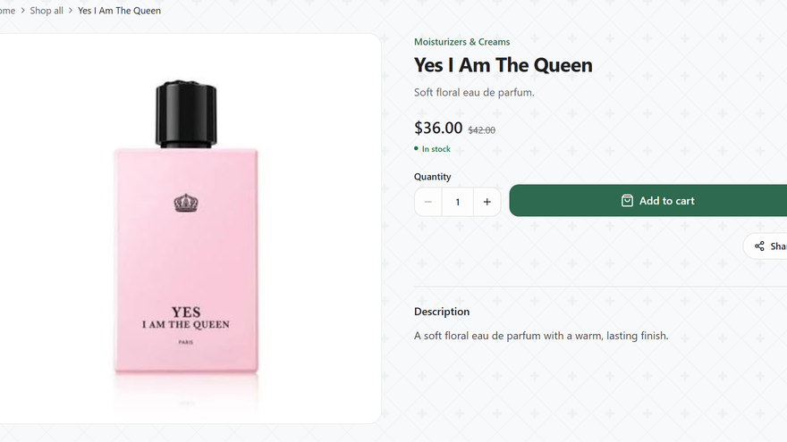
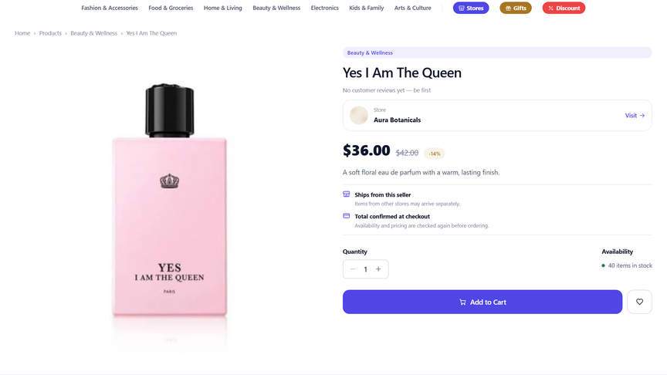
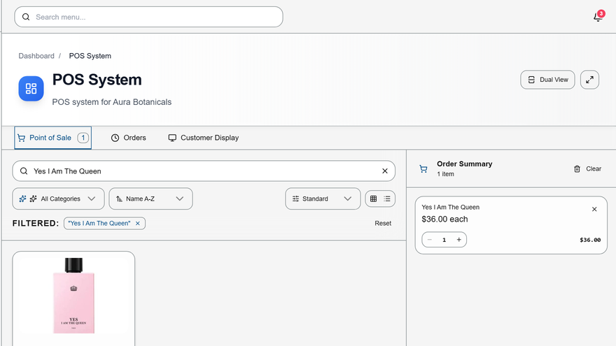

Add a product once. It’s live everywhere.
ENTERED ONCE
Yes I Am The Queen
$36.00 · Stock 40
$36 · Stock 40
$36 · Stock 40
$36 · Stock 40
Own storefront
Marketplace
POS at the counter
Notes:
[1:00–1:20]
Here is how it works. The merchant adds a product once — name, price and stock. It appears on their own storefront, in our marketplace and in their POS. Same price, same stock, everywhere.

Slide 5
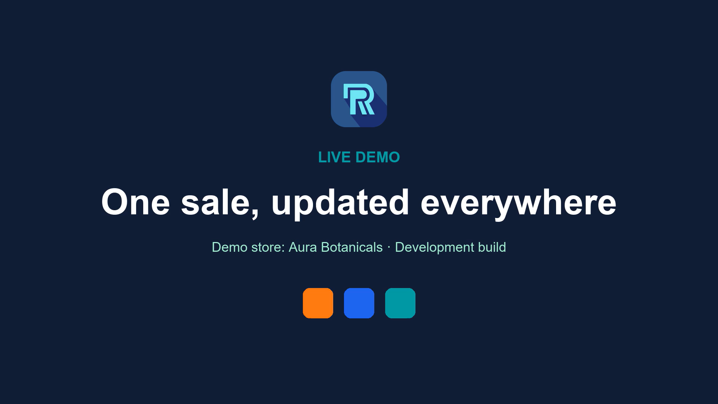

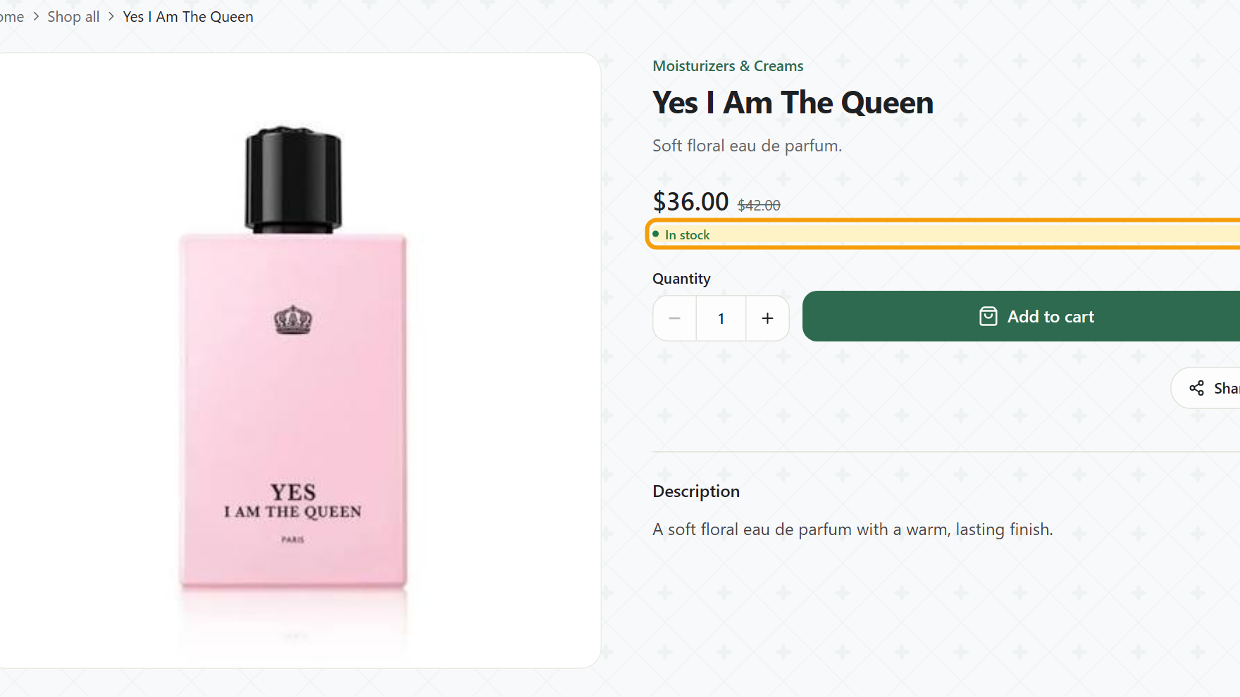
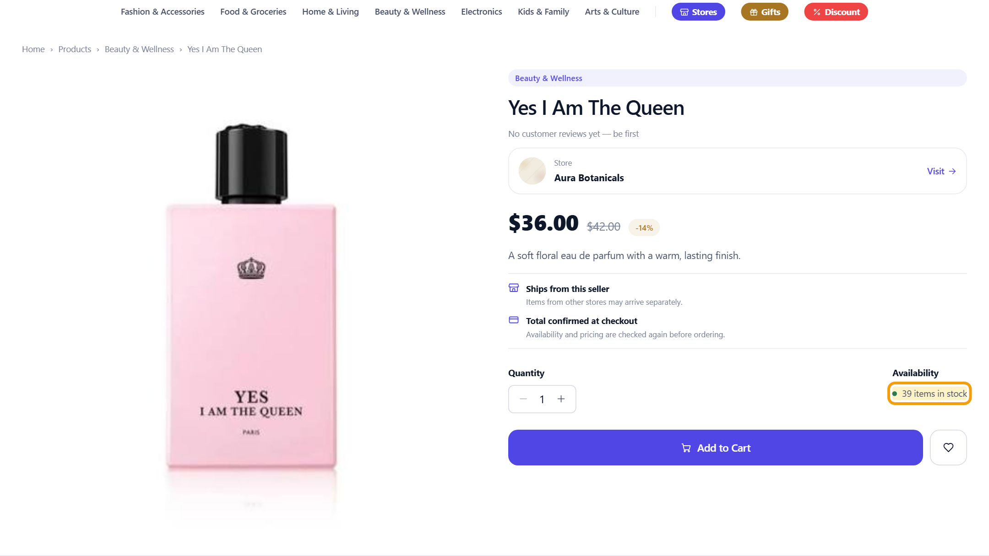
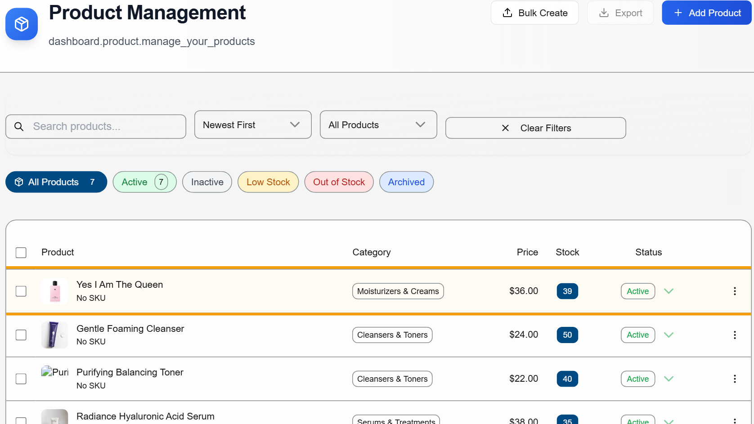



Sell one at the counter. Every channel knows.
SOLD 1 AT THE COUNTER
Yes I Am The Queen
Stock 40 → 39
Still in stock
Stock 39
Stock 39
Own storefront
Marketplace
Merchant dashboard
Real screens captured after one POS cash sale in Rentify’s development build (demo store: Aura Botanicals).
Notes:
[1:20–1:45]
And it works today. Our demo store had forty bottles of this perfume. We sold one at the counter. Seconds later, the marketplace and the merchant dashboard both showed thirty-nine. One sale, updated everywhere.
(Q&A: Demo data in our development build, not customer orders.)

Slide 6




What makes Rentify different
01
02
03
−1
0%
POS
39
39
39
small %
Storefront
Marketplace
Start anywhere
One stock everywhere
Fair pricing
Notes:
[1:45–2:10]
Three things make Rentify different. Start anywhere — begin on the marketplace and add a storefront and POS later, without re-listing. One stock everywhere, as you just saw. And fair pricing — nothing on the merchant’s own sales; we only earn when our marketplace brings the sale.
(Q&A: Tesla wasn’t the first electric car either — we aim to be the platform merchants don’t have to stitch together.)

Slide 7









Who we serve first
Free plan
Starter plan
WE START IN
Phnom Penh
1 in 5
Cambodian businesses are here
Facebook seller
Small shop
FIRST CATEGORIES
37%
20%
TODAY
f
TODAY
Fashion
Beauty
ON RENTIFY
ON RENTIFY
Marketplace
Storefront
POS
Electronics
Home
Sources: NIS Economic Census 2022 (Phnom Penh has 20% of establishments); Ministry of Commerce iTrade Bulletin, March 2025 (37% / 20% = share of online purchases).
Notes:
[2:10–2:30]
We serve two merchants first. The Facebook seller starts free on our marketplace. The small shop starts on Starter with a storefront and POS. We begin in Phnom Penh — home to one in five Cambodian businesses — with fashion and beauty, the two biggest online categories.

Slide 8





Start free. Upgrade when you grow.
Pro
$10 /mo
MOST SHOPS
Starter
$5 /mo
Free
$0
Marketplace
Storefront
POS
Marketplace
Storefront
POS
Marketplace
Storefront
POS
Own domain
Staff
Insights
3% on marketplace sales
0% on your own sales
0% on your own sales
Notes:
[2:30–2:55]
So what does it cost a merchant to start? Nothing. [pause]
On our Free plan, any shop can sell on the Rentify Marketplace at no cost. We only take a tiny 3%, and only when our marketplace brings them a sale. No sale, no fee.
When they're ready for their own storefront and a POS at the counter, it's five dollars a month, or ten for Pro. And on their own channels, they keep 100% of every sale.
We only earn when our merchants earn.
(Q&A: prices and the 3% rate are proposals to test in the pilot. 3% is on the product price of completed marketplace orders; commission starts with online payments in 2027. If running long, drop 'or ten for Pro'.)

Slide 9

A growing market, counted from the ground up
CAMBODIA E-COMMERCE
410,600
2024
$1.51B
TAM
retail shops in Cambodia
2025*
$22.4M / yr
$1.78B
65,400
+17.9% a year
SAM
specialized stores: fashion, beauty, electronics, home…
$3.6M / yr
TOP ONLINE PURCHASES
HOW THEY PAY
37%
20%
47%
Fashion
Beauty
pay by QR
≈1,130
SOM
Our first categories are the two biggest.
paying shops by Year 3
$61.6K / yr
*2025 projected. Sources: Ministry of Commerce, iTrade Bulletin Mar 2025 (Profitence e-commerce report 2024); NIS Economic Census 2022. Value = shops × US$54.5/yr ($5 plan, 10% VAT removed); SOM from team model; Proposed 3% commission, to be tested with pilot merchants.
Notes:
[2:55–3:20]
The market is growing: Cambodian e-commerce was 1.51 billion dollars in 2024, up about 18% a year. Counting from the ground up, there are about 410,000 retail shops — a 22 million dollar subscription market. We focus on 65,000 specialised stores, and aim for about 1,100 paying shops by Year 3.
(Q&A: $1.51B is total e-commerce sales value, not our revenue. Values use the $5 plan with 10% VAT removed.)

Slide 10







Go-to-market: merchants first, buyers follow
01
NOW · Q4 2026
02
2027
03
2027+
f
f
Markets
FB groups
UniPreneur
10
Store link
Customers
We bring shops
Shops bring customers
Buyers find more shops
Goal: 10 pilot shops
0% on their own sales
Commission on marketplace sales
More buyers bring more shops
PILOT PASSES IF
7 of 10 shops stay active
≥99% stock accuracy
6 of 10 will pay
Notes:
[3:20–3:45]
We go merchants first. This quarter we bring ten pilot shops through market visits, Facebook groups and UniPreneur. In 2027 those shops bring their own customers through storefront links. Then buyers discover more shops in the marketplace — and more buyers bring more shops.
(Q&A: Pilot passes if 7 of 10 shops stay active, stock is at least 99% accurate, and 6 of 10 will pay.)

Slide 11
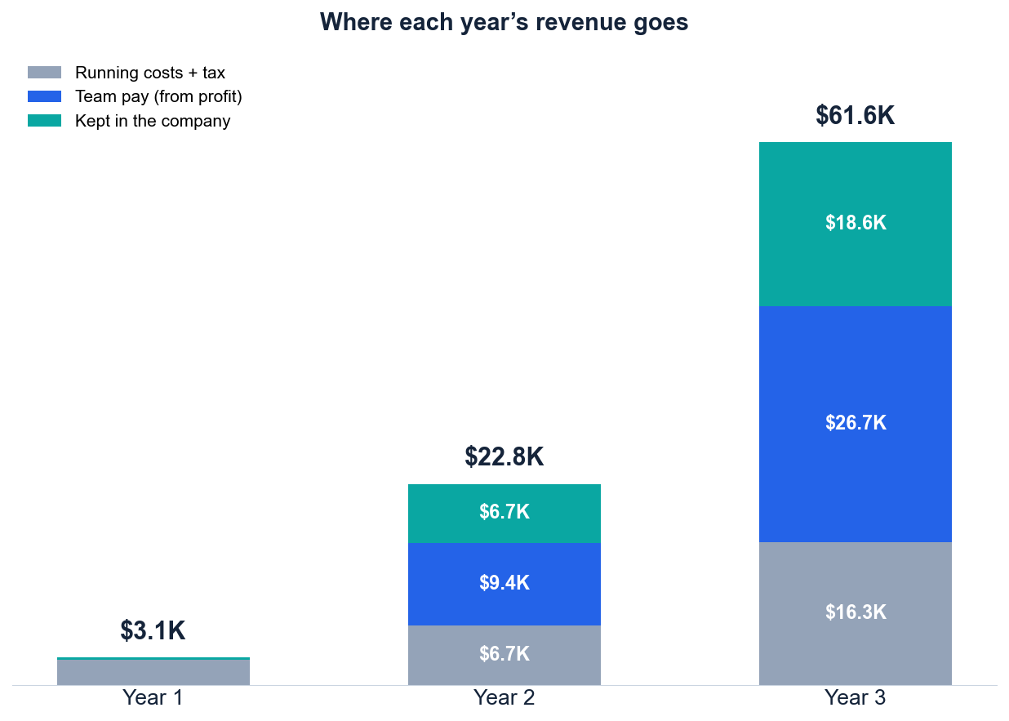
Three-year projection
Bootstrapped: team unpaid in Year 1, then paid from profit · subscriptions only
$61.6K
Year 3 revenue after 10% VAT
Year 1
covers its own costs, team unpaid
~110
paying shops cover all running costs
$1.1K
cash needed to start
Team pay per founder: $0 → ~$150 → ~$420 a month (half of profit, max $500). With 3% commission the team reaches $500 in Year 3 and $27.0K is kept. After 10% VAT and Cambodian taxes. All inputs to validate in the pilot.
Notes:
[3:45–4:05]
We are bootstrapped. Year 1 covers its own costs with the team unpaid. Revenue grows to about 62,000 dollars in Year 3. About 110 paying shops cover all running costs, and we need only about 1,100 dollars to start.
(Q&A: All inputs are assumptions to validate in the pilot. Detail in the appendix.)

Slide 12





What merchants told us
MOCK QUOTES — replace with real feedback before presenting
MERCHANT
MERCHANT
MERCHANT
Eolra
Kour Manith
Apsara Fairy
Perfume store
Coffee shop & restaurant
Restaurant & coffee
“I sell on Facebook and in my shop. Keeping stock the same in both is my biggest headache.”
“A POS that also puts my menu online would save me hours every week.”
“If it is free to start, I would try the marketplace this month.”
MERCHANT
ADVISOR
Hyper-Tech Store
Dr. Po Sovinda
Electronics store
Senior Lecturer, Strategy
“Customers ask on Telegram if items are in stock. I have to check by hand.”
“Prove it with a small pilot first. Measure stock accuracy and repeat use.”
Mock quotes for layout only. Replace with each validator’s real words and confirm permission to show names and logos.
Notes:
[4:05–4:25]
[MOCK — replace with what validators really said.] We have already spoken with merchants and an advisor. Here is what they told us.
(Q&A: Do not present mock quotes as real feedback.)

Slide 13





The team behind Rentify
Long Mengchheng
Hong Thanbrathna
Khemrak Pasey
Mom Sothireak
Vy Seoul
Team Lead
Idea Founder
Business Lead
Pitch Lead
Developer
Builds and runs the team
Builds the platform
Outreach and strategy
Presents our brand story
Designs the UX/UI
Sell everywhere. Manage once.
Thank you.
Notes:
[4:25–4:45]
We are five students who have already built this platform. Our next step is ten pilot shops in Phnom Penh, starting this quarter. Rentify: sell everywhere, manage once. Thank you.
(Q&A: Stop here and keep this slide up for Q&A.)

Slide 14
Appendix
Competitors · Market math · Financial detail · Business model canvas · Delivery partners
Notes:
Use appendix slides only when a question calls for them.
14

Slide 15
Competitor evidence
Alternative | Publicly described offer | What we compare in pilots
Khmer24 | Broad listings across goods, property, jobs and services | Seller workflow for stock and orders
Smile Shop | Multi-merchant app with delivery, payment and returns | Merchant brand and storefront control
VTENH | Marketplace with nationwide delivery, card and ABA payments | Seller terms and total cost
Shopify | Online store and POS with synced inventory | Local fit, setup effort and cost
Khmum eShop | Marketplace, merchant tools, POS and white-label (closest) | Setup time, storefront, stock accuracy
Public descriptions checked 24–25 Sep 2026: khmer24.com, khsmileshop.com, vtenh.com, shopify.com/pos, startupcambodia.gov.kh (Khmum). Not a hands-on feature audit.
Notes:
Khmum overlaps with our concept. Our advantage must be proven through merchant tasks: setup time, stock accuracy and total cost. Do not claim we are cheaper or better until pilots measure it.
15

Slide 16
Financial detail (bootstrapped model)
US$ | Year 1 | Year 2 | Year 3 | Assumption
Subscription revenue | 3,142 | 22,846 | 61,586 | Paying shops 58 → 419 → 1,129 × $5 plan; 10% VAT removed
Cost of service | 687 | 1,569 | 3,013 | Servers, database, storage, email ($50 → $225 / month) + 14% withholding
Sales & marketing | 472 | 2,646 | 6,869 | 10% of revenue + referral credits; growth is founder-led
Software, office, legal | 1,687 | 847 | 1,721 | Shared AI tools, registration (~$840), patent tax; no office rent
Profit before team pay | 295 | 17,784 | 49,983 | Team works for equity until this is positive
Team pay (incl. NSSF) | 0 | 9,426 | 26,741 | Unpaid in Year 1; then half of profit, max $500 / founder / month
Tax on profit | 59 | 1,672 | 4,648 | 1% monthly prepayment; 20% profit tax
Kept in the company | 236 | 6,687 | 18,594 | Reserve for growth and bad months
Pay per founder / month | $0 | ~$148 | ~$417 | 5 founders, all doing product, sales and support
With 3% commission: kept | 399 | 8,349 | 27,018 | Team reaches the $500 cap in Year 3
About 110 paying shops cover running costs; about 765 would pay all 5 founders $500 / month (1.2% of the 65,433-store SAM). Cash needed to start: about $1.1K. Tax rules and prices checked Sept 2026; confirm with an accountant. Model: docs/rentify-financial-model.xlsx.

Slide 17





From 10 shops to profit
YEAR 3
~$420
YEAR 3 · 2029
~1,130
per founder / month
YEAR 2 · 2028
Paid from profit; $18.6K kept
~420
paying shops
YEAR 1 · 2027
Referrals and partners
~60
paying shops
NOW · Q4 2026
Shops bring their buyers
10
paying shops
Public launch + KHQR
pilot shops
Shop visits, Facebook groups
Paying shops = yearly average from the team’s financial model. Pilot passes if 7 of 10 shops stay active, stock is ≥99% accurate and 6 of 10 will pay.

Slide 18
Market sizing: how we counted
 | Shops | Basis | × US$54.5 / yr
TAM | 410,623 | All retail establishments, ISIC division 47, excluding fuel stations (4730) | US$22.4M
SAM | 65,433 | Specialized non-food retail, ISIC 4741–4774: fashion, cosmetics, electronics, household, books, toys, sports, second-hand | US$3.6M
SOM | ≈1,129 | Year 3 subscription revenue (US$61,586) ÷ US$54.5 — average paying shops in the team model | US$61.6K
Why US$54.5? The $5 average plan × 12 months, with 10% VAT removed. Free-plan shops pay no subscription.
Market context Cambodian e-commerce: US$1.51B (2024) → US$1.78B (2025, projected), +17.9% a year. Fashion 37% and beauty 20% of online purchases. This is sales value, not Rentify revenue.
Small businesses 49% of Cambodian establishments have only one employee (Economic Census 2022).
Not counted Marketplace commission, and home-based Facebook sellers the census barely captures (only 162 establishments list internet retail as their main activity).
Sources: NIS Economic Census 2022 (final report Table 2.10; leaflet); Ministry of Commerce iTrade Bulletin, March 2025.

Slide 19
Business model canvas
Key partners
Key activities
Value proposition
Relationships
Customer segments
Pilot merchants
Delivery carriers
Payment provider (online payments, 2027)
SME associations
Build and run the platform
Onboard and approve sellers
Buyer support and moderation
Merchants: sell on their own storefront, the marketplace and at the counter from one store.
Buyers: products from many Cambodian stores with clear seller and delivery details.
Assisted onboarding
Khmer and English support
Facebook sellers
Small retail shops selling online and at a counter
Buyers in Cambodia
Key resources
Channels
One-store catalog and stock
Storefront templates, marketplace, POS
Shop visits, Facebook seller groups
Merchant storefront links, referrals
Cost structure
Revenue streams
Engineering and hosting · Seller onboarding and moderation · Buyer support · Sales and marketing
Subscriptions: Free, Starter $5, Pro $10 per month (proposed)
Marketplace commission: proposed 3% on marketplace sales, from 2027; 0% on own storefront and POS
Notes:
Consistent with slides 9–11: subscription revenue at launch; commission starts only with online payments.
18

Slide 20
Cambodia delivery partner options
Carrier | Publicly described offer | Confirm before pilot
Vireak Buntham | Parcels, tracking, COD, insurance | Routes, prices, remittance
J&T Express | Cambodia parcel booking and tracking | Local COD, returns, insurance
ZTO Cambodia | Domestic parcels; business inquiry | Quotes, COD and data link
Grab for Business | Urban parcel booking and tracking | Area, size limit and COD
All candidates are prospective. Compare identical parcels; no carrier terms are signed.
Notes:
Merchants fulfil their own orders at launch. Delivery partnerships are options to evaluate, not agreements.
19

