Slide 1

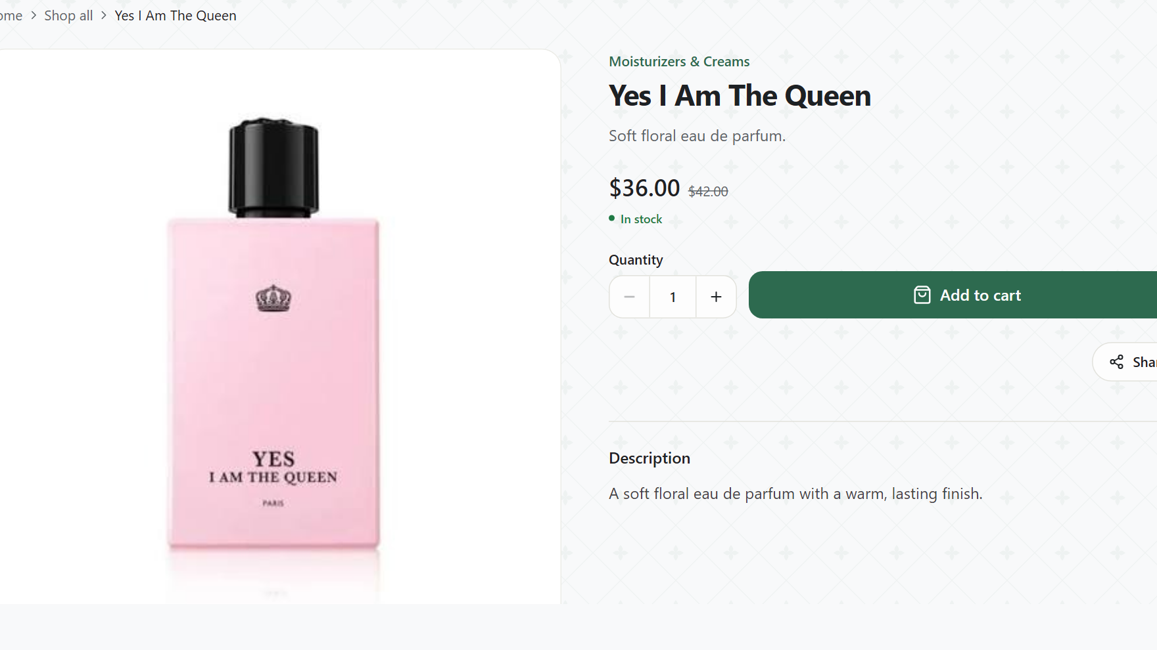
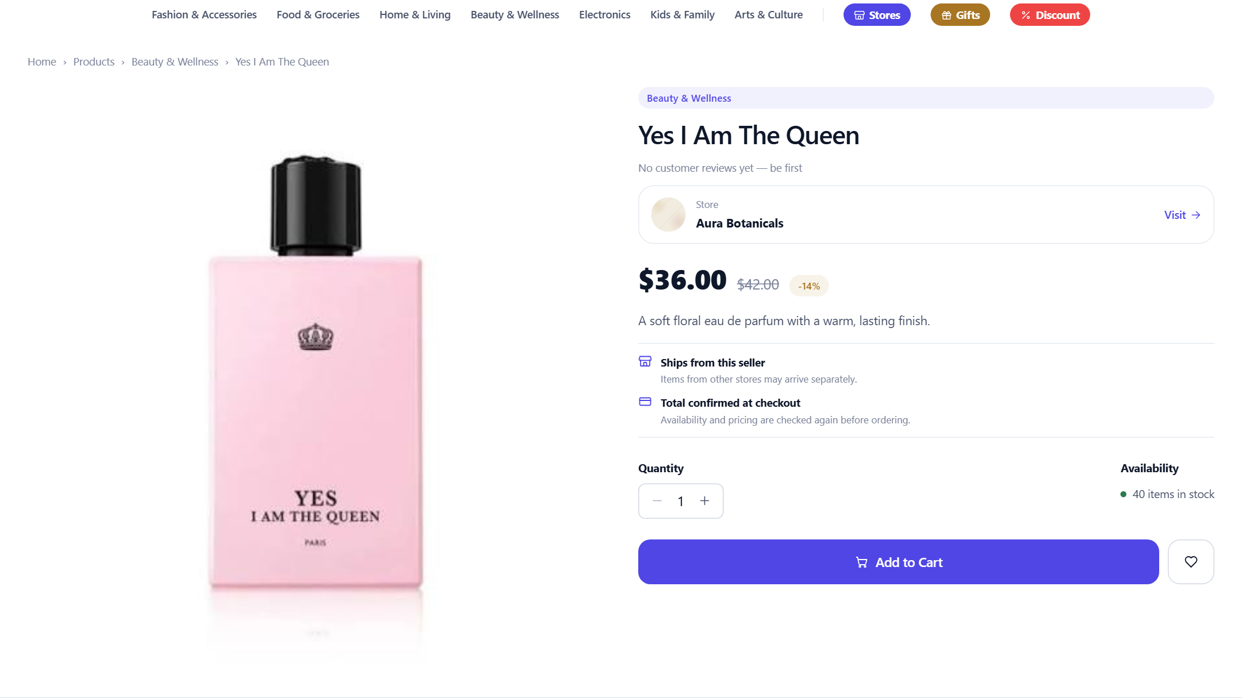
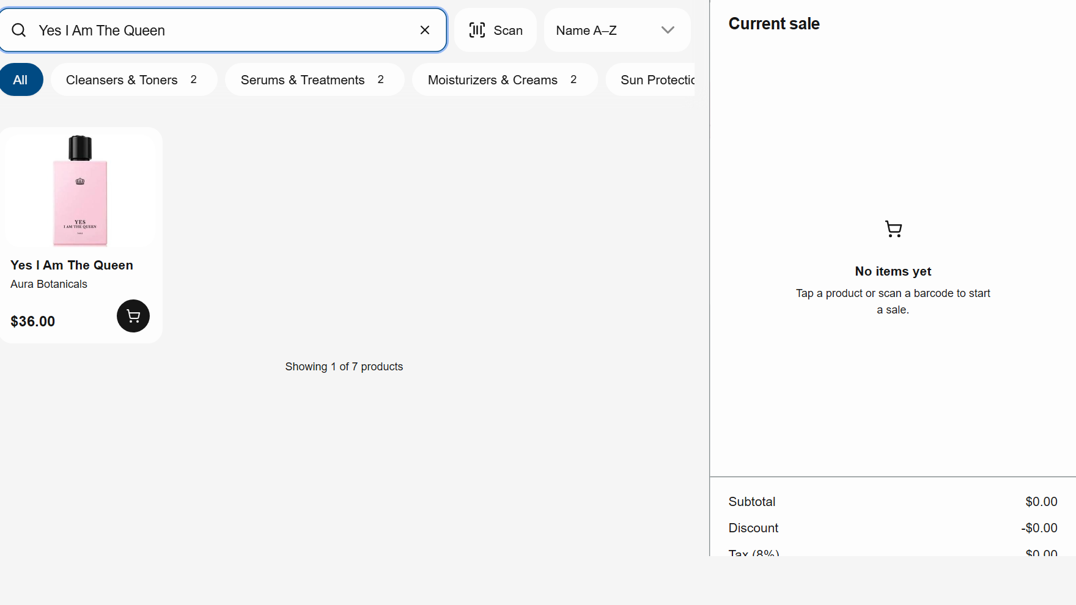



Add a product once. It’s live everywhere.
ENTERED ONCE
Yes I Am The Queen
$36.00 · Stock 40
$36 · Stock 40
$36 · Stock 40
$36 · Stock 40
Own storefront
Marketplace
POS at the counter
Real screens from Rentify’s working development build (demo store: Aura Botanicals).
Notes:
[1:05–1:25]
Here is how Rentify works. The merchant adds a product once — name, price and stock. It appears immediately on their own storefront, in the shared marketplace and in their POS at the counter. Same price, same stock, everywhere. No copying, no re-listing.

