Slide 1
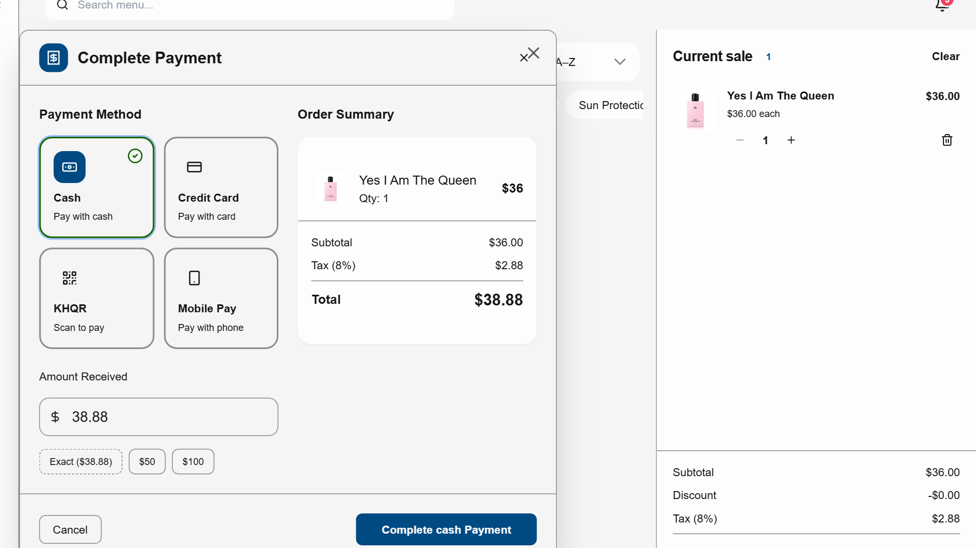
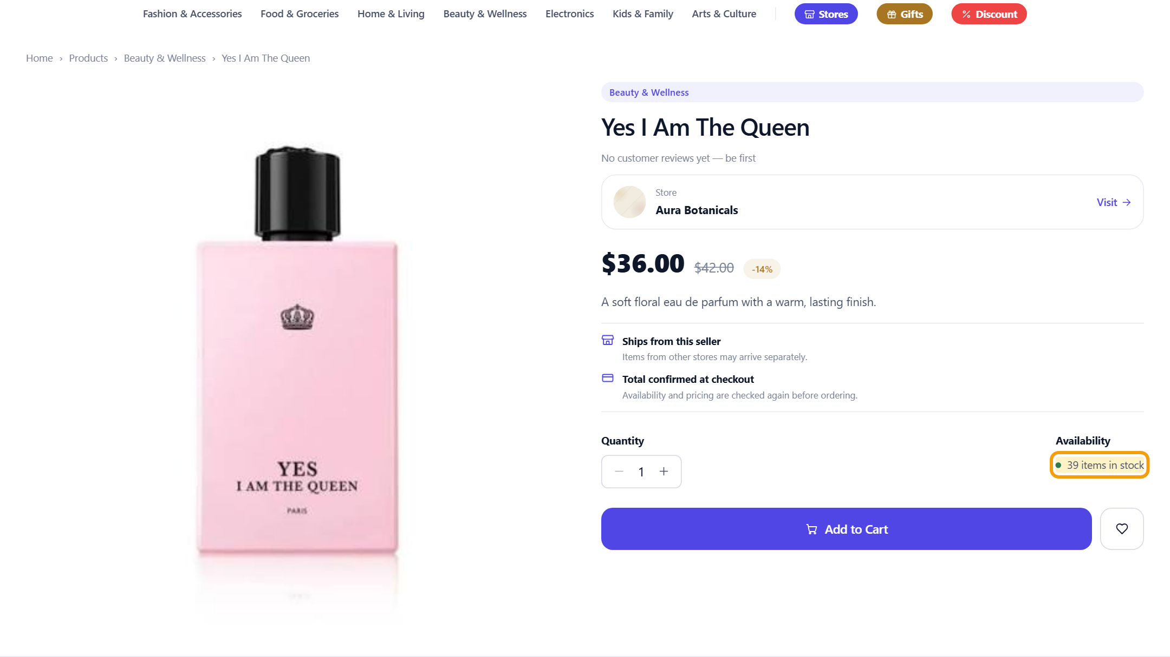

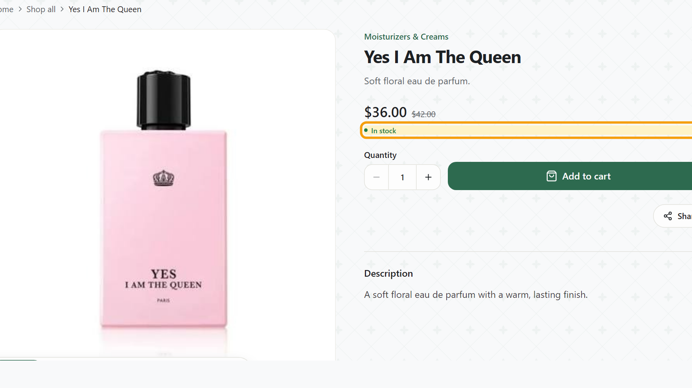

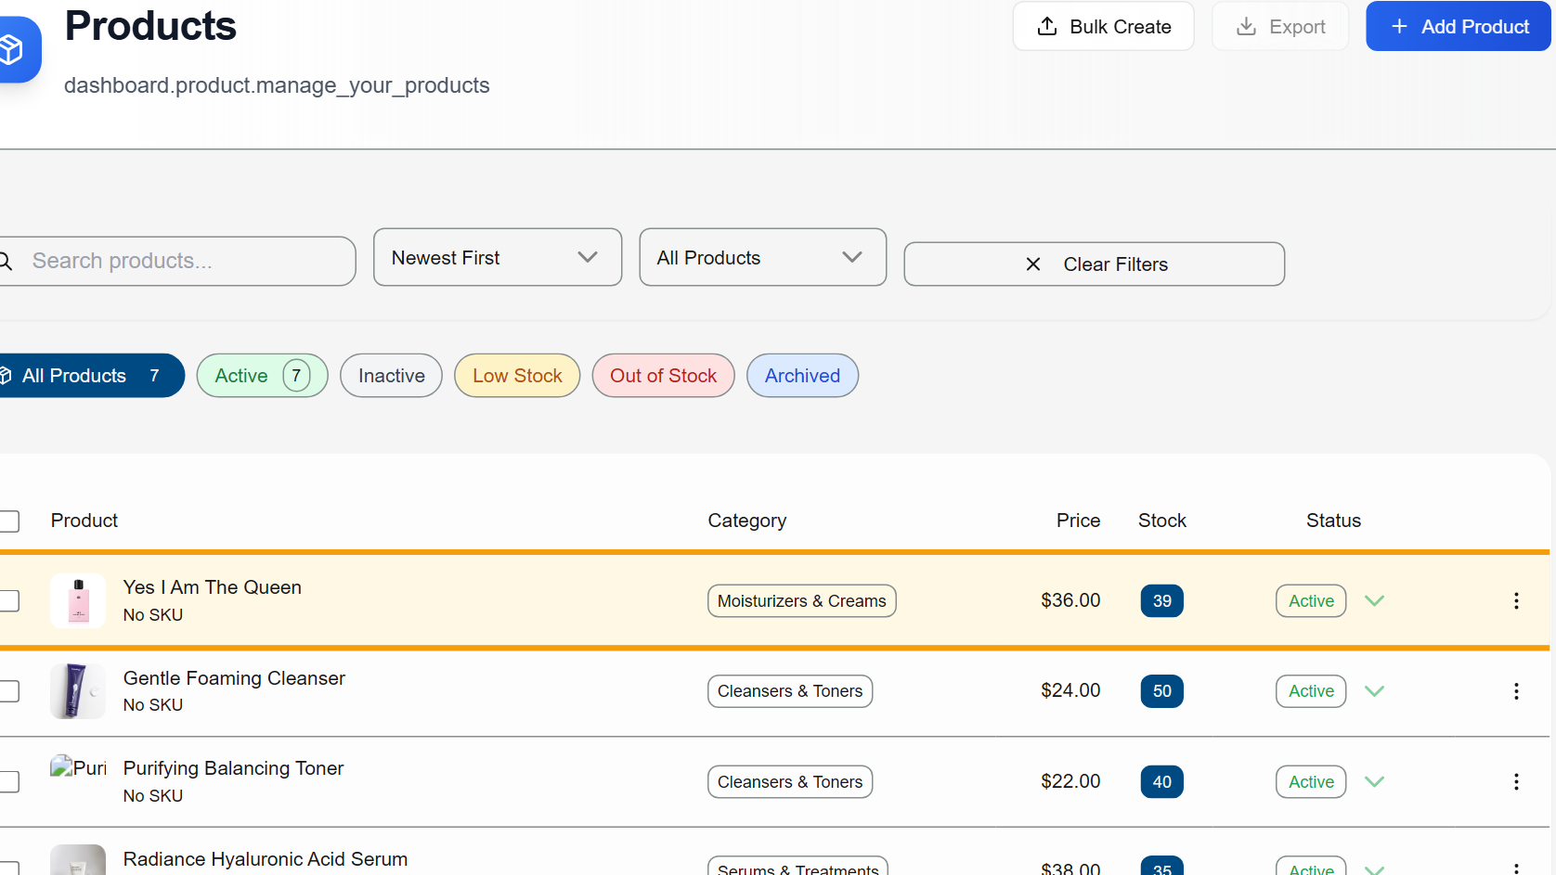



Add once. Sell once. Every channel in sync.
1
Sold at the POS
Every channel updates
1
2
2
−1
Marketplace
39 in stock
ONE STOCK
40 → 39
Own storefront
In stock
BEFORE THE SALE · ADDED ONCE
Yes I Am The Queen · Stock 40
Dashboard
Stock 39
live on all three
Real screens: one cash sale on Rentify POS, captured in our development build (demo store: Aura Botanicals). No second update was made.
Notes:
[1:00–1:45]
Here is Rentify working. The merchant adds a product once, and it's live on their storefront, in our marketplace and in their POS. Now a customer buys one bottle at the counter. We had forty. The moment the sale completes, the stock drops to thirty-nine everywhere — the marketplace shows thirty-nine, the merchant dashboard shows thirty-nine, and the storefront stays in stock. One sale, one stock, every channel in sync. No second update.
(Q&A: real screens from our development build with demo data, not customer orders.)

