Slide 1


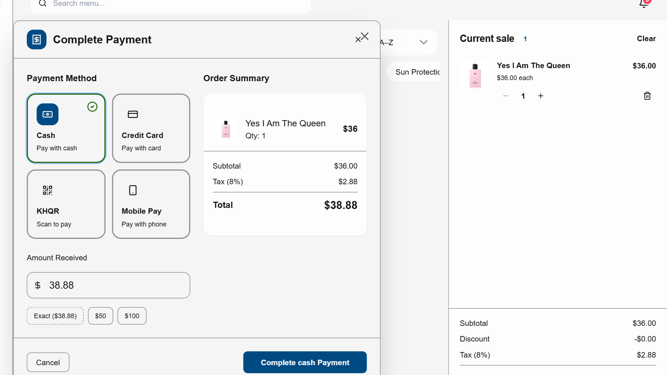
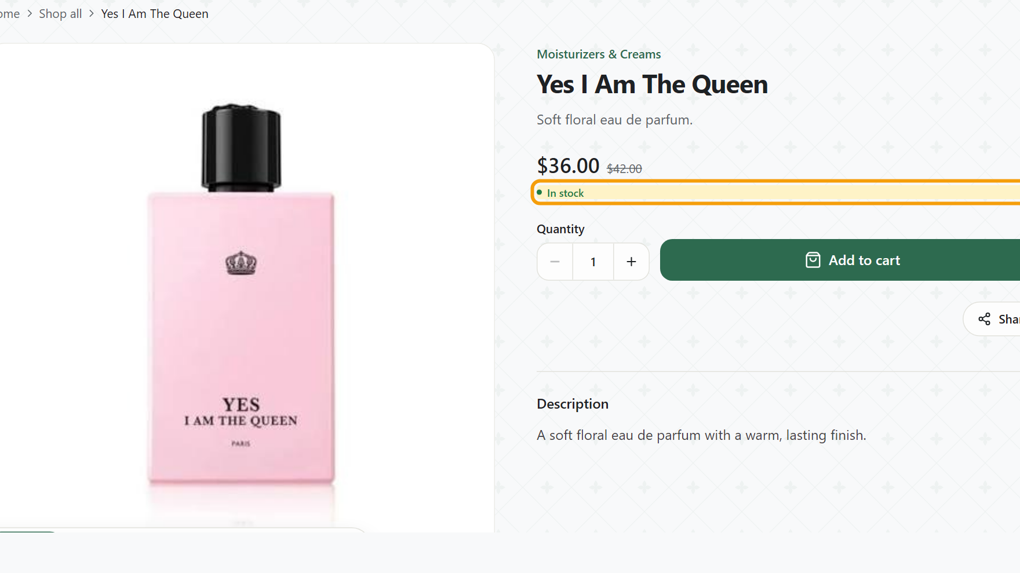
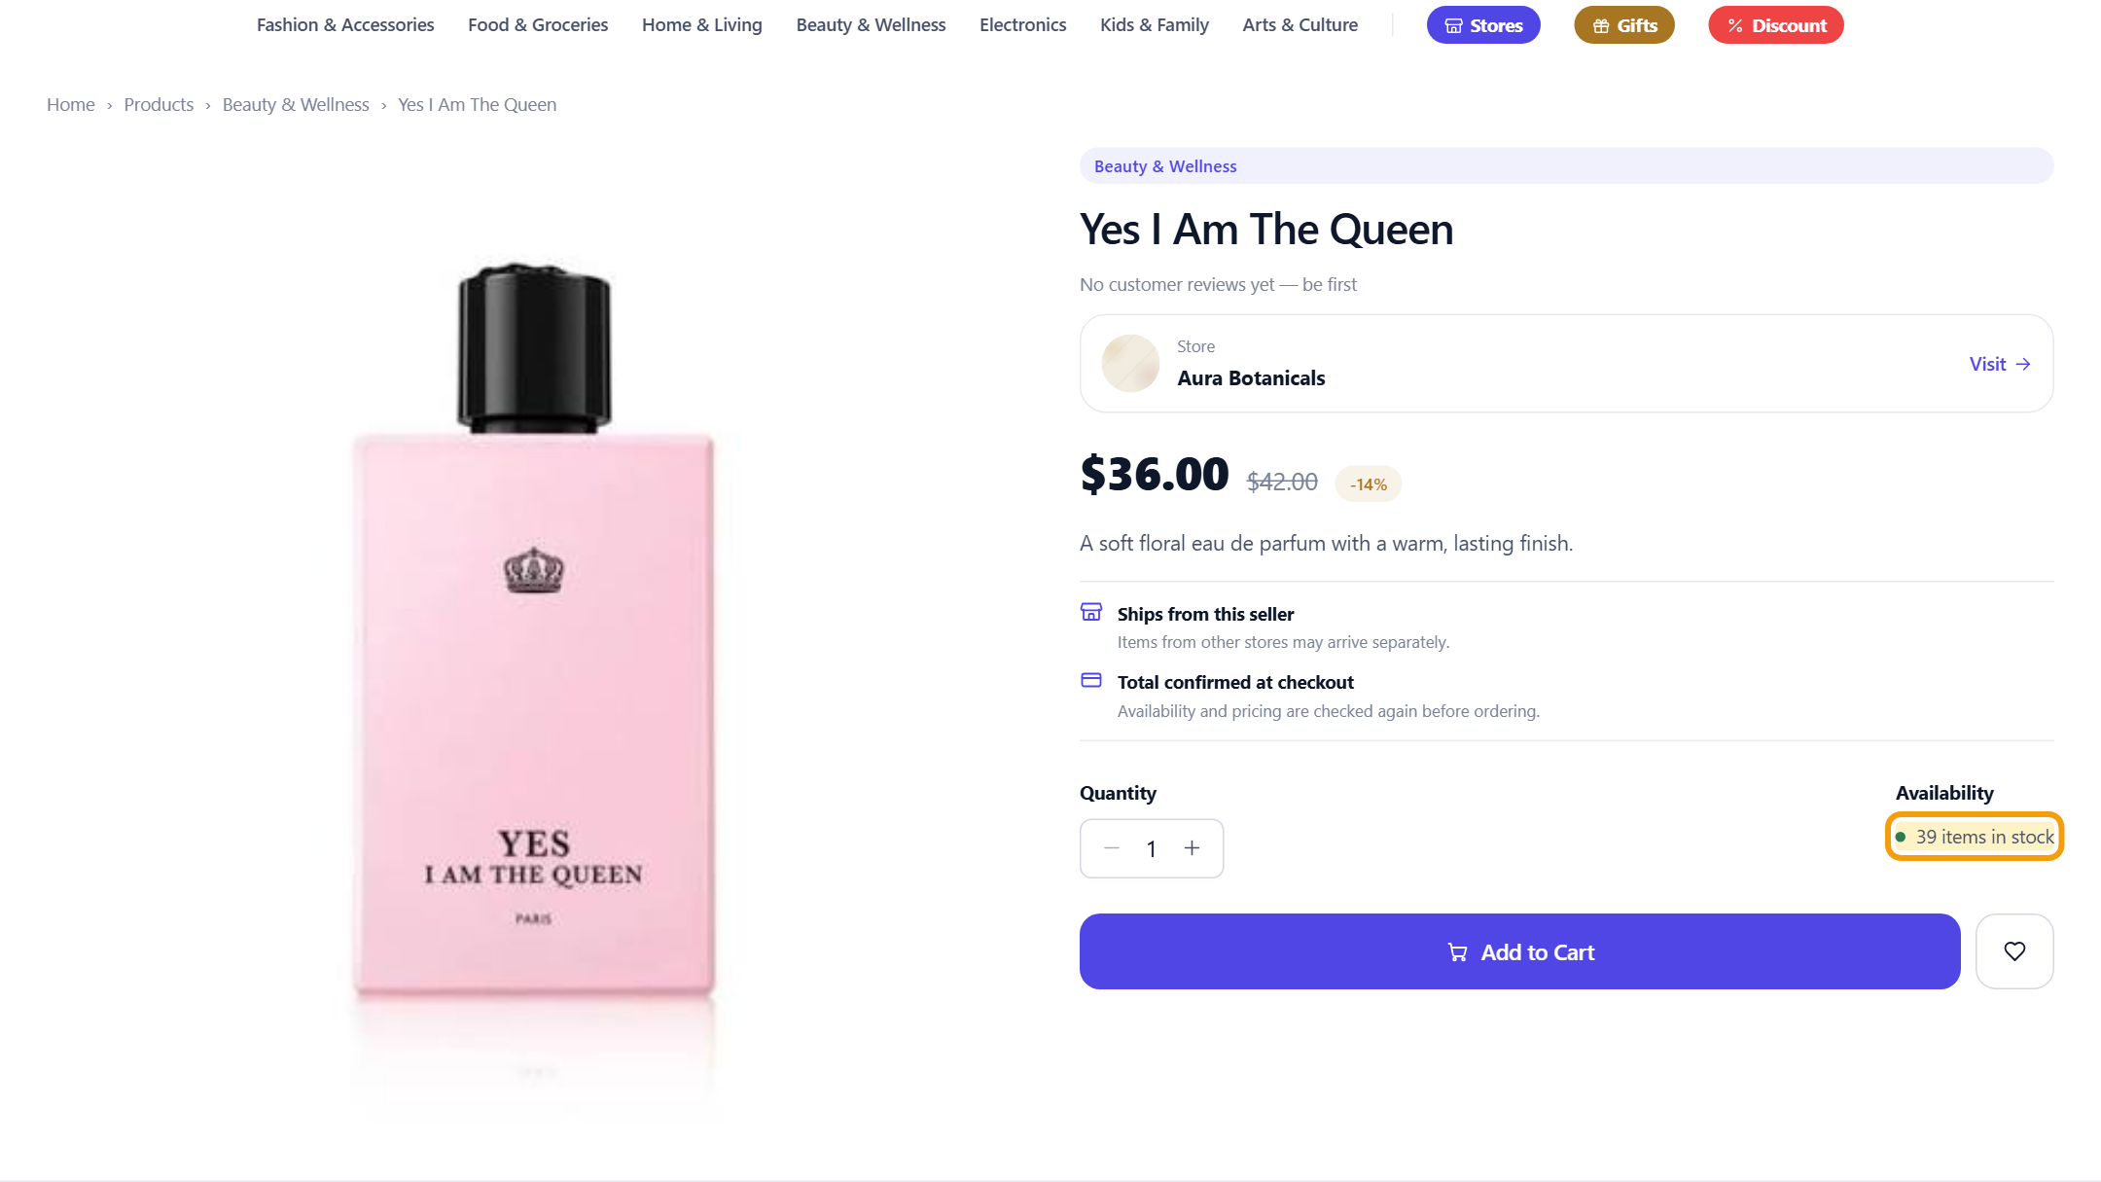



Sell one at the counter. Every channel knows.
SOLD 1 AT THE COUNTER
Yes I Am The Queen
Stock 40 → 39
Sold 1
Still in stock
Stock 39
POS at the counter
Own storefront
Marketplace
Real screens: one cash sale on Rentify POS updates every channel from one stock. Development build, demo store Aura Botanicals.
Notes:
[1:25–1:50]
Now we sell one bottle at the counter with Rentify POS. Stock was 40. Seconds later the marketplace shows 39 in stock and the storefront stays live with the right stock. One sale, updated everywhere — no notebook, no second update.
(Q&A: demo data in the development build, not customer orders.)

