Slide 1

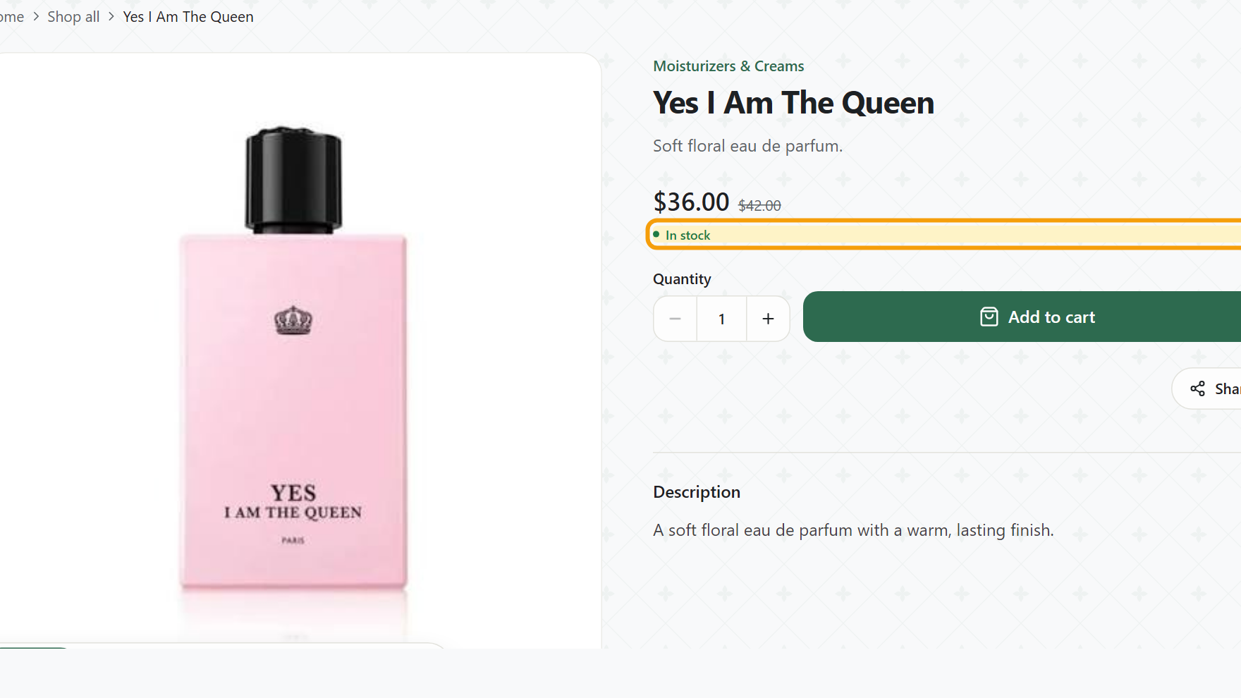
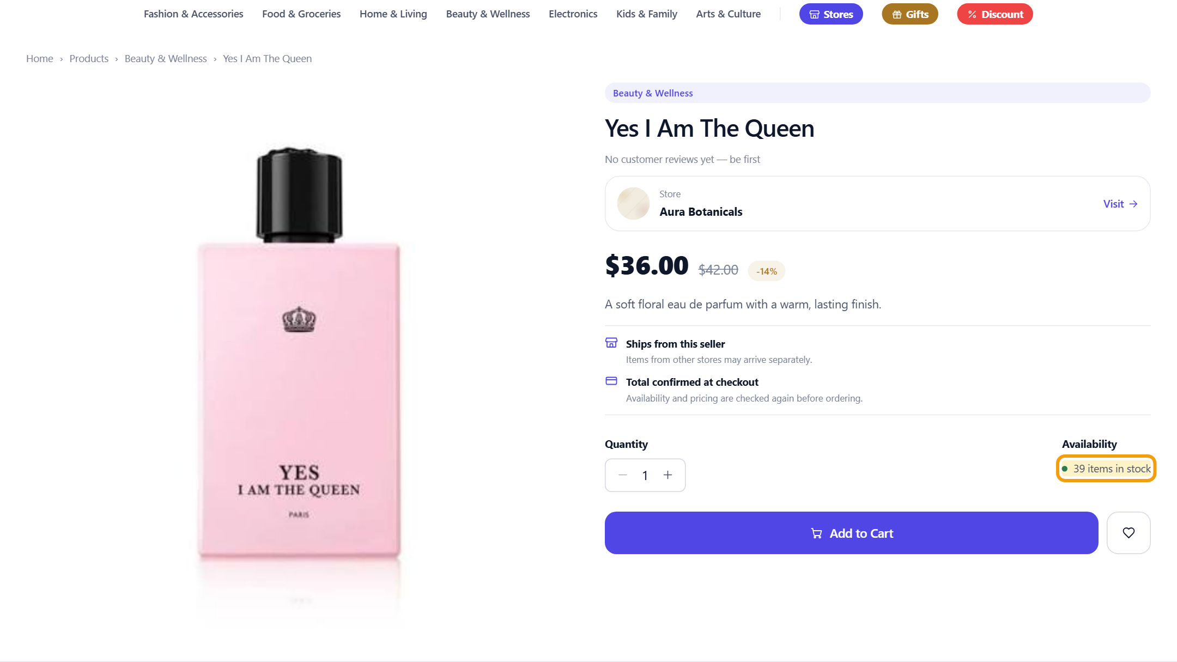
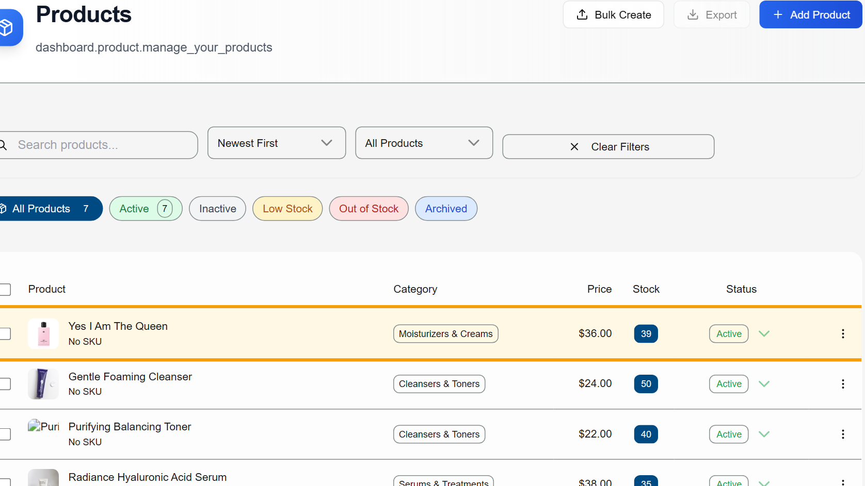



Sell one at the counter. Every channel knows.
SOLD 1 AT THE COUNTER
Yes I Am The Queen
Stock 40 → 39
Still in stock
Stock 39
Stock 39
Own storefront
Marketplace
Merchant dashboard
Real screens captured after one POS cash sale in Rentify’s development build (demo store: Aura Botanicals).
Notes:
[1:25–1:50]
Now we sell one bottle at the counter with Rentify POS. Stock was 40. Seconds later the marketplace shows 39 in stock, the merchant dashboard shows 39, and the storefront stays live with the right stock. One sale, updated everywhere — no notebook, no second update.
(Q&A: demo data in the development build, not customer orders.)

