Slide 1






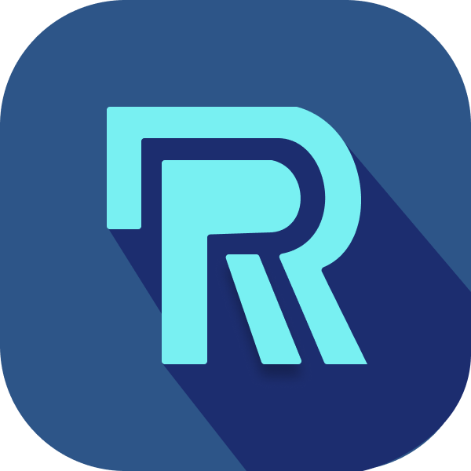
How Rentify compares
WHAT THEY OFFER
WHY CHOOSE RENTIFY
Marketplace
Storefront
POS
Khmer24 · VTENH
Your own brand too
Marketplaces
Facebook page
Real stock and checkout
Social selling
POS apps
Sell online, same stock
Counter only
Shopify
Cambodian marketplace built in
Global store builder
Khmum
Sign up yourself · free start
Contact form to join · no public prices
Rentify
All three · one stock · free to start
Khmum proves Cambodian merchants want this. Rentify makes it simple enough for any small shop to start today, for free.
Lit tiles = channels each alternative publicly offers (checked Sep 2026). Khmum shops sell as a page in the Khmum app or via a custom white-label app. Full comparison in appendix.
Notes:
[Competition]
Merchants already have options — but most cover only one piece. Marketplaces like Khmer24 and VTENH bring buyers, but no brand of your own. A Facebook page has no real stock or checkout. POS apps only work at the counter. Shopify has no Cambodian marketplace. Khmum is closest to us — they offer all three, and they prove Cambodian merchants want this. The difference is how you get it: Khmum merchants join through their sales team and sell inside the Khmum app. With Rentify, any shop signs up itself, starts free, and gets its own storefront website in minutes — all on one stock.
(Q&A: lit tiles reflect public descriptions, not a hands-on audit. Against Khmum we will compare setup time, stock accuracy and total cost in the pilot.)

