Slide 1
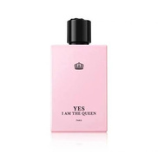



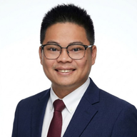
What merchants told us
MOCK QUOTES — replace with real feedback before presenting
MERCHANT
MERCHANT
MERCHANT
Elora
Kour Manith
Apsara Fairy
Perfume store
Coffee shop & restaurant
Restaurant & coffee
“I sell on Facebook and in my shop. Keeping stock the same in both is my biggest headache.”
“A POS that also puts my menu online would save me hours every week.”
“If it is free to start, I would try the marketplace this month.”
✓ Will use Rentify at launch
MERCHANT
ADVISOR
Hyper-Tech Store
Dr. Po Sovinda
Electronics store
Senior Lecturer, Strategy
“Customers ask on Telegram if items are in stock. I have to check by hand.”
“Prove it with a small pilot first. Measure stock accuracy and repeat use.”
✓ Will use Rentify at launch
Mock quotes for layout only. Replace with each validator’s real words and confirm permission to show names and logos.
Notes:
[MOCK] Replace these quotes with what each validator actually said. Do not present mock quotes as real feedback.

