Slide 1
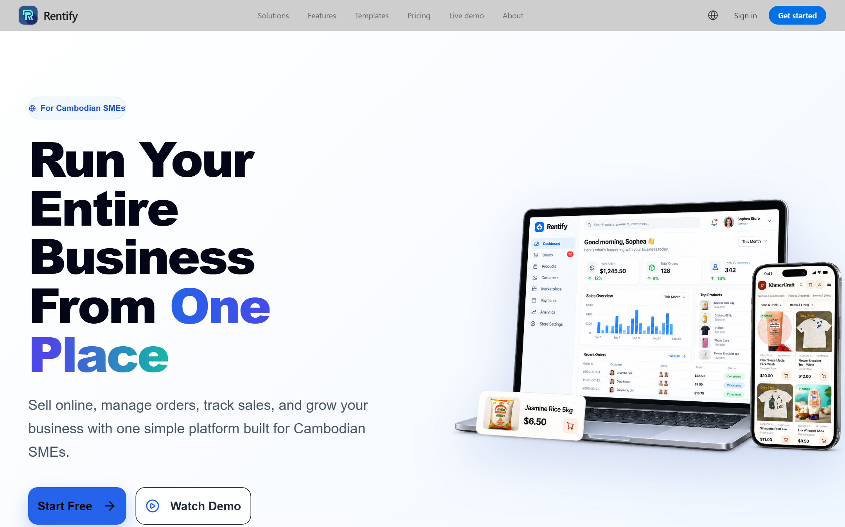




TRY IT YOURSELF
Rentify is live.
Try it now.
Scan the QR code with your phone camera
Explore templates and the live demo
Start free, no credit card needed
rentify.mekhla.digital
Scan to try Rentify
Notes:
[Q&A / demo]
Rentify is live. Scan the QR code to explore our templates, try the live demo, and start free, with no credit card needed.
(Before presenting: open rentify.mekhla.digital once to make sure it is up. Keep this slide on screen during Q&A so judges can scan it.)

