Slide 1
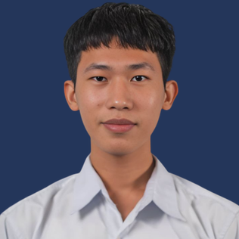
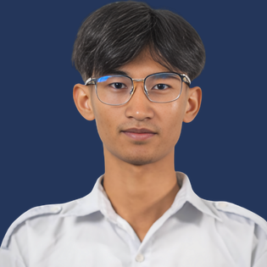
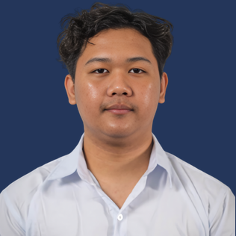
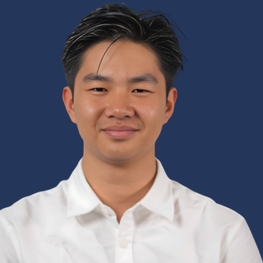
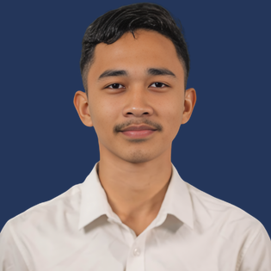



The team behind Rentify
Long Mengchheng
Hong Thanbrathna
Khemrak Pasey
Mom Sothireak
Vy Seoul
Team Lead
Idea Founder
Business Lead
Pitch Lead
Developer
Builds and runs the team
Builds the platform
Outreach and strategy
Presents our brand story
Designs the UX/UI
Sell everywhere. Manage once.
Thank you.
Notes:
[4:18–4:45]
We are five students who have already built this platform. Our next step is ten pilot shops in Phnom Penh, starting this quarter. Rentify: sell everywhere, manage once. Thank you.
[Stop here. Keep this slide up for Q&A.]

