Slide 1
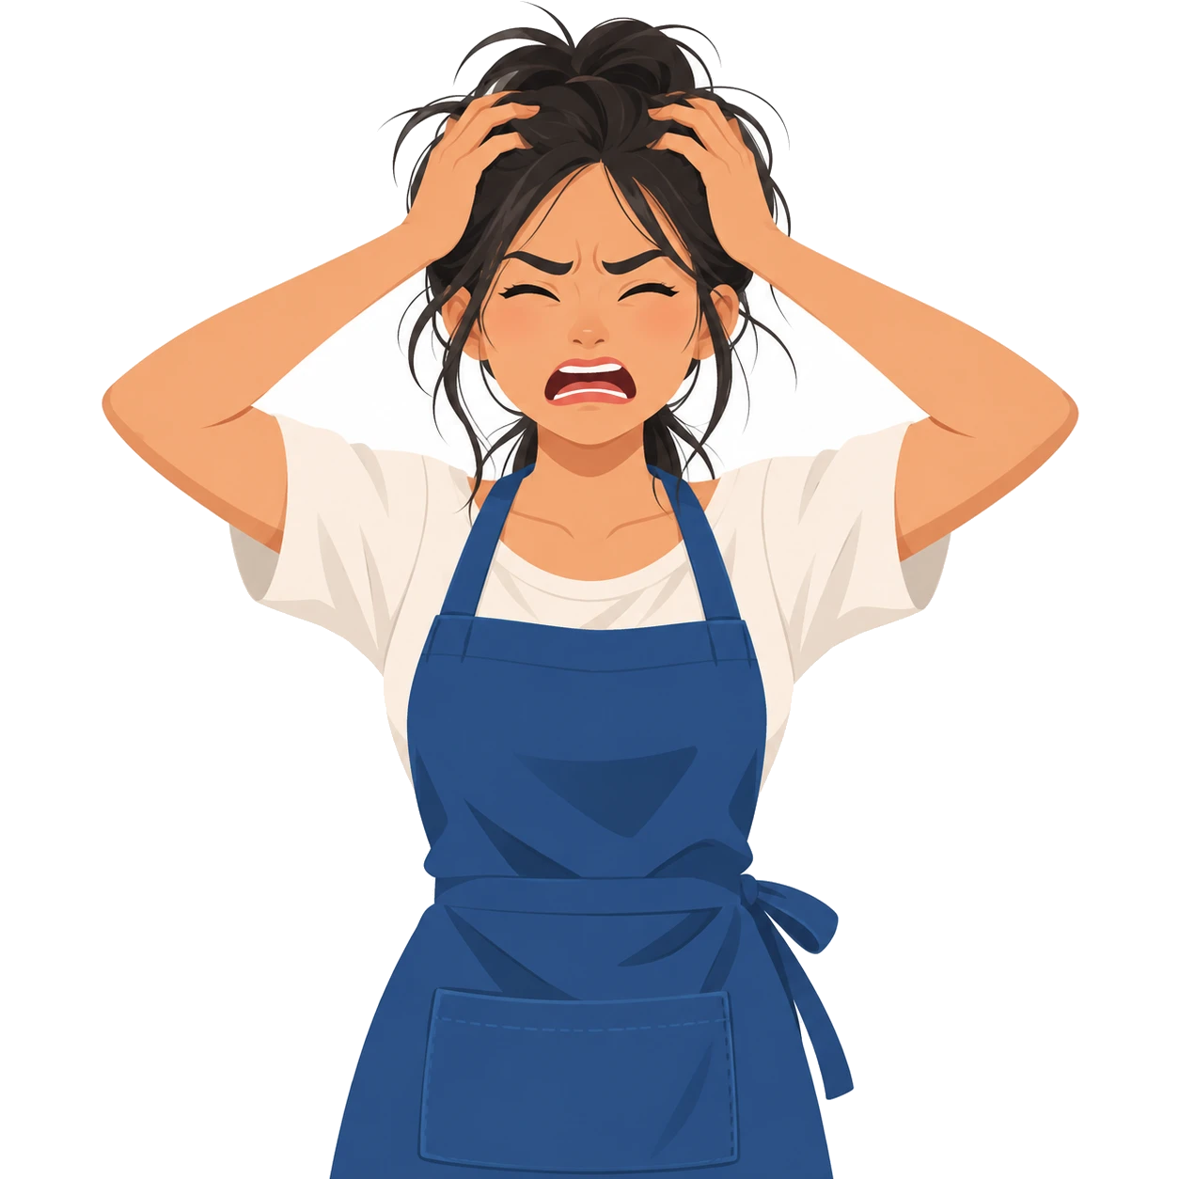



One merchant. Too many places to update.
f
?
Where’s my order??
Facebook
IN STOCK
POS at the counter
SOLD OUT
??
Khmer24 listing
OLD PRICE
Stock: 3? 5? 0?
Telegram
27 new orders
Illustrative scenario and AI-generated image. How often this happens will be measured in our first merchant pilots.
Notes:
[0:15–0:40]
But their tools don't connect. Orders arrive on Telegram, products are listed on Facebook and Khmer24, stock lives in a notebook, and sales happen on a separate POS. So when the last item sells at the counter, Facebook still says it's in stock and Khmer24 shows the old price. The result is an apology, a refund and a lost customer.
(Evidence: illustrative scenario. Replace with real merchant quotes once pilot conversations happen.)

