Slide 1
User blog service Group D, kalina, Jiaqi, Jianfei, Mengchuan, Jiefan, Ishant

Slide 2
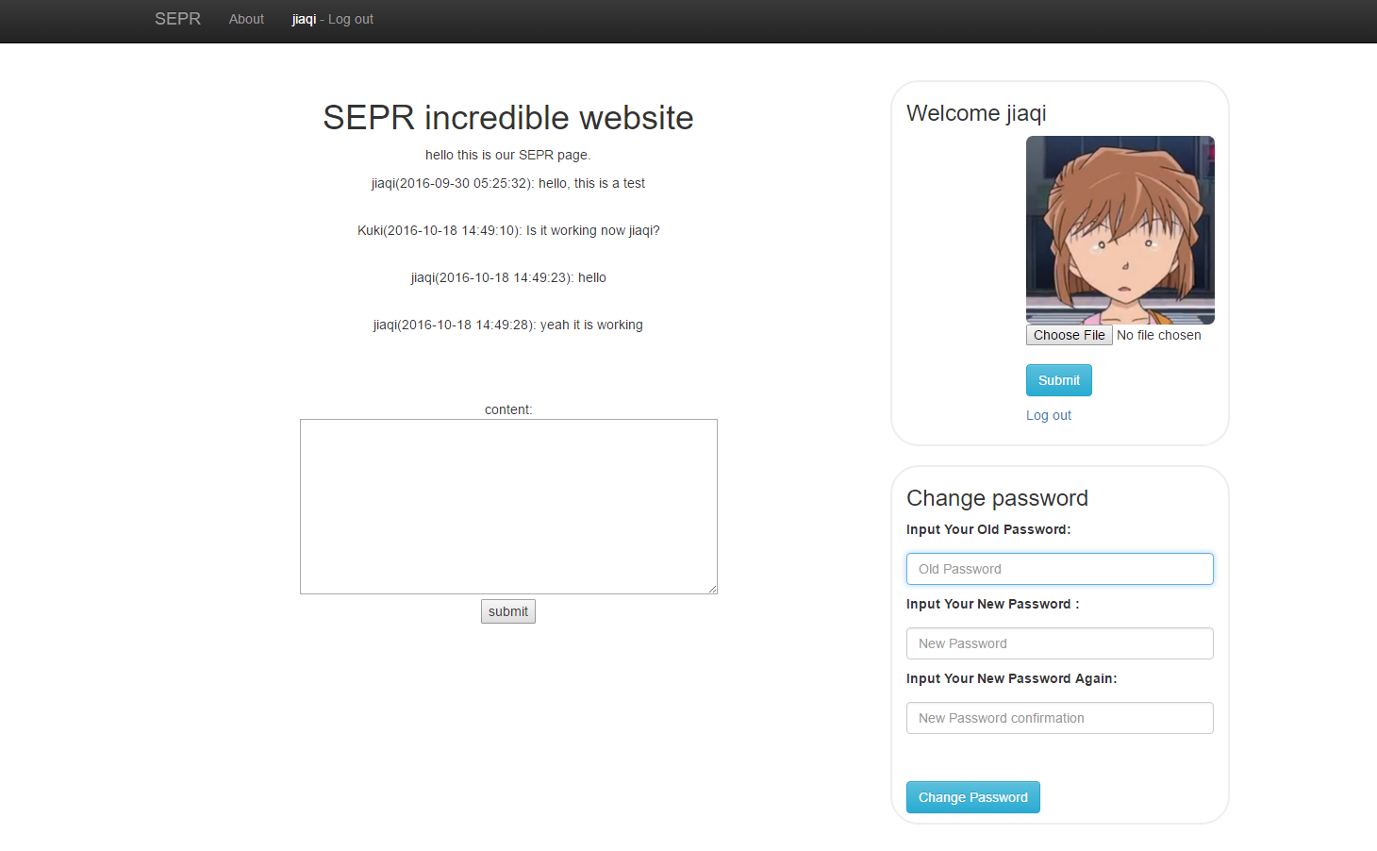
Application introduction
A simple application which allows users to leave messages to each other.

Slide 3
Functionalities
Register
Login
Change password
Avatar upload
Comment
Administrator functions
Ban users
Delete comments

Slide 4
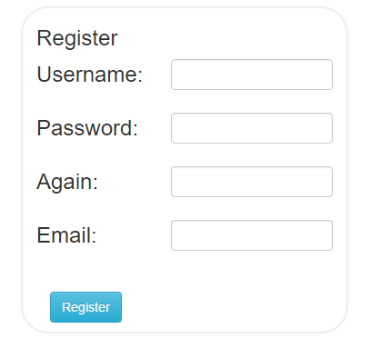
Register
Length check.
Regular expression check – emails and passwords.
Format check (for email).
Password encryption(salting).
Use mysqli to execute the query.
Use mysqli functions to sanitize the input.
Frontend and backend input checks.

Slide 5
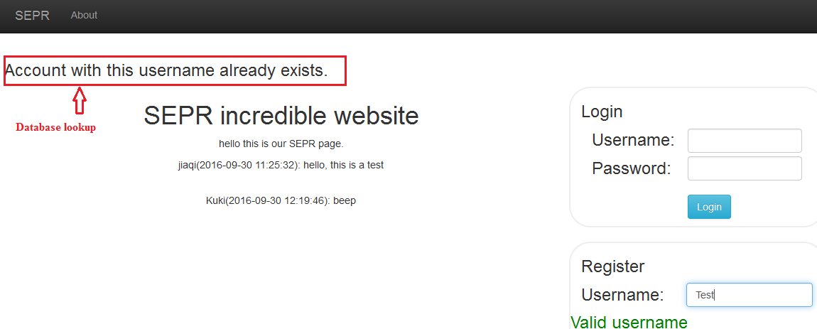
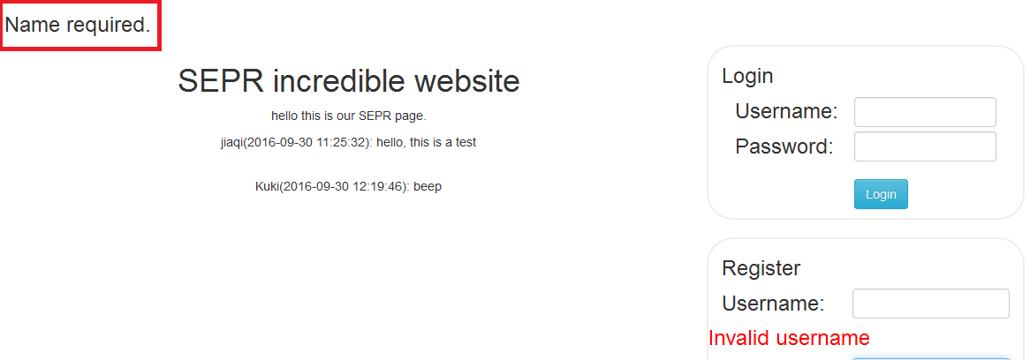
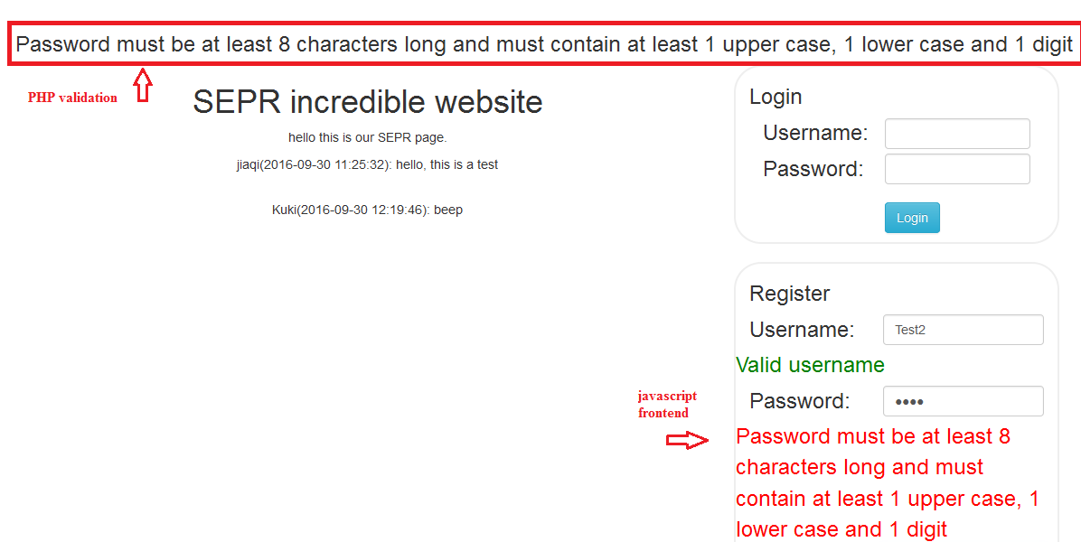
Register

Slide 6
Brute force and lookup tables
Can’t be prevented.
Make it harder for the attacker.
Add randomly generated salts to each user password and encrypt.
Each user – different salt.
Force users to create long and complex passwords.

Slide 7
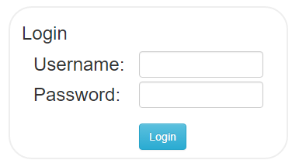
Login
Length check.
Regular expression check.
Use mysqli to execute the query.
Use mysqli functions to sanitize the input.

Slide 8
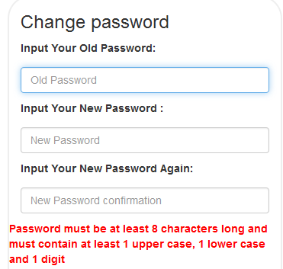
Change password
Check if old pw is valid.
Checks if new passwords are valid format.
Generate new salt.
Notes:
SQL injection will be prevented

Slide 9
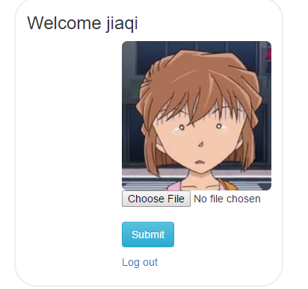
Avatar upload
File format check.
Change the uploaded file name.
Use mysqli to execute the query.
Use mysqli functions to sanitize the input.

Slide 10
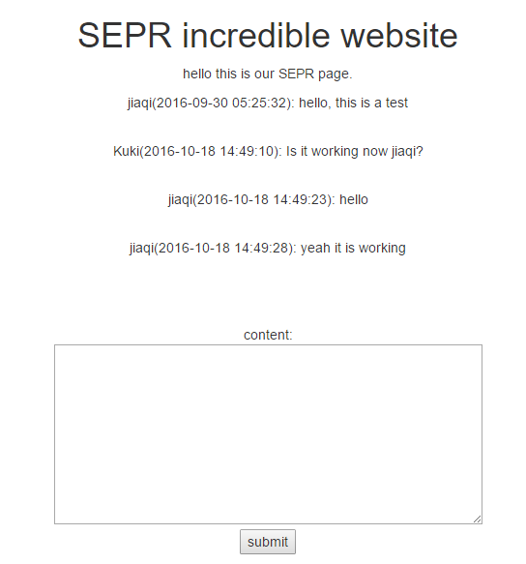
Comment
Use mysqli to execute the query.
Use mysqli functions to sanitize the input.

Slide 11
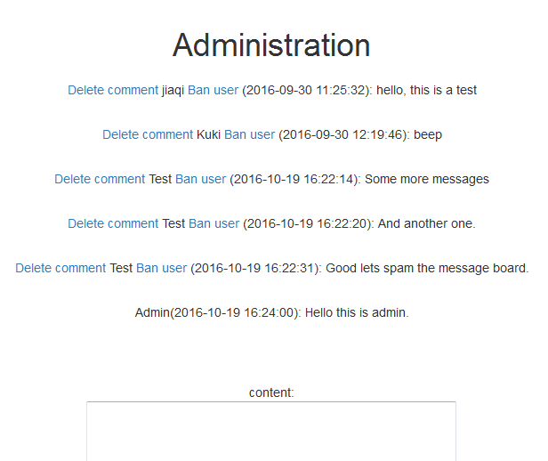
Admin function
Use mysqli to execute the query.
Use accesslevels to gain access to admin functions.
Can’t ban or delete comments of a user with higher access level.

Slide 12
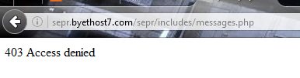

Indexing
Restrict access to files from url.
Udated the .htaccess file.

Slide 13
demo

Slide 14
Questions?

