Slide 1
User blog service Group D, kalina, Jiaqi, Jianfei, Mengchuan, Jiefan, Ishant

Slide 2
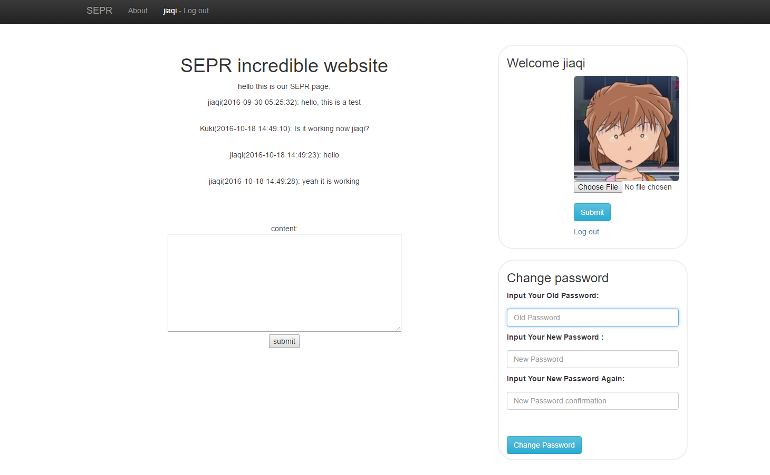
Application introduction
A simple application which allows users to leave messages to each other.

Slide 3
Functionalities
Register
Login
Change password
Avatar
Comment
Admin function

Slide 4
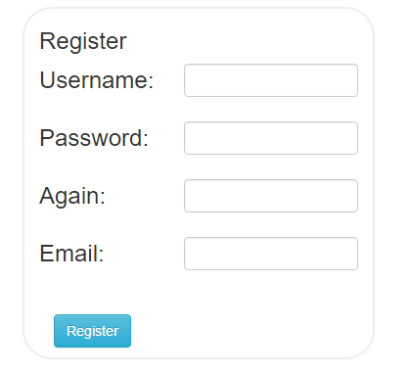
Register
Length check.
Regular expression check.
Format check (for email).
Password encryption(salting).
Use mysqli to execute the query.
Use mysqli functions to sanitize the input.
Frontend and backend input checks.

Slide 5
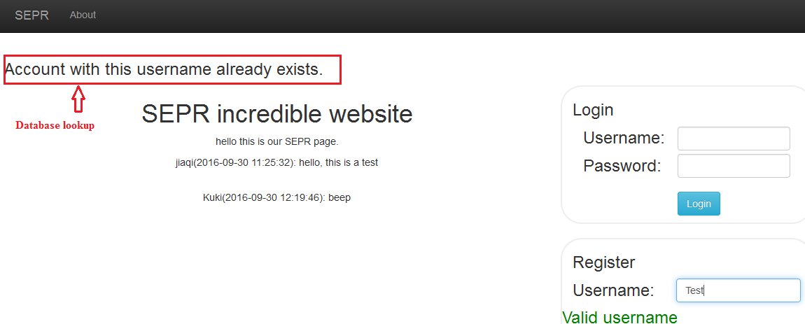
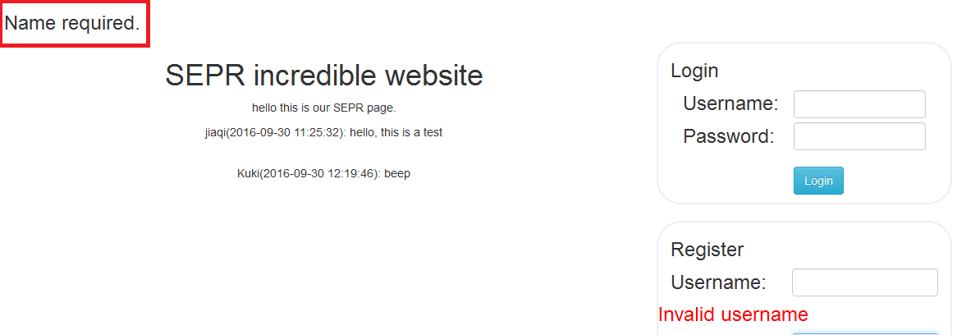
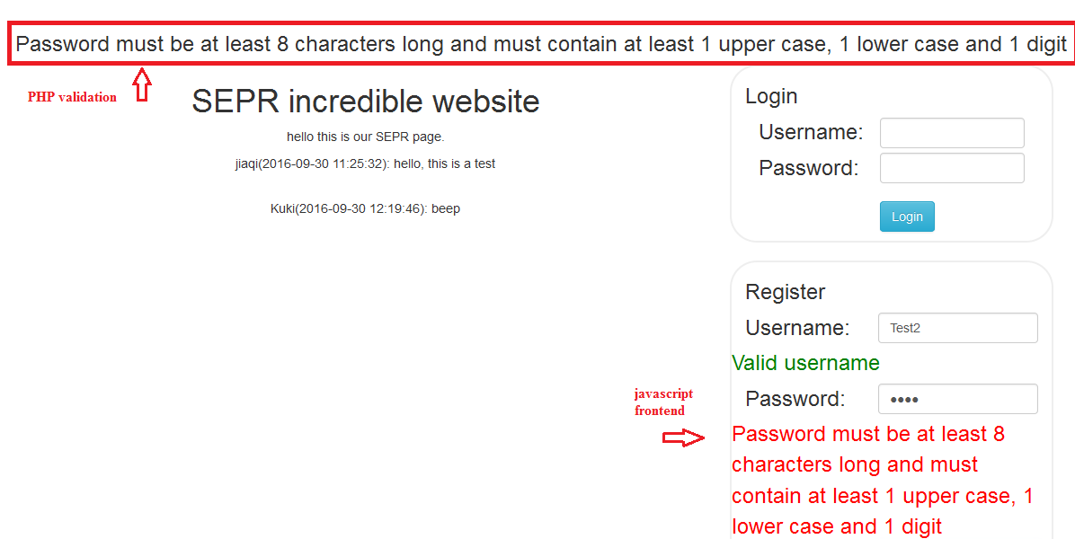
Register

Slide 6
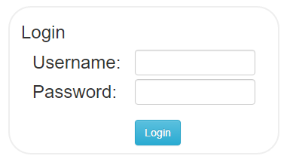
Login
Length check.
Regular expression check.
Use mysqli to execute the query.
Use mysqli functions to sanitize the input.

Slide 7
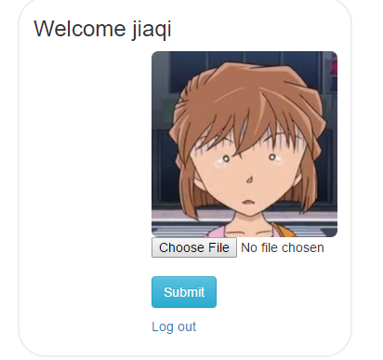
Avatar
File format check.
Change the uploaded file name.
Use mysqli to execute the query.
Use mysqli functions to sanitize the input.

Slide 8
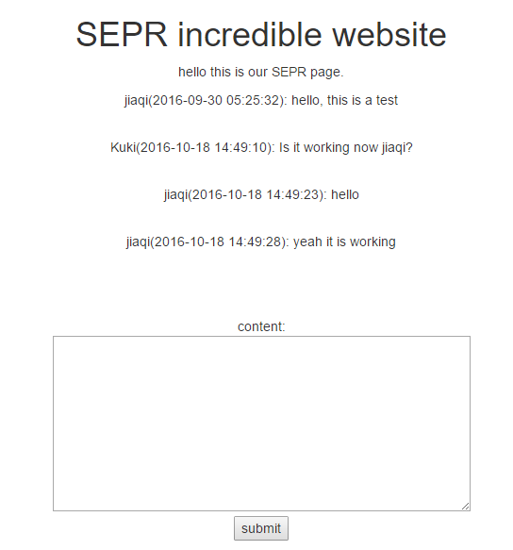
Comment
Length check.
Regular expression check.
Use mysqli to execute the query.
Use mysqli functions to sanitize the input.

Slide 9
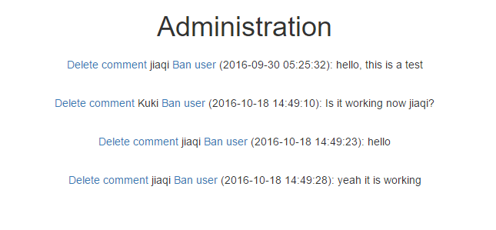
Admin function
Use mysqli to execute the query.
Use accesslevels to gain access to admin functions.
Can’t ban or delete comments of a user with higher access level.

Slide 10
Brute force and lookup tables
Can’t be prevented.
Make it harder for the attacker.
Add randomly generated salts to each user password and encrypt.
Each user – different password.

Slide 11
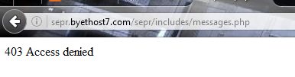

Indexing
Restrict access to files from url.
Udated the .htaccess file.

Slide 12
Questions?

