Slide 1
User blog service Group D, kalina, Jiaqi, Jianfei, Mengchuan, Jiefan, Ishant

Slide 2
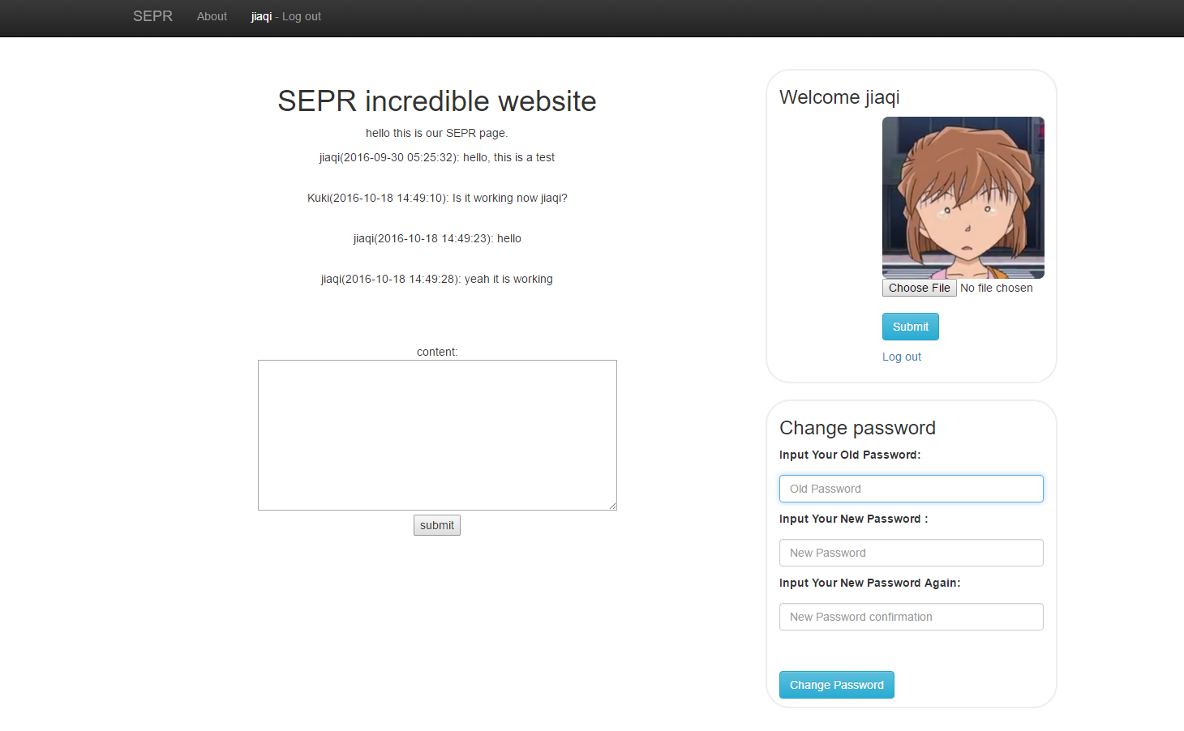
Application introduction
A simple application which allows users to leave messages to each other.

Slide 3
Functionalities
Register
Login
Change password
Avatar
Comment
Admin function

Slide 4
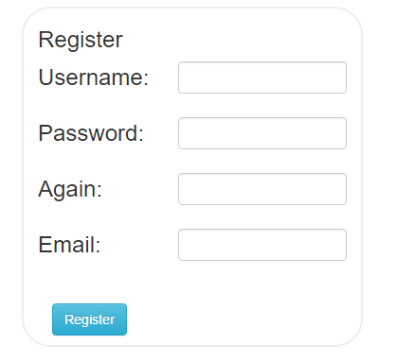
Register
Length check.
Regular expression check.
Format check (for email).
Password encryption(salting).
Use mysqli to execute the query.
Use mysqli functions to sanitize the input.

Slide 5
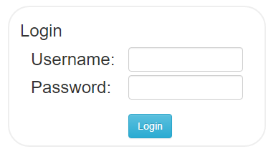
Login
Length check.
Regular expression check.
Use mysqli to execute the query.
Use mysqli functions to sanitize the input.

Slide 6
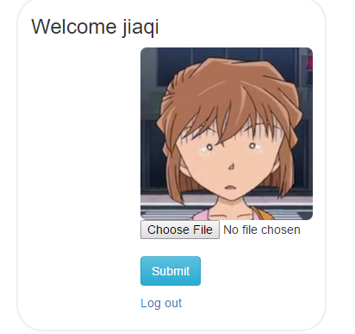
Avatar
File format check.
Change the uploaded file name.
Use mysqli to execute the query.
Use mysqli functions to sanitize the input.

Slide 7
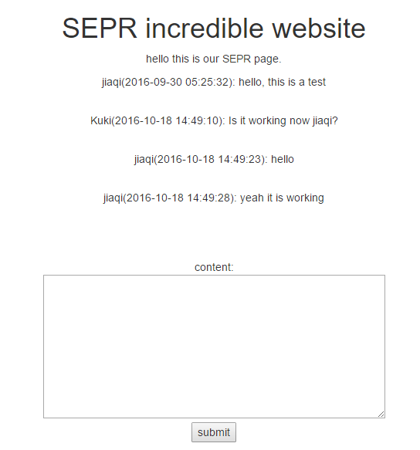
Comment
Length check.
Regular expression check.
Use mysqli to execute the query.
Use mysqli functions to sanitize the input.

Slide 8
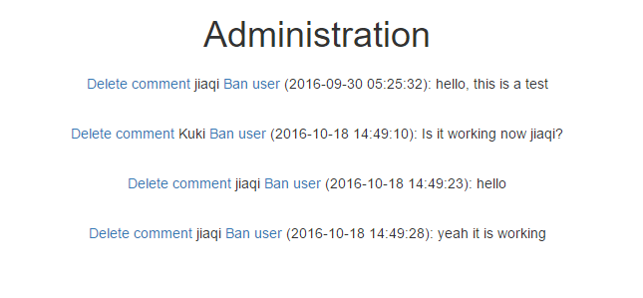
Admin function
Use mysqli to execute the query.

Slide 9
Questions?

