Slide 1
FEDformer: Frequency Enhanced Decomposed Transformer for Long-term Series Forecasting
Tian Zhou Ziqing Ma Qingsong Wen Xue Wang Liang Sun Rong Jin
Machine Intelligence Technology, Alibaba Group

Slide 2
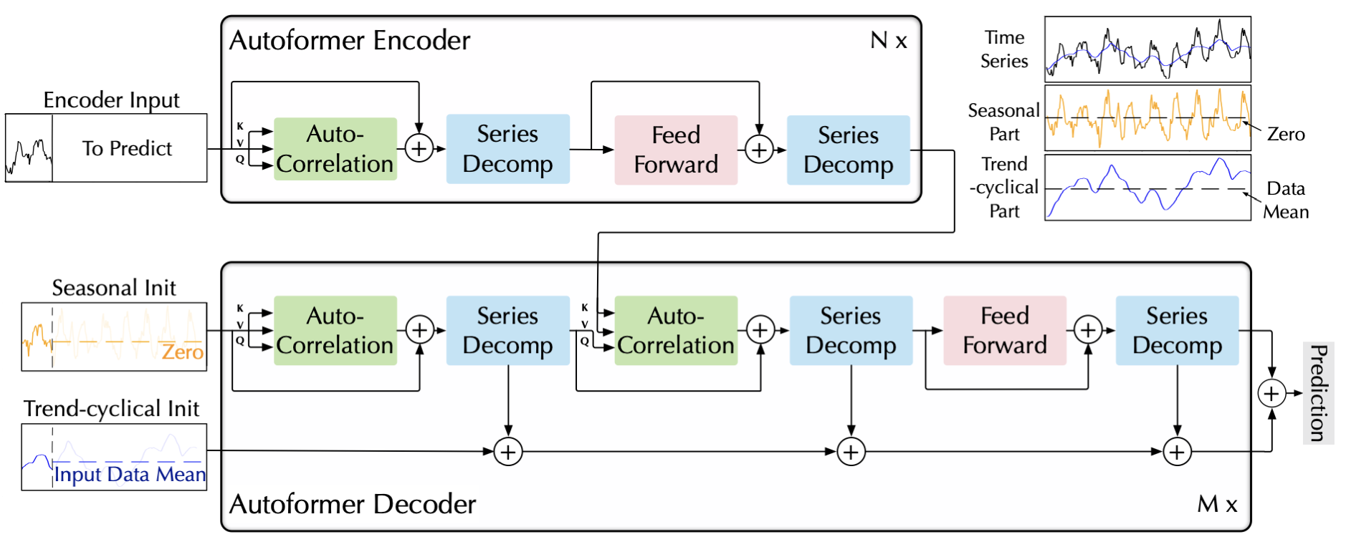
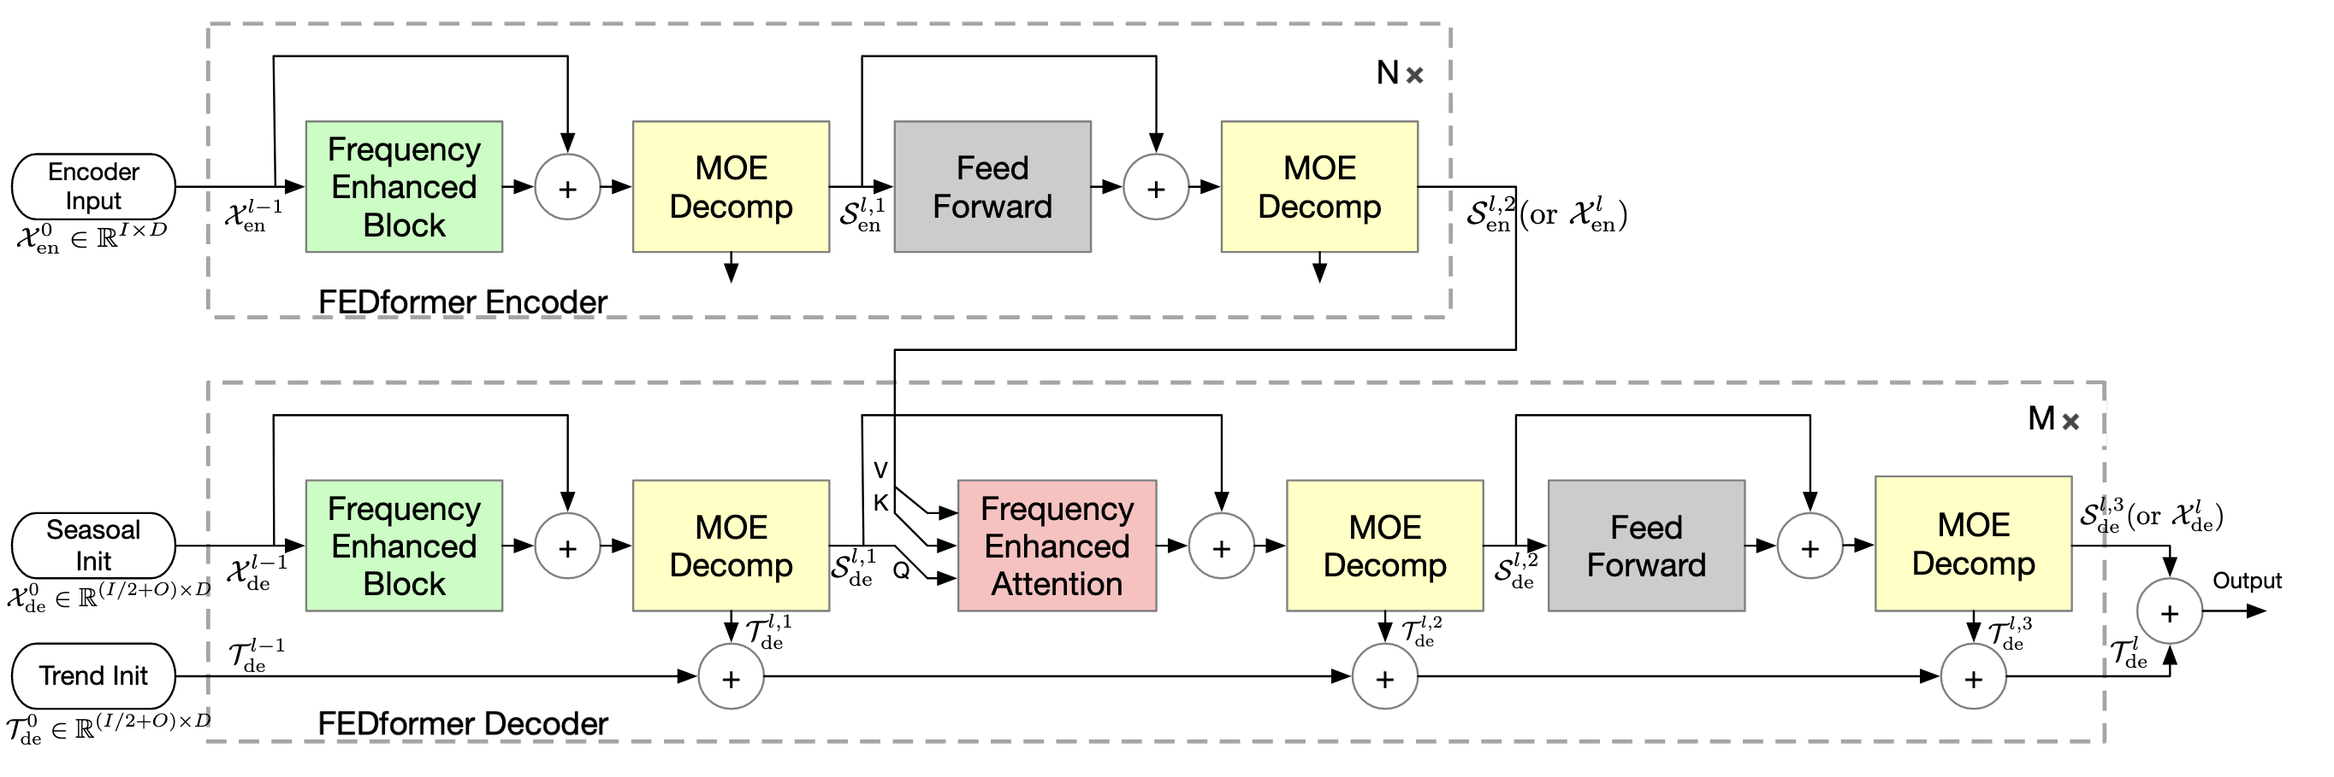

Slide 3
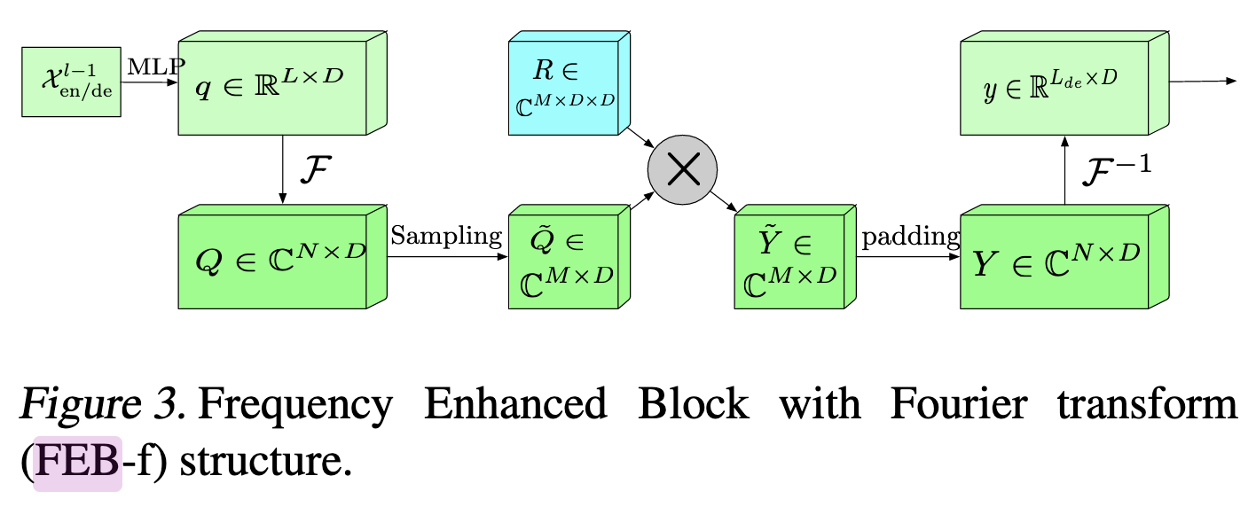
Frequency Enhanced BlocK (FEB)

Slide 4
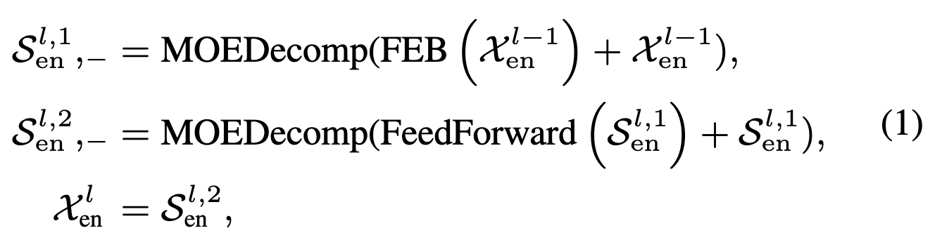
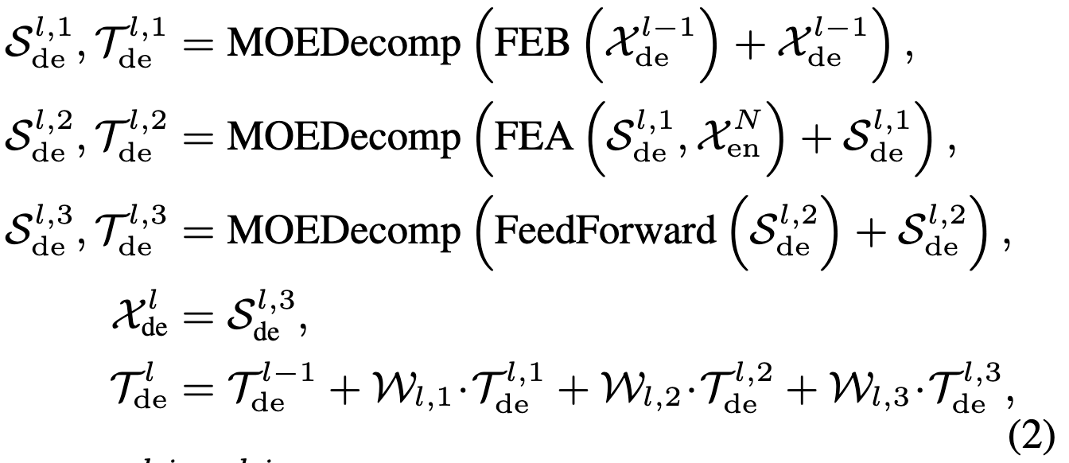
MOEDecomp Mixture of Experts for Seasonal-Trend Decomposition
Encoder
Decoder

Slide 5
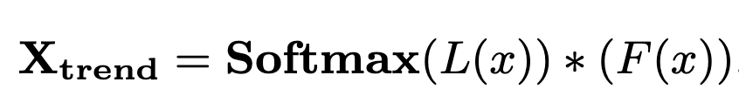
MOEDecomp Mixture of Experts for Seasonal-Trend Decomposition

