Slide 1
Temporal Pattern Attention for Multivariate Time Series Forecasting
Shih, Shun-Yao, et al. “Temporal Pattern Attention for Multivariate Time Series Forecasting.” Machine Learning, vol. 108, no. 8–9, June 2019, pp. 1421–41. Crossref, https://doi.org/10.1007/s10994-019-05815-0.

Slide 2
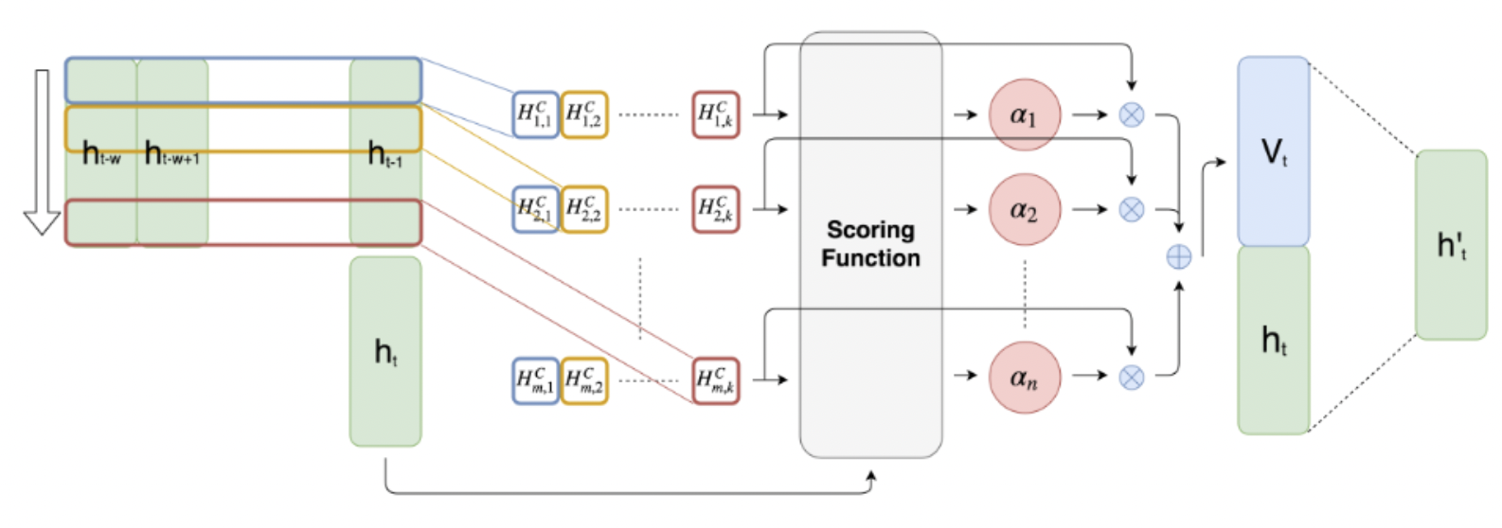
时序注意力机制

Slide 3
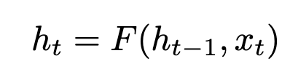

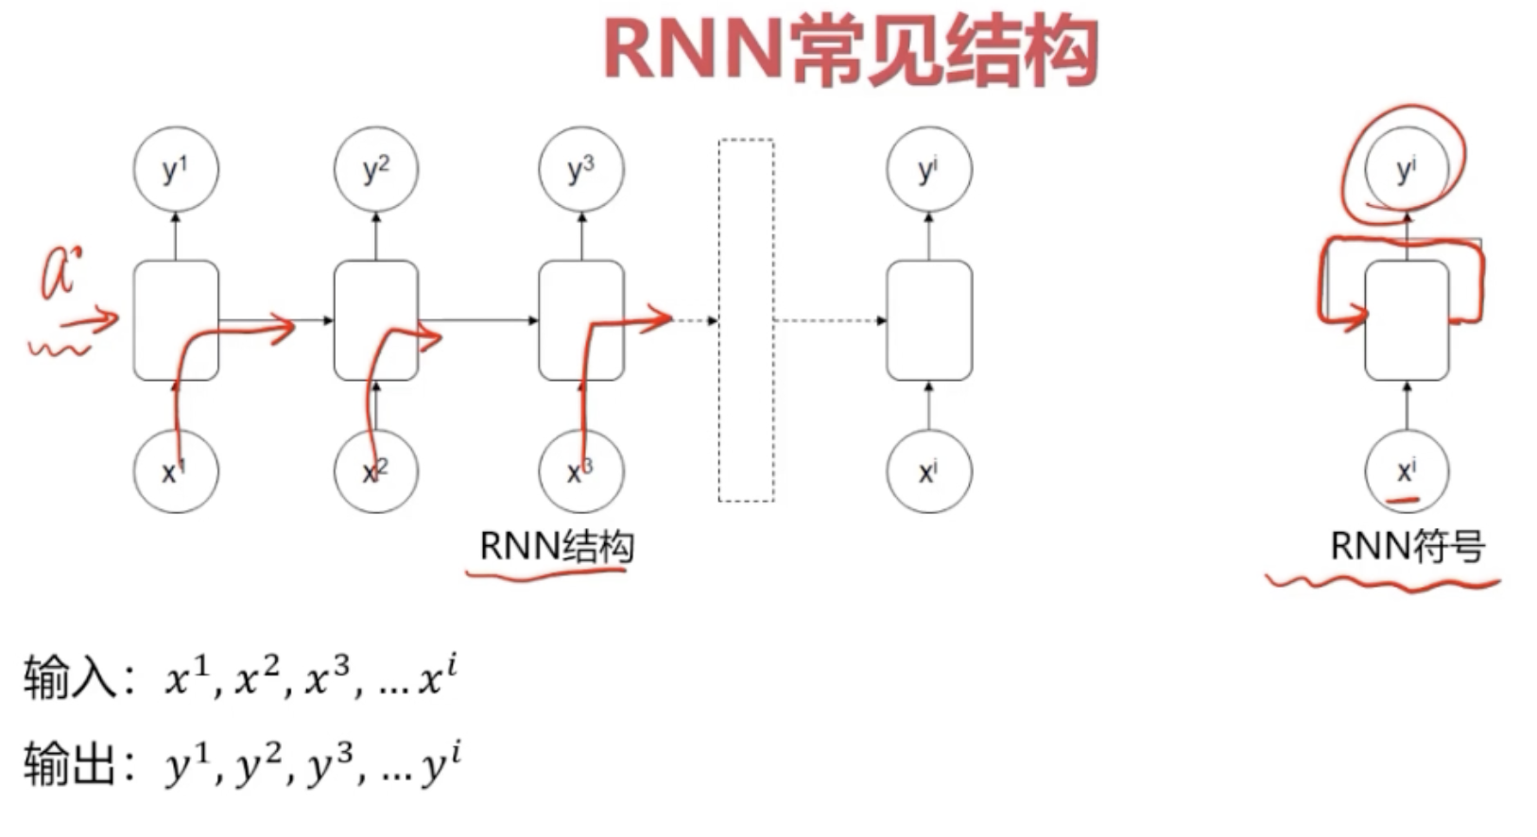
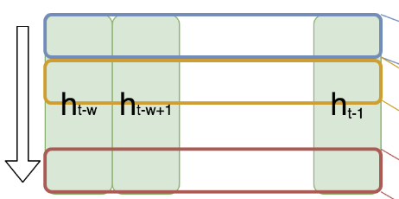
RNN 部分
输入：
RNN层输出：

Slide 4
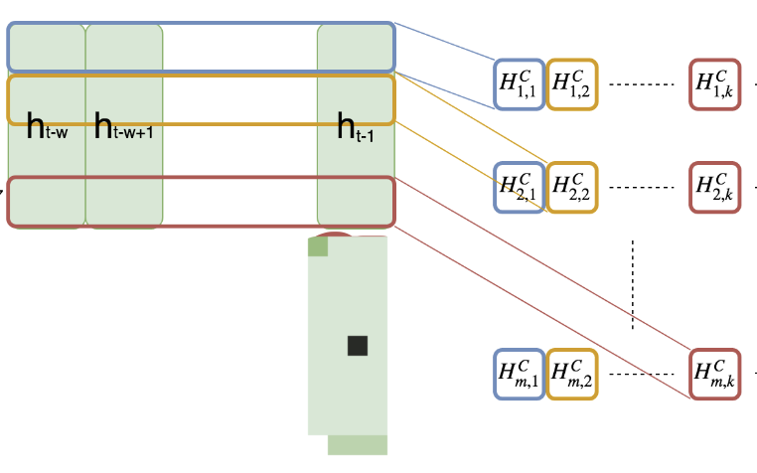

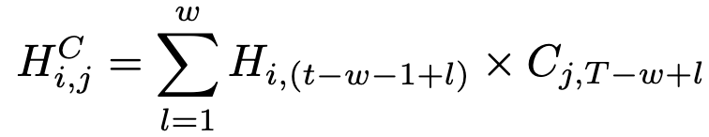

CNN 部分
文中指定 T = w

Slide 5


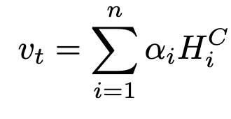

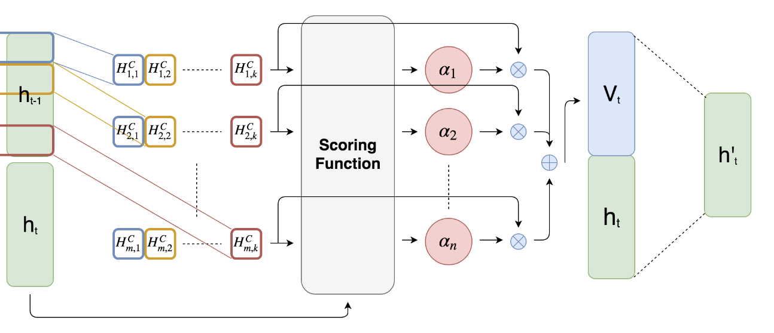
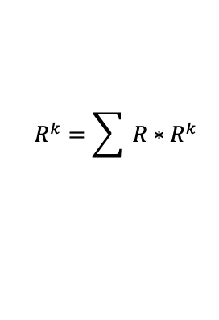

Proposed Attention Mechanism
Scoring function：
R = $R^{1∗k} ∗R^{k*m} ∗R^{1∗m}$
Attention weight：
Context vector:
$$R^{k}=\sum{ R∗R^{k} }$$

Slide 6
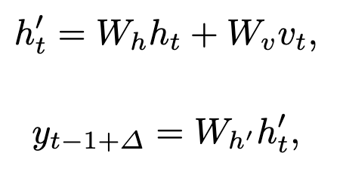
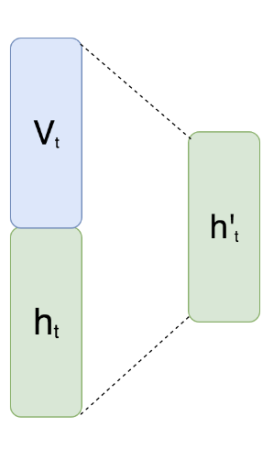
预测结果部分 （全连接部分）

