Slide 1
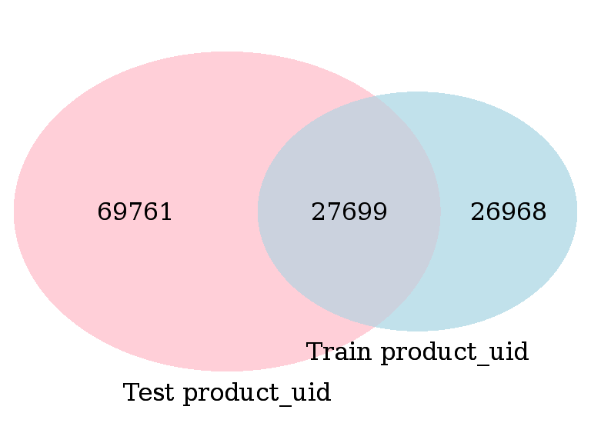
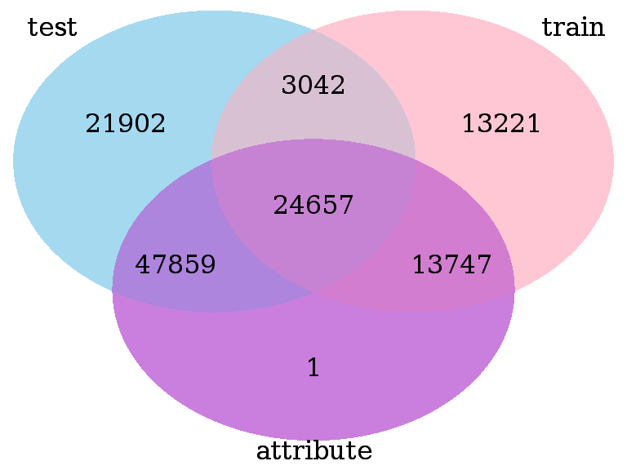
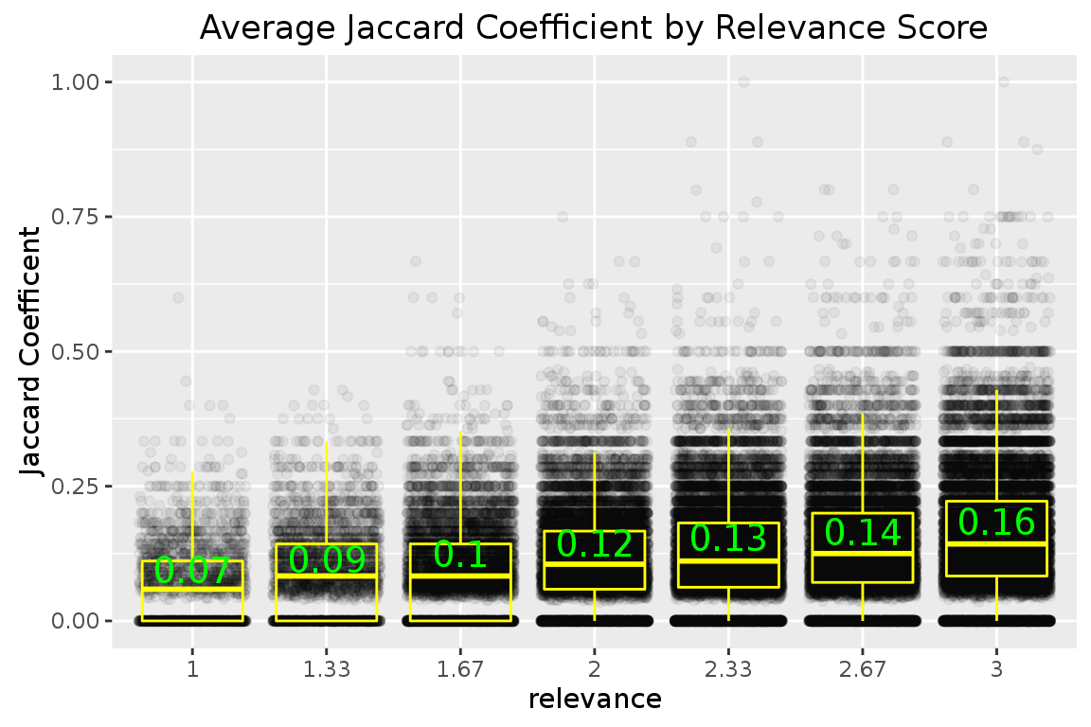
Home Depot Search Relevance
GentlemenGaga
NYU
Contribution
Feature Extraction and Method
Data Exploration
Reference
Data are generally provided by Home Depot from Kaggle platform, which including product information, search term, and tagged relevance scores. Basically, we need to predict the relarent between search term and product information which consist of product title, product description, product attributes.
First of all, we try to explore the relationship between product title and search term. We found higher relevant product would have higher Jaccard similarity between product title and search term, which turn out a fundation for our prediction.
For product attributes, there are 2044648 rows, and 86263 unique product. There are more than 5,000 kinds of categories, then we check out some top categories and the top frequency for color family as following:
Experiments and Results
Acknowledgement
Attribute Name | Percent of Product
MFG Brand name | 99.98%
Bullet02 | 99.98%
Bullet03 | 99.96%
Bullet04 | 99.90%
Bullet01 | 99.63%
product width (in.) | 70.87%
bullet05 | 70.17%
product height (in.) | 63.41%
product depth (in.) | 62.20%
product weight (lb.) | 52.37%
Color Family | Percent of Product
color/finish | 48.12%
color | 33.11%
color/finish family | 7.21%
fixture color/finish | 5.37%
fixture color/finish family | 4.77%
shade color family | 2.62%
actual color temperature (k) | 2.33%
color rendering index | 1.65%
top color family | 1.30%
color family | 1.15%

