Slide 1

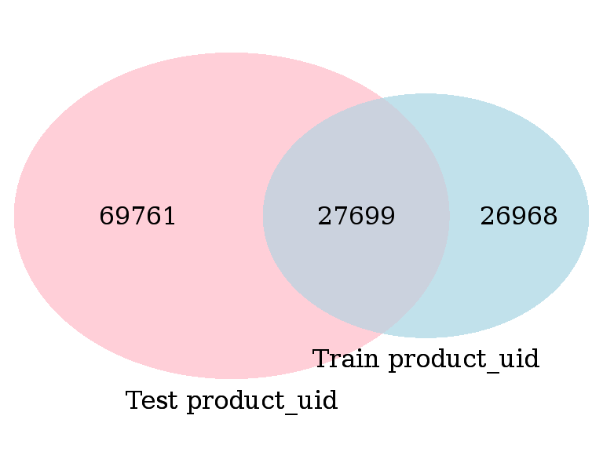
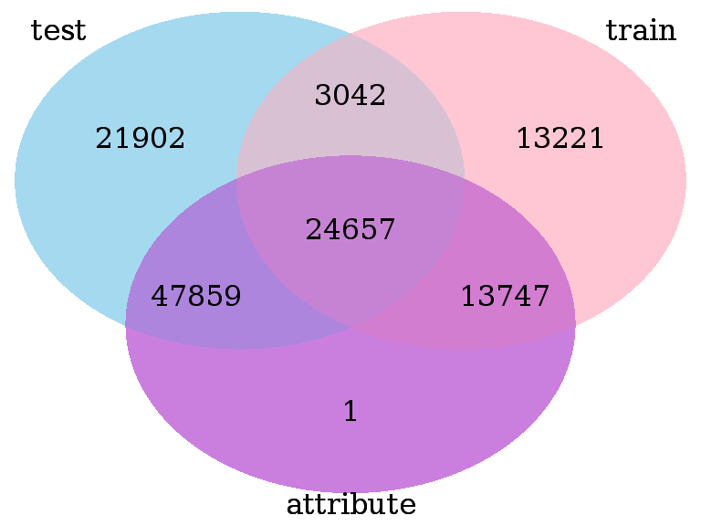
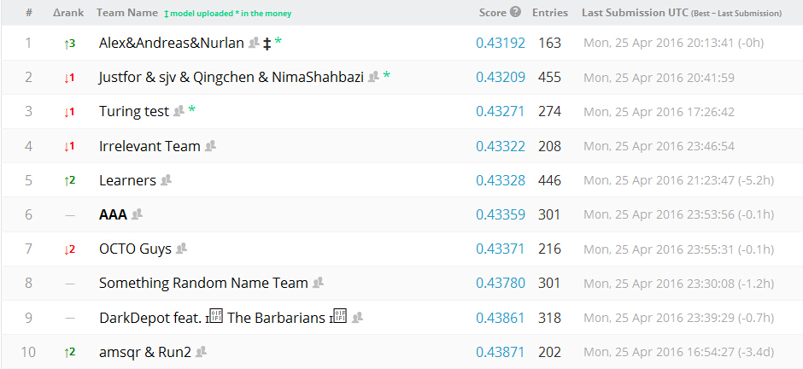
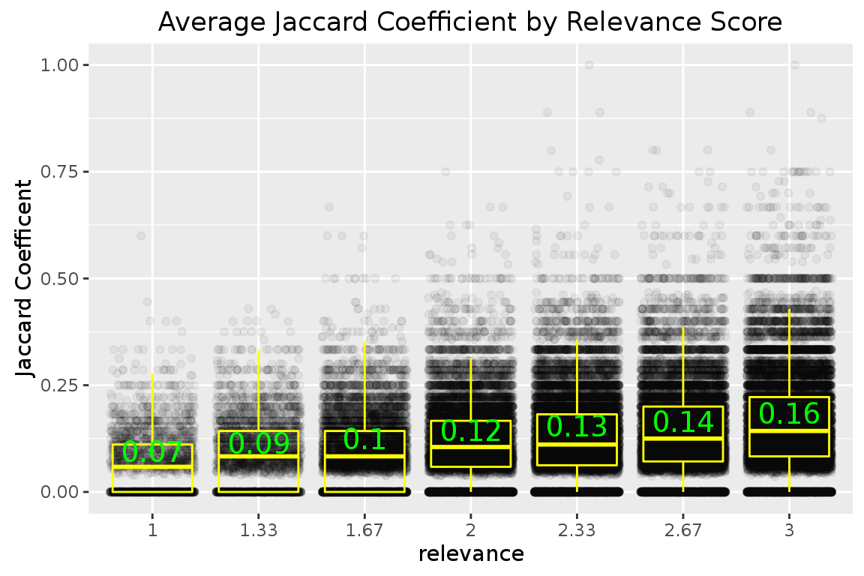
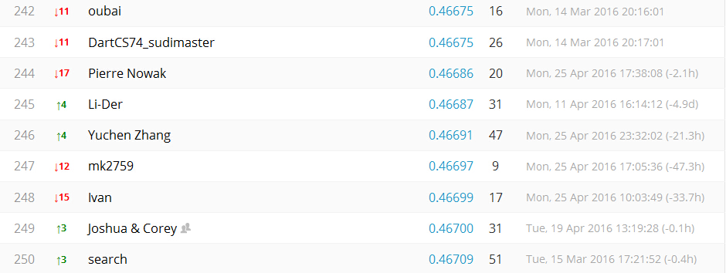
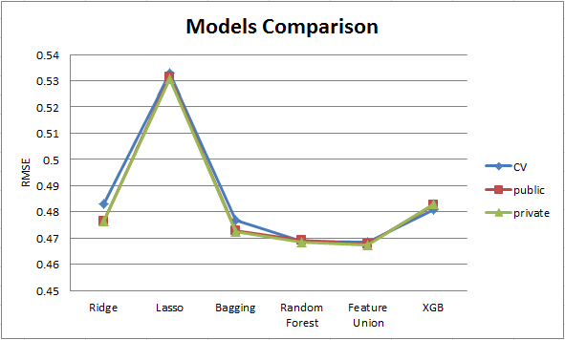
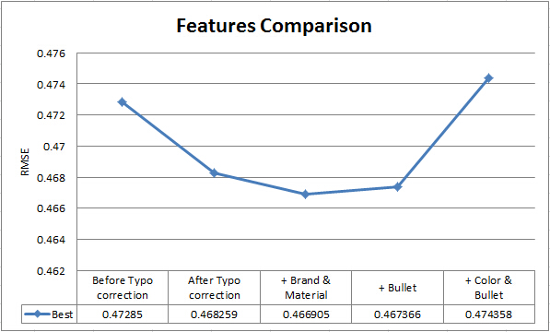

Home Depot Search Relevance
Yuanbin Wang Mengdi Wang Han Gan
New York University
Contribution
Feature Engineering and Learning Method
We introduce a method for improving customer's online shopping experience by accurately predicting the relevance of search results. Given a search query, whether uniformed or arbitrary keywords, returning the most expected product title by relevance is essential for a good customer experience. The result of relevance is scaled from 1 to 3, which indicates our final prediction.
We choose the dataset from Home Depot. However, the model is applicable to any shop that provides the details of their product.
The workflow of our solution can be concluded into the following steps, which are illustrated in Figure 4:
Data preprocessing. In this step, we apply some basic text processing techniques to the data, including segmentation, number and measurement normalization, word capitalization, stopwords removal. Besides, we use google type correction to correct typos in the search term and use Porter Algorithm to stem the text.
Feature Extraction. In this stage, we extract features from training, test data, attribute files and product description files. These features contains text mining features from search term, brand name, description, etc. and numeric features like length, count, ratios. Finally, we have extracted features, and more details are showed in Figure 5.
Model training. As a regression problem, we have selected three types of machine learning models for prediction. They are linear regression models including Lasso and Ridge, ensemble models like Bagging and random forest, and XGboost model. Additionally, feature weighting is used between numeric models and text mining models during the model training process.
Parameter Tuning and evaluation. We use RMSE as evaluation and splitted data set into 44% training and 80% training set. Grid search is adopted for searching best parameter.
Data Cleaning
Segmentation
Normalization
Capitalization
Stop words removal
Typo Correction
Stemming
Feature Extraction
Model Training
Parameter Tuning
(Grid Search)
Evaluation
(RMSE, CV, running time)
Numeric:
Lengths, Ratios Matching, Count
Linear Regression
Lasso, Ridge
Random Forest: weighted by features
Text Mining:
TF-IDF, Word2Vec
XGBoost
Feature Weighting
Data Exploration
Data are generally provided by Home Depot from Kaggle platform, which including product information, search term, and tagged relevance scores. Basically, we need to predict the relarent between search term and product information which consist of product title, product description, product attributes.
First of all, we try to explore the relationship between product title and search term. We found higher relevant product would have higher Jaccard similarity between product title and search term, which turn out a fundation for our prediction.
For product attributes, there are 2044648 rows, and 86263 unique product. There are more than 5,000 kinds of categories, then we check out some top categories and the top frequency for color family as following:
Figure 4, Work Flow
Attribute features
Brand
Material
Color
Bullets
Word matching
Search term
Title
Description
Last query word
Attributes words and previous
Lengths and ratios
The Lengths of the search term, title,
description,
attribute words
The lengths of the matching word
The ratios between different lengths
TF-IDF, SVD
TF-IDF combined by search term, brand, title, description
Word2Vec Similarity
‘With’,
‘Without’,
‘For’
SVD
+
Weighted
Combined by search term, title, description, attribute, brand, material
Kaggle Competition Rank
Top1 Result: 0.43192
Our best Result: 0.466905
Rank: 246/2125
Figure 2, Test vs. Train
Figure 4, Test, Train, Attribute
Figure 5, Feature Categories
Experiments and Results
For each id in the test set, our relevance prediction is a real number in [1,3]. For those values that exceed this range, we reset them to the closest bound (e.g. 1 or 3).
Those results are evaluated by Root Mean Squared Error (RMSE), which is very common and an excellent general purpose error metric for continuous numerical predictions. RMSE amplifies and severely punishes large errors.
$$RMSE=\sqrt{\frac{1}{n}\sum_{i=1}^{n}{{\left(y_{i}−{\hat{y}}_{i}\right)}^{2}}}$$
In models comparison, there are three types of error: Cross-validation, public (on 30% of the test data), private (on complete test data). From the chart, we can see that Feature Union model stands out from others. It is a combination model of Random Forest, and weighted TFIDF+SVD text features. The taking time of those models are close.
To show our experiments in extracting features, we also compared the results by different features. The best result is when we add brand and material together with basic features after typo correction, which gives us 0.4669. The results support our acknowledge that features should be chosen wisely, not as more as possible.
In here
Figure 3, Average Jaccard Coefficient by Relevance
Attribute Name | Percent of Product
MFG Brand name | 99.98%
Bullet02 | 99.98%
Bullet03 | 99.96%
Bullet04 | 99.90%
Bullet01 | 99.63%
product width (in.) | 70.87%
bullet05 | 70.17%
product height (in.) | 63.41%
product depth (in.) | 62.20%
product weight (lb.) | 52.37%
Color Family | Percent of Product
color/finish | 48.12%
color | 33.11%
color/finish family | 7.21%
fixture color/finish | 5.37%
fixture color/finish family | 4.77%
shade color family | 2.62%
actual color temperature (k) | 2.33%
color rendering index | 1.65%
top color family | 1.30%
color family | 1.15%
Acknowledgement
Figure 6, Models Comparison
Figure 7, Feature Comparison
Figure 4, Attribute Name rank
Table 2, Color Family rank

