Slide 1
Assessing Uniformity in Sampling of Sedentary Times
3rd Harvard Data Science Symposium
Xiang Meng (Harvard University, xmeng@g.harvard.edu)
Joint work with Walter Dempsey, Predrag (Pedja) Klasnja (UMich); Peng Liao, Susan Murphy (Harvard); Nick Reid (U of Washington)
I have no disclosures to make

Slide 2
Introduction
We designed an experiment to provide data for a mobile health intervention
Question: Need to investigate how often, and in what context should a mobile intervention be provided.
The “micro-randomized trial” (MRT) involves sequential decisions within each randomization.

Slide 3
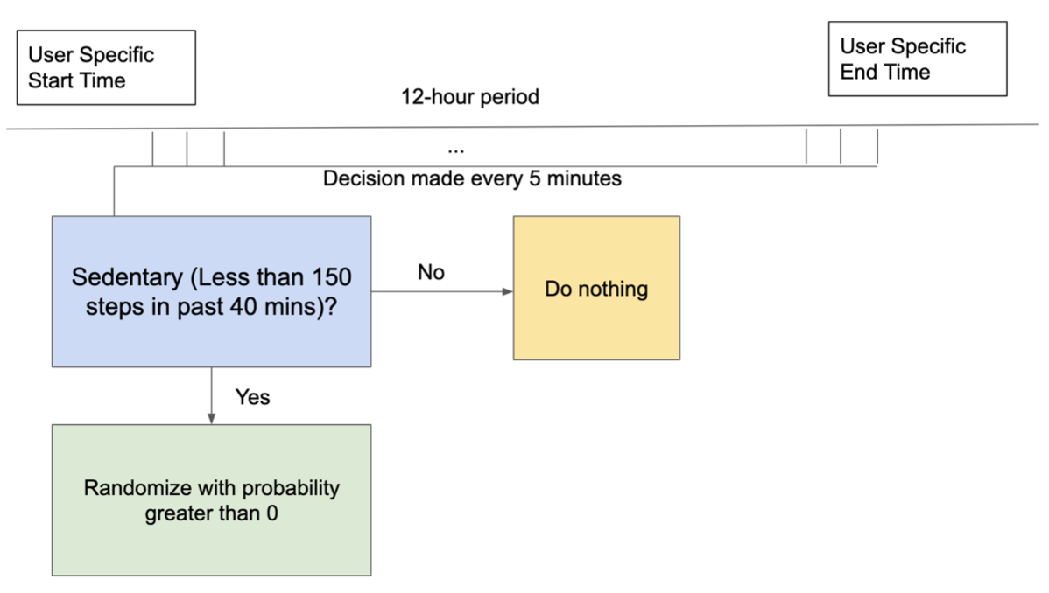
MRT: Micro-Randomized Trial

Slide 4
Delivery and MRT Randomization Probabilities
Algorithm goal:
We designed the MRT using a soft budget targeting an average of 0.5 Intervention per Block $B_{t}$ (8am-12pm, 12pm-4pm, 4pm-8pm)
Uniform distribution in sedentary times
Algorithm: The randomization probabilities at each available time is given by $\frac{N_{1}^{*}-∑_{s∈B_{t},s≤t-1}π_{s}}{1+g_{t}}$
Manually truncate to [0.005, 0.995] in practice
Tuning parameters:
$g_{t}$: forecast of the remaining sedentary times in the block.
$N_{1}^{*}$ desired average number of interventions per block.
$B_{t}$: 4 hour block containing time t.

Slide 5
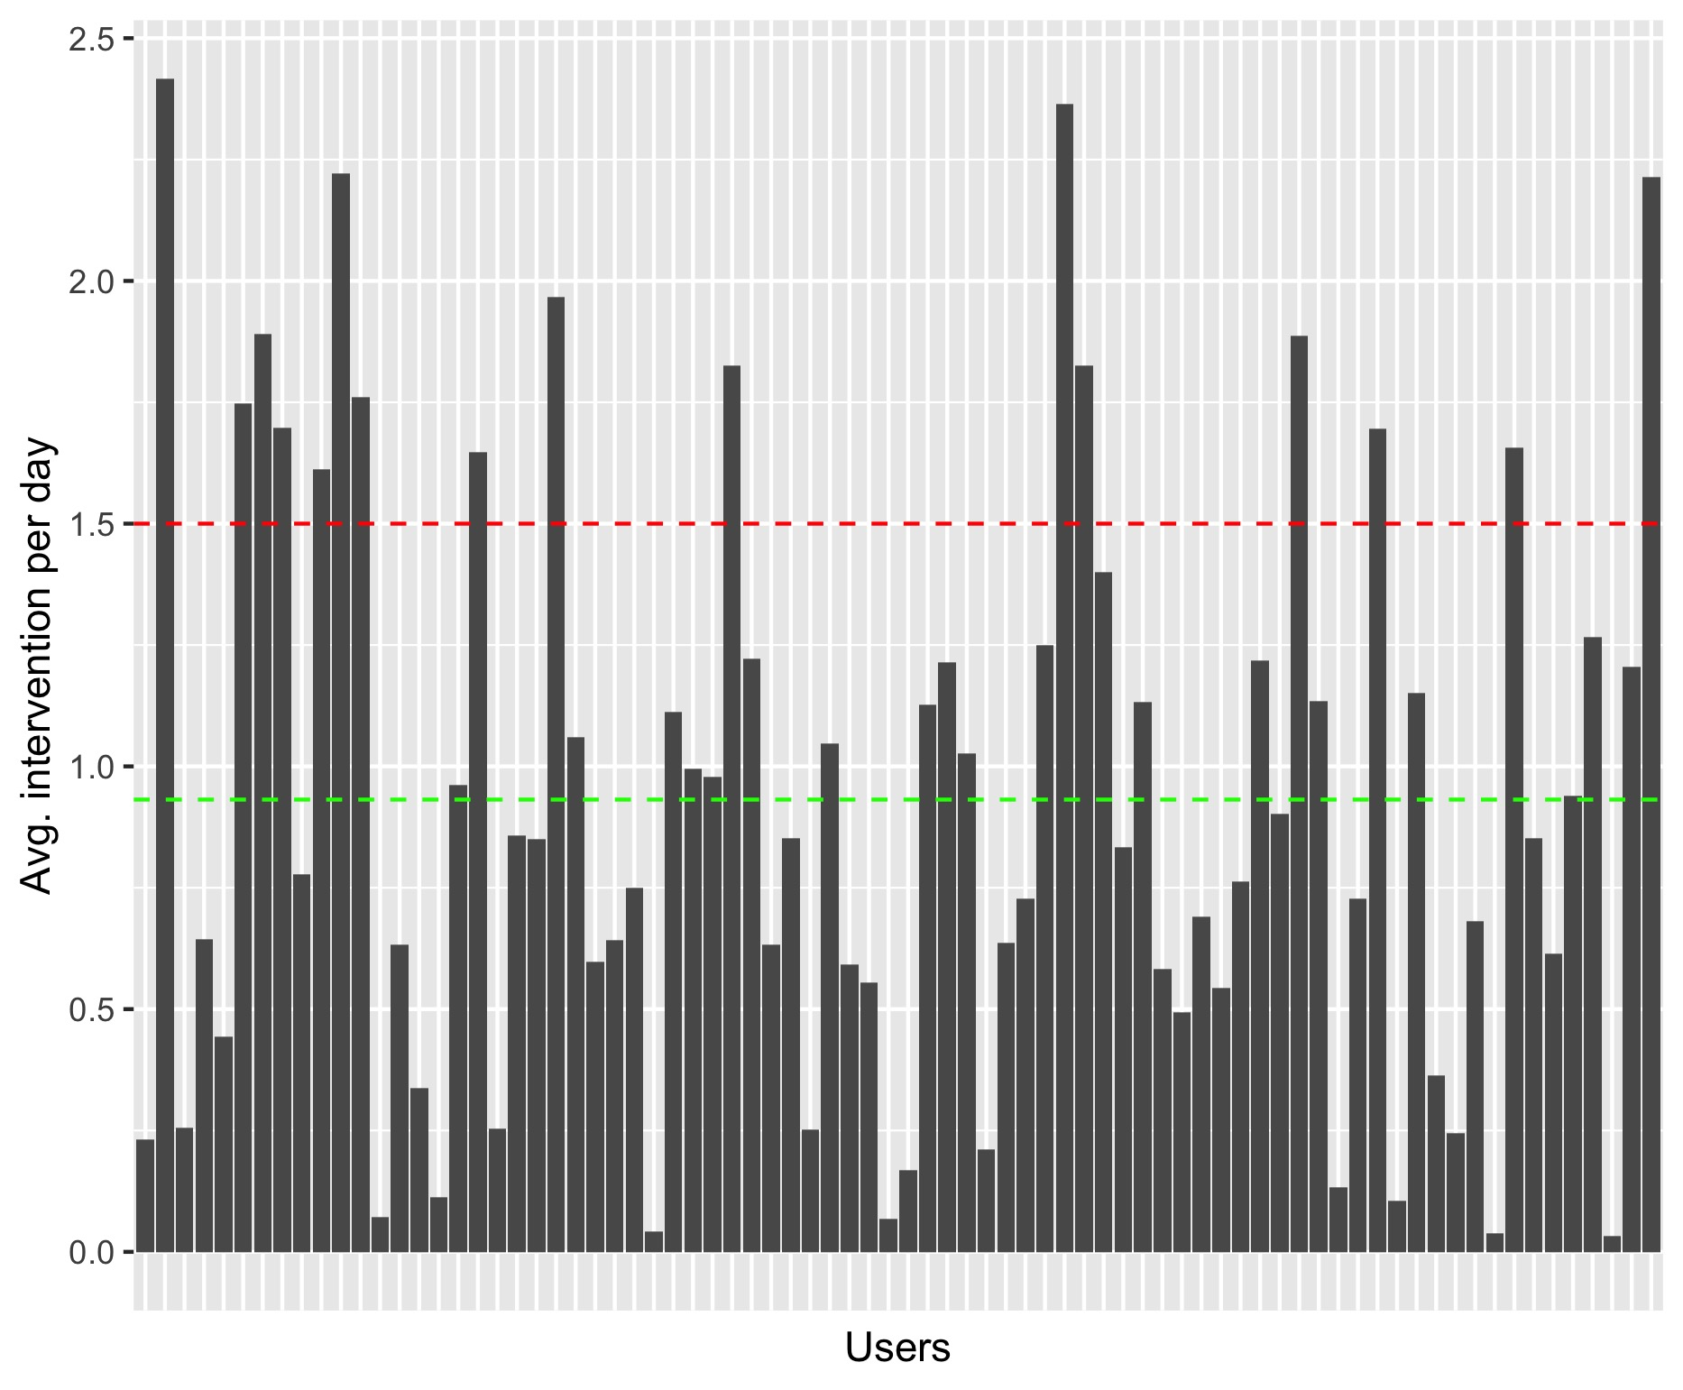
How many interventions were delivered in each block and each day?
Result from 78 Users
Goal: 0.5 per block and 1.5 per day.
Green dashed line is the user average (0.932)

Slide 6
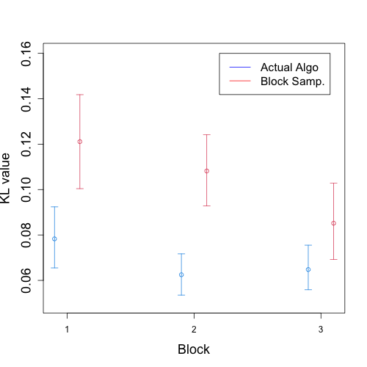
A Comparison Using KL Divergence
Compare with a baseline algorithm, Block sampling---Use one randomisation probability for each block, across all users.

Slide 7
Thanks for your attention!
Any questions?

