Slide 1
Activity 11: Data Preprocessing
ML for Health, Week 11

Slide 2
Instructions
In each of the following scenarios, you’ll consider how a specific variety of healthcare data (x) can be used to predict an associated outcome (y)
Your goal is to (concisely) describe a process by which (x) can be transformed into a fixed length vector suitable for use in a logistic regression or other predictive model
Simple is good
When we reconvene, each group will present one of the scenarios

Slide 3






Scenario 1: Diagnosis Codes
Predict patients’ 10-year survival probability (y) based on diagnosis codes documented in their chart over the past year (x).
-> How can you transform each sequence into a vector that has the same length for every patient?
Binary classification: predict p(survive > 10 years)
E11
E08.32
J44.1
E11
I48.2
I50.3
time
$$t_{1}$$
$$t_{2}$$
$$t_{3}$$
$$t_{4}$$
$$t_{5}$$
$$t_{6}$$

Slide 4
Scenario 2: Irregular Measurements
Predict patients’ probability of becoming hypoglycemic within the next 6 hours (y) based on vitals and other measurements collected over the last 12 hours (x). Assume that in the average patient, there are many more measurements than shown below.
-> How can you transform each sequence into a vector with no missing values that has the same length for every patient?
Binary classification: predict p(hypoglycemia)
BP
BG
Urine output
Temp
HR
BP
time
$$t_{1}$$
$$t_{2}$$
$$t_{3}$$
$$t_{4}$$
$$t_{5}$$
$$t_{6}$$

Slide 5
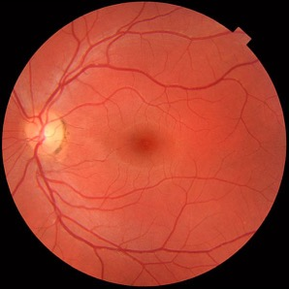
Scenario 3: Images with Side Information
Predict whether patients should be referred for diabetic retinopathy (y) based on fundoscopic images and demographic information (e.g. age, sex) (x).
-> How can you combine image features with demographic features in a predictive model?
Binary classification: predict p(referrable diabetic retinopathy)
Age
Sex
Race
Ethnicity

