Slide 1
Envirotyping Case Study
Matthew Engelhard

Slide 2
Smoking Environments have distinctive characteristics that can be identified using machine learning
Engelhard MM, Oliver JA, Henao R, Hallyburton M, Carin LE, Conklin CA, McClernon FJ. Identifying Smoking Environments From Images of Daily Life With Deep Learning. JAMA Netw Open. 2019;2(8):e197939.
Notes:
A few important points here.
We can predict. Don’t necessarily need to fine-tune the model; in fact, for this application, it is better NOT to do this to maintain interpretability.
We can characterize different types of environments. Again, interpretability is key here. Move from understanding labeled environments vs clusters of environmental features. Not all living rooms are the same.

Slide 3
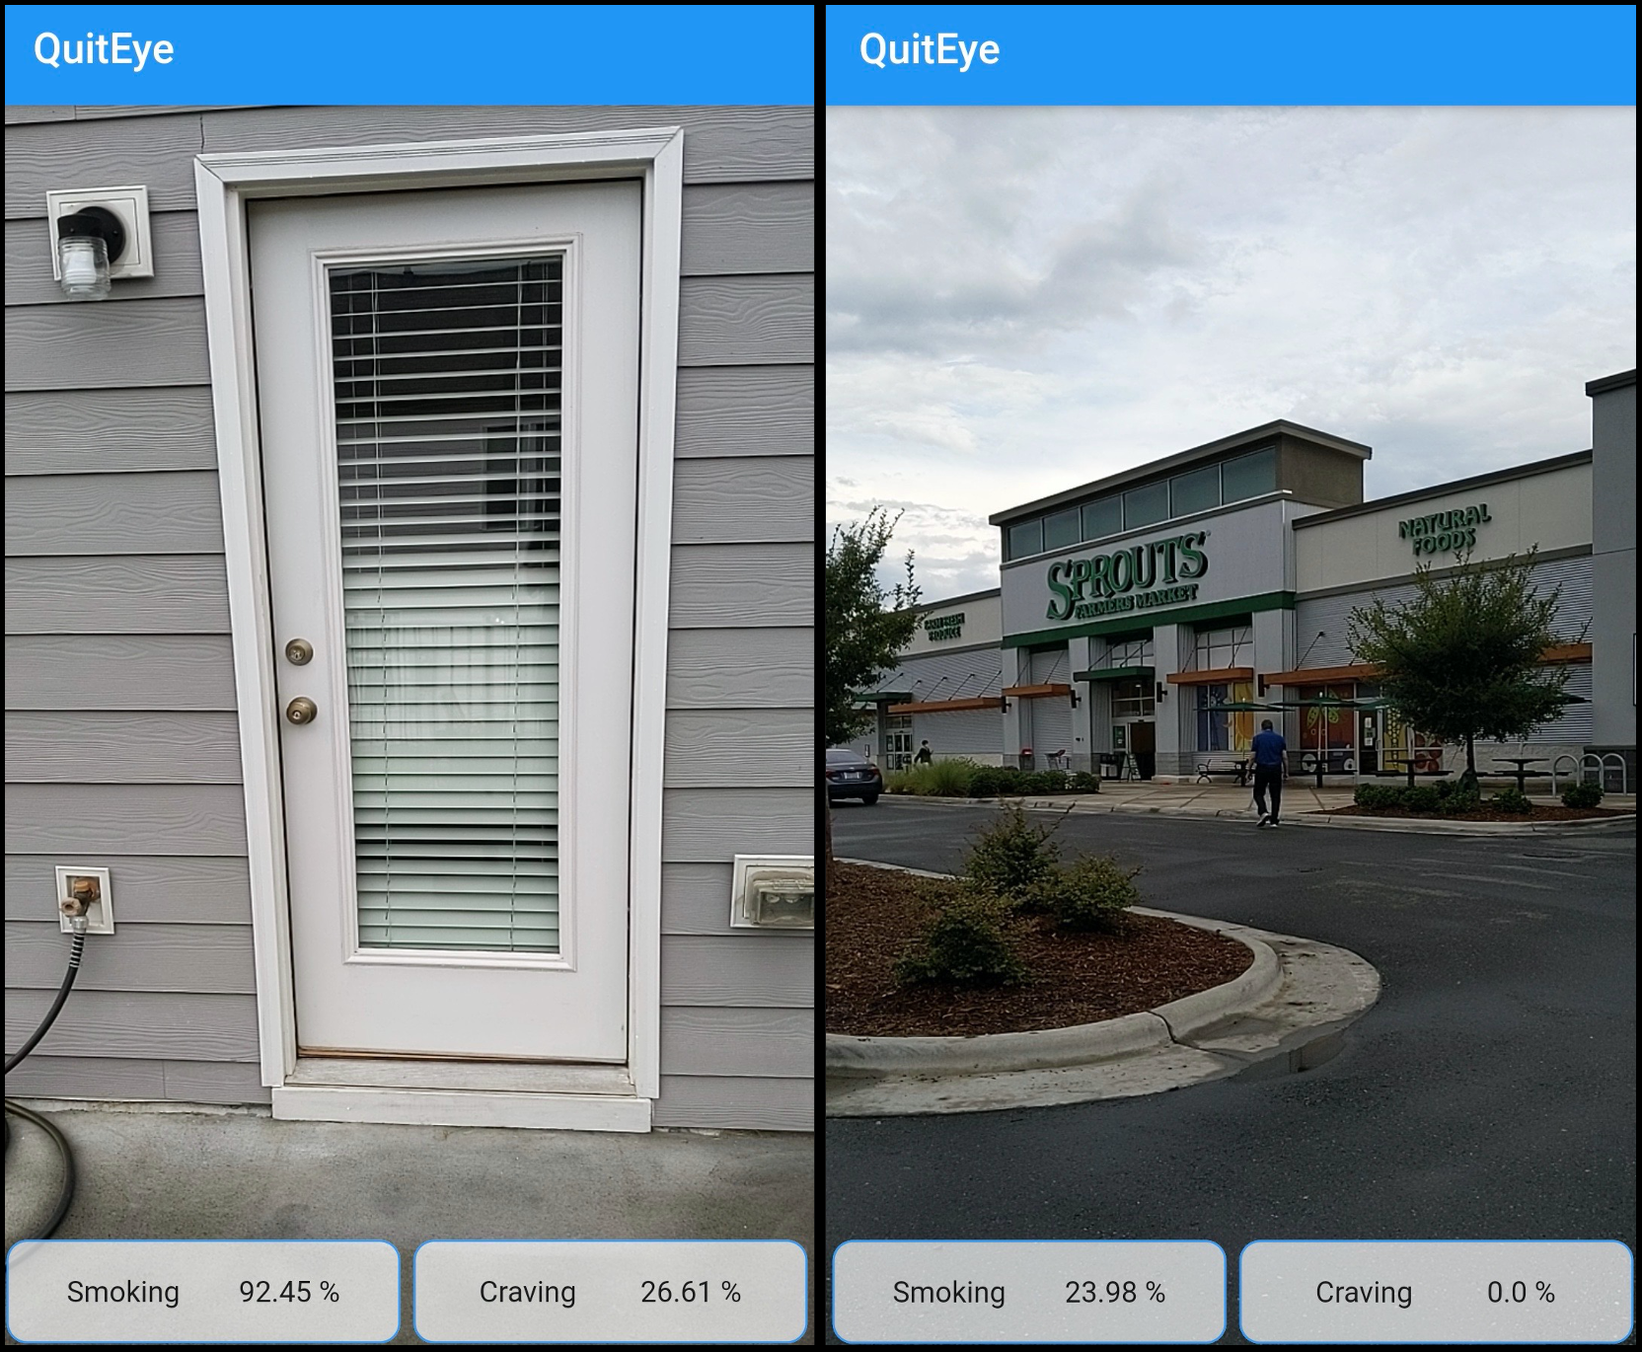
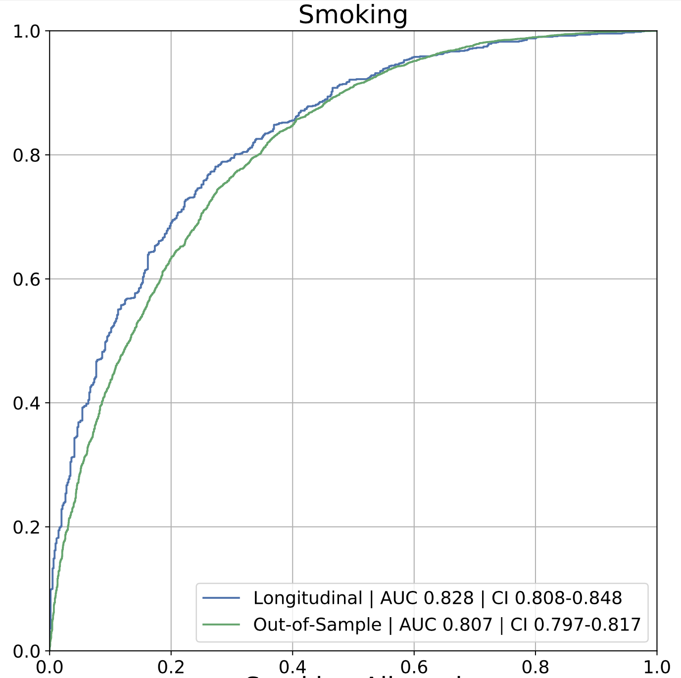
These characteristics can be used to predict environment-associated smoking risk in real time
Engelhard MM, D’Arcy J, Oliver JA, Kozink K, McClernon FJ. Machine Learning Prediction of Smoking Risk from Repeated Sampling of Environmental Images. Submitted to JMIR
NIDA 5R21DA047131
Notes:
What can we do with this kind of tech.
Well, predicting in real time is part of it, but there’s more – goal is to understand
So, for example, we know that low SES -> more pro smoking environments -> harder to quit
We want to understand that chain in more detail.

