Slide 1
Sequences and Time-Series
Matthew Engelhard

Slide 2
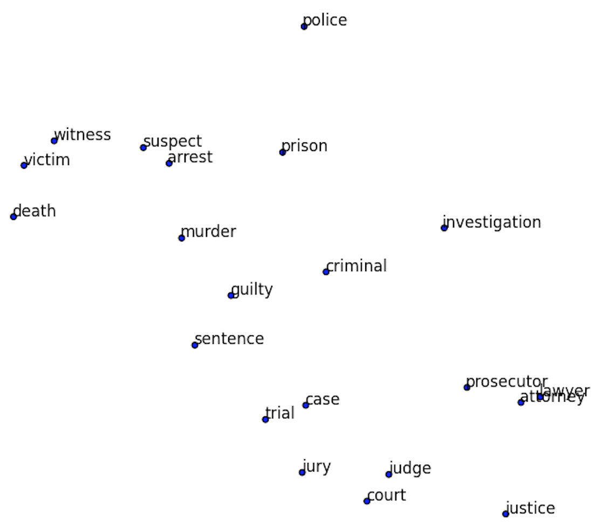
Recall: Word embeddings allow us to quantify word meaning
If we zoom in on a small region of our word map, it’s all related words.
Note the similarity of all the words as a whole, but also of the individual neighbors.
“Lawyer” and “attorney” are nearly identical in space!

Slide 3
Applying Word Embeddings to a Sentence
Look up words individually to obtain their vectors
Construct a sequence of vectors
This is a sentence
x_{i}
Notes:
Remember: each of these is a dense vector, learned as we discussed, where each dimension of the vector represents a distinct semantic attribute – a specific element of meaning

Slide 4
Sequences of measurements: same structure
Day 1 Day 2 Day 3 Day 4
Temp
BP
HR
RR
SpO2
Glucose
x_{i}

Slide 5
We can make predictions for each:
Word
Document (e.g. clinical note)
Collection of documents (e.g. notes for all patients)

Slide 6
Task 1: Predict a label associated with each word
This movie is awful
adj. noun verb adj.
y_{i1}
y_{i2}
y_{i3}
y_{i4}
Notes:
esta es una frase

Slide 7
Task 1: Predict a label (?) associated with each word
This movie is awful
esta pelicula es horrible
y_{i1}
y_{i2}
y_{i3}
y_{i4}
Notes:
esta es una frase

Slide 8
Multi-Class Logistic Regression (many classes)
z(pelicula)
softmax
p(pelicula)
p(horrible)
p(es)
v(this)
p(esta)
z(esta)

Slide 9
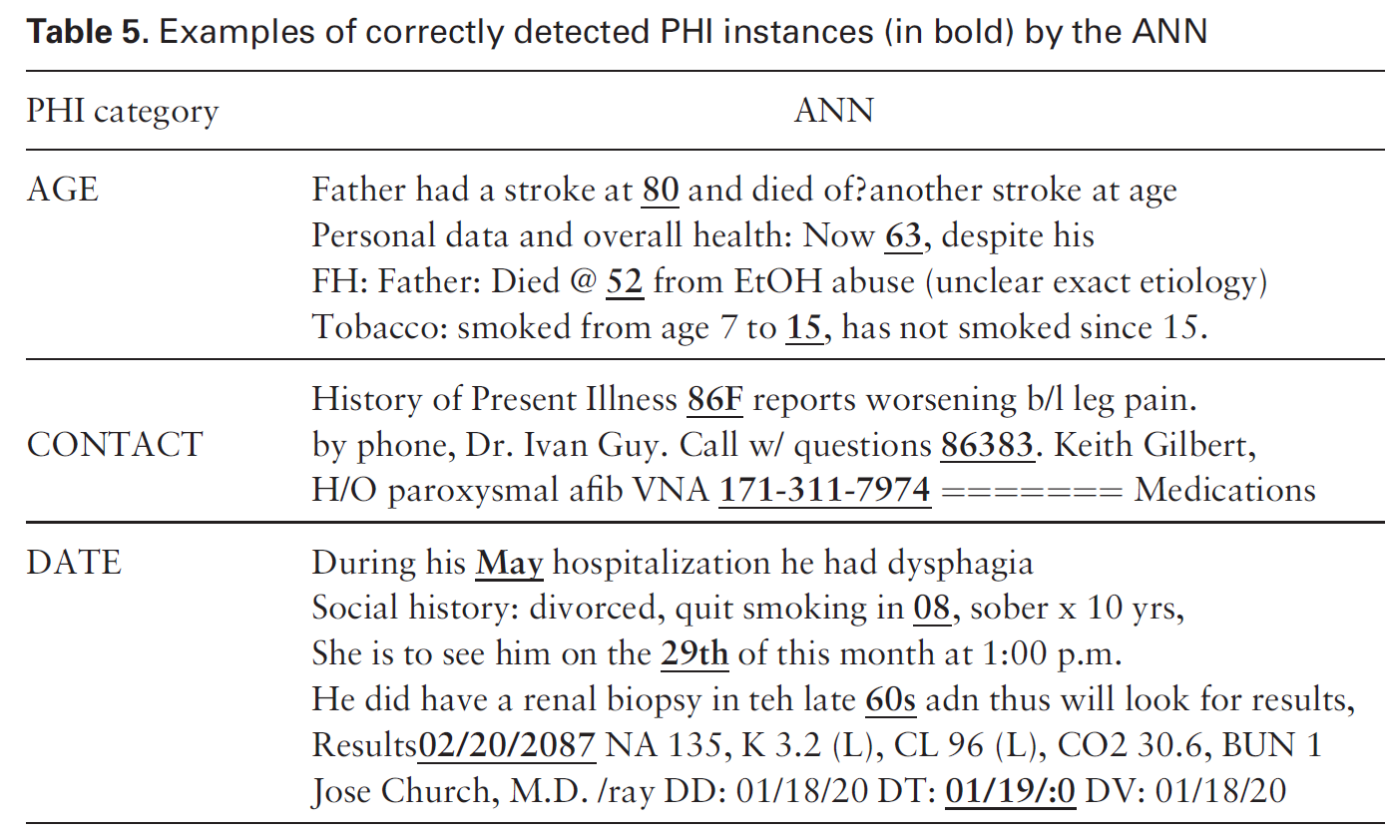
Deidentification of Patient Notes
A bidirectional RNN is used to identify PHI (18 HIPAA fields)
i2b2: 889 discharge summaries, >28k PHI tokens
MIMIC: 1635 discharge summaries, >60k PHI tokens
State of the art sensitivity and F1 metric on both datasets
De-identification of patient notes with recurrent neural networks
Dernoncourt F, Lee JY, Uzuner O, Szolovits P
JAMIA 24(3), 2017, 596–606
Notes:
Deidentification is a big challenge
Ideally want 100% sensitive removal of PHI, but there’s a huge amount to identify and human rates are pretty low when done at scale
Expert systems out there – manually curated rule-set – that does this
The idea – we want to use an RNN approach – very similar to the one David described – to do this
Use two datasets, including one generated specifically for this task based on discharge summaries coming from MIMIC
Point out that they say ANN instead of RNN

Slide 10
Task 1: Predict a label associated with each word
My SSN is 111-22-3333
not PHI not PHI not PHI PHI
y_{i1}
y_{i2}
y_{i3}
y_{i4}
Notes:
esta es una frase

Slide 11
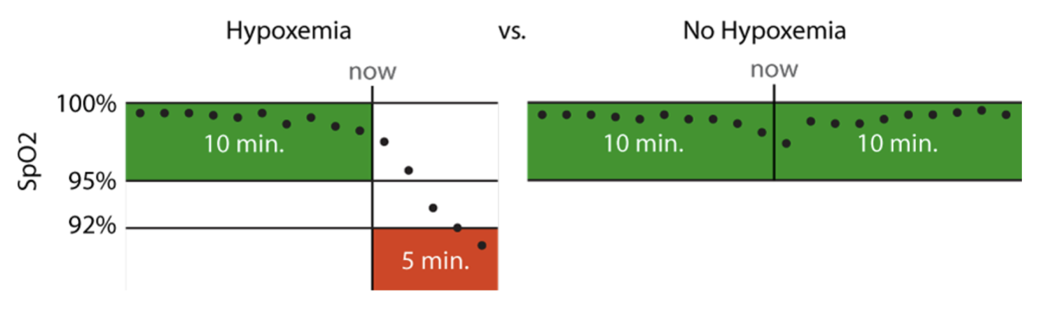
Hypoxemia Prediction during Surgery
Real-time Prediction Task:
hypoxemia (yes/no) in the next 5 minutes
based on data from the Anesthesia Information Management System
static features + real-time features collected up to that time point
Notes:
5 min window: long enough to allow an anaesthesiologist to intervene, but short enough to represent near-term risks that would benefit from immediate attention
This is actually what’s used for the anesthesiologist comparison
Model training was less strict

Slide 12

Task 1: Predict label assoc. with each time point
$t_{1}$ $t_{2}$ $t_{3}$ $t_{4}$
Temp
BP
HR
RR
SpO2
Glucose
not hypoxemic not hypoxemic hypoxemic not hypoxemic
y_{i1}
y_{i2}
y_{i3}
y_{i4}
Notes:
This is what we do in diagnosis prediction, for instance

Slide 13

Task 2: Predict a label associated with the document
This movie is awful
y_{i}
x_{i}
Notes:
esta es una frase

Slide 14
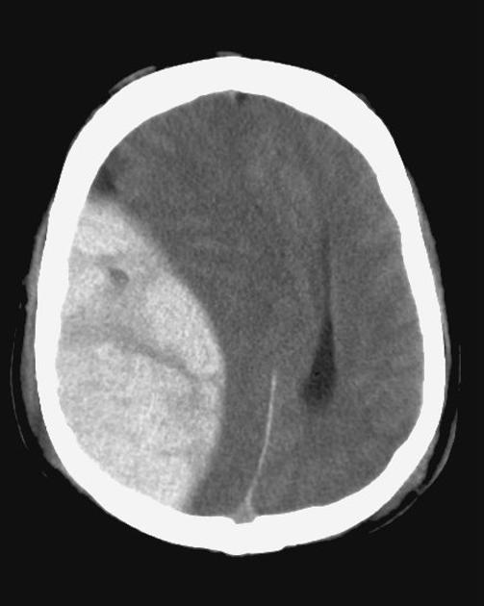
Classification of radiology reports using neural attention models, IJCNN 2017
Mass effect from extradural hemorrhage
https://radiopaedia.org
Notes:
How does all this affect medicine?
There are five parts to this course. We’ll be talking about the basics of neural networks; CNNs; natural language processing; time-series modeling; and reinforcement learning.
Imaging is already there – we’re getting ML-based diagnostics – plain images, dermoscopy, ultrasound, fundoscopic images, radiology, pathology, etc.
NLP is right on the cusp – so far the ‘NLP’ that’s out there hasn’t been very smart – very context aware – but NLP systems are right at human-performance, and it’s going to start making a huge impact very soon. Can only hope that NLP starts reducing some of the documentation burden placed on physicians.
RL is also very close, though evaluation here is more difficult.

Slide 15
Task 2: Predict a label associated with the report
Intracranial mass effect noted
y_{i}
x_{i}
Notes:
esta es una frase

Slide 16

Task 2: Predict a label associated with the note
Child demonstrates protodeclarative point
y_{i}
x_{i}
Notes:
esta es una frase

Slide 17

Task 2: Predict label assoc. with all measurements
$t_{1}$ $t_{2}$ $t_{3}$ $t_{4}$
0 (survival)
y_{i}
Temp
BP
HR
RR
SpO2
Glucose
x_{i}
Notes:
This is what we do in diagnosis prediction, for instance

Slide 18
First Challenge: Sequences Vary in Length
Sentences/text have different # words
Time-series have different # measurement times
More generally, even for models where we’re making predictions for each word or time point, we have to deal with the whole history of previous words / measurements
Easy solution: aggregate over words/time points

Slide 19
VSWEM allows us to convert a variable-length sentence to a fixed-length feature vector
This is a sentence
max
MAX
Notes:
We will come back to this idea in the time-series models

Slide 20
Similarly, we can aggregate measurements in a time-series
$t_{1}$ $t_{2}$ $t_{3}$ $t_{4}$
Temp
BP
HR
RR
SpO2
Glucose
x_{i3}
not hypoxemic not hypoxemic hypoxemic not hypoxemic
y_{i1}
y_{i2}
y_{i3}
y_{i4}
Notes:
This is what we do in diagnosis prediction, for instance
Could do this for all previous measurements
OR for the last N measurements

Slide 21
Similarly, we can aggregate measurements in a time-series
$t_{1}$ $t_{2}$ $t_{3}$ $t_{4}$
Temp
BP
HR
RR
SpO2
Glucose
Max
Min
Avg
Slope
SD
Skew
etc
x_{i3}
not hypoxemic not hypoxemic hypoxemic not hypoxemic
y_{i1}
y_{i2}
y_{i3}
y_{i4}
Notes:
This is what we do in diagnosis prediction, for instance

Slide 22
Second Challenge: Is there a better way to aggregate?
A sentence is more than the average (or max) of its words
A time-series is more than the average / min / max / SD of individual measurements
We’d like to interpret words or measurements in context
Deep learning: we learn what’s important about the sequence rather than choosing features or summary stats

Slide 23
Recurrent Neural Networks

Slide 24
Predict a label associated with each word
This movie is awful
LogReg
LogReg
LogReg
LogReg
esta pelicula es horrible
y_{i1}
y_{i2}
y_{i3}
y_{i4}
Notes:
esta es una frase
We’re going to predict the corresponding word
A SINGLE prediction model – in this case logistic regression -- does all this.

Slide 25
Predict a label associated with each word
This movie is awful
MLP
MLP
MLP
MLP
esta pelicula es horrible
y_{i1}
y_{i2}
y_{i3}
y_{i4}
Notes:
esta es una frase
With an MLP, it may do better, but it still won’t perform well
WHY?
Context matters.

Slide 26
Transfer relevant information about earlier words
This movie is awful
h_{i1}
h_{i2}
h_{i3}
MLP
MLP
MLP
MLP
esta pelicula es horrible
y_{i1}
y_{i2}
y_{i3}
y_{i4}
Notes:
esta es una frase

Slide 27
Transfer relevant information about earlier values
$t_{1}$ $t_{2}$ $t_{3}$ $t_{4}$
$x_{i1}$ $x_{i2}$ $x_{i3}$ $x_{i4}$
h_{i1}
h_{i2}
h_{i3}
MLP
MLP
MLP
MLP
not hypoxemic not hypoxemic hypoxemic not hypoxemic
y_{i1}
y_{i2}
y_{i3}
y_{i4}
Notes:
esta es una frase
Now, we COULD do this by carrying forward the summary statistics
But what do we always do in deep learning? We LEARN a representation that works best
In this case, a representation of the history.

Slide 28
Transfer relevant information about earlier values
$t_{1}$ $t_{2}$ $t_{3}$ $t_{4}$
$x_{i1}$ $x_{i2}$ $x_{i3}$ $x_{i4}$
h_{i1}
h_{i2}
h_{i3}
MLP
MLP
MLP
MLP
not hypoxemic not hypoxemic hypoxemic not hypoxemic
y_{i1}
y_{i2}
y_{i3}
y_{i4}
Notes:
esta es una frase
Remember, these are all the same MLP, just being applied to each measurement
Let’s zoom in on it to think about how it could work.

Slide 29
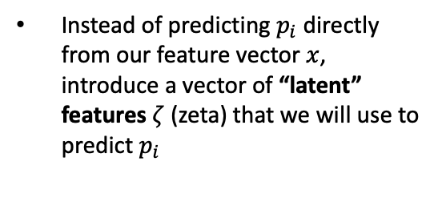


Instead of predicting $p_{i}$ directly from our feature vector $x$, introduce a vector of “latent” features $ζ$ (zeta) that we will use to predict $p_{i}$
Back to Lectures 2-3…
$p_{i}$ (probability of hypoxemia)
$$\text{ζ}\text{i}$$
x_{i}
Think of 𝜁 as a learned representation that is useful for predicting p
Since they are neither an input nor an output, the features ζ are said to be a “hidden” layer
Notes:
Here we have an MLP that predicts the current output from the current measurements.
This is simple – we covered this in our early lectures.

Slide 30



$p_{i2}$ = probability of hypoxemia ($y_{i2}$)
$\text{ζ}\text{i}$₂
x_{i2}
$$x_{i2}$$
Since they are neither an input nor an output, the features ζ are said to be a “hidden” layer

Slide 31



$p_{i2}$ = probability of hypoxemia ($y_{i2}$)
$$\text{ζ}\text{i}\text{2}$$
$$\text{h}\text{i}\text{2}$$
x_{i2}
$$\text{h}\text{i}\text{1}$$
$$x_{i2}$$

Slide 32
$p_{i2}$ = probability of hypoxemia ($y_{i2}$)
$$\text{ζ}\text{i}\text{2}$$
$$\text{h}\text{i}\text{2}$$
x_{i2}
$$\text{h}\text{i}\text{1}$$
$$x_{i2}$$
current word / measurements

Slide 33
$p_{i2}$ = probability of hypoxemia ($y_{i2}$)
$$\text{ζ}\text{i}\text{2}$$
$$\text{h}\text{i}\text{2}$$
used to make prediction
x_{i2}
$$\text{h}\text{i}\text{1}$$
$$x_{i2}$$

Slide 34
$p_{i2}$ = probability of hypoxemia ($y_{i2}$)
$$\text{ζ}\text{i}\text{2}$$
$$\text{h}\text{i}\text{2}$$
x_{i2}
$$\text{h}\text{i}\text{1}$$
$$x_{i2}$$
learned representation of previous words / history

Slide 35
$p_{i2}$ = probability of hypoxemia ($y_{i2}$)
updated representation of previous words / history
$$\text{ζ}\text{i}\text{2}$$
$$\text{h}\text{i}\text{2}$$
x_{i2}
$$\text{h}\text{i}\text{1}$$
$$x_{i2}$$

Slide 36
We learn what’s important about previous values
$t_{1}$ $t_{2}$ $t_{3}$ $t_{4}$
$x_{i1}$ $x_{i2}$ $x_{i3}$ $x_{i4}$
h_{i1}
h_{i2}
h_{i3}
MLP
MLP
MLP
MLP
not hypoxemic not hypoxemic hypoxemic not hypoxemic
y_{i1}
y_{i2}
y_{i3}
y_{i4}
Notes:
esta es una frase

Slide 37
Recurrent MLP (NN): these are all the same / have same weights
$t_{1}$ $t_{2}$ $t_{3}$ $t_{4}$
$x_{i1}$ $x_{i2}$ $x_{i3}$ $x_{i4}$
h_{i1}
h_{i2}
h_{i3}
MLP
MLP
MLP
MLP
not hypoxemic not hypoxemic hypoxemic not hypoxemic
y_{i1}
y_{i2}
y_{i3}
y_{i4}
Notes:
esta es una frase

Slide 38
Task 1: Predict a label associated with the sequence
$t_{1}$ $t_{2}$ $t_{3}$ $t_{4}$
$x_{i1}$ $x_{i2}$ $x_{i3}$ $x_{i4}$
h_{i1}
h_{i2}
h_{i3}
MLP
MLP
MLP
MLP
0 (survival)
y_{i}
Notes:
esta es una frase

Slide 39
Hypoxemia Prediction: Use learned representation of previous measurements
Real-time Prediction Task:
hypoxemia (yes/no) in the next 5 minutes
based on data from the Anesthesia Information Management System
static features + real-time features collected up to that time point
Notes:
5 min window: long enough to allow an anaesthesiologist to intervene, but short enough to represent near-term risks that would benefit from immediate attention
This is actually what’s used for the anesthesiologist comparison
Model training was less strict

Slide 40
Common RNN Variants
Gated Recurrent Unit (GRU)
Long Short Term Memory (LSTM)
Bidirectional RNNs
Look at previous words and upcoming words
Usually not appropriate for time-series
Notes:
What does recurrent mean? (describe)

Slide 41
Deidentification of Patient Notes
A bidirectional RNN is used to identify PHI (18 HIPAA fields)
i2b2: 889 discharge summaries, >28k PHI tokens
MIMIC: 1635 discharge summaries, >60k PHI tokens
State of the art sensitivity and F1 metric on both datasets
De-identification of patient notes with recurrent neural networks
Dernoncourt F, Lee JY, Uzuner O, Szolovits P
JAMIA 24(3), 2017, 596–606
Notes:
Deidentification is a big challenge
Ideally want 100% sensitive removal of PHI, but there’s a huge amount to identify and human rates are pretty low when done at scale
Expert systems out there – manually curated rule-set – that does this
The idea – we want to use an RNN approach – very similar to the one David described – to do this
Use two datasets, including one generated specifically for this task based on discharge summaries coming from MIMIC
Point out that they say ANN instead of RNN

Slide 42
Note: we can also generate text this way.
This movie is awful
h_{i1}
h_{i2}
h_{i3}
MLP
MLP
MLP
MLP
esta pelicula es horrible
y_{i1}
y_{i2}
y_{i3}
y_{i4}
Notes:
esta es una frase

Slide 43
Note: we can also generate text this way.
[Start] this movie is
h_{i1}
h_{i2}
h_{i3}
MLP
MLP
MLP
MLP
this movie is horrible
y_{i1}
y_{i2}
y_{i3}
y_{i4}
Notes:
esta es una frase

Slide 44
Summary
For sequential data, a key challenge is how to represent the history of previous measurements or words
The simplest approach is to choose summary statistics
Instead, the recurrent neural network learns how to summarize earlier information such that prediction performance is maximized
Very recently, the RNN has been superseded by transformer networks, but the principles are largely the same: we use a deep neural network to refine word representations based on context

