Slide 1
On p vs n (# predictors vs # examples)
ML 4 Health, Supplementary

Slide 2
Suppose we have the following data
Patient | Predictor 1 (numeric) | Predictor 2 (numeric) | Outcome (numeric)
A | .5 | .75 | 1.5
B | 1 | .75 | 1.25
> Goal: find the linear equation that best predicts the outcome

Slide 3
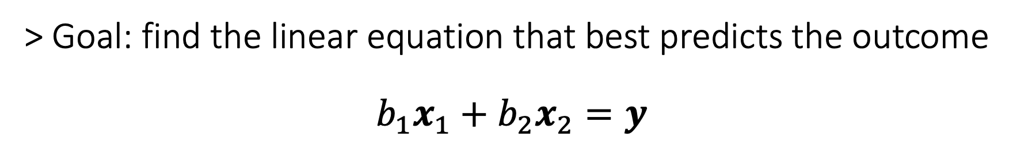
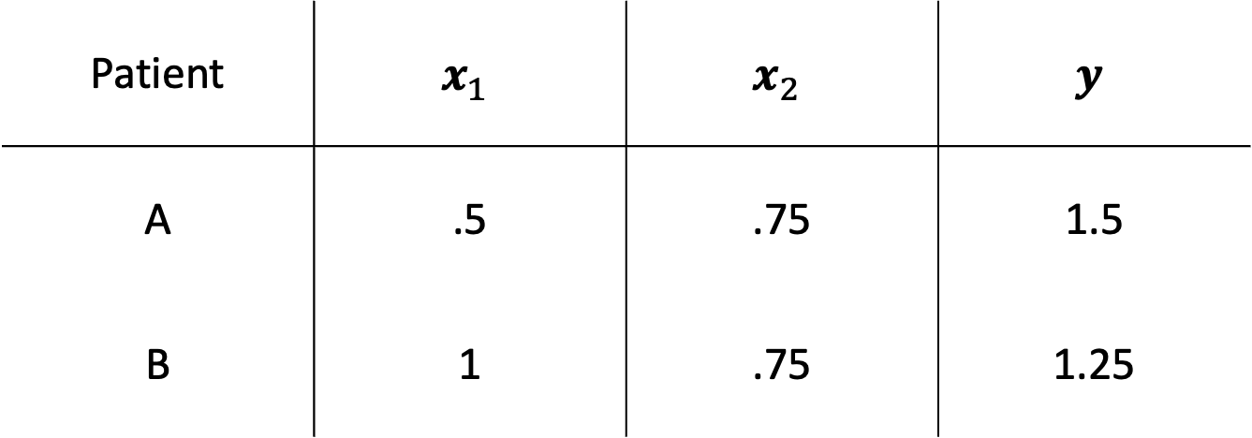
Patient | $$x_{1}$$ | $$x_{2}$$ | $$y$$
A | .5 | .75 | 1.5
B | 1 | .75 | 1.25
> Goal: find the linear equation that best predicts the outcome
$$b_{1}x_{1}+b_{2}x_{2}=y$$

Slide 4

value in patient B
$$y$$
1
1
value in patient A

Slide 5
value in patient B
$$y$$
1
1
value in patient A

Slide 6

value in patient B
$$y$$
1
$$x_{1}$$
1
value in patient A

Slide 7
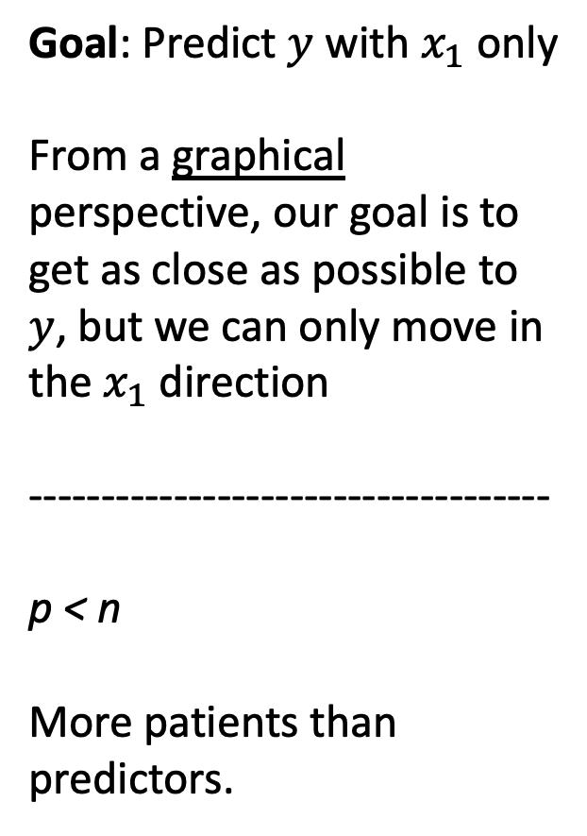
Goal: Predict $y$ with $x_{1}$ only
From a graphical perspective, our goal is to get as close as possible to $y$, but we can only move in the $x_{1}$ direction
------------------------------------
p < n
More patients than predictors.
value in patient B
$$y$$
1
$$x_{1}$$
1
value in patient A

Slide 8

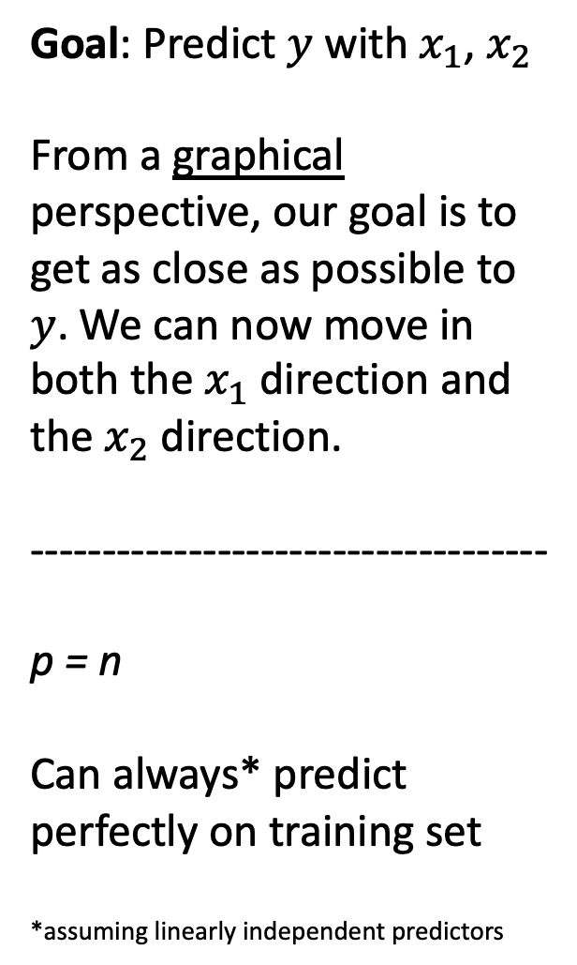
Goal: Predict $y$ with $x_{1}$, $x_{2}$
From a graphical perspective, our goal is to get as close as possible to $y$. We can now move in both the $x_{1}$ direction and the $x_{2}$ direction.
------------------------------------
p = n
Can always* predict perfectly on training set
*assuming linearly independent predictors
value in patient B
$$y$$
1
$$x_{1}$$
$$x_{2}$$
1
value in patient A

Slide 9
Goal: Predict $y$ with $x_{1}$, $x_{2}$
From a graphical perspective, our goal is to get as close as possible to $y$. We can now move in both the $x_{1}$ direction and the $x_{2}$ direction.
------------------------------------
p = n
Can always* predict perfectly on training set
*assuming linearly independent predictors
value in patient B
$$y$$
1
$$x_{1}$$
$$x_{2}$$
1
value in patient A

