Slide 1
Understanding Model Predictions
Matthew Engelhard

Slide 2
Interpretable versus Explainable

Slide 3
Interpretable versus Explainable
An interpretable model:
It is easy to for us to understand why the model makes the predictions that it makes.
An explainable model:
One or more techniques can be used to provide a human-friendly explanation for each model prediction.
Notes:
Bike versus car?
Bike:
Why did it turn left? I can see the handles
Why did it move forward? I can see the chain
Why did it stall? The chain fell off
Car:
Why did it turn left? It’s because I turned the wheel left… but I can’t really see how turning the wheel left makes the wheel go left
Why did it move forward? It’s because you pushed the pedal.
Why did it stall? You let the clutch out too quickly.

Slide 4


Interpretable Explainable
Notes:
Think about going to the mechanic…
If the brake stops working, will you be able to see why?

Slide 5
We can interpret APACHE III
Suppose a new patient is transferred to the ICU, and the (logistic regression) model predicts their mortality risk is high.
Q: Is it hard to figure out why it made that prediction?
Notes:
Cautions:
not causal
Many predictors can be highly correlated
When we use many predictors, coefficients can be somewhat arbitrary as a result
Don’t assign too much meaning here

Slide 6

We can interpret APACHE III
Suppose a new patient is transferred to the ICU, and the (logistic regression) model predicts their mortality risk is high.
Q: Is it hard to figure out why it made that prediction?
A: No. You can look at the coefficients to see which variables increased and decreased the predicted probability.
LOG ODDS
𝜎
y
age
sex
SBP
HR
temp
RR
WBC
HCT
$$β1 β8$$
y, associated label:
(0 = live, 1 = die)
x₁ | x₂ | x₃ | x₄ | x₅ | x₆ | x₇ | x₈
Notes:
Cautions:
not causal
Many predictors can be highly correlated
When we use many predictors, coefficients can be somewhat arbitrary as a result
Don’t assign too much meaning here

Slide 7
We can interpret a count-based NLP model
Suppose you use logistic regression with count-based features, and your model predicts that that an SMS you receive is urgent.
Q: Is it hard to figure out why it made that prediction?
Notes:
Cautions:
not causal
Many predictors can be highly correlated
When we use many predictors, coefficients can be somewhat arbitrary as a result
Don’t assign too much meaning here

Slide 8
We can interpret a count-based NLP model
Suppose you use logistic regression with count-based features, and your model predicts that that an SMS you receive is urgent.
Q: Is it hard to figure out why it made that prediction?
A: No. You can look at the coefficients to see which words increased and decreased the predicted probability.
LOG ODDS
𝜎
y
shaking
clinic
morning
mom
sickness
breastfeed
passed
where
$$β1 β8$$
y, associated label:
(0 = not urgent, 1 = urgent)
x₁ | x₂ | x₃ | x₄ | x₅ | x₆ | x₇ | x₈
Notes:
Cautions:
not causal
Many predictors can be highly correlated
When we use many predictors, coefficients can be somewhat arbitrary as a result
Don’t assign too much meaning here

Slide 9
In linear models, parameter values show the effect of the corresponding feature.

Slide 10
Other Interpretable Models?

Slide 11
Other Interpretable Models?
Decision Tree
HR > 130?
no
yes
live
temp > 40℃?
no
yes
live
die

Slide 12
Can we interpret a deep learning NLP model?
Suppose you apply a deep neural network to a sequence of word vectors, and your model predicts that that the SMS you receive is urgent.
Q: Is it hard to figure out why it made that prediction?

Slide 13
Can we interpret a deep learning NLP model?
Suppose you apply a deep neural network to a clinical note, and your model predicts it is describing a pulmonary embolism.
Q: Is it hard to figure out why it made that prediction?
NLP
Encoder
pulmonary embolism
logistic
regression
label
vector of
document attributes
document
Notes:
So, there are a few different types of natural language processing encoders one might consider for a given problem
But at the end of the day, each type takes a document or text passage as input and converts it to a feature vector that we can use to predict an outcome of interest via logistic regression or another simple model

Slide 14
Can we interpret a deep learning NLP model?
Suppose you apply a deep neural network to a sequence of word vectors, and your model predicts that that the SMS you receive is urgent.
Q: Is it hard to figure out why it made that prediction?
A: Yes, it’s hard to figure out, because the effect of a given word on model predictions depends on the rest of the document.
So, we can’t directly interpret the model’s predictions.
However, we have ways of asking the model to explain itself.

Slide 15
Feature importance in complex models
Permutation importance
If I shuffle around the patients’ ages, how much do model predictions change?
Gradient-based methods
As I slowly change the patients’ ages, how quickly do model predictions change?
(saliency maps)
As I change the patient’s age to a baseline value, how much do model predictions change?
(integrated gradients)
SHAP Values
If I excluded age from the model, how much would the prediction change?

Slide 16
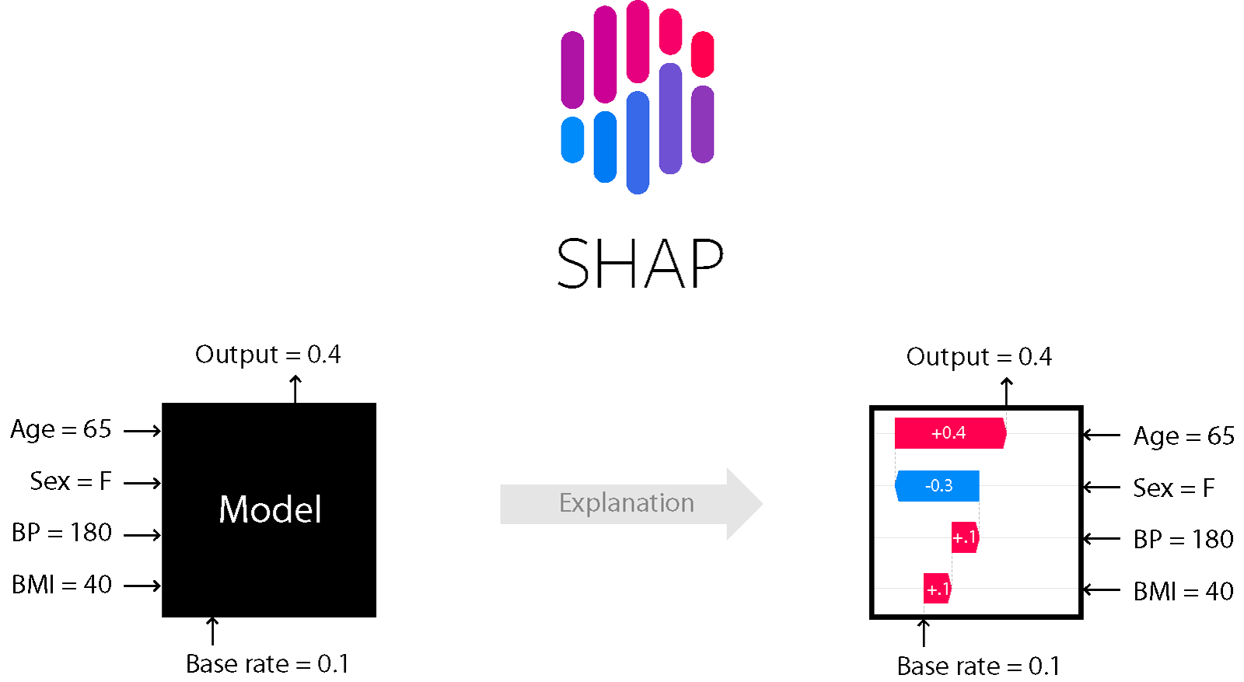
Most common: SHAP Values
Key differences compared to interpretation:
Explanations apply to individual predictions, not the model as a whole
Computing them can be computationally expensive

Slide 17
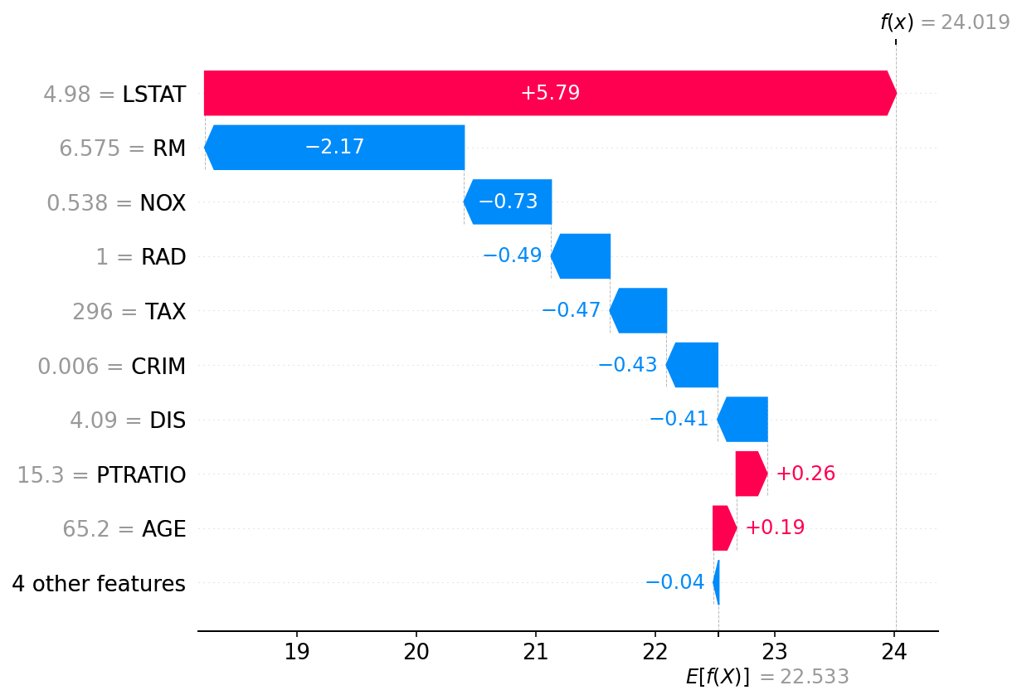
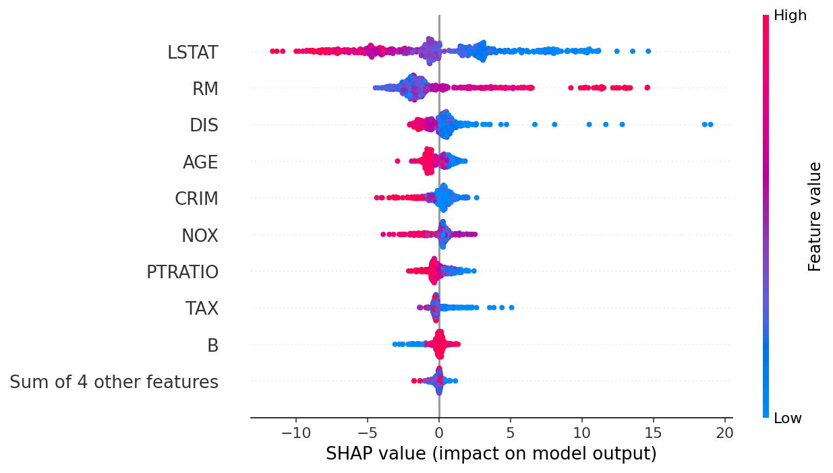
SHAP Values
For one prediction For all predictions
https://github.com/slundberg/shap

Slide 18
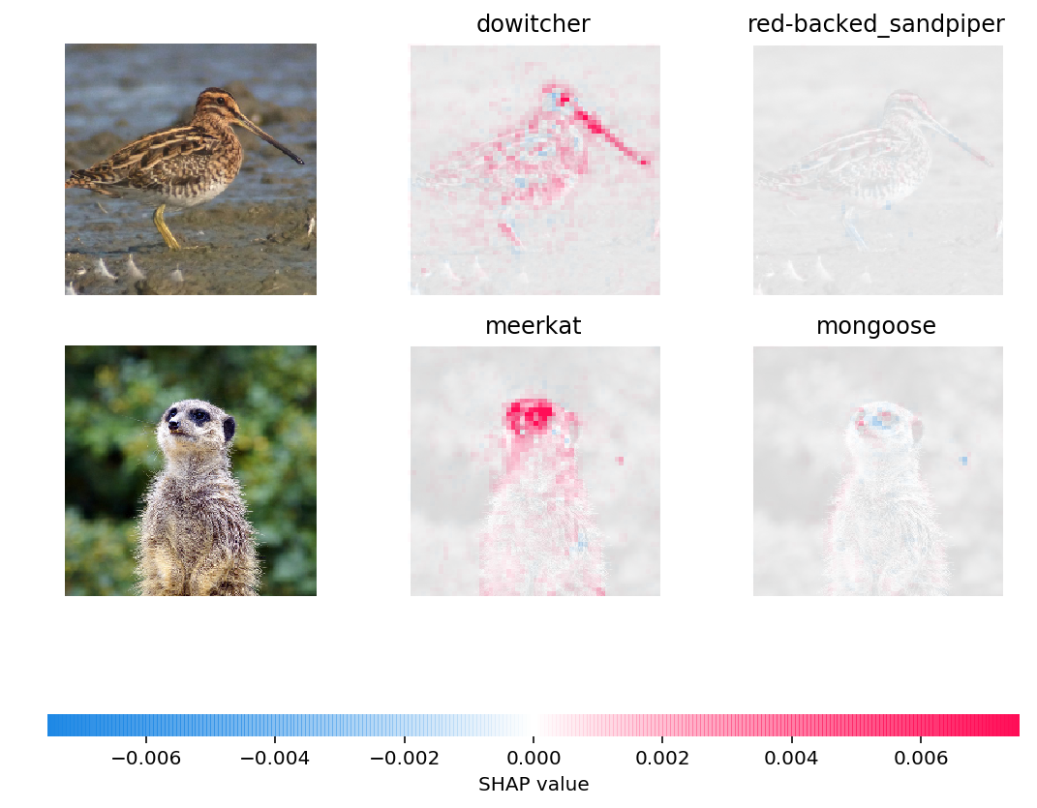
We can explain a CNN’s predictions
Suppose you apply a CNN to images of animals, and the model predicts that an animal is a meerkat.
Q: Is it hard to figure out why it made that prediction?
A: Yes, an explanation can be provided:
Similarly, we can identify passages within a text document that would change predictions most if they were removed.
Caveats:
This is for a single example; not clear how to summarize across all examples for images and text
Can be very computationally expensive

Slide 19
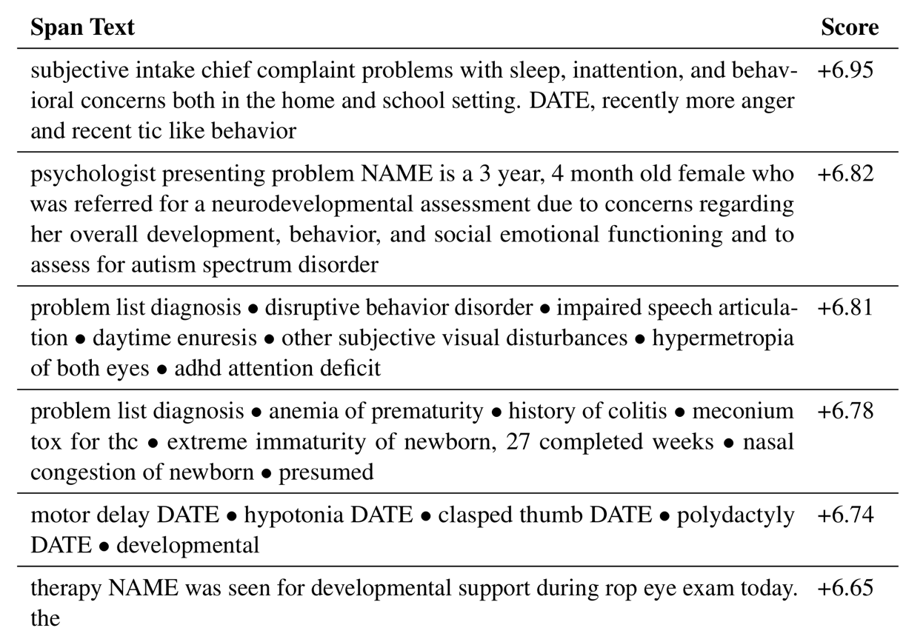
Natural Language Processing: Which Text is Predictive?
Passage (from note) | Change in predicted autism dx log-odds
Developmental and behavioral concerns are highly predictive
Premature birth and perinatal complications are also highly predictive
Subramanian V, Engelhard MM, Berchuck SI, Chen L, Carin L. SpanPredict: Extraction of Predictive Document Spans with Neural Attention. NAACL 2021

Slide 20
Saliency maps from Esteva et al.
Saliency maps show gradients for each pixel with respect to the CNN’s loss function. Darker pixels represent those with more influence.
How would this compare to a dermatologist’s explanation?
Notes:
Suppose you were learning to identify lesions from a dermatologist.
You can’t inspect her thought process, but she can give you an explanation…

Slide 21

Interpretable ? Explainable where does clinician decision-making fall on this spectrum?
Notes:
Think about going to the mechanic…
If the brake stops working, will you be able to see why?

Slide 22
Perspectives on Interpretability

Slide 23
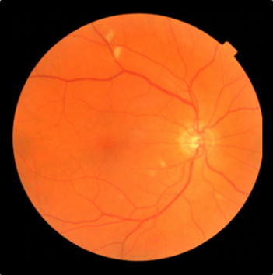
Compared to simpler models, DNNs are a black box. We can explain model predictions, but it’s case by case.
Retinopathy? Yes/No
Notes:
Want to highlight the issue of interpretability
How can we trust a ”black box” diagnostic if we don’t know what’s happening inside?

Slide 24

Is PSA measurement a black box?
PSA Level
Notes:
At the same time, I might question whether we fully understand even more traditional diagnostics.
For instance, I might know that PSA is an enzyme found in the prostate, but I have only a very rudimentary understanding of how PSA levels are detected, or how reliable a PSA measurement might be
gamma-seminoprotein or kallikrein-3 (KLK3), is a glycoprotein enzyme encoded in humans by the KLK3 gene

Slide 25
Is clinician decision-making a black box?
Retinopathy? Yes/No
Notes:
Think about going to the mechanic…
If the brake stops working, will you be able to see why?

Slide 26
Two competing perspectives
Interpretability will be central to FDA regulation of clinical decision support.
We can only use tools if we fully understand how they work
We just need to make sure our tools are valid and reliable
Notes:
At the end of the day there are two competing perspectives.
Those that think we must fully understand how these tools work to trust them
And those who think that we just need to know that they DO work.
But that means rigorously and repeatedly validating them, in a variety of settings – health systems, patient populations, other conditions

Slide 27
Conclusions
A predictive model is interpretable if it’s easy to understand how it works – in other words, the effect of features on model predictions
Neural networks are not interpretable, but we have techniques that can quantify the effect of features on each individual prediction – in other words, explain the prediction
There are a wide range of perspectives on the importance of interpretability and explainability. However, it appears the FDA regulation of clinical decision support will turn on whether the tool is interpretable.
Interpretable models still do not tell us anything about causation.

