Slide 1
Overfitting
Matthew Engelhard
Notes:
Hi Everyone
In previous lectures, we’ve talked about models, their parameters, and the idea that we want to tune those parameters to those values that give us the best predictions on the training set
But we haven’t talked about how that tuning takes place, or what we even mean by the “best” values of our parameters
In this lecture, we’ll define what we mean by “best”
And we’ll start building some intuition around how that tuning process takes place
By the end of the lecture, you should know what is meant by the loss associated with a particular model
You should also understand the specific loss used for binary classification problems – called the cross-entropy loss – and with some practice, you should be able to calculate it if you’re given model-predicted probabilities and the associated binary labels
And finally, you should be able to describe, from an intuitive perspective, how model parameters are typically tuned in machine learning

Slide 2
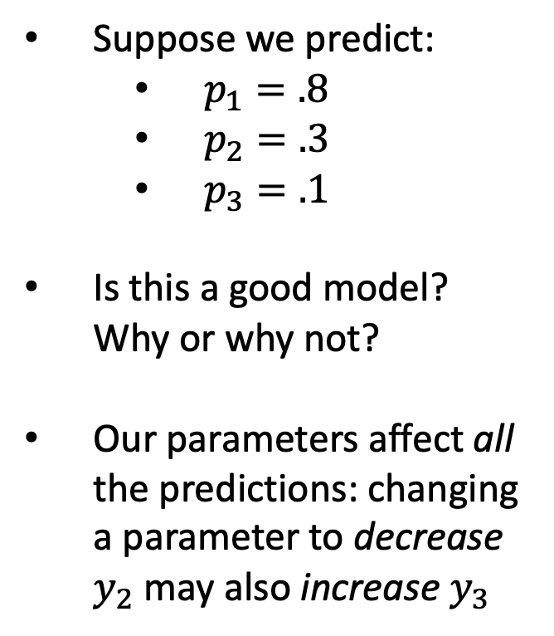
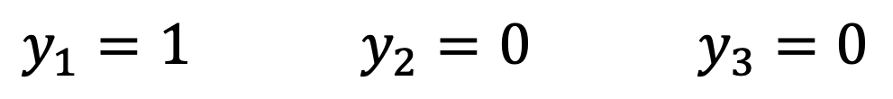
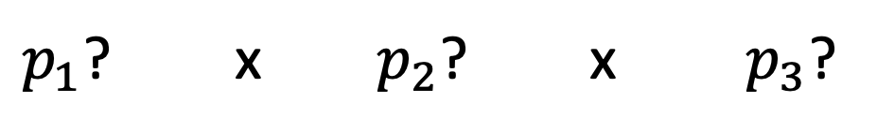
Recall: improving one prediction may worsen another
Suppose we predict:
$p_{1}=.8$
$p_{2}=.3$
$p_{3}=.1$
Is this a good model? Why or why not?
Our parameters affect all the predictions: changing a parameter to decrease $y_{2}$ may also increase $y_{3}$
$y_{1}=1$ $y_{2}=0$ $y_{3}=0$
(dies) (survives) (survives)
$p_{1}$? x $p_{2}$? x $p_{3}$?

Slide 3
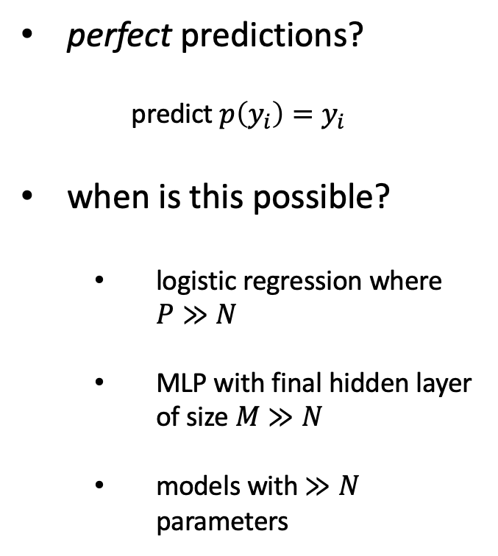
With a big enough model, this is no longer true.
perfect predictions?
predict $p\left(y_{i}\right)=y_{i}$
when is this possible?
logistic regression where $P≫N$
MLP with final hidden layer of size $M≫N$
models with $≫N$ parameters
$y_{1}=1$ $y_{2}=0$ $y_{3}=0$
(dies) (survives) (survives)
$p_{1}$? x $p_{2}$? x $p_{3}$?

Slide 4
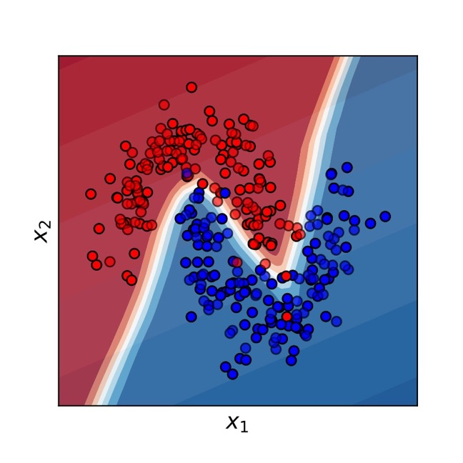
We like flexible, non-linear decision boundaries…

Slide 5
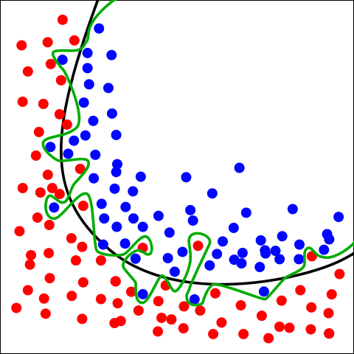
But when we start making our decision boundary arbitrarily complex to `fit’ the training set… this is overfitting
Green boundary:
Correct predictions for all training data
Very likely to be overfitting
Black boundary:
Balance between fit and model complexity
-> The black boundary is likely to perform better on new data
By Chabacano - Own work, CC BY-SA 4.0, https://commons.wikimedia.org/w/index.php?curid=3610704
Notes:
Willingness to embrace complex models → need this better approach to overfitting.

Slide 6
Overfitting
“Overfitting” happens when the learned model increases complexity to fit the observed training data too well – will not work to predict future data!
What would we want to use to fit these example data points?

Slide 7
With a complex enough model, we can typically predict our training labels perfectly.
The simpler model is likely
best with limited data
May be justified;
the validation set will tell us
Perfect predictions,
but unlikely to generalize
Notes:
Notice that the 8-order fit will take some big parameter values – we penalize them, we prevent this

Slide 8


































To protect against overfitting, see how well the model performs on previously unseen data.
Refine Model
$$x_{1}$$
$$y_{1}$$
$$x_{1}$$
$$y_{1}$$
$$x_{2}$$
$$y_{2}$$
$$x_{2}$$
$$y_{2}$$
$$x_{3}$$
$$y_{3}$$
$$x_{3}$$
$$y_{3}$$
$$x_{4}$$
$$y_{4}$$
$$x_{4}$$
$$y_{4}$$
$$x_{1}$$
$$y_{1}$$
$$x_{N−1}$$
$$x_{2}$$
$$y_{2}$$
$$x_{N−1}$$
$$y_{N−1}$$
$$x_{N}$$
$$y_{N}$$
$$x_{3}$$
$$y_{3}$$
$$x_{N}$$
$$y_{N}$$
Training Set
$$x_{4}$$
$$y_{4}$$
Test
$$x_{N−1}$$
$$y_{N−1}$$
$$x_{N}$$
$$y_{N}$$
$({b_{0},b}_{1},…b_{N})$
Validation
Estimate Performance on Validation Set
Final Performance Evaluation

Slide 9
Early Stopping
During optimization, we can check the validation loss as we go.
Instead of optimizing to convergence, we can optimize until the validation loss stops improving
Saves computational cost
Performs better on validation (and test) sets
Widely used technique in the field
Best Validation (and Generalization) Here
Training Loss Keeps Improving

Slide 10
Other Ways to Use the Validation Set
Choosing between models (e.g. MLP, LR)
Choosing how strongly to regularize the model, i.e. penalize parameters
Choosing network depth, width, etc.
Many other “hyperparameters” we might tune

Slide 11
Conclusions
Learning consists in setting model parameters to maximize some measure of fit (or equivalently, minimize some loss)
This sounds easy, but is difficult in practice when working with complex models
Greater model complexity is often, but not always, advantageous
Proper model validation is critical to estimate real-world performance and prevent overfitting

