Slide 1
Activity: Understanding Logistic Regression

Slide 2
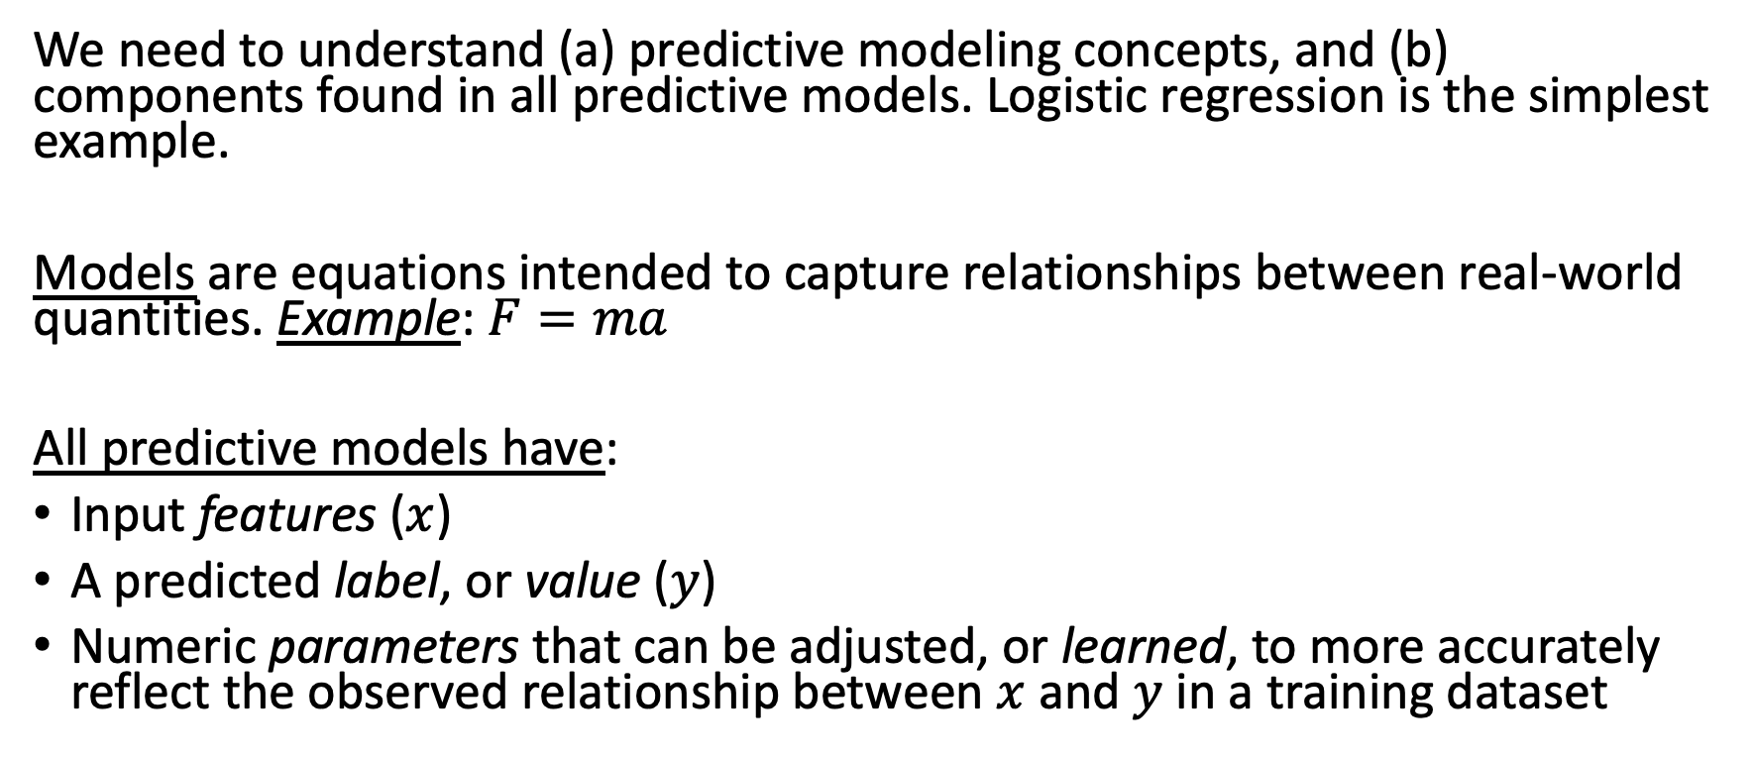
Why is this critical?
We need to understand (a) predictive modeling concepts, and (b) components found in all predictive models. Logistic regression is the simplest example.
Models are equations intended to capture relationships between real-world quantities. Example: $F=ma$
All predictive models have:
Input features ($x$)
A predicted label, or value ($y$)
Numeric parameters that can be adjusted, or learned, to more accurately reflect the observed relationship between $x$ and $y$ in a training dataset
Notes:
Is F=ma correct? Is it useful?
Features, predictors, independent variables
Label, value, dependent variable(s)

Slide 3
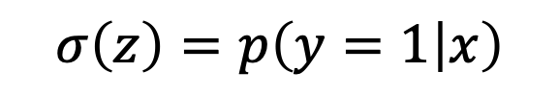

Logistic Regression: a linear model with a logistic “link” function that converts the prediction to a probability
$$σ\left(z\right)=p\left(y=1 | x\right)$$
$$σ$$
z
b₁
b_{M}
x₁
x_{M}
$$p\left(y=1 | x\right)=σ(b_{1}x_{1}+b_{2}x_{2}+…+b_{M}x_{M})$$
Notes:
Note: sometimes we use I to denote that there are multiple people
So, logistic regression is (1) a linear model, combined with (2) the logistic link function
We want to be able to represent this more compactly, because as we move through the course, our models will be getting more complicated!
We’ll use the circle shown here, with a sigma in the middle, to indicate that the logistic (or sigmoid) function is being applied, in this case to z_i, resulting in a prediction about the probability that y_i is 1, as shown at the top.
Remember that in our ICU example, y_i = 1 corresponds to death, and y_i = 0 corresponds to survival
Note that unlike before, you can no longer see the arrows going to z – this is just to make things a little less messy, and in our slides, the arrows will always move bottom to top – but these arrows are actually important to indicate the direction of information flow within the graph.

Slide 4
Logistic Regression: a linear model with a logistic “link” function that converts the prediction to a probability
$$σ\left(z\right)=p\left(y=1 | x\right)$$
$$σ$$
z
A way to represent the intercept (i.e., bias) term
Usually this will be omitted, but the term is almost always present
b₁
b_{M}
b₀
x₁
x_{M}
1
$$p\left(y=1 | x\right)=σ(b_{0}+b_{1}x_{1}+b_{2}x_{2}+…+b_{M}x_{M})$$
Notes:
Note: sometimes we use I to denote that there are multiple people
So, logistic regression is (1) a linear model, combined with (2) the logistic link function
We want to be able to represent this more compactly, because as we move through the course, our models will be getting more complicated!
We’ll use the circle shown here, with a sigma in the middle, to indicate that the logistic (or sigmoid) function is being applied, in this case to z_i, resulting in a prediction about the probability that y_i is 1, as shown at the top.
Remember that in our ICU example, y_i = 1 corresponds to death, and y_i = 0 corresponds to survival
Note that unlike before, you can no longer see the arrows going to z – this is just to make things a little less messy, and in our slides, the arrows will always move bottom to top – but these arrows are actually important to indicate the direction of information flow within the graph.

Slide 5
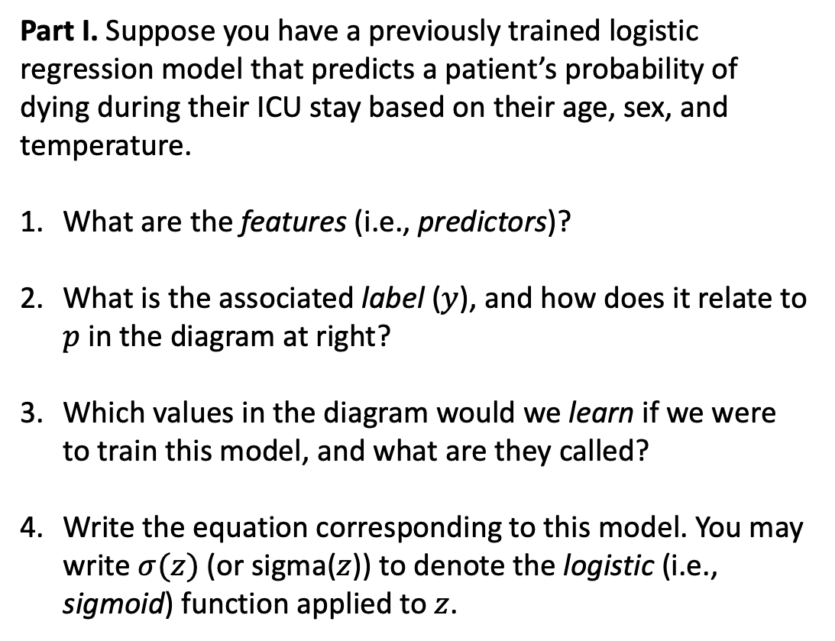
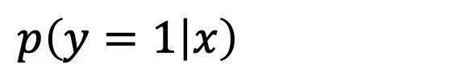
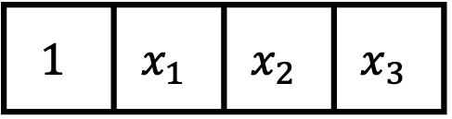


Part I. Suppose you have a previously trained logistic regression model that predicts a patient’s probability of dying during their ICU stay based on their age, sex, and temperature.
What are the features (i.e., predictors)?
What is the associated label ($y$), and how does it relate to $p$ in the diagram at right?
Which values in the diagram would we learn if we were to train this model, and what are they called?
Write the equation corresponding to this model. You may write $σ(z)$ (or sigma($z$)) to denote the logistic (i.e., sigmoid) function applied to $z$.
$$p\left(y=1 | x\right)$$
$$σ$$
$$z$$
b₀
b₁
b₂
b₃
$$1$$ | $$x_{1}$$ | $$x_{2}$$ | $$x_{3}$$
Temperature
Sex
Age
Intercept
Notes:
Mention that features are often called independent variables; labels often called dependent variable(s)
Parts I and II in breakout rooms.
Part III: come together and we can discuss.

Slide 6
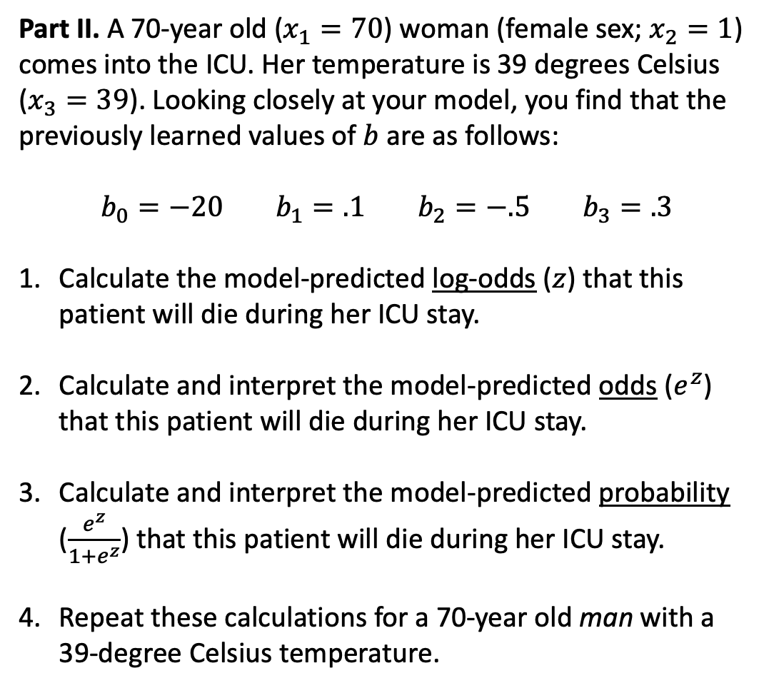
Part II. A 70-year old ($x_{1}=70$) woman (female sex; $x_{2}=1$) comes into the ICU. Her temperature is 39 degrees Celsius ($x_{3}=39$). Looking closely at your model, you find that the previously learned values of $b$ are as follows:
$$b_{0}=−20 b_{1}=.1 b_{2}=−.5 b_{3}=.3$$
Calculate the model-predicted log-odds ($z$) that this patient will die during her ICU stay.
Calculate and interpret the model-predicted odds ($e^{z}$) that this patient will die during her ICU stay.
Calculate and interpret the model-predicted probability ($\frac{e^{z}}{1+e^{z}}$) that this patient will die during her ICU stay.
Repeat these calculations for a 70-year old man with a 39-degree Celsius temperature.
$$p\left(y=1 | x\right)$$
$$σ$$
$$z$$
b₀
b₁
b₂
b₃
$$1$$ | $$x_{1}$$ | $$x_{2}$$ | $$x_{3}$$
Temperature
Sex
Age
Intercept

Slide 7
Part III. Unfortunately, your patient’s condition deteriorates, and despite everyone’s best efforts, she passes away in the ICU.
Consider the relationship between this outcome and the probability of mortality predicted by your model.
The following questions do not have clear yes or no answers. They are designed to get you thinking about model fit and performance.
Was your model’s prediction correct? Why or why not?
Was your model’s prediction good? Why or why not?
Is there any additional information you could collect to help you answer (1) and (2)?
Next time, we will continue to explore these questions.
$$p\left(y=1 | x\right)$$
$$σ$$
$$z$$
b₀
b₁
b₂
b₃
$$1$$ | $$x_{1}$$ | $$x_{2}$$ | $$x_{3}$$
Temperature
Sex
Age
Intercept

