Slide 1
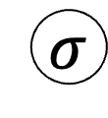
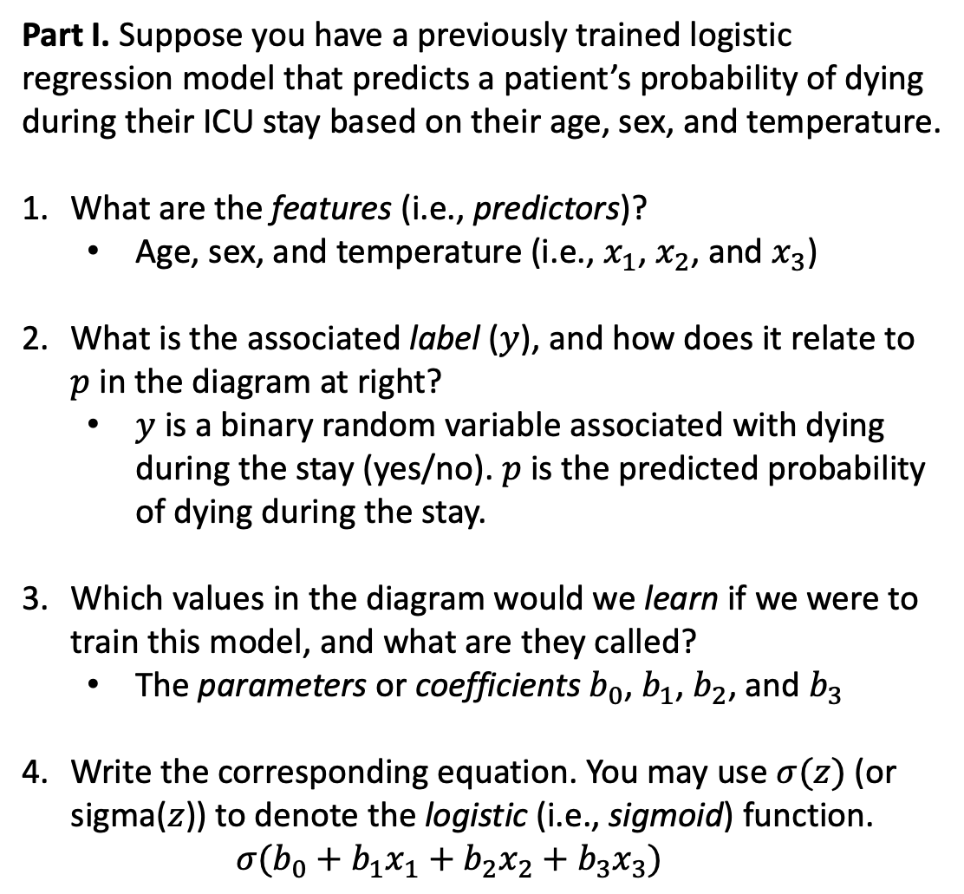
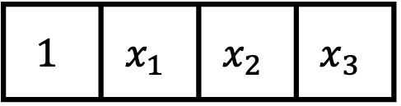

Part I. Suppose you have a previously trained logistic regression model that predicts a patient’s probability of dying during their ICU stay based on their age, sex, and temperature.
What are the features (i.e., predictors)?
Age, sex, and temperature (i.e., $x_{1}$, $x_{2}$, and $x_{3}$)
What is the associated label ($y$), and how does it relate to $p$ in the diagram at right?
$y$ is a binary random variable associated with dying during the stay (yes/no). $p$ is the predicted probability of dying during the stay.
Which values in the diagram would we learn if we were to train this model, and what are they called?
The parameters or coefficients $b_{0}$, $b_{1}$, $b_{2}$, and $b_{3}$
Write the corresponding equation. You may use $σ(z)$ (or sigma($z$)) to denote the logistic (i.e., sigmoid) function.
$$σ(b_{0}+b_{1}x_{1}+b_{2}x_{2}+b_{3}x_{3})$$
$$σ$$
$$z$$
b₀
b₁
b₂
b₃
$$1$$ | $$x_{1}$$ | $$x_{2}$$ | $$x_{3}$$
Temperature
Sex
Age
Intercept

Slide 2
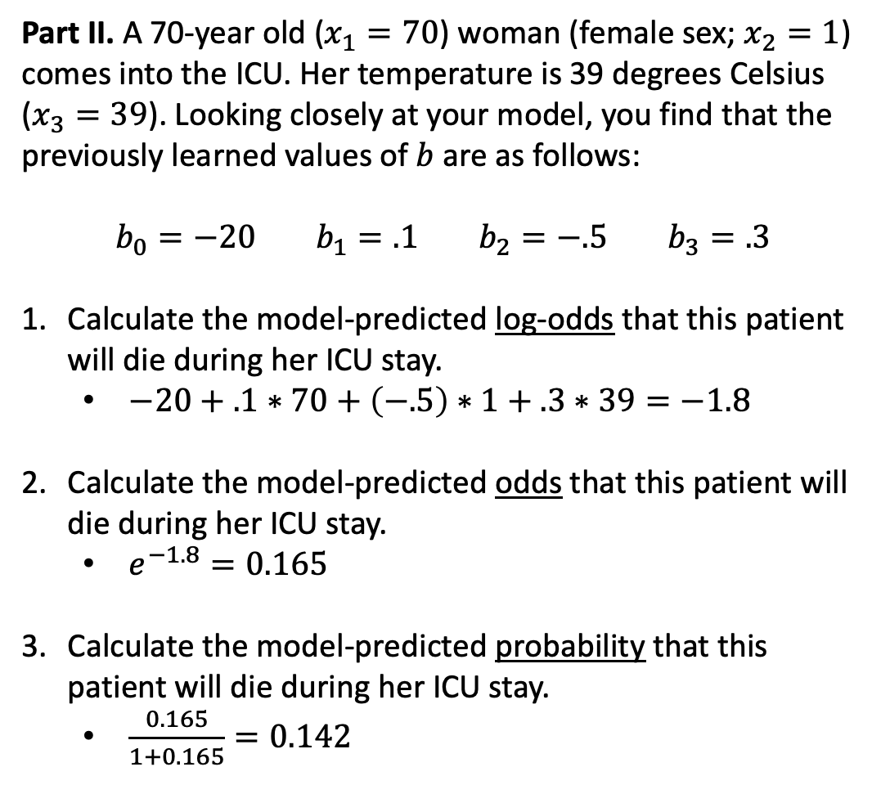
Part II. A 70-year old ($x_{1}=70$) woman (female sex; $x_{2}=1$) comes into the ICU. Her temperature is 39 degrees Celsius ($x_{3}=39$). Looking closely at your model, you find that the previously learned values of $b$ are as follows:
$$b_{0}=−20 b_{1}=.1 b_{2}=−.5 b_{3}=.3$$
Calculate the model-predicted log-odds that this patient will die during her ICU stay.
$−20+.1∗70+\left(−.5\right)∗1+.3∗39=−1.8$
Calculate the model-predicted odds that this patient will die during her ICU stay.
$e^{−1.8}=0.165$
Calculate the model-predicted probability that this patient will die during her ICU stay.
$\frac{0.165}{1+0.165}=0.142$
$$σ$$
$$z$$
b₀
b₁
b₂
b₃
$$1$$ | $$x_{1}$$ | $$x_{2}$$ | $$x_{3}$$
Temperature
Sex
Age
Intercept

Slide 3
Part III. Unfortunately, your patient’s condition deteriorates, and despite everyone’s best efforts, she passes away in the ICU.
Was your model’s prediction correct? Why or why not?
It is impossible to know. We only see the outcome; we do not know how probable or improbable it was.
Was your model’s prediction good? Why or why not?
Knowing that most patients do not die during a given ICU stay, the predicted probability of death was relatively high. Thus, the prediction appears to be consistent with the outcome. However, it is hard to be confident based on only one patient.
Is there any additional information you could collect to help you answer (1) and (2)?
One way to determine whether the prediction was good would be to observe outcomes for many similar patients (i.e., ~70-year old women with ~39 degree temperatures). If the proportion who die is similar to the model-predicted probability, then the model’s prediction is good.
$$σ$$
$$z$$
b₀
b₁
b₂
b₃
$$1$$ | $$x_{1}$$ | $$x_{2}$$ | $$x_{3}$$
Temperature
Sex
Age
Intercept

