Slide 1
Working with Multi-Modal Health Data
Matthew Engelhard

Slide 2
Working with categorical variables
One-hot / Cell coding
Embeddings

Slide 3
Cell / “One-hot” encoding
Familiar from linear models: e.g. 0 for male, 1 for female
Requires # features equal to # categories
Always categorical: diagnosis codes, procedure codes
Reduce to categorical: look at which labs are collected, ignore values
Consider similarity to bag of words models…
Notes:
Patient = bag of codes

Slide 4
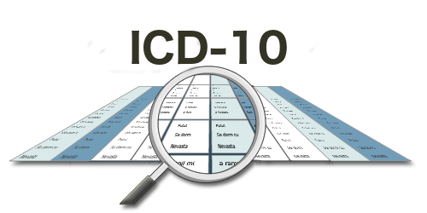
Very large number of categories
Option 1: don’t worry about it
Option 2: group manually or using existing software (e.g. clinical classification software)
Option 3: use or create embeddings
pre-train
learn directly

Slide 5
Measurements over time
Option 1: Count number of occurrences (+ log transform)
Option 2: If we have embeddings, we can aggregate (like VSWEM)
Option 3: Use a sequential model (covered in the next lecture)
How do we incorporate information about the TIMESTAMP??
Positional embedding
Temporal embedding

Slide 6
Working with irregularly spaced measurements
Aggregation
Imputation

Slide 7
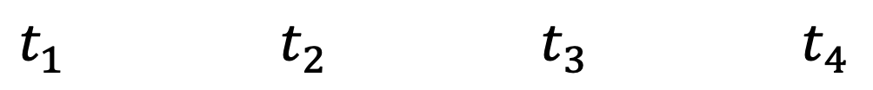
Measurements in the ICU
0 (survival)
$t_{1}$ $t_{2}$ $t_{3}$ $t_{4}$
y_{i}
Temp
BP
HR
RR
SpO2
Glucose
x_{i}
Notes:
This is what we do in diagnosis prediction, for instance

Slide 8
Measurements in the ICU
$t_{1}$ $t_{2}$ $t_{3}$ $t_{4}$
0 (survival)
y_{i}
Temp
BP
HR
RR
SpO2
Glucose
x_{i}

Slide 9
Measurements on the Wards…
time
blood pressure
chest xray
culture
glucose
CMP
CBC
This is a major difficulty!
Notes:
Also true for diagnosis codes, etc

Slide 10
Simplest Method…
time
blood pressure
chest xray
culture
glucose
CMP
CBC
aggregate in hour 1
aggregate in hour 2
aggregate in hour 3
aggregate in hour 4…

Slide 11
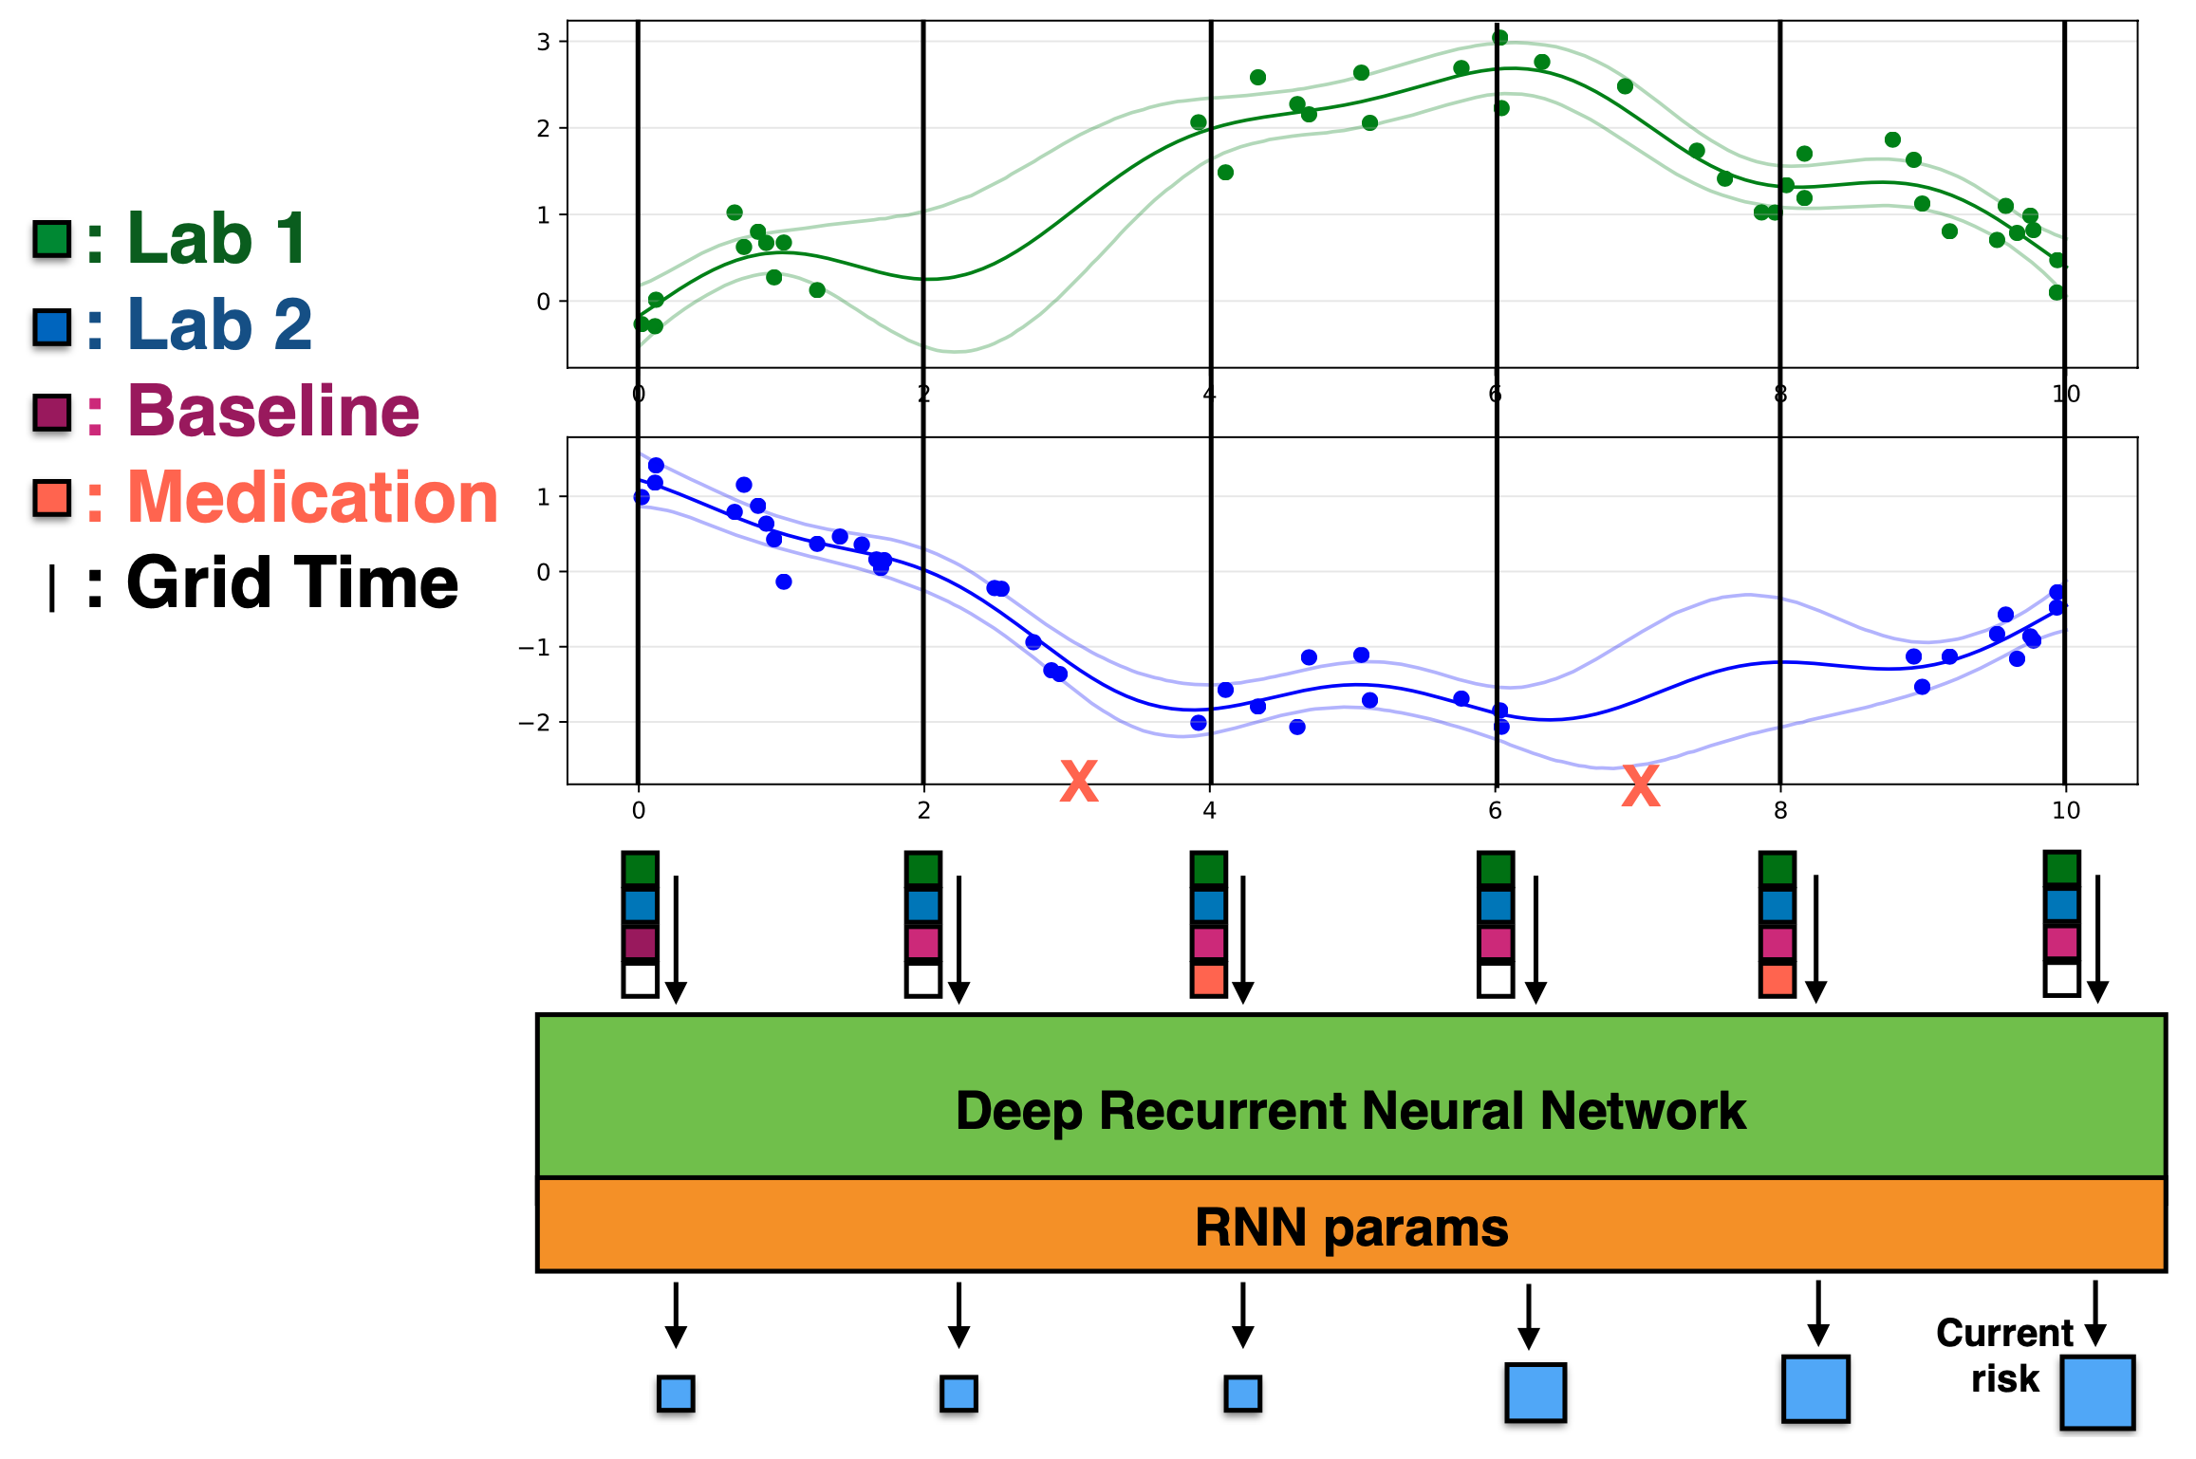
DIHI Sepsis Watch
<- Use GP regression to predict measurements at regular intervals
<- Predict sepsis risk using an RNN

Slide 12
In the EHR, measurements are highly “sparse”
Many more missing measurements than non-missing
Consider diagnosis codes, procedure codes, uncommon labs, etc
We want to learn from these measurements, but most patients don’t have them
Choose an aggregation window to reduce this, but nevertheless a great deal of imputation is required

Slide 13
Making predictions from multi-modal data
“Data fusion”

Slide 14
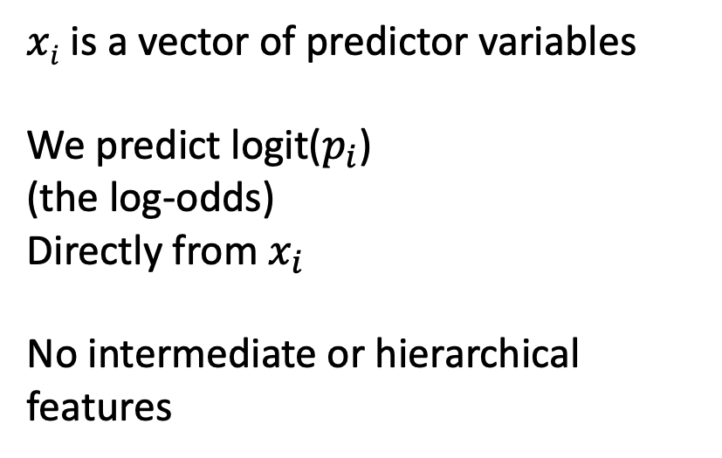

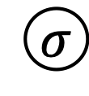
Logistic Regression
$$p_{i}$$
$xi$ is a vector of predictor variables
We predict logit($p_{i}$)
(the log-odds)
Directly from $x_{i}$
No intermediate or hierarchical features
$$σ$$
z_{i}
b₁
b_{M}
x_{i1}
x_{iM}
Notes:
So, the final portions of the retinopathy prediction architecture look like logistic regression
The difference is these features. Instead, we have a deep CNN

Slide 15
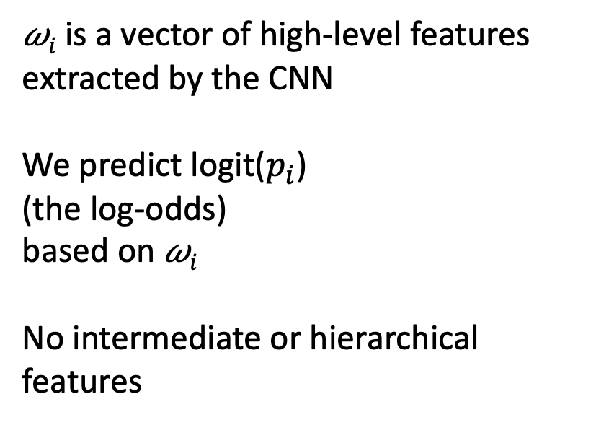


Convolutional Neural Network
$$p_{i}$$
$$σ$$
𝜔$i$ is a vector of high-level features
extracted by the CNN
We predict logit($p_{i}$)
(the log-odds)
based on 𝜔$i$
No intermediate or hierarchical features
z_{i}
b₁
b_{M}
𝜔_{i1}
𝜔_{iM}
Convolutional Neural Network

Slide 16
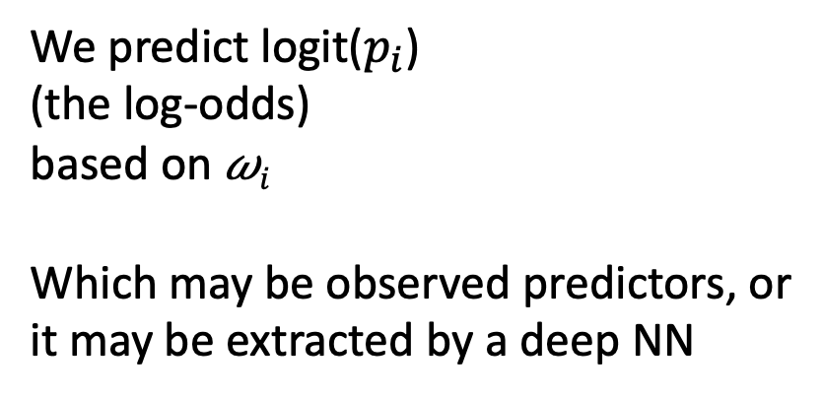
Any Modality
$$p_{i}$$
$$σ$$
We predict logit($p_{i}$)
(the log-odds)
based on 𝜔$i$
Which may be observed predictors, or it may be extracted by a deep NN
z_{i}
b₁
b_{M}
𝜔_{i1}
𝜔_{iM}
Data Collection and/or Feature Extraction

Slide 17
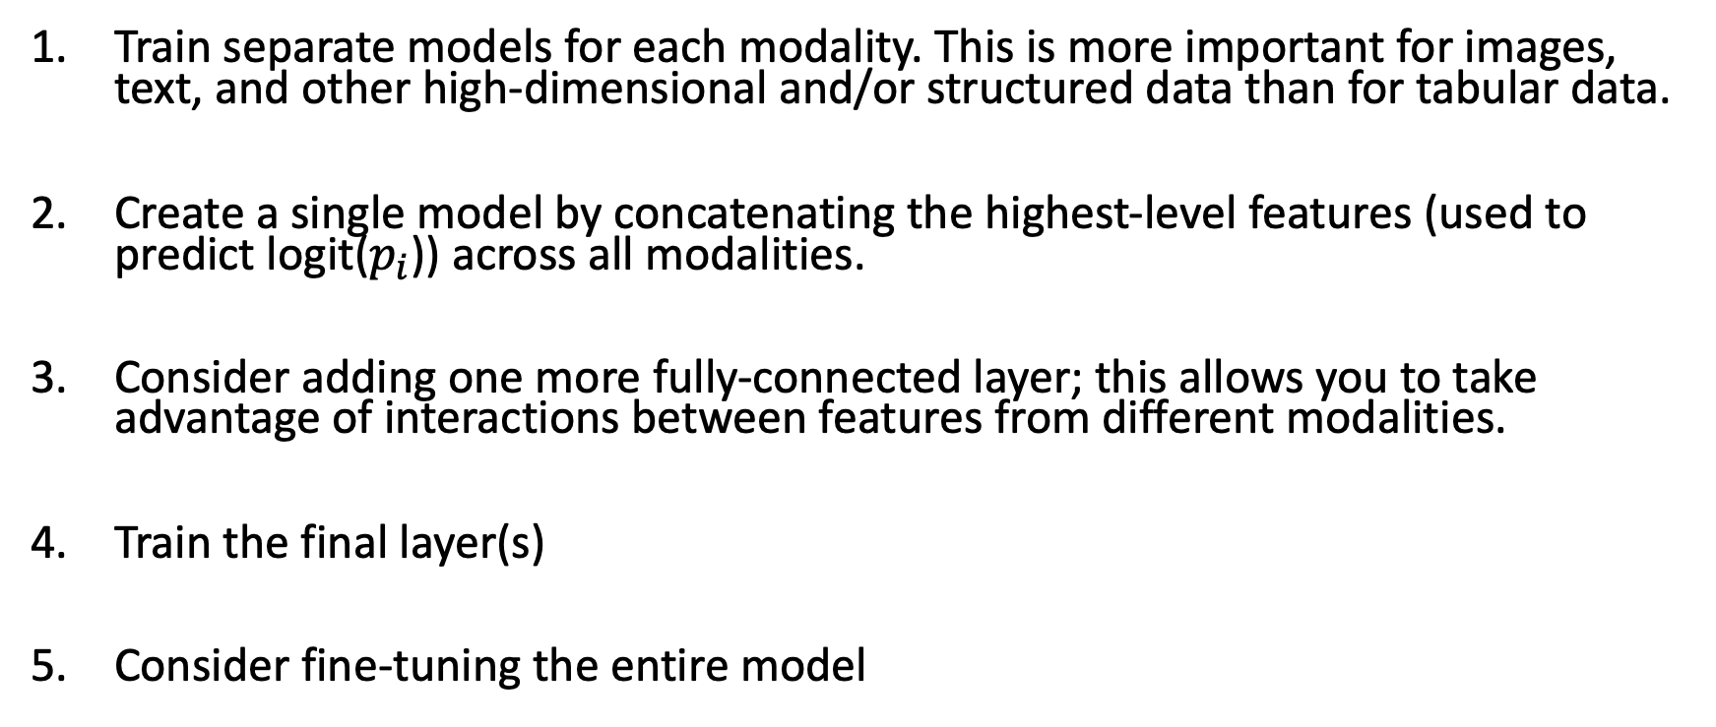
Combining Modalities
Train separate models for each modality. This is more important for images, text, and other high-dimensional and/or structured data than for tabular data.
Create a single model by concatenating the highest-level features (used to predict logit($p_{i}$)) across all modalities.
Consider adding one more fully-connected layer; this allows you to take advantage of interactions between features from different modalities.
Train the final layer(s)
Consider fine-tuning the entire model

Slide 18

Combining Modalities
$$p_{i}$$
Train independently
Concatenate
Train together
Image
Side features
Text Document

Slide 19
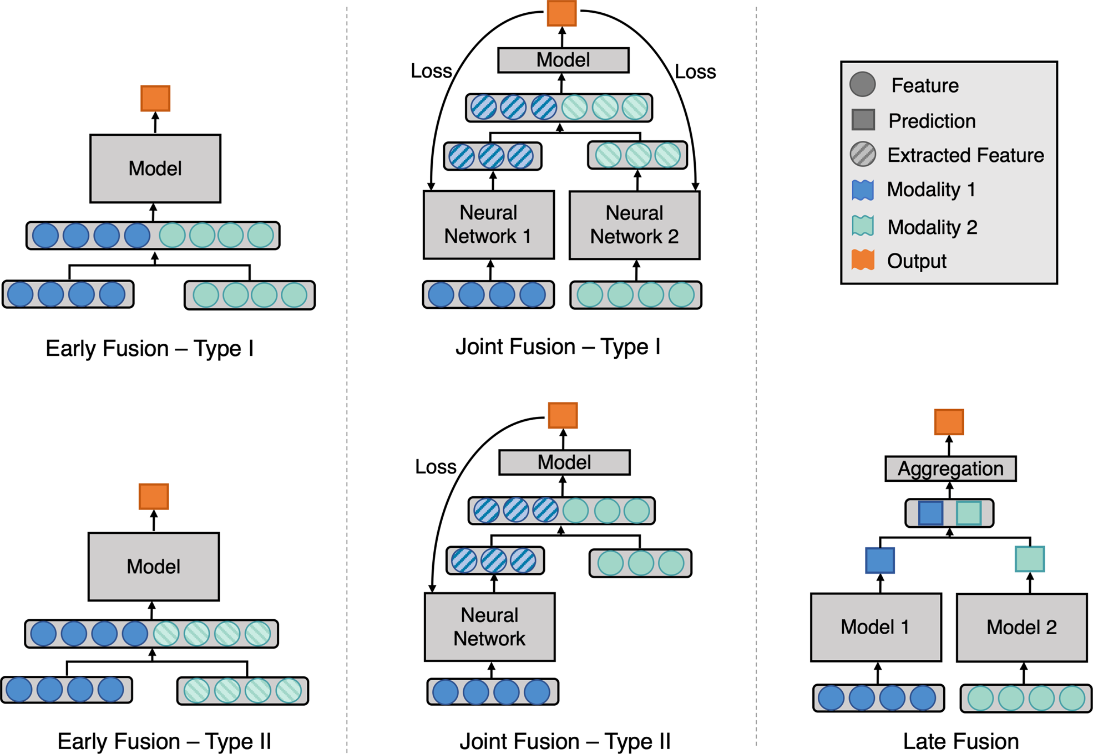
Huang, SC., Pareek, A., Seyyedi, S. et al. Fusion of medical imaging and electronic health records using deep learning: a systematic review and implementation guidelines. npj Digit. Med. 3, 136 (2020).

Slide 20
Conclusions
In healthcare, we commonly have the following challenges:
Categorical variables with a large number of categories (i.e. high cardinality)
Sparse measurements
Multiple modalities we need to integrate
Always start with the simplest method
Often, aggregating measurements/features performs quite well
Once our simple baseline is established, we can consider more complex models (e.g. RNNs for sequences)

