Slide 1
Activity: MLP Structure
ML for Health, Week 3

Slide 2
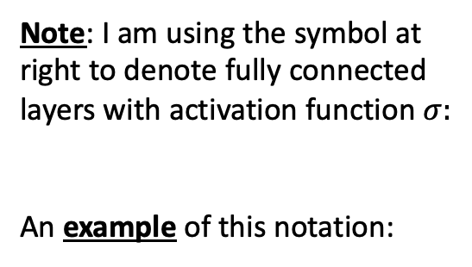


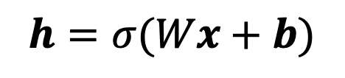
For each of the models on the pages to follow:
Note: I am using the symbol at right to denote fully connected layers with activation function $σ:$
An example of this notation:
Specify the number and size(s) of hidden layers.
Determine how many parameters the model contains, in total.
Write the output as a function of the input. In other words, write the equation defined by this model.
$$σ$$
$$h=σ(Wx+b)$$
$$σ$$
x

Slide 3


Logistic Regression
Specify the number and size(s) of hidden layers.
Determine how many parameters the model contains, in total.
Write the output as a function of the input. In other words, write the equation defined by this graph/model.
$$p$$
$$σ$$
x
Notes:
So, let’s get to it.
Returning to our logistic regression model, we’re going to make yet another simplification to our diagram

Slide 4



Shallow MLP (with 𝜎 activations)
Specify the number and size(s) of hidden layers.
Determine how many parameters the model contains, in total.
Write the output as a function of the input. In other words, write the equation defined by this model.
$$p$$
$$σ$$
h
$$σ$$
x
Notes:
So, let’s get to it.
Returning to our logistic regression model, we’re going to make yet another simplification to our diagram

Slide 5





Slightly Deeper MLP (with 𝜎 activations)
Specify the number and size(s) of hidden layers.
Determine how many parameters the model contains, in total.
Write the output as a function of the input. In other words, write the equation defined by this model.
$$p$$
$$σ$$
$h_{2}$
$$σ$$
$h_{1}$
$$σ$$
x
Notes:
So, let’s get to it.
Returning to our logistic regression model, we’re going to make yet another simplification to our diagram

Slide 6







Which model contains more parameters?
$$p$$
$$p$$
$$σ$$
$$σ$$
$h_{3}$
$h_{2}$
$$σ$$
$h_{2}$
$$σ$$
$h_{1}$
$$σ$$
$h_{1}$
$$σ$$
$$σ$$
x
x
Notes:
So, let’s get to it.
Returning to our logistic regression model, we’re going to make yet another simplification to our diagram

Slide 7






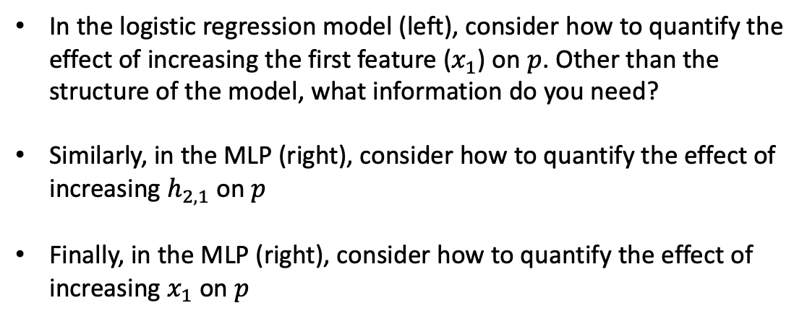





Challenge
In the logistic regression model (left), consider how to quantify the effect of increasing the first feature ($x_{1}$) on $p$. Other than the structure of the model, what information do you need?
Similarly, in the MLP (right), consider how to quantify the effect of increasing $h_{2,1}$ on $p$
Finally, in the MLP (right), consider how to quantify the effect of increasing $x_{1}$ on $p$
$$p$$
$$σ$$
$h_{2,1}$
$h_{2}$
$$p$$
$$σ$$
$h_{1}$
$$σ$$
$$σ$$
$$x_{1}$$
x
$$x_{1}$$
x
Notes:
So, let’s get to it.
Returning to our logistic regression model, we’re going to make yet another simplification to our diagram

