Slide 1
CNN, in brief

Slide 2
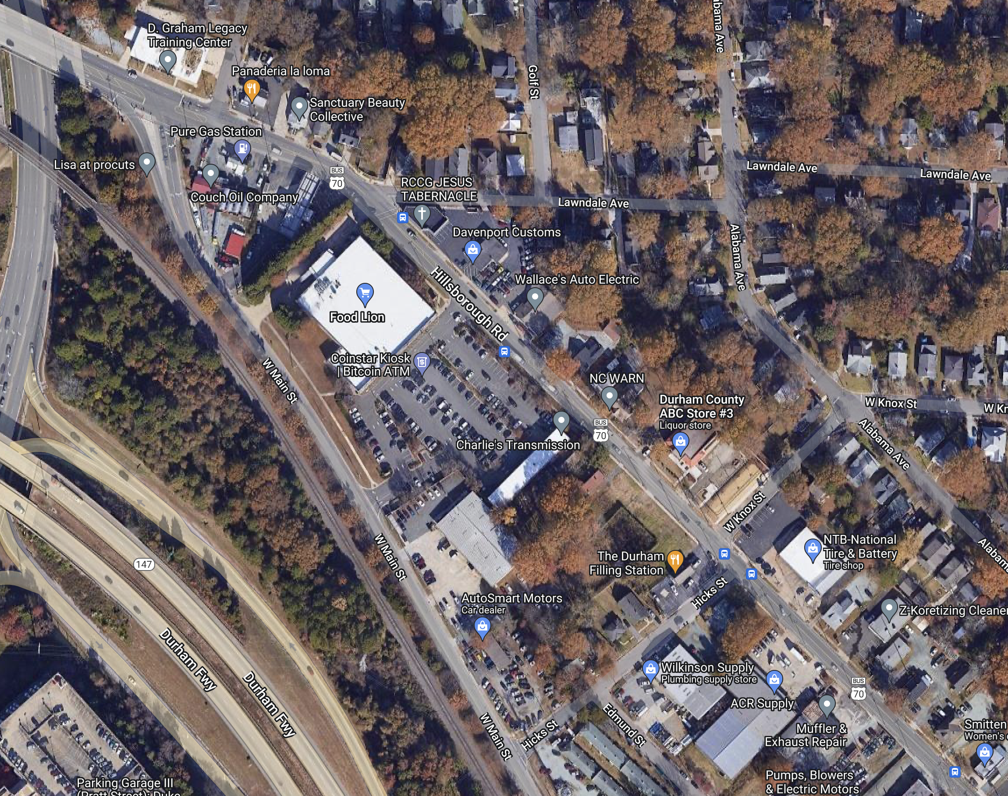
Level 1: Identify…
Houses
Commercial buildings
Road
Forest
Grass/fields
…from satellite data

Slide 3
Level 2: Is this a…
Farm
Suburban cul-de-sac
City street
Forest
Home
Commercial building
Grass/field
Trees
Road

Slide 4
Level 2: Is this a…
Farm
Suburban cul-de-sac
City street
Forest
Home
Commercial building
Grass/field
Trees
Road

Slide 5
Level 2: Is this a…
Farm
Suburban cul-de-sac
City street
Forest
Home
Commercial building
Grass/field
Trees
Road

Slide 6
Level 2: Is this a…
Farm
Suburban cul-de-sac
City street
Forest
Home
Commercial building
Grass/field
Trees
Road

Slide 7
Level 3: Is this area…
Farm | Farm | Farm | Farm | Farm
Farm | Farm | Farm | Farm | Farm
Farm | Farm | Farm | Farm | Farm
Farm | Farm | Farm | Farm | Farm
Farm | Farm | Farm | Farm | Farm
Urban
Suburban
Agricultural
Undeveloped

Slide 8
Level 3: Is this area…
Cul-de-sac | Cul-de-sac | Cul-de-sac | Cul-de-sac | Forest
Forest | City street | City street | City street | Forest
Cul-de-sac | Cul-de-sac | Cul-de-sac | Cul-de-sac | Farm
Cul-de-sac | Cul-de-sac | Cul-de-sac | Cul-de-sac | City street
Cul-de-sac | Cul-de-sac | Cul-de-sac | Cul-de-sac | City street
Urban
Suburban
Agricultural
Undeveloped

