Slide 1
Gradient Descent Example

Slide 2

Let’s try following the gradient

Slide 3
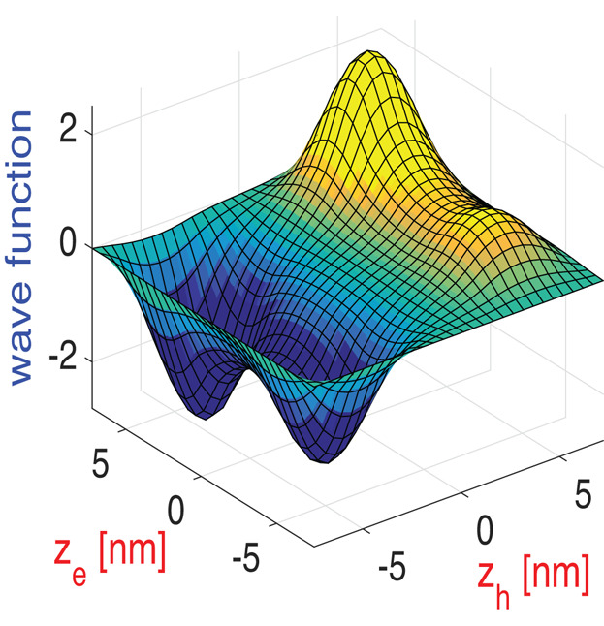
Another Example
Loss
Param 1
Param 2

