Slide 1
Activity: MLP Structure
ML for Health, Week 3
ANSWER KEY

Slide 2


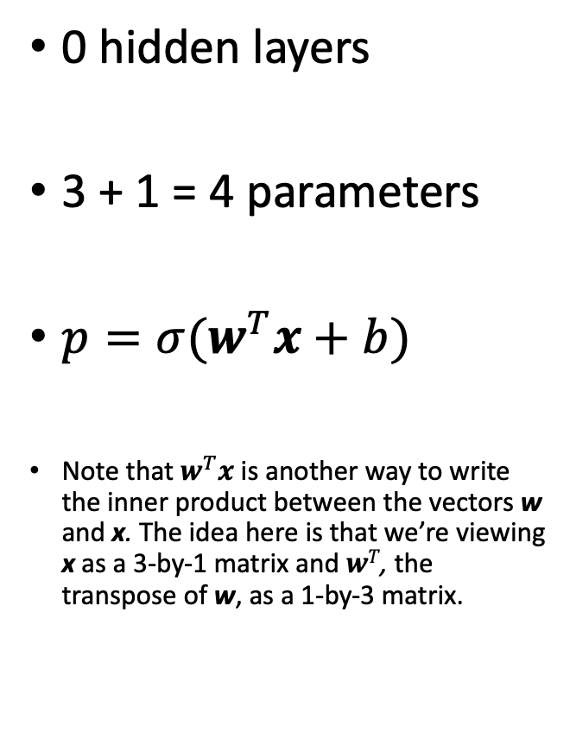
Logistic Regression
0 hidden layers
3 + 1 = 4 parameters
$p=σ(w^{T}x+b)$
Note that $w^{T}x$ is another way to write the inner product between the vectors w and x. The idea here is that we’re viewing x as a 3-by-1 matrix and $wT$, the transpose of w, as a 1-by-3 matrix.
$$p$$
$$σ$$
x
Notes:
So, let’s get to it.
Returning to our logistic regression model, we’re going to make yet another simplification to our diagram

Slide 3




Shallow MLP (with 𝜎 activations)
1 hidden layer of size 6
(3 x 6) + 6 + (6 x 1) + 1 = 31 parameters
$p=σ(w_{2}^{T}∗σ(W_{1}x+b_{1}) + b_{2})$
$$p$$
$$σ$$
h
$$σ$$
x
Notes:
So, let’s get to it.
Returning to our logistic regression model, we’re going to make yet another simplification to our diagram

Slide 4






Slightly Deeper MLP (with 𝜎 activations)
2 hidden layers, each of size 6
(3 x 6) + 6 + (6 x 6) + 6 + (6 x 1) + 1 = 73 parameters
$p=σ(w_{3}^{T}∗σ\left(W_{2}∗σ\left(W_{1}x+b_{1}\right)+ b_{2}\right)+b_{3})$
$$p$$
$$σ$$
$h_{2}$
$$σ$$
$h_{1}$
$$σ$$
x
Notes:
So, let’s get to it.
Returning to our logistic regression model, we’re going to make yet another simplification to our diagram

Slide 5












Which model contains more parameters?
$$p$$
$$p$$
$$σ$$
(6 x 1) + 1
+
(2 x 6) + 6
+
(6 x 2) + 2
+
(3 x 6) + 6
= 63 params
$$σ$$
(6 x 1) + 1
+
(6 x 6) + 6
+
(3 x 6) + 6
= 73 params
$h_{3}$
$h_{2}$
$$σ$$
$h_{2}$
$$σ$$
$h_{1}$
$$σ$$
$h_{1}$
$$σ$$
$$σ$$
x
x
Notes:
So, let’s get to it.
Returning to our logistic regression model, we’re going to make yet another simplification to our diagram

Slide 6








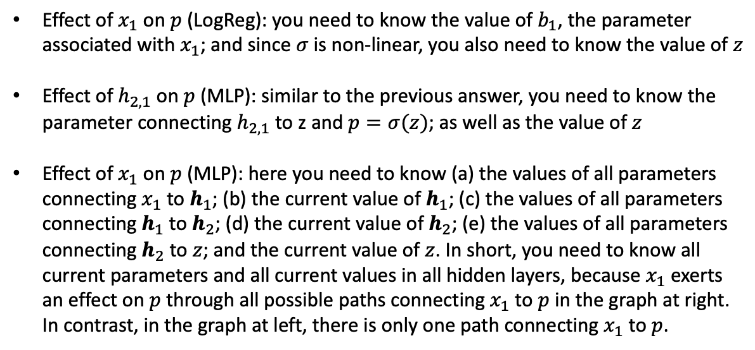


Effect of $x_{1}$ on $p$ (LogReg): you need to know the value of $b_{1}$, the parameter associated with $x_{1}$; and since $σ$is non-linear, you also need to know the value of $z$
Effect of $h_{2,1}$ on $p$ (MLP): similar to the previous answer, you need to know the parameter connecting $h_{2,1}$ to z and $p=σ(z)$; as well as the value of $z$
Effect of $x_{1}$ on $p$ (MLP): here you need to know (a) the values of all parameters connecting $x_{1}$ to $h_{1}$; (b) the current value of $h_{1}$; (c) the values of all parameters connecting $h_{1}$ to $h_{2}$; (d) the current value of $h_{2}$; (e) the values of all parameters connecting $h_{2}$ to $z$; and the current value of $z$. In short, you need to know all current parameters and all current values in all hidden layers, because $x_{1}$ exerts an effect on $p$ through all possible paths connecting $x_{1}$ to $p$ in the graph at right. In contrast, in the graph at left, there is only one path connecting $x_{1}$ to $p$.
$$p$$
$$σ$$
$h_{2}$
$$p$$
$$σ$$
$h_{1}$
$$σ$$
$$σ$$
$$x_{1}$$
x
$$x_{1}$$
x
Notes:
So, let’s get to it.
Returning to our logistic regression model, we’re going to make yet another simplification to our diagram

