Slide 1
Mpox Primer Monitor Workflow
Data Source
Nextclade Pipeline
GenBank Sequences
Data Transformation
Clade/Lineage Assignment
Variant Calling&Filtering
1
2
Overlaps Detection
Genomic Annotation
4
3
Variants&Primer Intersection
Impact Scoring Mechanism
Data Wrangling
Variants per Clade/Lineage
5
6
Genome Visualization
Tableau Dashboard
Variants&Primer Selection
IGV-HTML Reports
Variants per Geographic Location
Variants per Genomic Locus

Slide 2

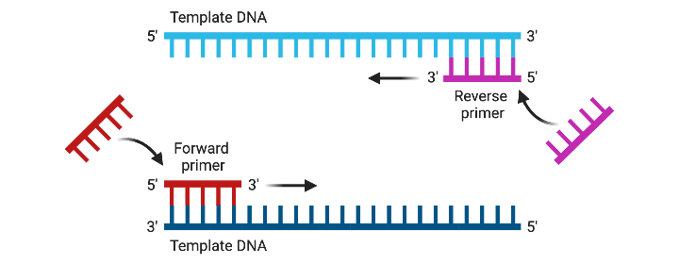
Variant Calling&Filtering
Impact Scoring Mechanism
Variants:
SNP < the mutated nucleotide >
Deletion < the deleted length - >
Insertion < the inserted length + >
Clusters:
ALL (all available sequences)
Each Clade
Sublineages (A*, B*)
Each Lineage
Filters:
≥5% frequency of SNP in cluster
≥2 absolute count of INDEL
Scores:
At 5’ (≤3bp) <SCORE = 1>
At 3’ (≤2bp) <SCORE = 2>
Near 3’ (2-5bp) <SCORE = 4>
Other position <SCORE = 3>
Multiplier for INDEL <SCORE * 10>
Exponent base for length <2^{SCORE}>
Range reduction <ln(2^{SCORE})>
Filters:
SCORE = 0 (no overlap) { 0,128,255 }
0<SCORE<1 (SNP at 5') { 255,128,0 }
SCORE > 1 (MNP/INDEL) { 255,0,0 }

