Slide 1
Analysis Wages in SF
Team members: Xu Deng Meng Hao Hsu

Slide 2
Agenda
Goals(One, Two, Three)
Use case
Data source
Methodology(Parsing and Cleansing Data, Machine Learning )
Acceptance criteria
Test case
Play framework UI

Slide 3
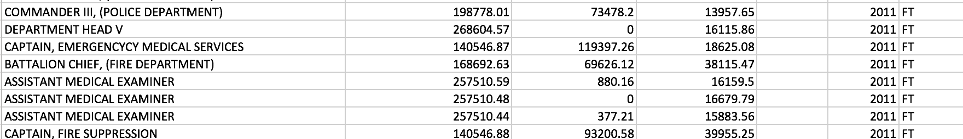
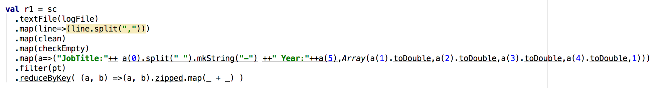
Goals One Divide Different Wages Level By Occupation
Same data
Will map the same job title together

Slide 4
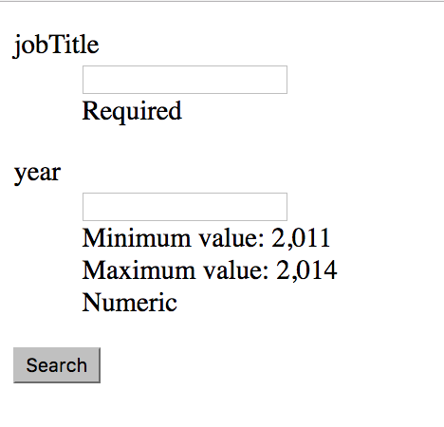
Goals Two User Can Search By Keywords

Slide 5
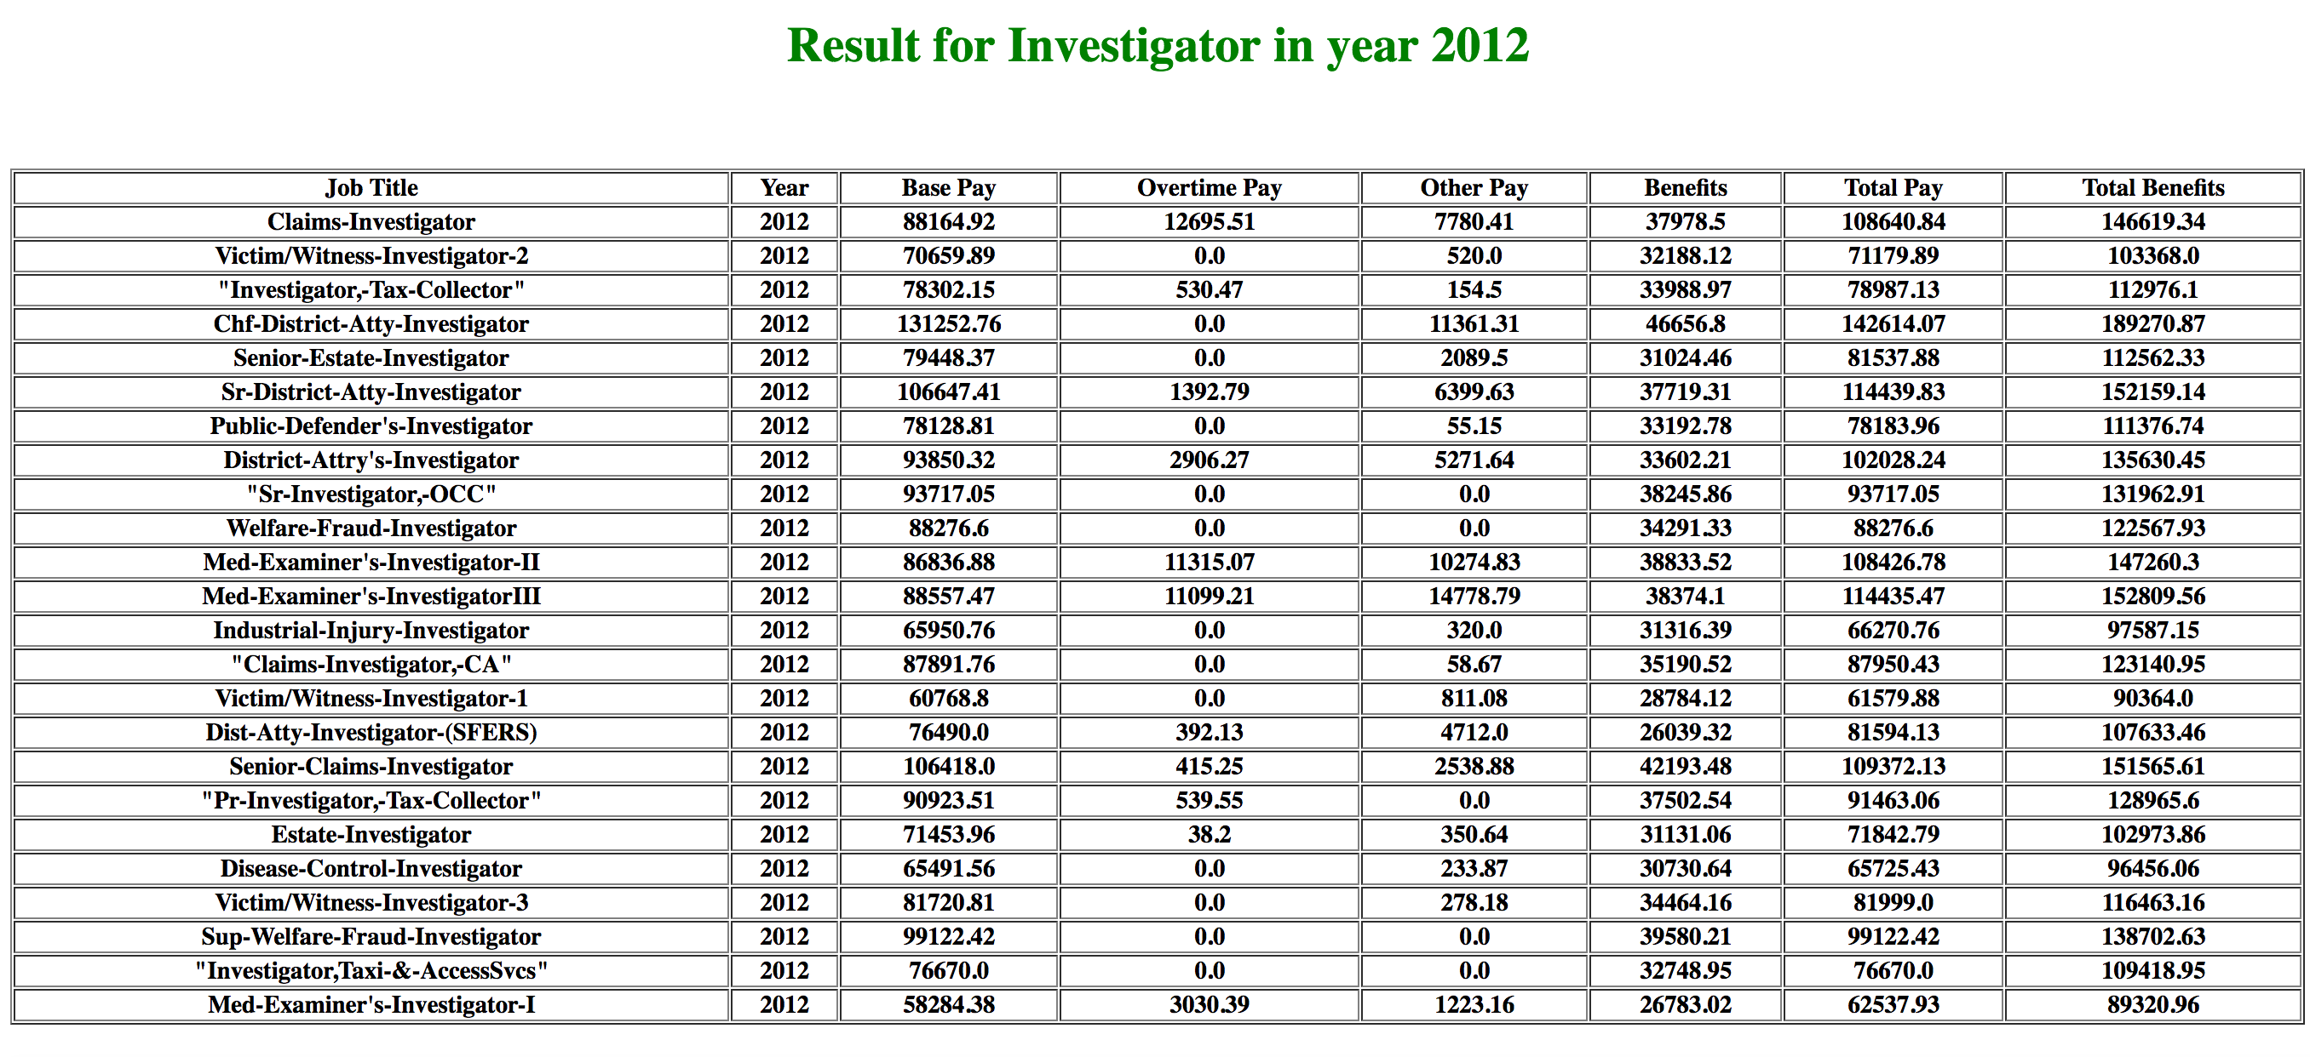
Goals Three User Should Get Helpful Information By Searching

Slide 6
Use case
For employer to gain business insight.
For employee to take references in salary negotiation.
For students and job-seeker to take into consideration in decision making.

Slide 7
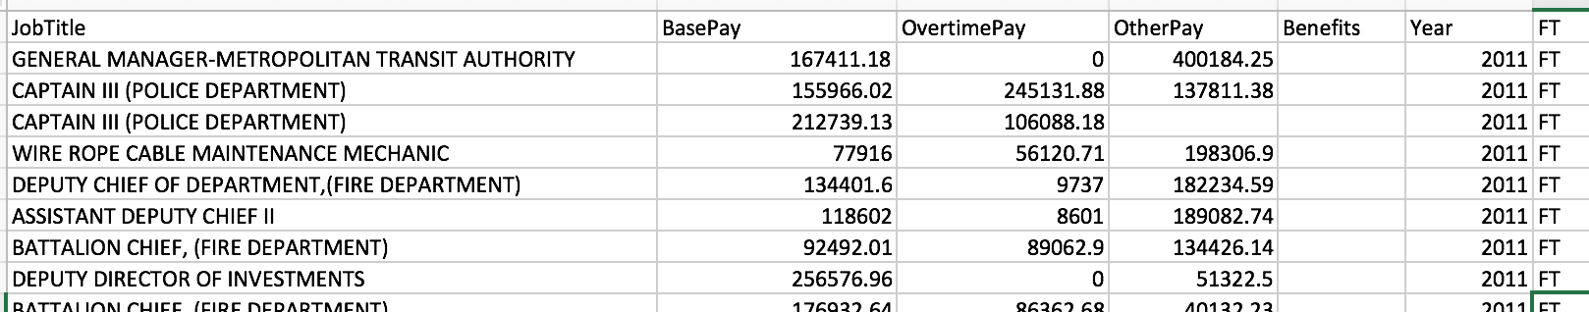
Data Source
Data source: One of the dataset from https://www.kaggle.com/kaggle/sf-salaries.
Show wages from 2011 to 2014 in San Francisco.
More than 150K employees in the dataset.
Notes:
Different city

Slide 8
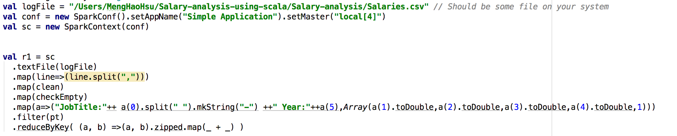
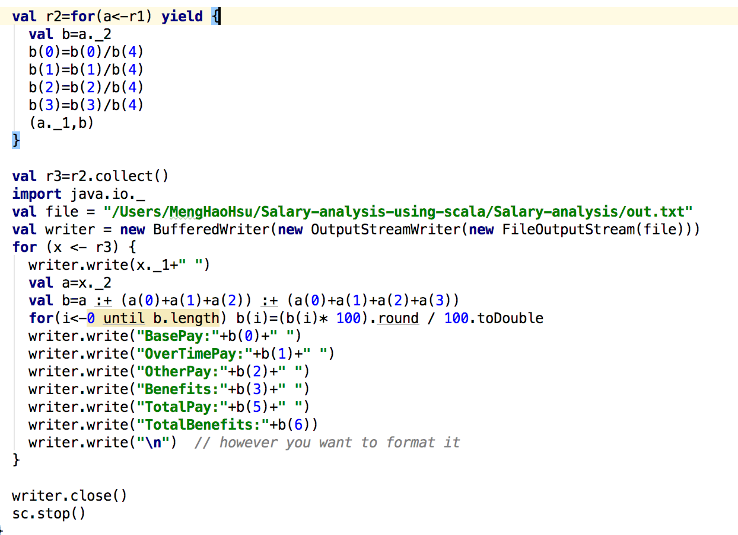
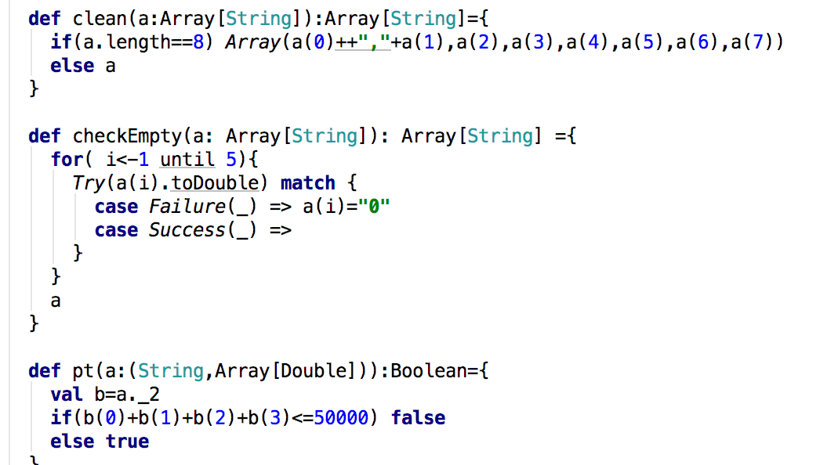
Methodology- Parsing and Cleansing Data
Read File
Write new File
Cleansing
Notes:
linear regression, logistic regression, k means cluster

Slide 9
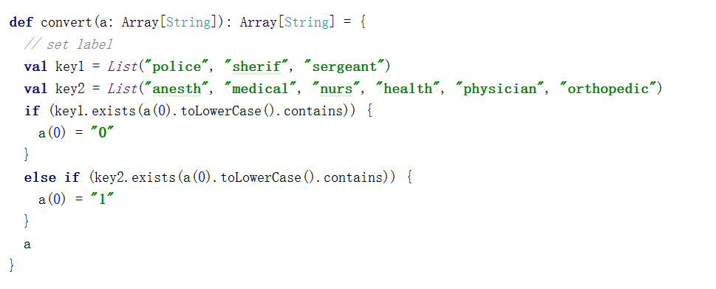
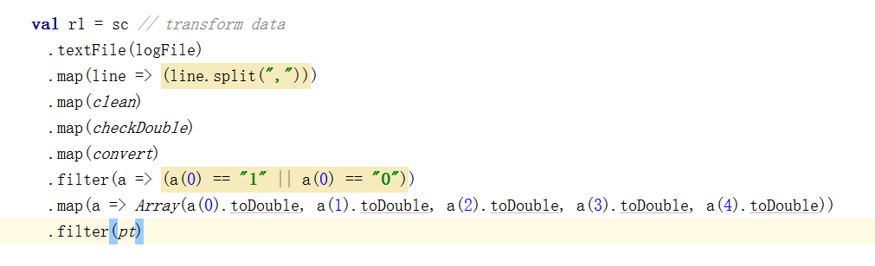
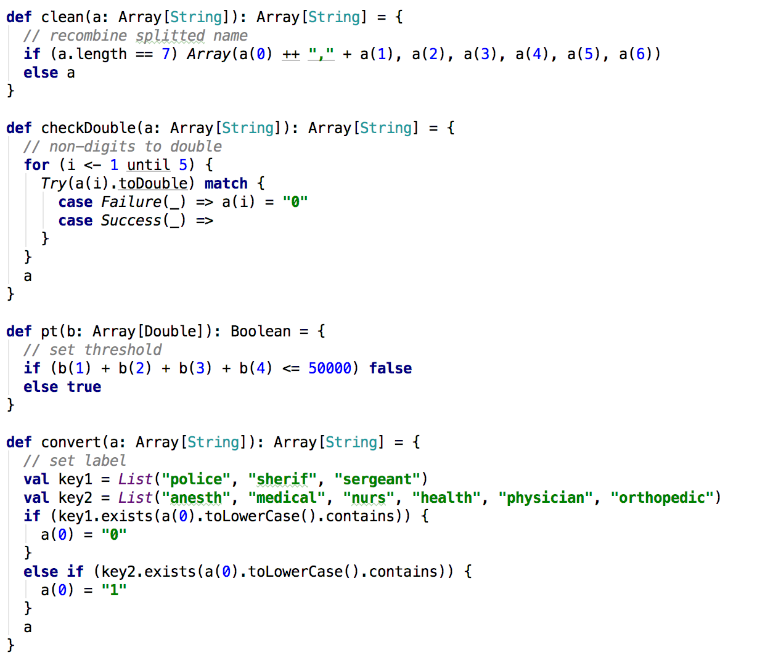
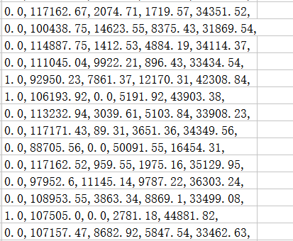
Methodology- Machine Learning
Set label for Police(0) and Medical(1) data
Apply method
Get the data
Method Detail

Slide 10
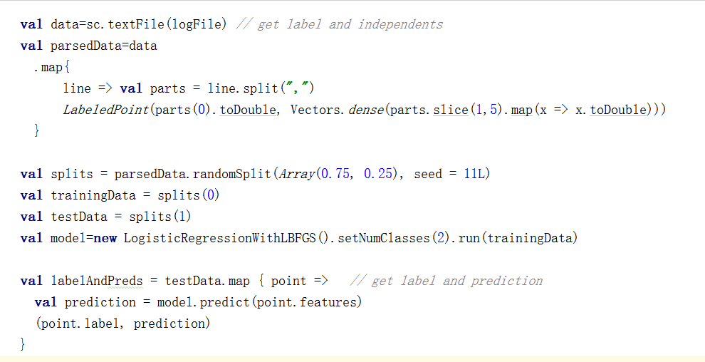
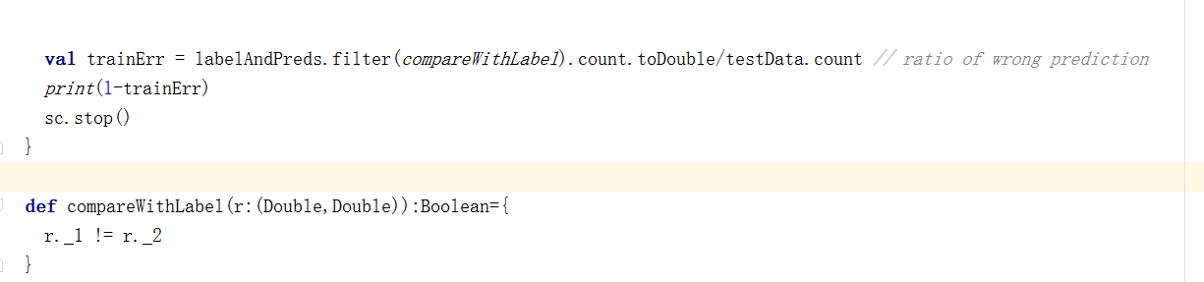
Acceptance Criteria
Read data and parse to standard format, train the model, compute accuracy:
70.449%

Slide 11
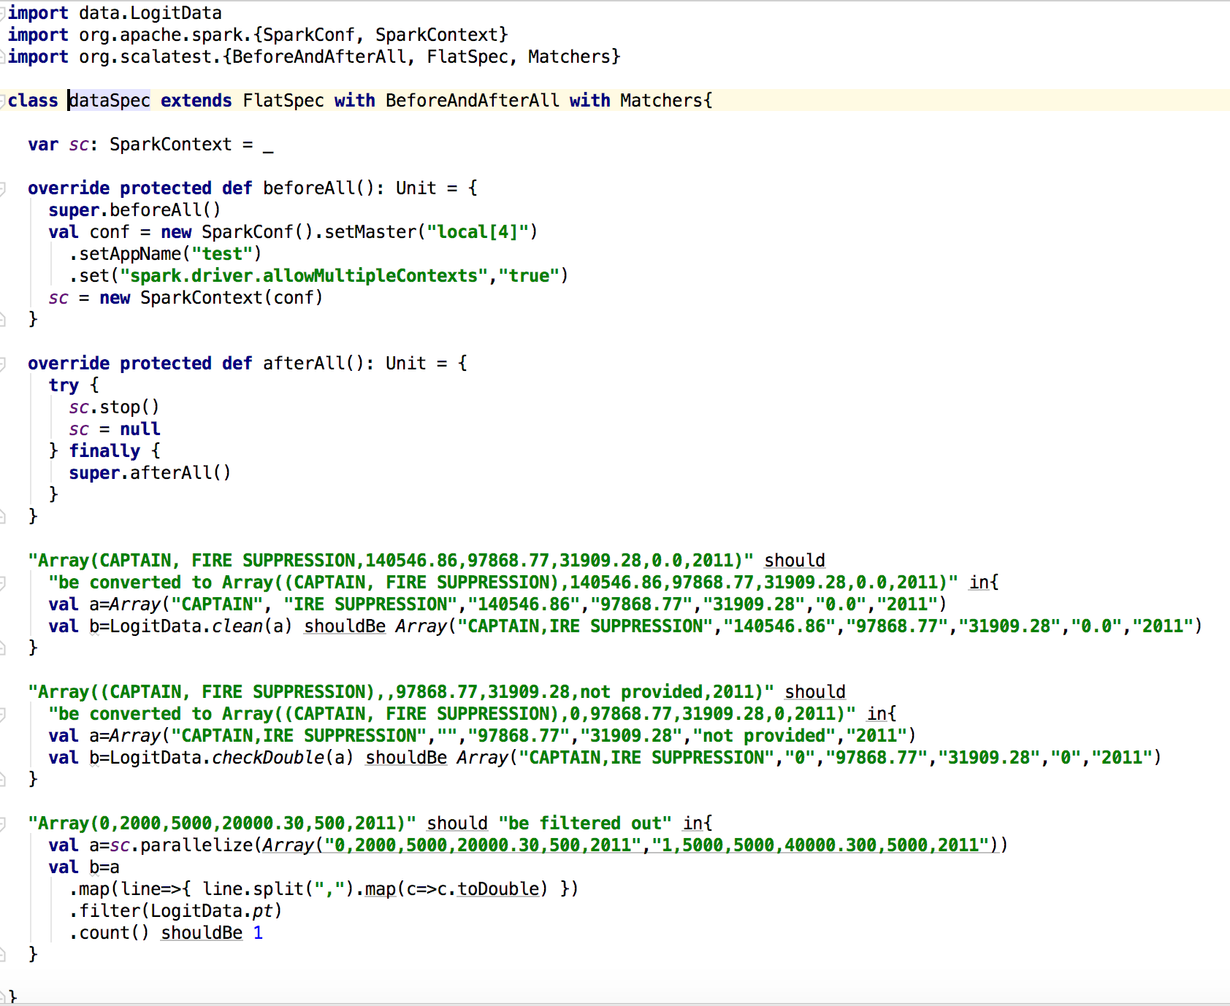
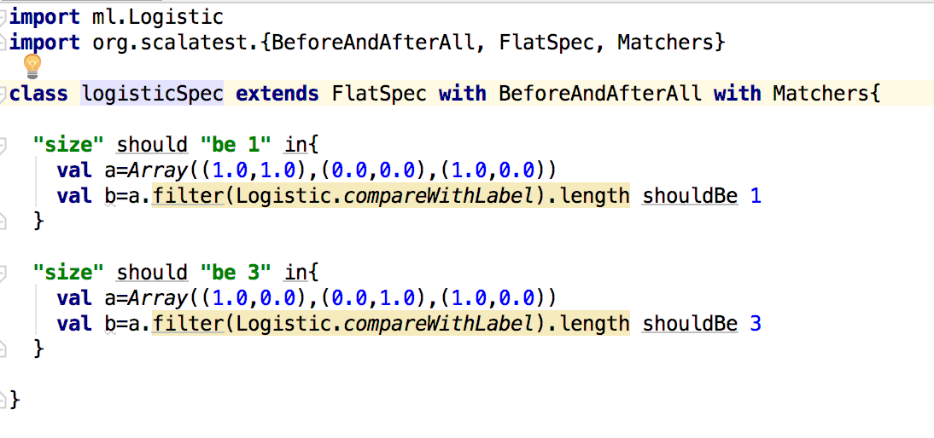
Test Case
dataSpec.scala
logistic.scala

Slide 12
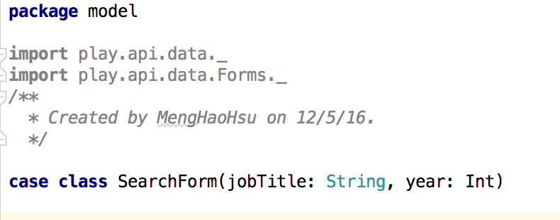
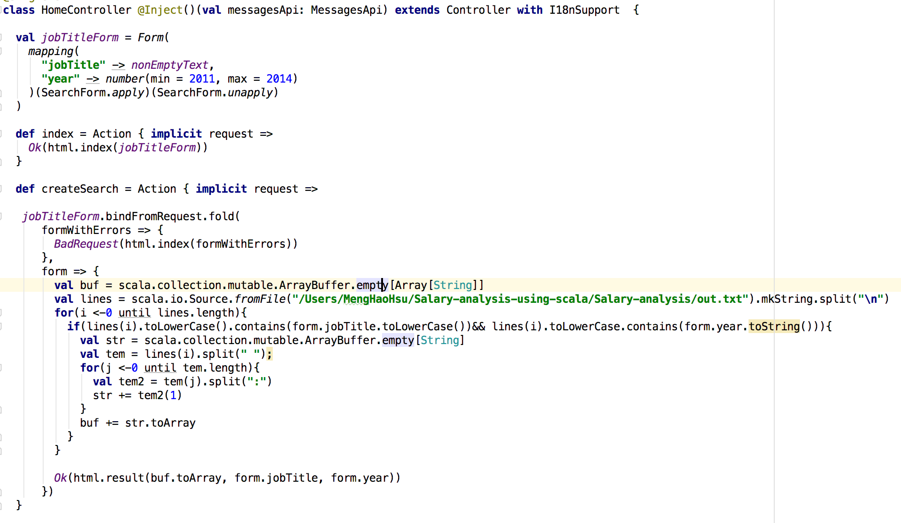
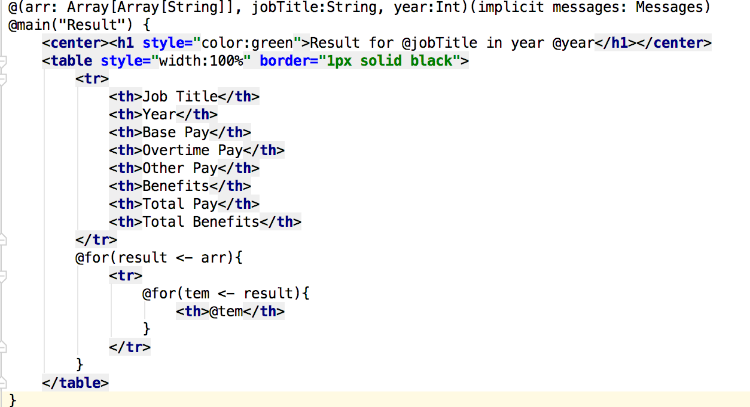
Play Framework ui
M
C
V

Slide 13
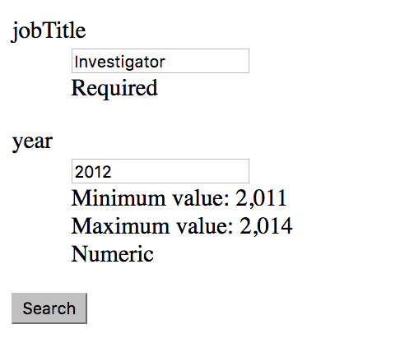

Slide 14
Thank you!

