Slide 1

9th IPP:
Online Optics Laboratory
Gong, Lifan
Chen, Zhengxu
Fan, Yiming
2014.9.23

Slide 2
Contents
Backgrounds
1
Product Intro.
2
Simulation
3
Future Improvements
4

Slide 3
1
Backgrounds
Optics Softwares
Powerful and exquisite…
But expensive!
Not designed for elementary demonstration…
For those ordinary users…
Need a simple and effective application!

Slide 4
2
Product Introduction
Web framework: Why Django & python?
Open source (easy to obtain)
Various libraries dedicated for computing…
E.g. numpy, matplotpy, openGL
Powerful interfaces
Programmers and engineers friendly
Django :a python based web application framework
Perfect match!
Easy to build & maintain

Slide 5
2
Product Introduction
Our server structure
Django as framework
nginx as server
MySQL database to store data
Some HTML templates

Slide 6
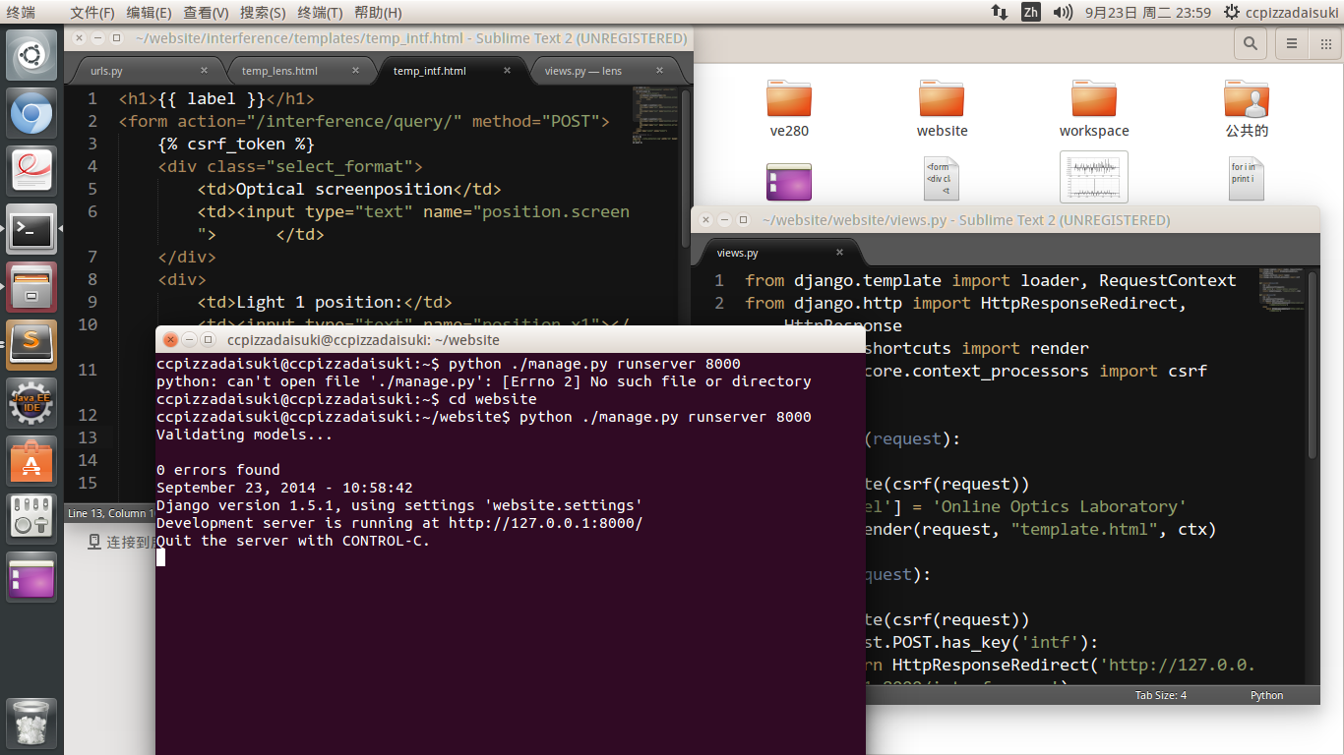
2
Product Introduction
More than 600 lines of python and HTML codes…

Slide 7
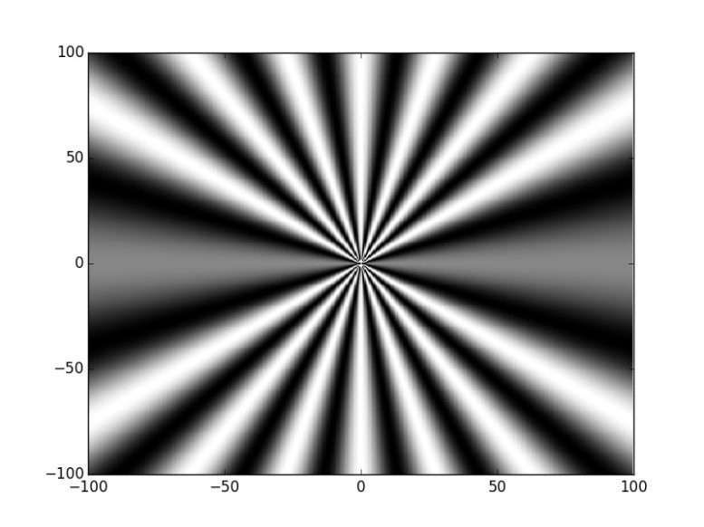
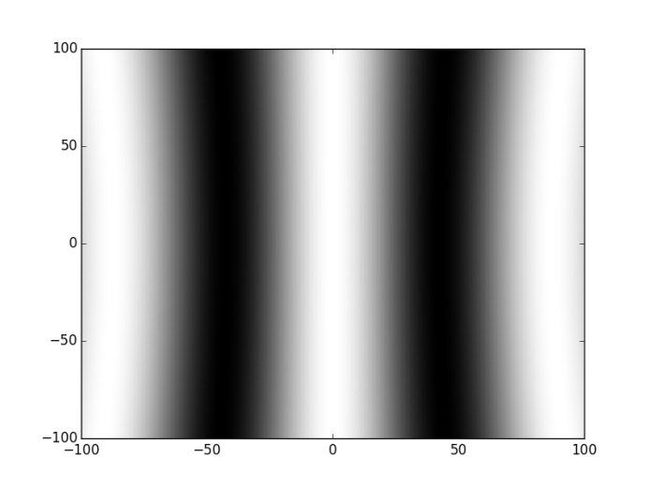
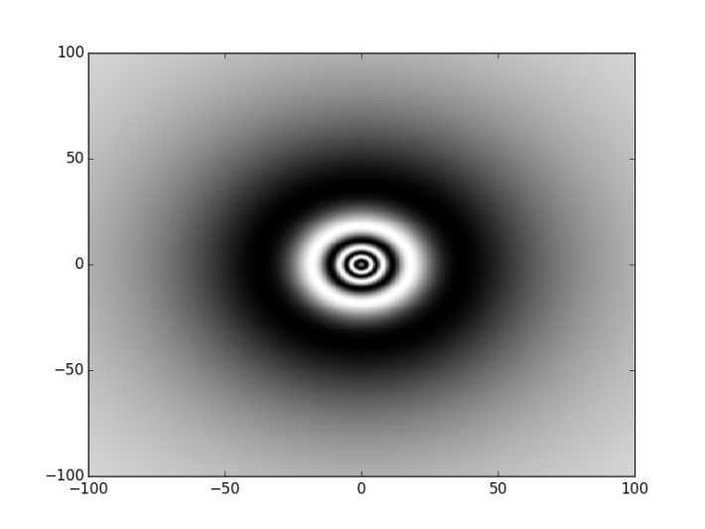
2
Product Introduction
Main functions
Interference, and…
Lens imaging

Slide 8
3
Simulation

Slide 9
4
Future Improvements
1
More sophisticated UI
2
More powerful realization (e.g. 3D plot)

Slide 10
Thanks for
watching!

