Slide 1



XIA: An Architecture for Evolvable Internet
Carnegie Mellon University
University of Wisconsin-Madison
Boston University

Slide 2

XIA: End-point and Network Evolution
Server
DIY
Client
DIY
Service
Service
Content
Network
Content
Host
Host
Multiple types of identifiers
Notes:
This demo will introduce you to XIA. One of the key things that set apart XIA is that XIA supports evolution in various parts of the network.

Slide 3

End-point Evolution
Server
DIY
Client
DIY
Service
Service
Content
Content ID
Content
Host
Host
Multiple types of identifiers
CID
HID
Intent
Fallback
Backwards compatible address

Slide 4

End-point Evolution (Demo)
Deployment on GENI (4 nodes)
Server
Client
(HTTP-XIA Proxy)
DIY
DIY
Service
Service
Content
Host
Content
Host
Network only support host-based forwarding
Host
Multiple types of identifiers
Host
CID
SID
HID
HID
Fallback
Fallback
Backwards compatible address
Notes:
End-points can evolve first without having to wait for network upgrades.

Slide 5
Network Evolution
Content requests served from cache
DIY
DIY
Service
Service
Content
Service
Content
Host
Host
In-network Content support
Host
Multiple types of identifiers
Content
cache
Host
CID
SID
HID
HID
Fallback
Fallback
Backwards compatible address

Slide 6
Service Migration
DYI
DYI
Service
Service
Content
Content
Host
Host
Multiple types of identifiers
SID
HID
Fallback

Slide 7
Posters/Demo
Deployment strategies over IP
XIA cloud/islands can be easily deployed on existing IP networks
Forwarding performance of XIA
XIA forwarding speed is comparable to that of IP
Project overview and prototype description

Slide 8
Network Evolution
Content requests served from cache
DIY
DIY
Service
cache
Service
Content
Content
Content
Host
In-network Content support
Host
Host
Multiple types of identifiers
Content
cache
Host
CID
SID
HID
HID
Fallback
Fallback
Backwards compatible address

Slide 9
Service Migration
DYI
DYI
Service
Service
Content
Content
Host
Host
SID
HID1
SID
HID
Fallback
HID2
SID

Slide 10
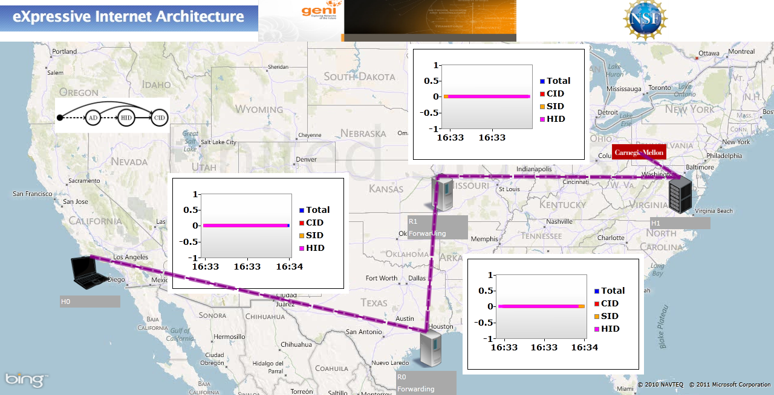
End-point Evolution

