Slide 1

Vaccine Passport
Mengjia Xu

Slide 2
Requirement
Vaccine inventory management;
Person identity definition;
Vaccination happens at someplace and sometime;
A certification is issued to the person and is recognized anywhere in the world;
Showing the certification anywhere it is required for poof of required protection (we call this the verification step).

Slide 3
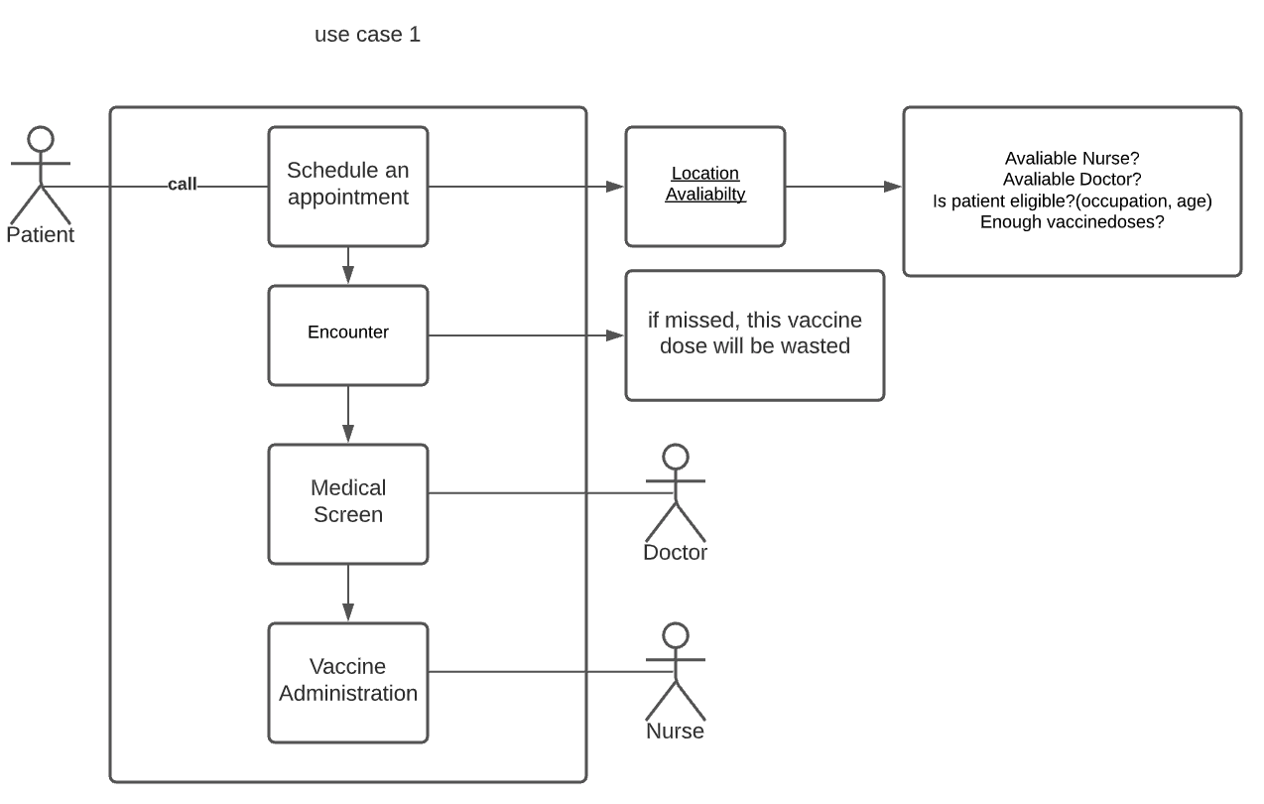
Use Case 1: get shot

Slide 4
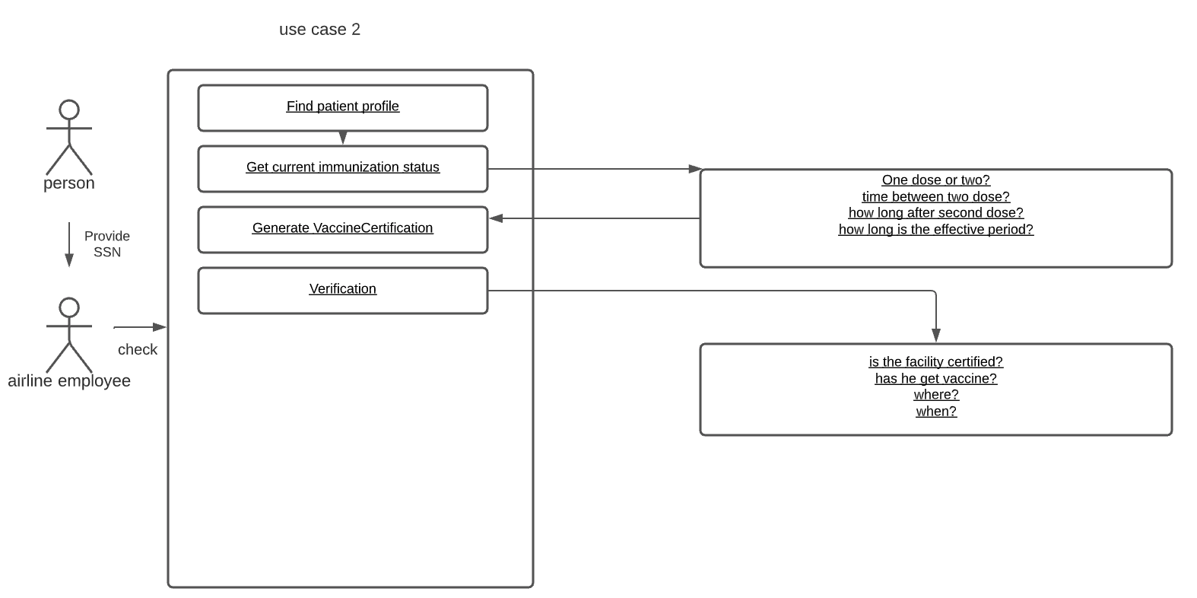
Use Case 2: Search & Verify Certification

Slide 5
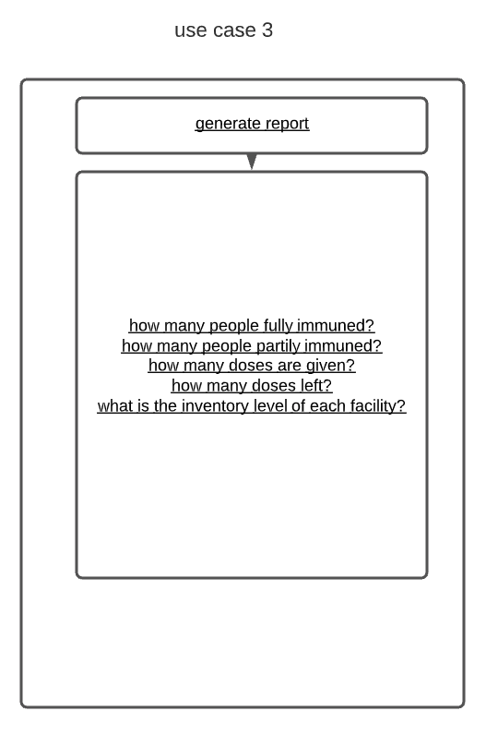
Use Case 3: Generate Report

Slide 6
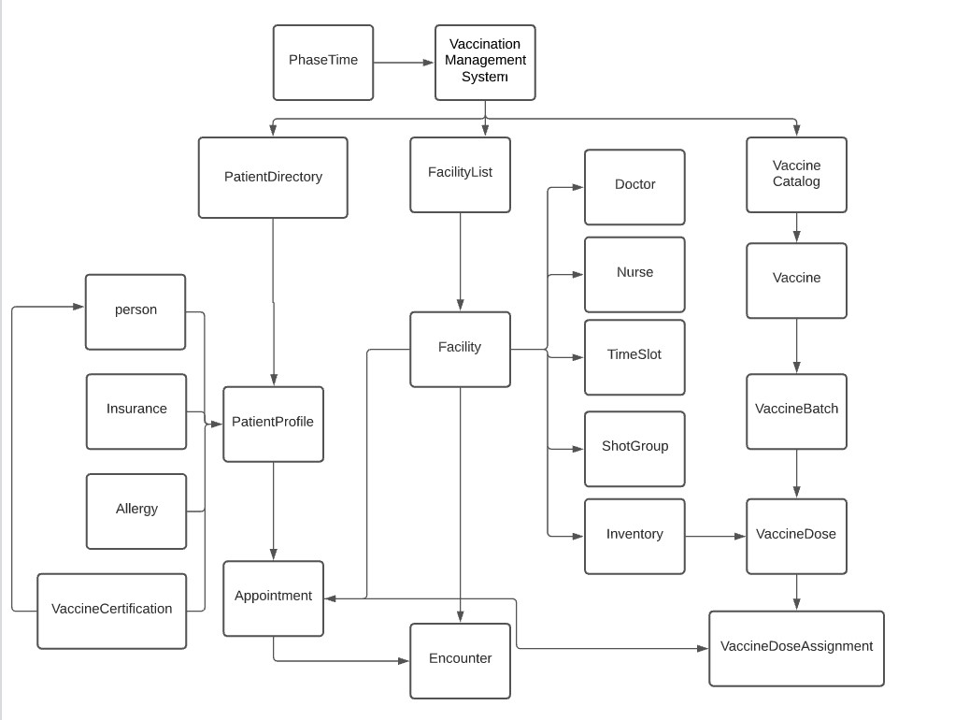

Slide 7
