Slide 1
AI Performance Advisor Automatic Software Performance Tuning Using AI Techniques
Li Guang Cheng
liguangc@cn.ibm.com
IBM China Research Lab

Slide 2
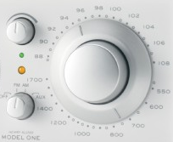
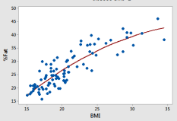
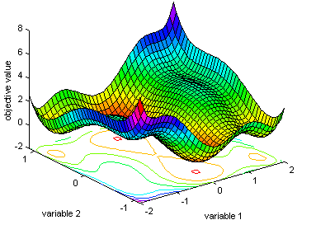
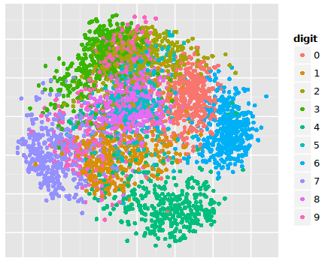
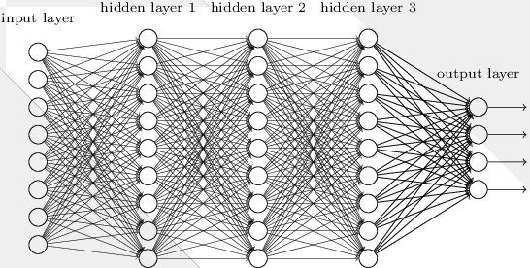
Automatic software performance tuning and AI techniques
Automatic Performance Tuning
Software tunes software, automatic tuning, autotuning
Was mainly driven by HPC
AI is a new use case
White-box vs Black-box
ML/DL Techniques
Bayesian Optimization
Deep Reinforcement Learning
Training
Existing evaluation data
Learn the pattern between tunable parameters and performance metrics
Inference
Predict the optimal configuration
Objective function??
Performance metrics as Dependent variables
Tunable parameters as Independent variables
Machine Learning & Deep Learning to learn the patterns

Slide 3

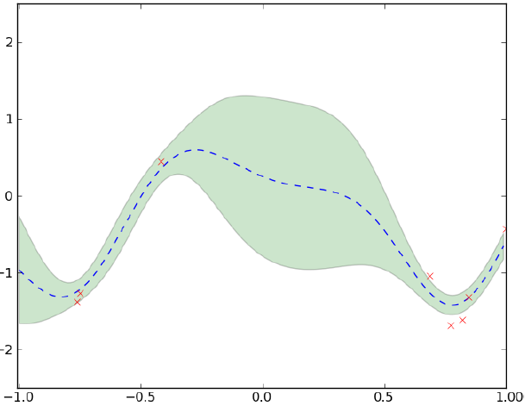

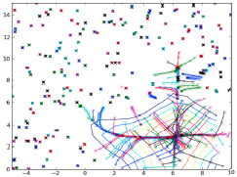





Automatic software performance tuning – Iterative Approach
Why Iterative?
Expensive evaluation
Guide the sampling
Speed up convergence
Configure Engine
Iteration
Input
Advisor
Training
Inference
Configure
Evaluate
Data augment
Target System
Tunable parameters
Performance metrics
Environment
Knowledgebase or users input
Controller
Observation Engine
Prior Data

Slide 4
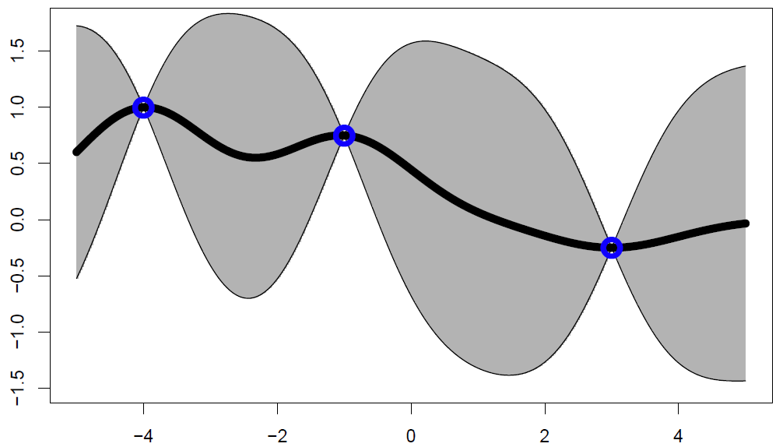
What is Bayesian Optimization?
Definition
Bayesian optimization is a sequential design strategy for global optimization of black-box functions that doesn't require derivatives.
Historical Overview
Closely related to statistical ideas such as Gaussian Process
Studied first by Kushner in 1964 and then Mockus in 1978
Started receiving serious attention in the current AI wave since 2007
Interest exploded when it was realized that Bayesian optimization provides an excellent tool for finding good ML hyperparameters
Being used widely in auto machine learning, emerging as a tool in generic global black-box optimization cases
Iterative Logic
Build a probabilistic model for the objective, and compute the posterior predictive distribution
Use GP to fit the existing performance metric data
Optimize a proxy function(Utility Function, Acquisition Function) based on the posterior predictive distribution
Select the next point to evaluate based on the acquisition function
Augment the data and update GP
Continue the loop until some criteria is met
Gaussian Process
History of how past parameters have performed
Bayesian Optimization
New, optimal parameters
Evaluate the new, optimal parameters
Bayesian Optimization

Slide 5
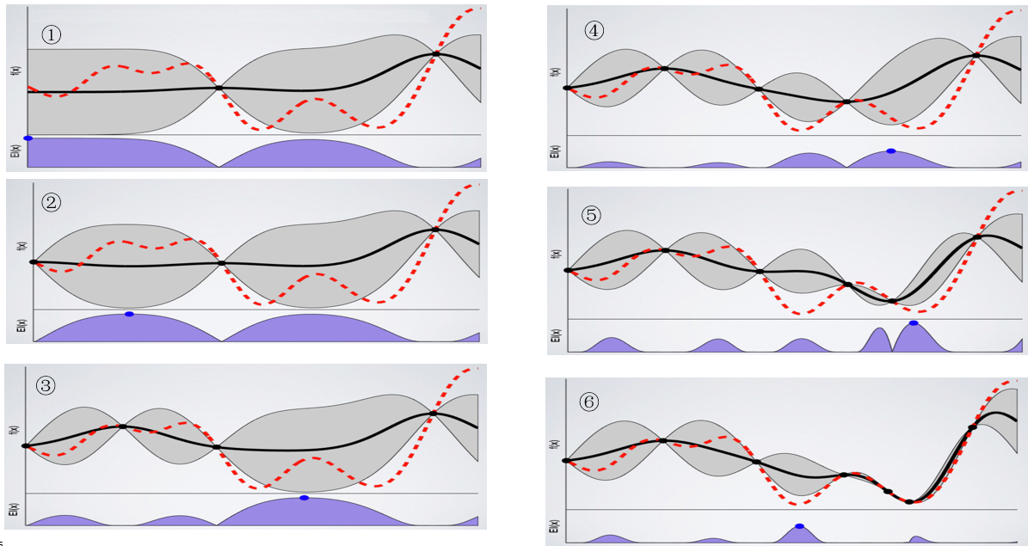
Bayesian Optimization illustration

Slide 6
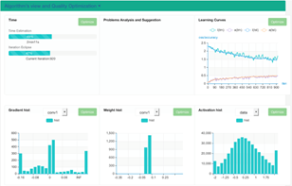
AI Performance Advisor
Overview
Automatic performance tuning toolkit, using AI techniques
For any application, from simple client-server system to complex distributed applications
Black-box derivative-free optimization
Cross-layer tunables and metrics
Iterative sampling->training->inference cycles
Coding-free experiments
Use cases
Better performance with factory defaults
Performance optimization on new customer deployments, or after configuration changes
Online performance tuning
UI
Tuning Guide
[ ] tweak job parallelism
[ ] granularity of jobs
[ ] increase CPU
[ ] increase memory
[ ] decrease CPU
[ ] decrease memory
[ ] affinity vs. anti-affinity
[ ] reduce interference
[ ] enable CPU binding
[ ] ...
AI Performance Advisor
Fusing
models
Training
Reasoning
Inference
Advising
Tuning
application metrics
qps, latency, etc.
application tunables
container configuration
platform metrics
workload metrics & logs
workload patterns ...
scheduling parameters
affinity, ...
system metrics
system logs
cgroups tuning
smt toggling
Workload
Platform
Linux
Hardware Systems

Slide 7





How it works
Define the configurations that can be tuned
Parameter1: value1, value2,
Parameter2: string1,string2
Parameter3: x <= value <= y
How to configure the parameters
Optimal parameters:
Parameter1=value1
Parameter2=value2
Parameter3=…
…
ParameterX=…
Performance metrics:
metric1 = value1
metric2 = value2
metric3 = value3
Launching
output
Define how to benchmark
Tune the configuration and initialize the environment
Run the benchmark1/ benchmark2/benchmark3 etc
Finalize the tuning results with calculating different benchmark results with weight
Clean up environment
AI Performance Advisor
Define exit criteria
How many iterations to run
How much time we have to run the autotune
Tuning/Iterating
Finalized Configurations
Input

Slide 8
Deployment Topology
Systems
AI performance advisor node(service node)
Target system to be optimized(client system)
Components
Configuration file
Optimization engine
Config agent
Monitor agent
Benchmark tool
Controller
Logic
① Controller reads and parses the configuration file
② Gets tunable parameters suggestion from optimization engine
③ Config the tunable parameters to the target system through config agent on the nodes
④ Gets performance metrics through the monitor agent on the benchmark node
⑤ Augment the new performance metric to optimization engine
⑥ Repeat the steps 2, 3, 4 and 5 until a predefined condition is met
Tunable Parameters
Optimization Engine
Perf Metrics
①
②
⑥
⑤
Experiment Setup
Controller
Configuration File
AI Performance Advisor
Target system
④
③
Benchmark Node
Benchmark Tool
Monitor Agent
④
Config Agent
Config Agent
Application Instance
Application Instance
Worker Node1
Worker Node2

Slide 9
Use cases and Examples

Slide 10
Automatic Performance tuning for nginx service in ICP (1/2)
Tunable Parameters
nginx worker_processes (1 – 64)
nginx worker_connections (100 – 1024)
nginx keepalive_requests (100 – 1024)
Performance metrics
throughput(Requests per second)
Cluster Configuration
ICP 2.1.0.1
nginx 1.18.3
VMs: 4C/8G
Noisy neighbors, thus noisy performance data
No GPU or FPGA
Logic
① Connects to ICP API and get the service/PODs information
② Gets tunables suggestion from BO engine
③ Config the tunables to the nginx instances through action agent on the nodes
④ Gets performance metrics through the monitor agent on the web client node
⑤ Feeds the new performance metric to BO engine
⑥ Repeat the steps 2, 3, 4 and 5 until a predefined condition is met
Tunable Parameters
Bayesian Optimization Engine
Perf Metrics
②
⑥
⑤
ICP Env Config
Control Logic
Observation Daemon
Action Daemon
Configuration File
AI Advisor
Target system
④
①
③
Web Client Node
Web Benchmark Tool
Monitoring Agent
ICP Load Balancer
ICP Master Node
ICP API
ICP Worker Node1
ICP Worker Node2
Nginx Instance
Nginx Instance
Action Agent
Action Agent
Notes:
① ② ③ ④ ⑤ ⑥ ⑦ ⑧ ⑨ ⑩ ⑪ ⑫ ⑬ ⑭ ⑮ ⑯ ⑰ ⑱ ⑲ ⑳

Slide 11
Automatic Performance tuning for nginx service in ICP (2/2)
Configuration File
name: "nginx-demo" parameters: - name: "worker_processes" type: "int" min: 1 max: 64 configCmd: "sed -i 's/worker_processes.*/worker_processes $var;/' /etc/nginx/nginx.conf" configTarget: podContainers - name: "worker_connections" type: "int" min: 100 max: 1024 configCmd: "sed -i 's/worker_connections.*/worker_connections $var;/' /etc/nginx/nginx.conf" configTarget: "podContainers" - name: "keepalive_requests" type: "int" min: 100 max: 1024 configCmd: "sed -i 's/keepalive_requests.*/keepalive_requests $var;/' /etc/nginx/nginx.conf" configTarget: "podContainers" postHook: "/etc/init.d/nginx reload" metrics: - name: "qps" benchmarkClient: "9.186.106.204" benchmarkCmd: "ab -k -t 60 -c 100 -n 5000000 http://10.0.189.6:30291/ 2>/dev/null | grep \"Requests per second\" | awk '{print $4}'" weight: 1024 icpEnv: k8s_endpoint: "https://9.186.106.205:8001" k8s_namespace: "default" k8s_servicename: "my-nginx" k8s_token: "eyJhbGciOiJSUzI1NiIsInR5cCI6IkpXVCJ9.eyJpc3MiOiJrd…" exitCriteria: duration: “24hours" maxIterations: 200
Testing Result
Bayesian Optimization:
Run 200 iterations in 224 minutes
Found the “best” parameters in 27 iteration, uses 26 minutes
Suggested Tunable parameters:
> worker_processes = 3
> worker_connections = 100
> keepalive_requests = 555
Performance Improvements
> With default parameters: 5934.36 QPS
> With suggested parameters: 9019.28 QPS
> Improvement: 52%
Random Search
Run 200 iterations in 212 minutes
Found the “best” parameters in 62 iteration, uses 66 minutes
Suggested Tunable parameters:
> worker_processes = 3
> worker_connections = 670
> keepalive_requests = 886
Performance Improvements
> With default parameters: 5934.36 QPS
> With suggested parameters: 8487.65 QPS
> Improvement: 43%
Analysis(BO vs Random)
BO converges much faster
BO gets better performance metric
BO uses a little bit more computing time(5%)

Slide 12
Automatic Performance Tuning for ICP Ingress Controller - Configuration
Cluster Configuration
ICP 3.1
3 master nodes (8C 16G VM)
3 proxy nodes (8C 16G VM)
80 worker nodes(8C 16G VM)
10 vegeta client nodes(32C 128GB baremetal)
1000 backend nginx PODs
AI Performance Advisor Deployment
config_agent daemonset on all proxy nodes
monitor_agent deployment with 1 POD
advisor deployment with 1 POD
Benchmark Settings
Benchmark target: the ingress URL for the 1000 nginx PODs(http://icp-master-ligc.sl.cloud9.ibm.com/s1)
Each vegeta client sends 10000 requests per second
All 10 vegeta clients runs benchmark in parallel
Last for 90 seconds
Ingress Controller Tunable Parameters:
worker_processes: 1 – 128
worker_connections: 100 – 65536
keepalive_requests: 100– 65536
Linux Kernel Parameters
net.core.somaxconn: 100 – 65536
net.ipv4.tcp_max_tw_buckets: 65536 – 1440000
net.ipv4.tcp_max_syn_backlog: 512 – 3240000
net.ipv4.tcp_tw_reuse: 0,1
net.ipv4.tcp_tw_recycle: 0,1
net.ipv4.tcp_fin_timeout: 10 - 60
net.ipv4.tcp_slow_start_after_idle: 0,1
net.ipv4.tcp_low_latency: 0,1
100 iterations
Notes:
numaMemoryInterleave yes|no
nsdRAIDSmallBufferSize 4k ~ 1024k
nsdMaxWorkerThreads 512 ~ 8192
nsdRAIDSmallThreadRatio 0 ~ 20
nsdRAIDThreadsPerQueue 1 ~ 128
nsdRAIDFastWriteFSDataLimit 0 ~ (8192*1024)
nsdRAIDFastWriteFSMetadataLimit 0 ~ (8192*1024)
nsdRAIDFlusherBuffersLowWatermarkPct 1 ~ 90
nsdRAIDFlusherBuffersLimitPct 1 ~ 90
nsdRAIDFlusherTracksLowWatermarkPct 1 ~ 90
nsdRAIDFlusherTracksLimitPct 1 ~ 90
nsdRAIDFlusherFWLogHighWatermarkMB 16 ~ 65536
nsdRAIDFlusherFWLogLimitMB 64 ~ 262144
nsdRAIDFlusherThreadsLowWatermark 1 ~ 512
nsdRAIDFlusherThreadsHighWatermark 1 ~ 512
nsdRAIDBlockDeviceMaxSectorsKB 64|128|256|512|1024|2048|4096|8192|16384
nsdRAIDBlockDeviceNrRequests 32|64|128|256|512
nsdRAIDBlockDeviceQueueDepth 16|32|64|128|256
nsdMultiQueue 2 ~ 512
scatterBufferSize 32K ~ 8192k
maxMBpS 1024~16000
nspdQueues 64 ~ 1024
nsdRAIDTracks 64k 96k 128k 160k 192k 224k 256k
nsdRAIDBufferPoolSizePct 50~90

Slide 13
Automatic Performance Tuning for ICP-Ingress-Controller - Result
Significant improvements over the baseline number
Baseline QPS with default parameters: 3047
Autotuning QPS: 4980
Improves: 60%
Converge in 20 iterations in 2 hours
Consider <dimensions>*2 as the minimal iterations

Slide 14
Automatic Performance Tuning for ICP Ingress Controller – Analysis
Parameters | Suggested
worker_connections | 100
worker_processes | 1
keepalive_requests | 65536
net.ipv4.tcp_slow_start_after_idle | 1
net.ipv4.tcp_tw_recycle | 0
net.ipv4.tcp_fin_timeout | 34
net.ipv4.tcp_max_syn_backlog | 512
net.ipv4.tcp_tw_reuse | 0
net.core.somaxconn | 100
net.ipv4.tcp_low_latency | 0
net.ipv4.tcp_max_tw_buckets | 65536
Top 3 Parameters:
tcp_fin_timeout
worker_processes
tcp_max_tw_buckets

Slide 15

Automatic Performance Tuning for GPFS Mestor - Configuration
Hardware
6 x3650m4 nodes(99GB memory, 8 SAS disks per node, 16 logic processors per node, 2.7GHz CPU frequency)
1 10GB ethernet adapter per node
Mestor configuration
36 disks as RAID for data and meta data(2 as replace threshold)
12 disks as RAID for logtip(1 as replace threshold)
2MB as blocksize and 4K checksum granularity for logTip
4 way replication + 2MB blocksize + 4K checksum granularity for log
4 way replication + 1MB blocksize + 32K checksum granularity for meta disks
4+2P + 8MB blocksize + 32K checksum granularity for data disks
Note: cluster is configured with mmvdisk.
Spectrum Scale File System configuration
system pool with 1MB blocksize
data pool with 2MB blocksize
data replica 1 and meta replica 1
mpi
IOR
IOR
IOR
IOR
IOR
IOR
IOR
IOR
IOR
IOR
IOR
IOR
IOR
IOR
IOR
IOR
IOR
IOR
IOR
IOR
IOR
IOR
IOR
IOR
Spectrum Scale
Mestor(Declustered RAID)
10Gb Ethernet
4 among those 36 disks for data and meta data were broken before testing
32 disks valid; considering 4+2P, around 21.44 disks for real IO
SAS disk: IOPS is 120 for sequential 4K DIO; 150MB throughput for sequential 2M IO
The maximal throughput for large IO WRITE is 150 MB * 21.44 ~ 3216MB/s
Notes:
numaMemoryInterleave yes|no
nsdRAIDSmallBufferSize 4k ~ 1024k
nsdMaxWorkerThreads 512 ~ 8192
nsdRAIDSmallThreadRatio 0 ~ 20
nsdRAIDThreadsPerQueue 1 ~ 128
nsdRAIDFastWriteFSDataLimit 0 ~ (8192*1024)
nsdRAIDFastWriteFSMetadataLimit 0 ~ (8192*1024)
nsdRAIDFlusherBuffersLowWatermarkPct 1 ~ 90
nsdRAIDFlusherBuffersLimitPct 1 ~ 90
nsdRAIDFlusherTracksLowWatermarkPct 1 ~ 90
nsdRAIDFlusherTracksLimitPct 1 ~ 90
nsdRAIDFlusherFWLogHighWatermarkMB 16 ~ 65536
nsdRAIDFlusherFWLogLimitMB 64 ~ 262144
nsdRAIDFlusherThreadsLowWatermark 1 ~ 512
nsdRAIDFlusherThreadsHighWatermark 1 ~ 512
nsdRAIDBlockDeviceMaxSectorsKB 64|128|256|512|1024|2048|4096|8192|16384
nsdRAIDBlockDeviceNrRequests 32|64|128|256|512
nsdRAIDBlockDeviceQueueDepth 16|32|64|128|256
nsdMultiQueue 2 ~ 512
scatterBufferSize 32K ~ 8192k
maxMBpS 1024~16000
nspdQueues 64 ~ 1024
nsdRAIDTracks 64k 96k 128k 160k 192k 224k 256k
nsdRAIDBufferPoolSizePct 50~90

Slide 16
Automatic Performance Tuning for GPFS Mestor - Configuration
Selected 24 configurations and the valid values
numaMemoryInterleave yes|no
nsdRAIDSmallBufferSize 4k ~ 1024k
nsdMaxWorkerThreads 512 ~ 8192
nsdRAIDSmallThreadRatio 0 ~ 20
nsdRAIDThreadsPerQueue 1 ~ 128
nsdRAIDFastWriteFSDataLimit 0 ~ (8192*1024)
nsdRAIDFastWriteFSMetadataLimit 0 ~ (8192*1024)
nsdRAIDFlusherBuffersLowWatermarkPct 1 ~ 90
nsdRAIDFlusherBuffersLimitPct 1 ~ 90
nsdRAIDFlusherTracksLowWatermarkPct 1 ~ 90
nsdRAIDFlusherTracksLimitPct 1 ~ 90
nsdRAIDFlusherFWLogHighWatermarkMB 16 ~ 65536
nsdRAIDFlusherFWLogLimitMB 64 ~ 262144
nsdRAIDFlusherThreadsLowWatermark 1 ~ 512
nsdRAIDFlusherThreadsHighWatermark 1 ~ 512
nsdRAIDBlockDeviceMaxSectorsKB 64|128|256|512|1024|2048|4096|8192|16384
nsdRAIDBlockDeviceNrRequests 32|64|128|256|512
nsdRAIDBlockDeviceQueueDepth 16|32|64|128|256
nsdMultiQueue 2 ~ 512
scatterBufferSize 32K ~ 8192k
maxMBpS 1024~16000
nspdQueues 64 ~ 1024
nsdRAIDTracks 64k 96k 128k 160k 192k 224k 256k
nsdRAIDBufferPoolSizePct 10~90 ➔ 50 ~ 90
Notes:
numaMemoryInterleave yes|no
nsdRAIDSmallBufferSize 4k ~ 1024k
nsdMaxWorkerThreads 512 ~ 8192
nsdRAIDSmallThreadRatio 0 ~ 20
nsdRAIDThreadsPerQueue 1 ~ 128
nsdRAIDFastWriteFSDataLimit 0 ~ (8192*1024)
nsdRAIDFastWriteFSMetadataLimit 0 ~ (8192*1024)
nsdRAIDFlusherBuffersLowWatermarkPct 1 ~ 90
nsdRAIDFlusherBuffersLimitPct 1 ~ 90
nsdRAIDFlusherTracksLowWatermarkPct 1 ~ 90
nsdRAIDFlusherTracksLimitPct 1 ~ 90
nsdRAIDFlusherFWLogHighWatermarkMB 16 ~ 65536
nsdRAIDFlusherFWLogLimitMB 64 ~ 262144
nsdRAIDFlusherThreadsLowWatermark 1 ~ 512
nsdRAIDFlusherThreadsHighWatermark 1 ~ 512
nsdRAIDBlockDeviceMaxSectorsKB 64|128|256|512|1024|2048|4096|8192|16384
nsdRAIDBlockDeviceNrRequests 32|64|128|256|512
nsdRAIDBlockDeviceQueueDepth 16|32|64|128|256
nsdMultiQueue 2 ~ 512
scatterBufferSize 32K ~ 8192k
maxMBpS 1024~16000
nspdQueues 64 ~ 1024
nsdRAIDTracks 64k 96k 128k 160k 192k 224k 256k
nsdRAIDBufferPoolSizePct 50~90

Slide 17
Automatic Performance Tuning for GPFS Mestor - Result
Significant improvements over the baseline numbers
Closing to the hardware/theoretical bandwidth limit
Around 12 hours for each performance metric
50 iterations achieves acceptable result for most of the scenarios
Consider <dimensions>*2 as the minimal iterations

Slide 18
Automatic Performance Tuning for GPFS Mestor – Parameters
Two key parameters: nsdRAIDFastWriteFSDataLimit, scatterBufferSize

Slide 19
Automatic Performance Tuning for GPFS Mestor – Convergence progress
Cache write performance is affected by more tunable parameters, thus converged slower but got more improvements
Default configuration needs optimization – small baseline numbers

Slide 20
Automatic Performance Tuning for GPFS Mestor – Random Search vs BO
Random search best: 1973.37 MB/s
BO best: 2058.41 MB/s
Random search: 15 hours 2 minutes
BO: 13 hours 42 minutes

Slide 21
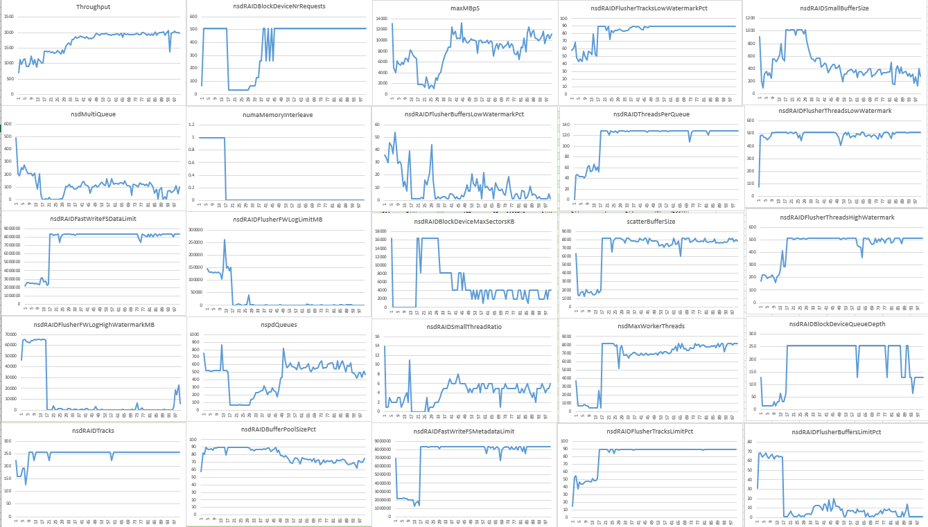
Automatic Performance Tuning for GPFS Mestor – An example of throughput and all tunables

Slide 22
Performance tuning for SPEC CPU 2017 on POWER(1/2)
Configuration
20 POWER 8 cores
128 GB memory
Ubuntu 16.04
SPEC CPU 2017
gcc 5.4.0-6
Tunable Parameters
prefetch level (0 – 33554431)
smt (1 – 8)
Huge pages (0 – 256)
Jemalloc chunk size (16 - 32)
Number of copies (1 - 20)
gcc optimization level(0,1,2,3,s,fast,g)
Performance metrics
500_perlbench_r_peak
Benchmark command: runcpu --config ppc64le-example.cfg --size ref --tuning peak --ignore_errors 500
Configuration file
name: "spec-cpu-power8" environment: "standalone" parameters: - name: "dscr" type: "int" min: 0 max: 33554431 configCmd: "ppc64_cpu --dscr=$var" configTarget: "127.0.0.1" - name: "smt" type: "int" min: 1 max: 8 configCmd: "ppc64_cpu --smt=$var" configTarget: "127.0.0.1" - name: "nr_hugepages" type: "int" min: 0 max: 256 configCmd: "sysctl -w vm.nr_hugepages=$var" configTarget: "127.0.0.1“
name: "lg_chunk" type: "int" min: 16 max: 32 configCmd: "echo MALLOC_CONF=lg_chunk:$var > /root/ligc/spec/run_500_perlbench_r_peak.conf" configTarget: "127.0.0.1“
name: "number_of_copies" type: "int" min: 1 max: 20 configCmd: "sed -i 's/copies = .*/copies = $var/' /root/ligc/spec/config/ppc64le-example.cfg" configTarget: "127.0.0.1" - name: "gcc_optimization_level" type: "enum" values: "0,1,2,3,s,fast,g" configCmd: "sed -i 's/-O.* -mcpu/-O$var -mcpu/g' /root/ligc/spec/config/ppc64le-example.cfg" configTarget: "127.0.0.1" metrics: - name: "500_perlbench_r_peak" benchmarkClient: "127.0.0.1" benchmarkCmd: "/root/ligc/spec/run_500_perlbench_r_peak.sh" weight: 1024 exitCriteria: duration: "96hours" maxIterations: 50

Slide 23
Performance tuning for SPEC CPU 2017 on POWER(2/2)
Testing Result
50 iterations in 12 hours
Performance with default configuration: 2.434475
Best performance: 45.80492 in iteration 31
smt: 1
dscr: 0
gcc_optimization_level: 3
lg_chunk: 23
nr_hugepages: 0
number_of_copies: 20
Iteration 5 achieves 90%
Iteration 8 achieves 93%
No obvious computing overhead from BO

Slide 24
Milestones and Roadmap

Slide 25


Milestones and Status
12/2018 - Explore
Online performance tuning
Deep reinforcement learning mechanism for automatic performance tuning
Automatically identify tunable parameters based on application performance characteristics
Domain knowledge aware automatic performance tuning
Automatic benchmark tool designer
9/2018 - Refinement
Build performance tuning knowledge-base for typical workloads
Fully automatic performance tuning for typical workloads
Bayesian Optimization research – adaptive noise-level, discrete objective function
6/2018 – Beta & Early users
Identify early users - Ongoing
Integrate and validate with pilot applications - Ongoing
Bayesian Optimization research – Higher dimensions, tunables dependencies
3/2018 - Development
Framework development – Done
Random search support – Done
Bayesian Optimization support - Done
Project Launch
4Q2017
1Q2018
2Q2018
3Q2018
4Q2018
1Q2019

Slide 26
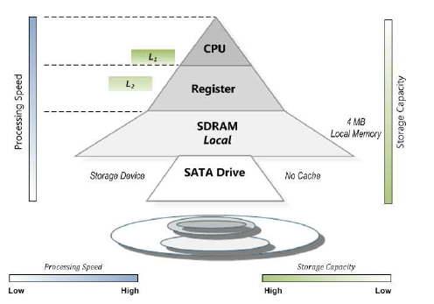
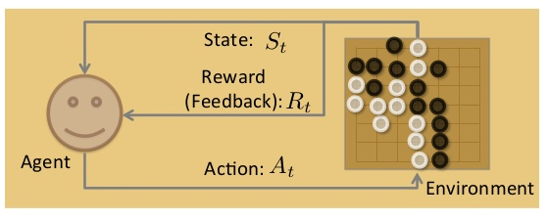
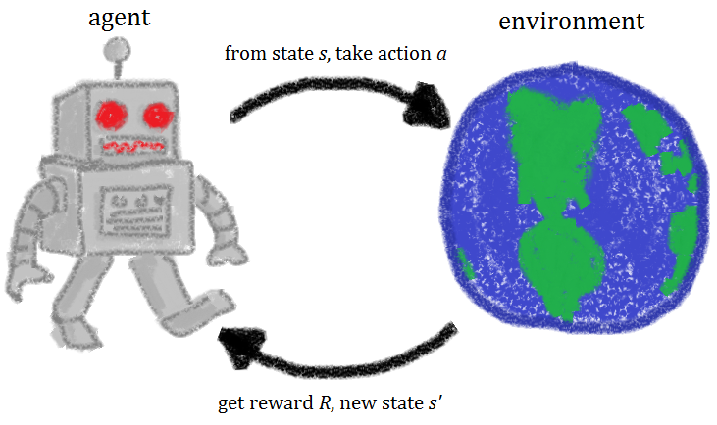
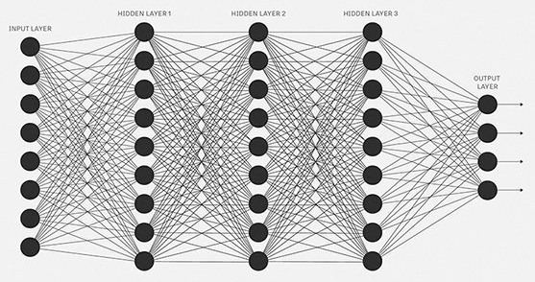
Technical roadmap for 2019 and beyond (1/2)
Application performance characteristics
System performance statistics snapshots
Deep Reinforcement Learning for online tuning
Network Intensive
GPU workload
CPU Intensive
Memory Intensive
Multi-threading
Disk I/O Intensive
Automatic tunable parameters identification
Tunable parameters

Slide 27
Technical roadmap for 2019 and beyond (2/2)
Domain-knowledge aware black-box automatic performance tuning
AI-based benchmark designer
x₁, x₂, … x_{n}
Workload Patterns
Benchmark Cases Store
Black-box application
OS Stats
Benchmark Designer
AI Performance Advisor
Middle-ware Stats
App Metric
App Metric
Benchmark Cases
F_{(x)}
Blindly black-box optimization slows down the convergence
Leverage useful domain knowledge items either from application itself or underneath layers like OS and middle-ware
Production System
Testing System

Slide 28
Long Term - AI Techniques for Performance Engineering
Automatic performance tuning(AI performance advisor currently does)
Bayesian Optimization for offline performance tuning
Reinforcement learning for online performance tuning
Knowledge-base for typical workloads
Performance advice through Logging/monitoring/events data analysis – AIOps
Traditional: rule-based, feature engineering
Unsupervised learning
Performance monitoring and alert – binary classification
Learn normal patterns in performance related logging/monitoring/events
Anomaly alert when anti-pattern information is found
Dependency detection and aggregation - clustering
Analyze and associate data and events from different components, helpful for root cause analysis
Performance prediction - regression
Predict performance trend through analyzing cross-layer performance metrics and indicators
Supervised learning: multi-class classification
Training: mapping between the existing data and tunable suggestions(bottlenecks, tunable parameters, autoscaling)
Inference: performance advice for logging/monitoring/events data that matches any pattern in trained models
Assigning a performance advice label to a piece of logging data from a predefined set of categories.
Transfer learning for workloads with similar characteristics
Real-time or offline

Slide 29
References
Jasper Snoek, Hugo Larochelle, Ryan P. Adams. Practical Bayesian Optimization of Machine Learning Algorithms. NIPS 2012
Ryan P. Adams. A Tutorial on Bayesian Optimization for Machine Learning. 2012
Nando de Freitas. Bayesian optimization, bandits and Thompson sampling. 2013
Luis Miguel Rios, Nikolaos V. Sahinidis. Derivative-free optimization: a review of algorithms and comparison of software implementations. 2013
Bobak Shahriari, Kevin Swersky, Ziyu Wang, Ryan P. Adams and Nando de Freitas. Taking the Human Out of the Loop: A Review of Bayesian Optimization. 2015
Javier González. Global Optimization with Gaussian Processes. 2015
Ian Dewancker,Michael McCourt,Scott Clark,Patrick Hayes,Alexandra Johnson,George Ke. A Stratified Analysis of Bayesian Optimization Methods. SigOpt 2016
JianQiao Liu, Ramki Ramakrishna, Alex Wiltschko. Twitter: Automated Tuning of the JVM with Bayesian Optimization. JavaOne 2016
Daniel Golovin, Benjamin Solnik, Subhodeep Moitra, Greg Kochanski, John Karro, D. Sculley. Google Vizier: A Service for Black-Box Optimization. 2017
Muhammad Bilal, Marco Canini. Towards Automatic Parameter Tuning of Stream Processing Systems. SoCC, 2017
Omid Alipourfard, Hongqiang Harry Liu, Jianshu Chen, Shivaram Venkataraman, Minlan Yu, Ming Zhang. CherryPick: Adaptively Unearthing the Best Cloud Configurations for Big Data Analytics. NSDI, 2017.
Joshua Cohen, Ramki Ramakrishna. Twitter: Automated Performance Tuning with Bayesian Optimization. MesosCon 2017
Yan Li, Kenneth Chang, Oceane Bel, Ethan L. Miller, Darrell D. E. Long. CAPES: Unsupervised Storage Performance Tuning Using Neural Network-Based Deep Reinforcement Learning. SC 2017

Slide 30
Backup

Slide 31
Bayesian Optimization with different dimensions and number of iterations
Details of the functions at https://www.sfu.ca/~ssurjano/
Bayesian Optimization in higher dimensions configuration
Convergence efficiency
Computing overhead optimization

Slide 32
Resources
Code Repositories:
https://github.ibm.com/ai-advisor-perf/monitor_agent
https://github.ibm.com/ai-advisor-perf/config_agent
https://github.ibm.com/ai-advisor-perf/advisor
Configuration files and benchmark scripts
https://github.ibm.com/ai-advisor-perf/advisor/examples
Documentation
https://github.ibm.com/ai-advisor-perf/advisor/blob/master/README.md

