Slide 1
Data Science Insurance Application on Tabular Data
Jin Meng
Oct 14th, 2025

Slide 2
Data Science in Insurance
Who are we? Data scientists → Advanced Analytics → Chief Data Office
What is our value? Help other divisions – Underwriting, Claims, Actual Pricing, Sales and Marketing
Turn data into insights
Build predictive, prescriptive, and diagnostic models
Enable automation
Support experimentation and data-driven decision-making
What are our deliveries?
Models: Pricing/rating model, rating selection model, submission prioritization/triage model (smart renewal model), claim reserve model, claim triage model, claim life circle model, fraud model, litigation potential detection, …
Apps: Pattern mining, document extraction, document summarization, document chat, …
Dashboards
Data pipelines

Slide 3
Modeling Procedure Overview
Model Design
Data Collection
Data Exploration
Model Selection
Implementation
Recap business problem
Decide model structure
Collect data from internal and 3rd party sources
Data ETL
Data cleaning
Feature engineering
Data Sampling
Perform missing value imputation, variable transformation, stability check, predictiveness check, etc.
Conduct variable reduction
Compare and select modeling techniques
Fine tune model – Hyper-parameter tuning
Review and validate final model performance
Help deploy and maintain model in production
Help generate explainable predictions on new, unseen data
Provide training for model users

Slide 4
Model Design
Experience period Exposure period
Driver
Age group
Gender
Credit score
Area of residence
Traffic index
Vehicle
Age group
Body
Value
Target
Total claim loss
Claim frequency
Claim severity
Target potential customers with low risk
ML Model
Claim Frequency
x
Claim severity given a claim happens
=
Total claim loss
Pol effective date
Pol expiration date

Slide 5
Step 2: Data Collection
Work with data engineers and data analysts
SQL server | Alteryx | Tableau | R shiny
A lot of external data sources nowadays
Internal
Geographic
Weather
Credit
Vehicle related:
– make
– age
– value
– type
Policy related:
– # of claims in the past 1, 2, 3 years
– # of claims by type
US census:
– population density
– house unit
FBI crime:
– # of hit-run crimes
– # of crimes after sundown
FARS:
– # of fatal crashes

Slide 6



Step 3: Data Exploration
Data Cleaning | Data Splitting | Data Exploration
Missing value imputation Outlier detection | Training frame -> Fit model (Out-of-time) hold-out frame -> Test model performance | Univariate analysis Data visualization Statistical summary Multivariate analysis Predictor vs target Interaction and correlation between predictors Variable reduction PCA Cluster analysis – SAS VARCLUS procedure

Slide 7
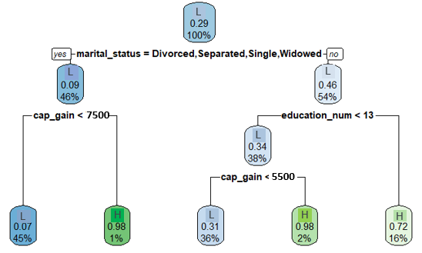


Step 4: Model Selection
Commonly used modeling techniques
(penalized) Generalized Linear Model (GLM): g(μ)$=β_{0}+ β_{1}X_{1}+ ⋯+β_{p}X_{p}$
Tree-based Models:
Decision Tree
Ensemble Tree
– Random Forest
– Gradient Boosting Machine (GBM)
Fine tune model
Validate model performance on hold-out frames

Slide 8
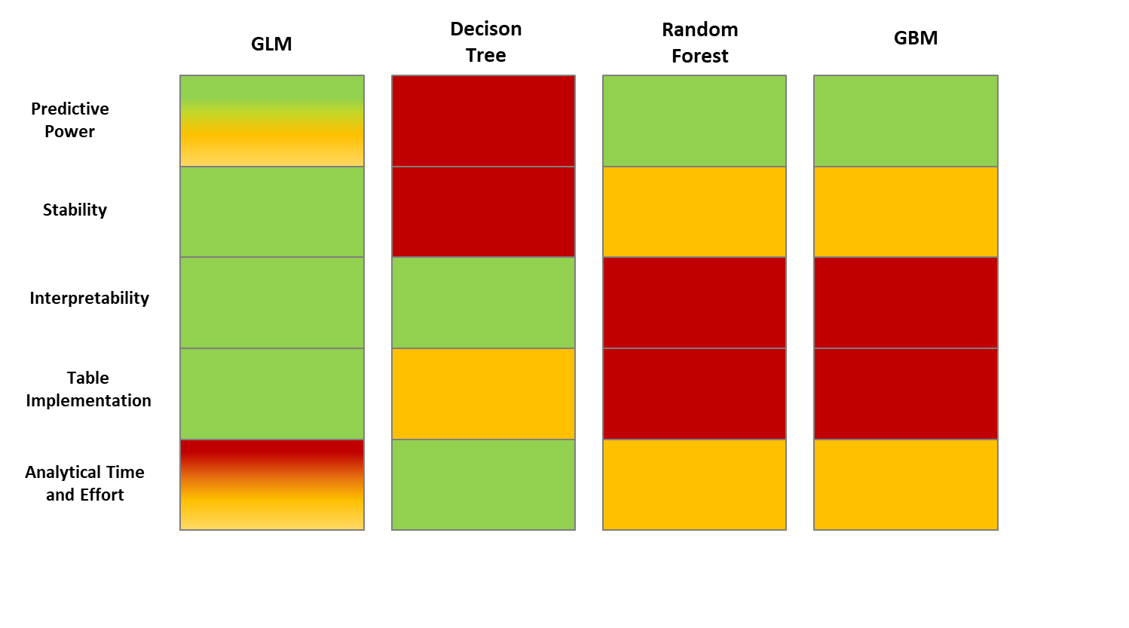
Different Modeling Techniques Comparison

Slide 9
Step 5: Model Implementation
Deploy and maintain model in production
price new/return policies
give reason for premium change
generate pricing report
Provide training for model users
underwriting department
Analyze and trace model performance in analytical reports and dashboards

Slide 10
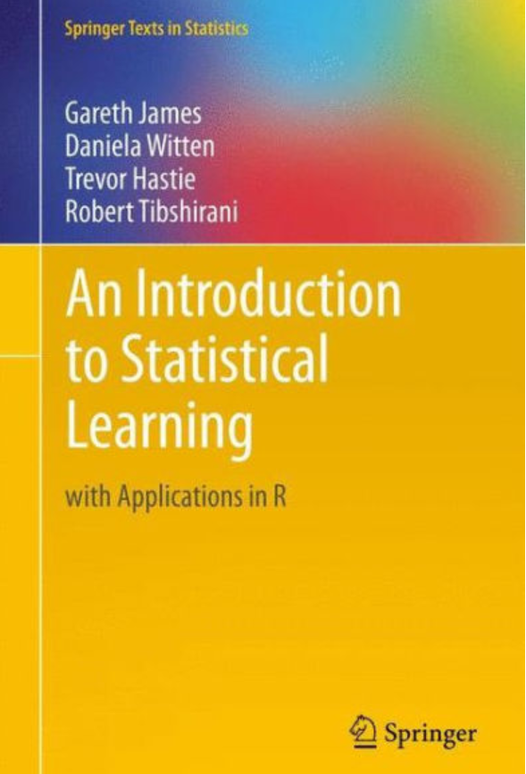


Some personal tips
Rigorous statistical training
Master / know / browse ML techniques
Python / R / SAS / SQL

Slide 11


