Slide 1
Auto Insurance Case Study
Jin Meng

Slide 2
Modeling Procedure Overview
Model Design
Data Collection
Data Exploration
Model Selection
Implementation
Recap business problem
Decide model structure
Minor change to the collected data
Pre-analysis on data
Split data
Conduct variable reduction
Hyper-parameter tuning
Final model evaluation
Create risk groups
Revival business insight

Slide 3
Model Design
Experience period Exposure period
Driver
Age group
Gender
Credit score
Area of residence
Traffic index
Vehicle
Age group
Body
Value
Target
Total claim loss
Claim frequency
Claim severity
Target potential customers in 2018 with low risk
ML Model
Claim Frequency
x
Claim severity given a claim happens
=
Total claim loss
Pol effective date
Pol expiration date

Slide 4
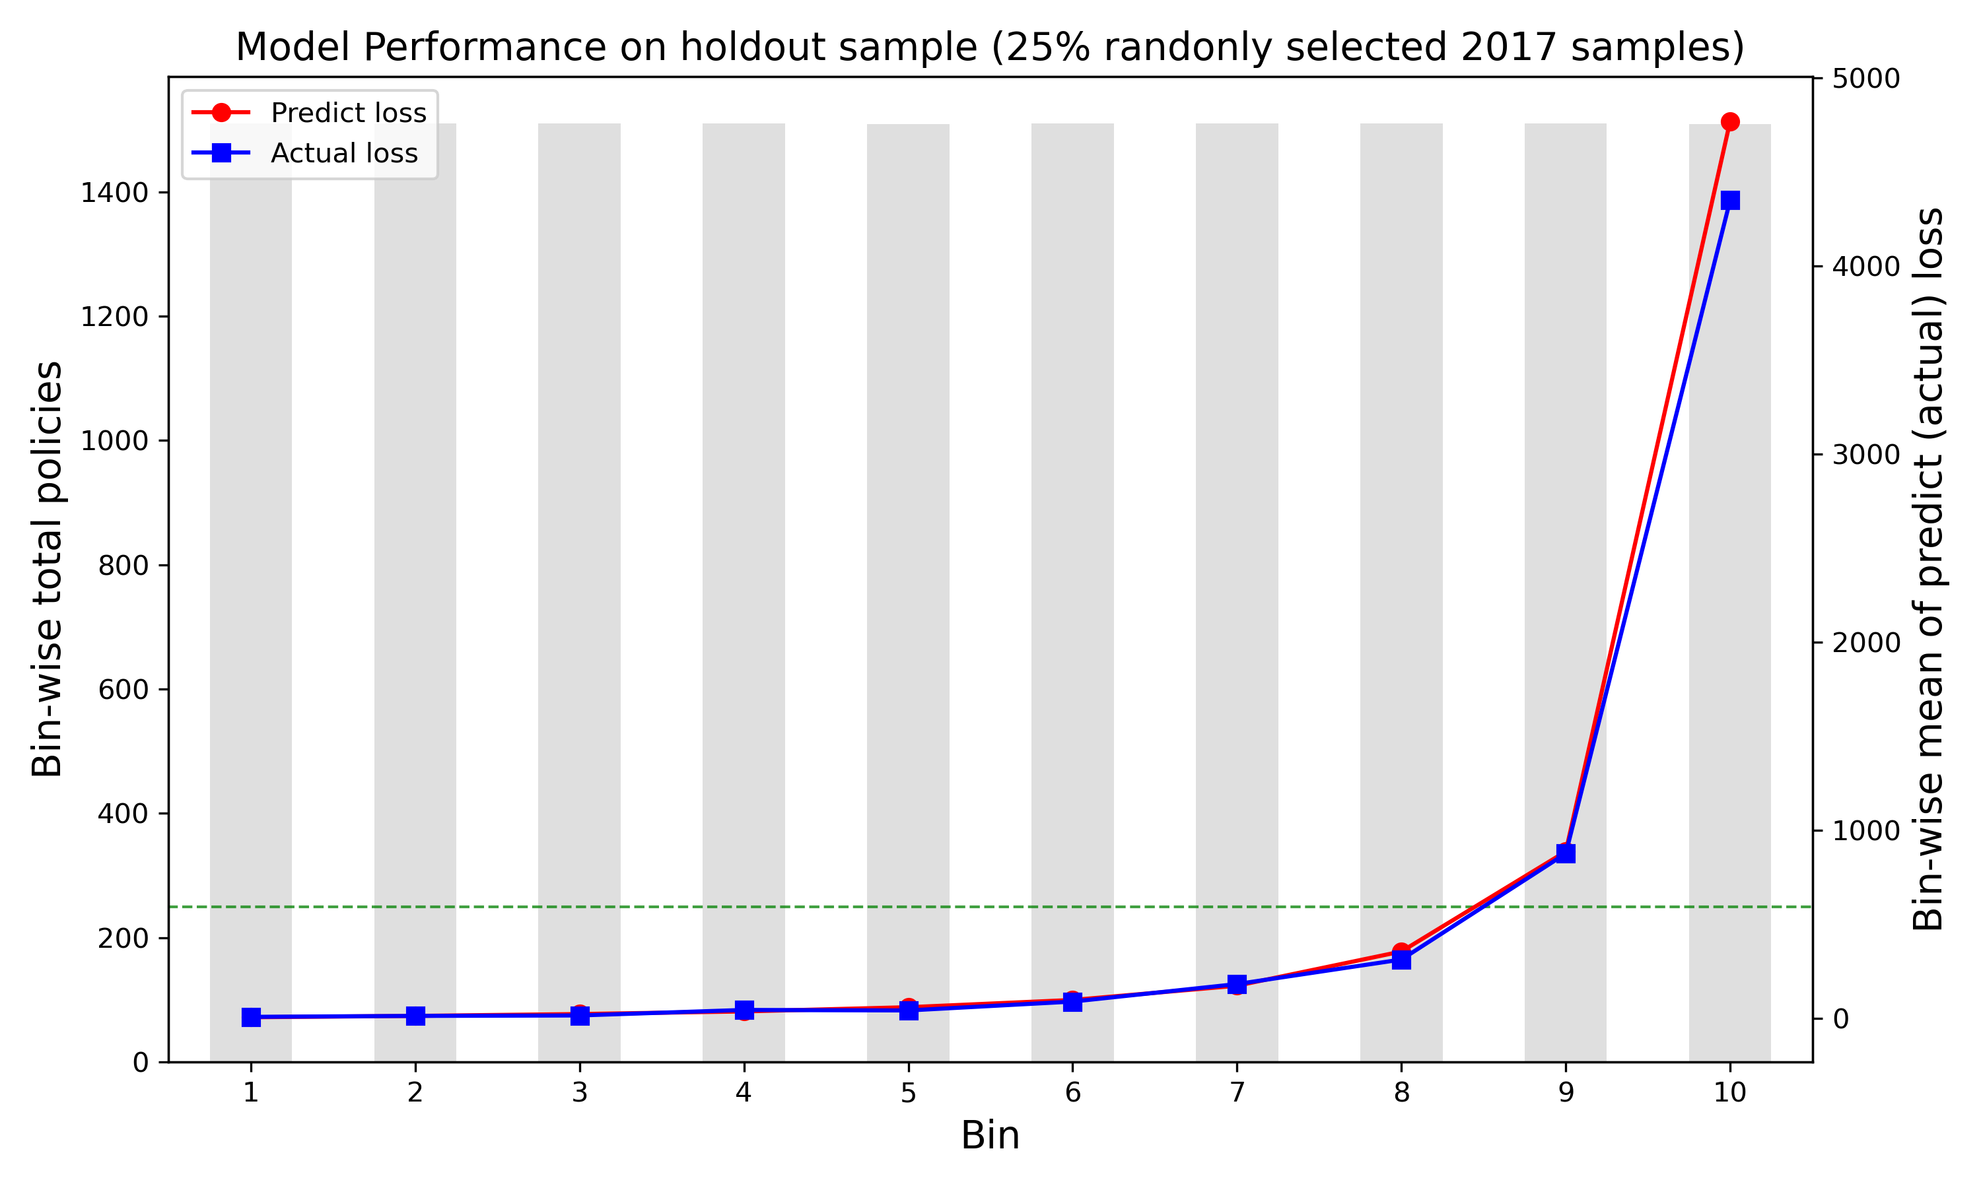
Model Structure and Performance
Model structure
Frequency sub-model: GBM with Poisson likelihood as loss function
Severity sub-model: GBM with Gamma likelihood as loss function
Model performance
Top lift = 7.32
Gini = 0.83
RMSE = $2415
MAE = $692

Slide 5
Risk Grouping
Bin | Number of Policies | Average predict loss | Predict loss lower boundary | Predict loss upper boundary | Percentage of total predict loss
1 | 747 | $ 7 | $ 2 | $ 10 | 0.11%
2 | 746 | $ 14 | $ 10 | $ 18 | 0.23%
3 | 747 | $ 23 | $ 18 | $ 30 | 0.39%
4 | 746 | $ 38 | $ 30 | $ 48 | 0.64%
5 | 746 | $ 62 | $ 48 | $ 77 | 1.03%
6 | 747 | $ 100 | $ 77 | $ 129 | 1.68%
7 | 746 | $ 181 | $ 129 | $ 252 | 3.02%
8 | 747 | $ 374 | $ 252 | $ 540 | 6.28%
9 | 746 | $ 899 | $ 540 | $ 1,442 | 15.05%
10 | 746 | $ 4,275 | $ 1,443 | $ 37,853 | 71.56%
Preferred group
40% policies with 1.4% predict loss
Standard group
40% policies with 12% predict loss
Sub-standard group
20% policies with 87% predict loss
Quote Number | Bin | Predict loss | Top reason category | Top 1 reason | Top 2 reason | Top 3 reason
88242762 | 1 | $ 2 | Preferred | Credit score is excellent (750 - 850) | Vehicle value is not high (< $10000) | Age of vehicle is not young (4)
10939415 | 2 | $ 9 | Preferred | Credit score is excellent (750 - 850) | Driver is female | Vehicle type has low loss experience (hardtop)
78842794 | 3 | $ 18 | Preferred | Vehicle value is not high (<$10000) | Age of vehicle is not young (4) | Driver is female
54073896 | 9 | $ 622 | Sub-standard | Age of driver is young (DOB 1990 - 1999) | Vehicle type has high loss experience (truck) | Driver is male
87705237 | 10 | $ 37,853 | Sub-standard | Credit score is very bad (less than 560) | Age of vehicle is young (1) | Age of driver is old (DOB less than 1949)

Slide 6
Top Reasons
Bin | Number of Policies | Average predict loss | Predict loss lower boundary | Predict loss upper boundary | Percentage of total predict loss
1 | 747 | $ 7 | $ 2 | $ 10 | 0.11%
2 | 746 | $ 14 | $ 10 | $ 18 | 0.23%
3 | 747 | $ 23 | $ 18 | $ 30 | 0.39%
4 | 746 | $ 38 | $ 30 | $ 48 | 0.64%
5 | 746 | $ 62 | $ 48 | $ 77 | 1.03%
6 | 747 | $ 100 | $ 77 | $ 129 | 1.68%
7 | 746 | $ 181 | $ 129 | $ 252 | 3.02%
8 | 747 | $ 374 | $ 252 | $ 540 | 6.28%
9 | 746 | $ 899 | $ 540 | $ 1,442 | 15.05%
10 | 746 | $ 4,275 | $ 1,443 | $ 37,853 | 71.56%
Preferred group
40% policies with 1.4% predict loss
Standard group
40% policies with 12% predict loss
Sub-standard group
20% policies with 87% predict loss
Quote Number | Bin | Predict loss | Top reason category | Top 1 reason | Top 2 reason | Top 3 reason
88242762 | 1 | $ 2 | Preferred | Credit score is excellent (750 - 850) | Vehicle value is not high (< $10000) | Age of vehicle is not young (4)
10939415 | 2 | $ 9 | Preferred | Credit score is excellent (750 - 850) | Driver is female | Vehicle type has low loss experience (hardtop)
78842794 | 3 | $ 18 | Preferred | Vehicle value is not high (<$10000) | Age of vehicle is not young (4) | Driver is female
54073896 | 9 | $ 622 | Sub-standard | Age of driver is young (DOB 1990 - 1999) | Vehicle type has high loss experience (truck) | Driver is male
87705237 | 10 | $ 37,853 | Sub-standard | Credit score is very bad (less than 560) | Age of vehicle is young (1) | Age of driver is old (DOB less than 1949)

Slide 7
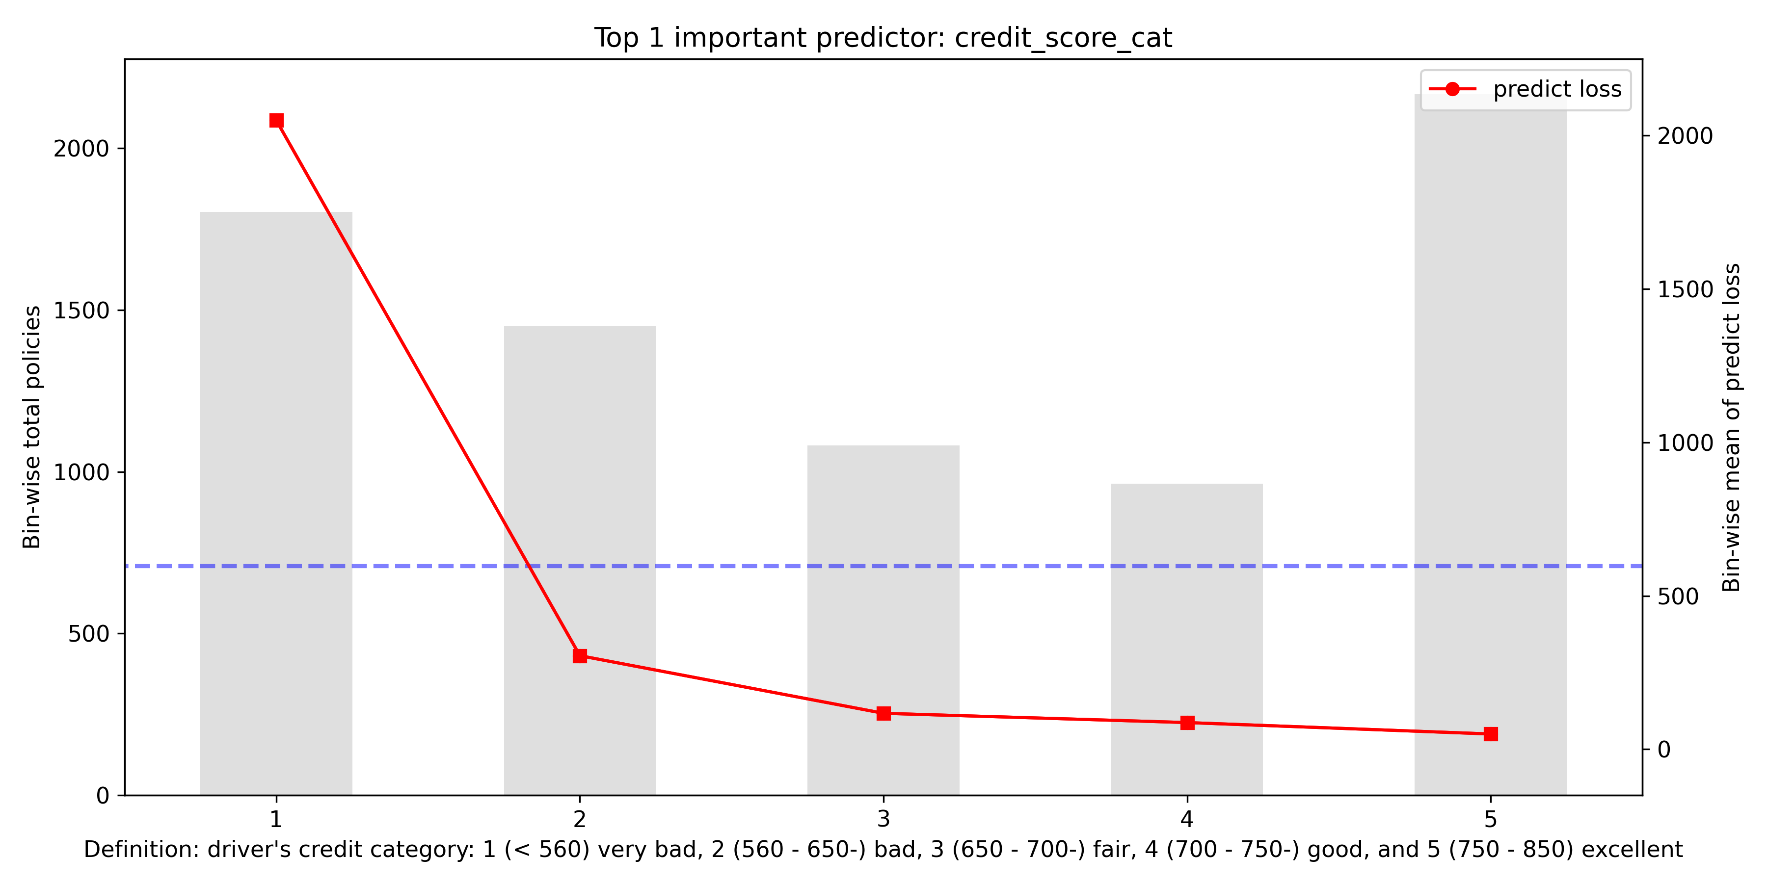
Credit Score Category
$1450
$480
$510
$550
Top 1 most risky predictor group;
In sub-standard business, 1220 / 1492 show it as the top 1 reason.
Top 1, 2, 3 least risky predictor groups;
In preferred business, 2656 / 2986 show it as the top 1 reason.

Slide 8
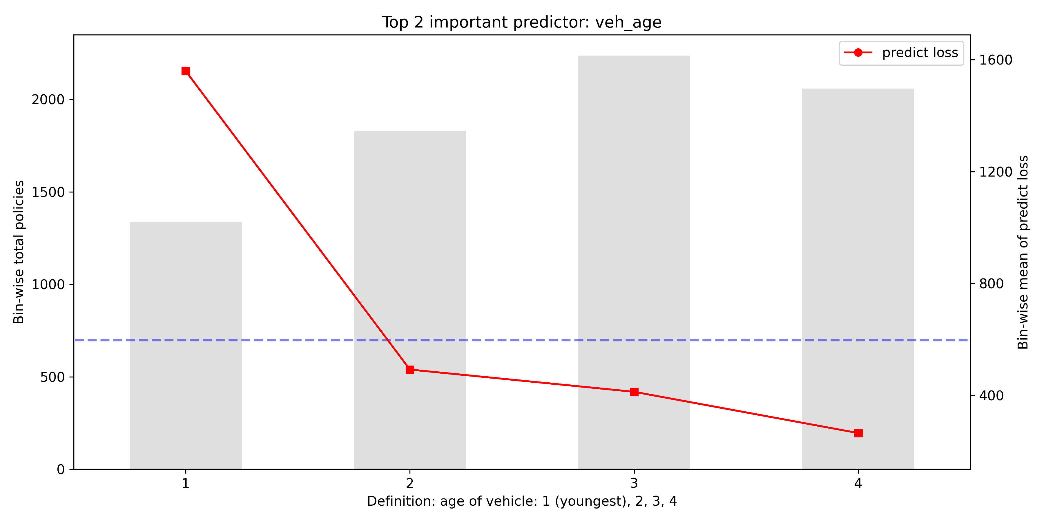
Vehicle Age
$960
$330
Top 5 most risky predictor group;
In sub-standard business, 391 / 1492 show it as the top 1 or 2 reason.
Top 5 least risky predictor group;
In preferred business, 488 / 2986 show it as the top 1 or 2 reason.

Slide 9
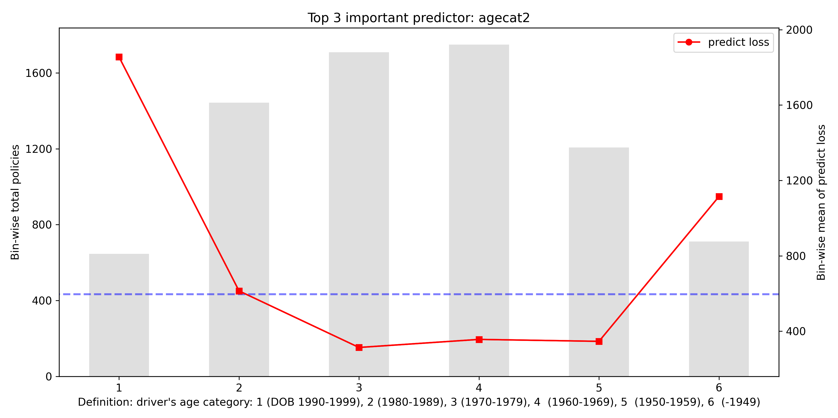
Driver Age Category
$1260
$520
$280
$240
Top 2 most risky predictor group;
In sub-standard business, 333 / 1492 show it as the top 1 or 2 reason.
Top 7 and 10 least risky predictor groups;
In preferred business, 586 / 2986 show it as the top 1 or 2 reason.
Top 9 most risky predictor group;
In sub-standard business, 125 / 1492 show it as the top 1 or 2 reason.

Slide 10
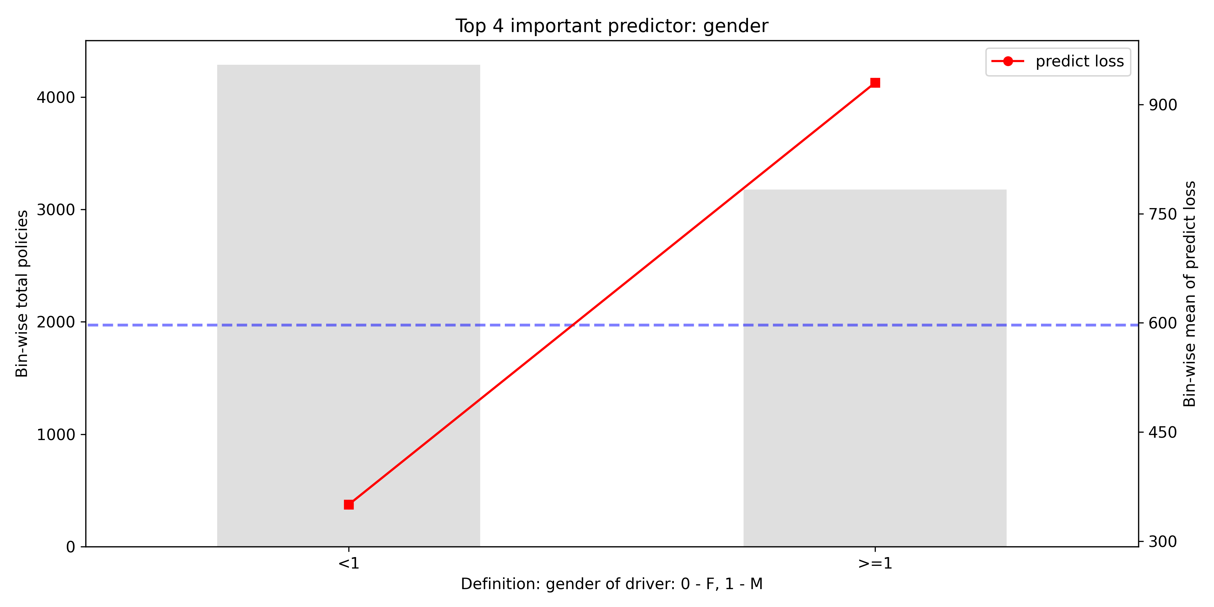
Gender
$250
Top 10 least risky predictor group;
In preferred business, 767 / 2986 show it as the top 1 or 2 reason.

Slide 11
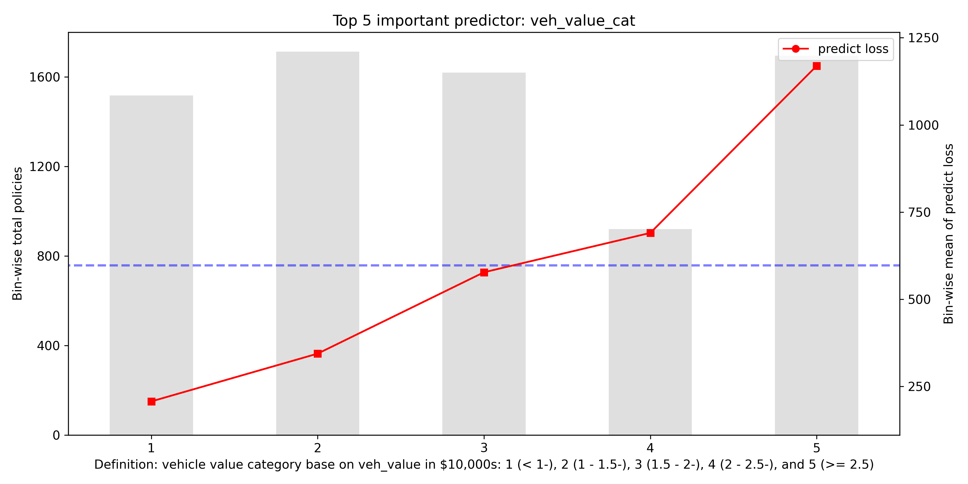
Vehicle Value Category
$570
$250
$390
Top 4 and 8 least risky predictor groups;
In sub-standard business, 1396 / 2986 show it as the top 1 or top 2 reason.
Top 8 most risky predictor group;
In preferred business, 247 / 1493 show it as the top 1 or 2 reason.

Slide 12
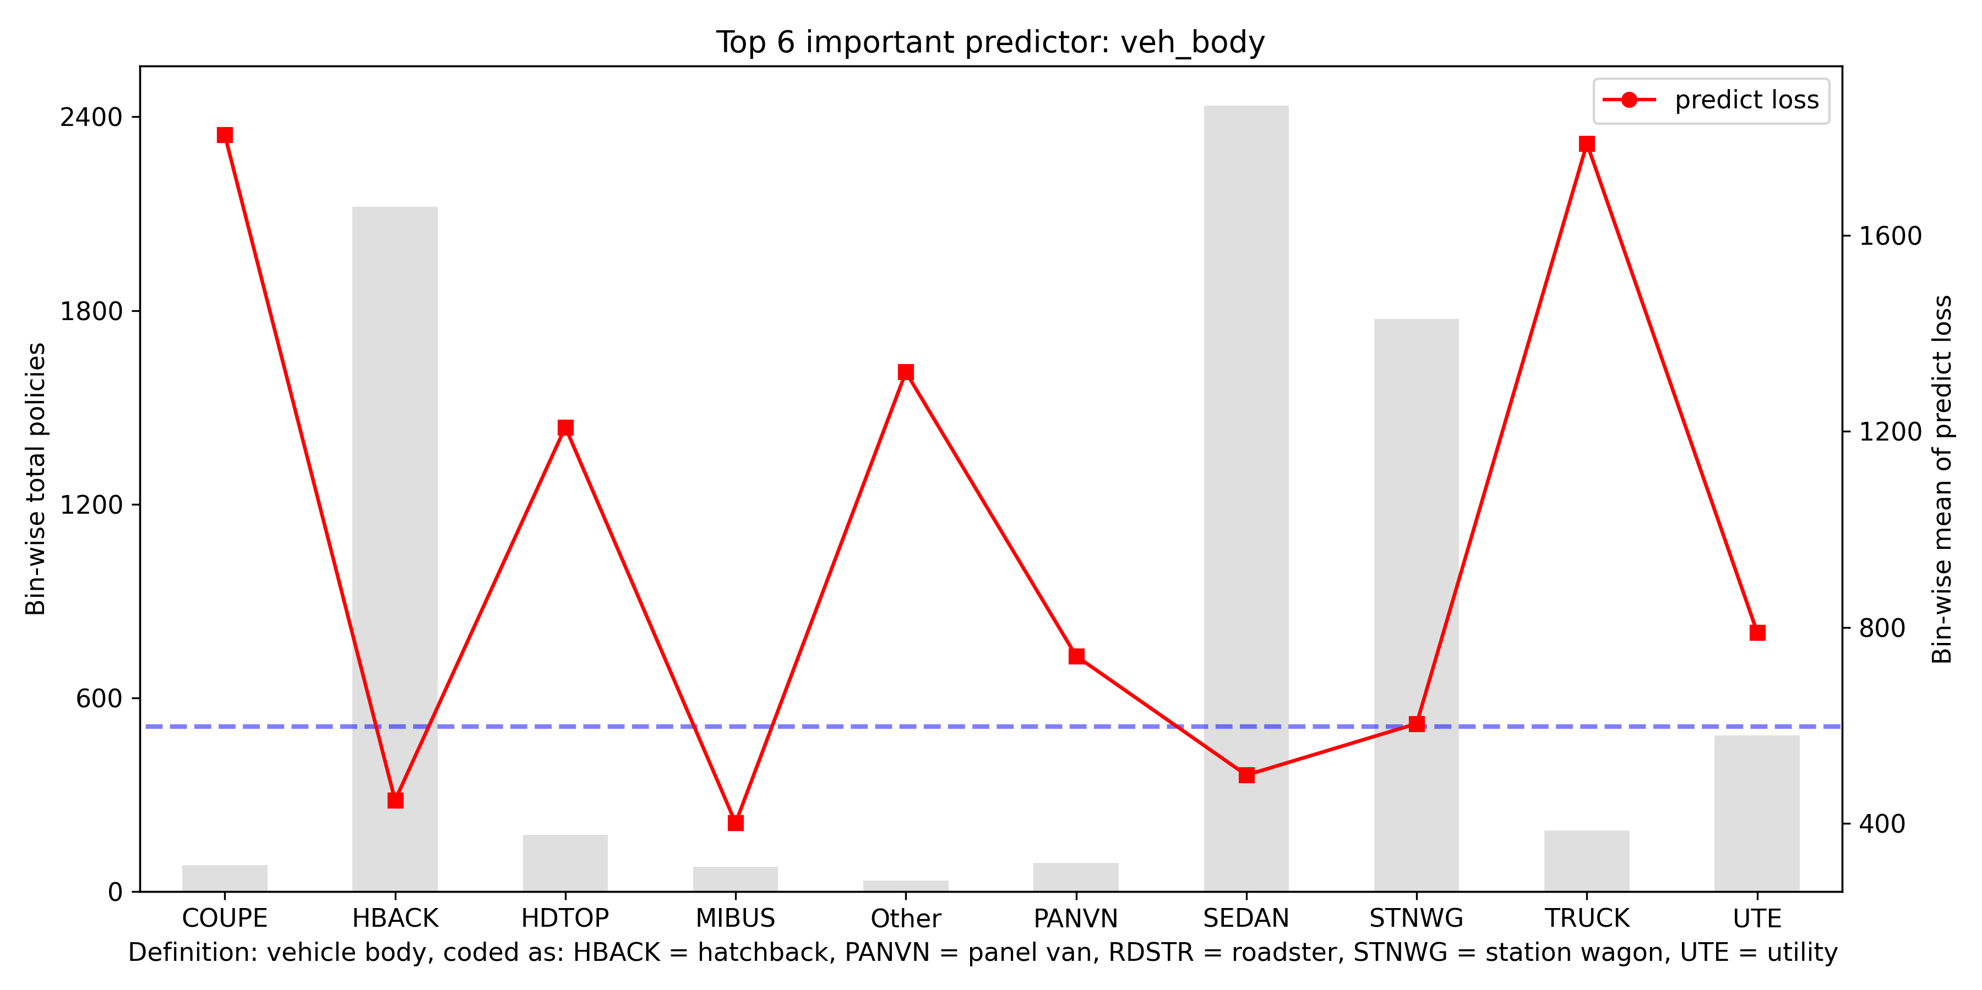
Vehicle Body
$1200
$1190
$610
$720
Top 3 (COUPE), 4 (TRUCK), 6 (Other - motorized caravan, convertible, bus, and roadster), and 7 (HDTOP) most risky predictor groups;
In sub-standard business, 152 / 1492 show it as the top 1 or 2 reason.
For these four vehicle body types, nearly half are predicted as sub-standard policies. Hence, do not recommend writing the uncommon vehicle body types due to a lot of uncertainty.

Slide 13
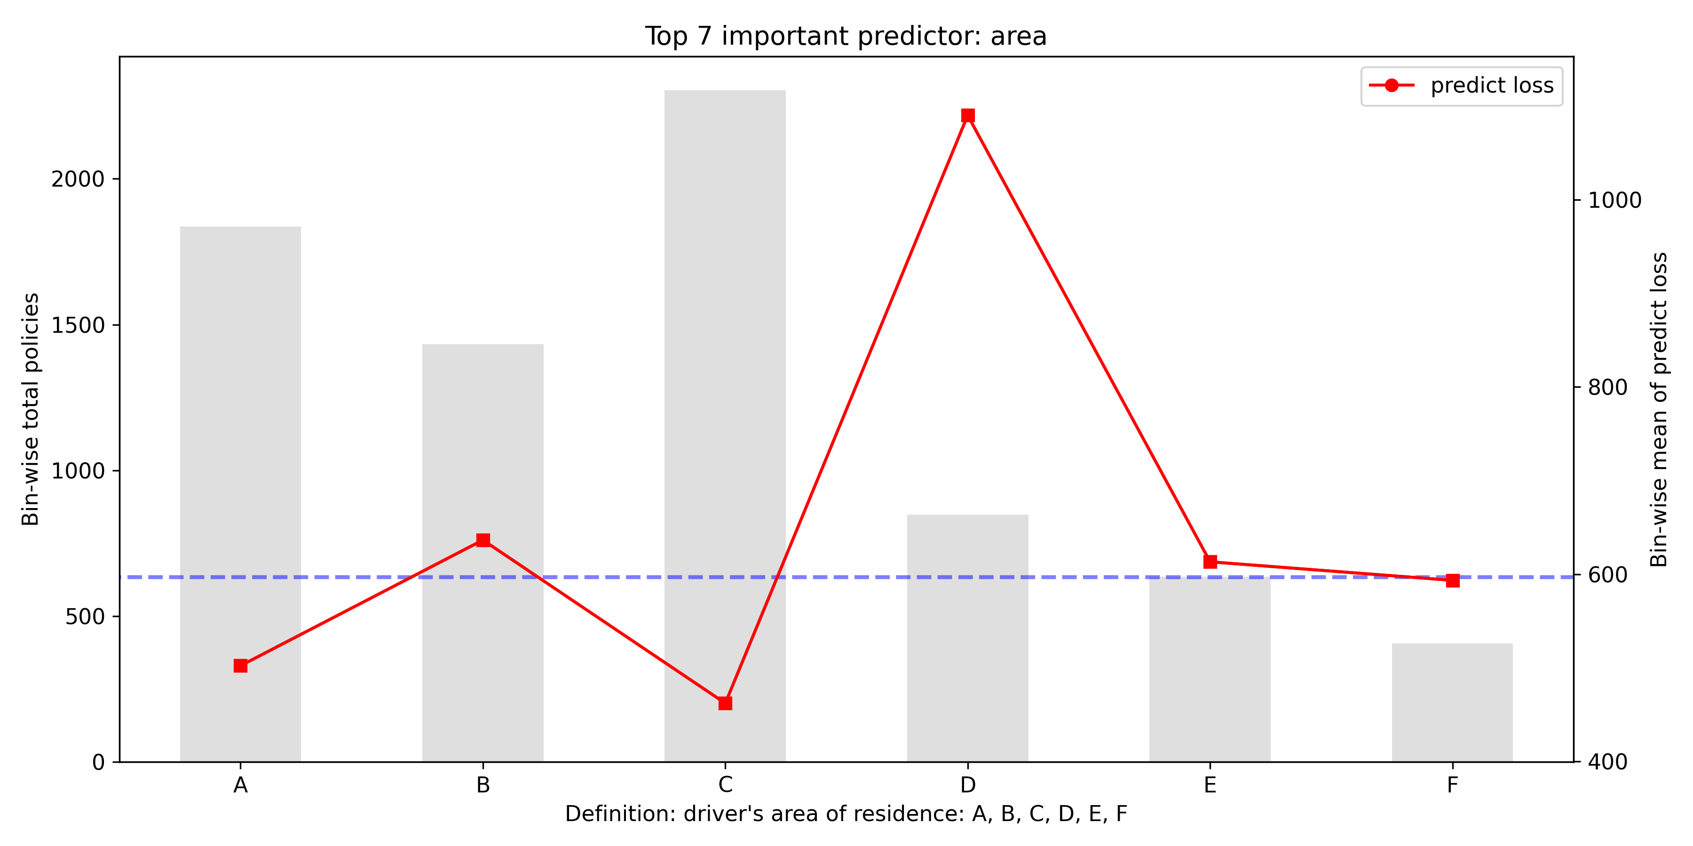
Driver’s Area
$490
Top 10 most risky predictor group;
In sub-standard business, 110 / 1492 show it as the top 1 or 2 reason, mostly as the top 2 reason.

Slide 14
Risk Group Summary and Marketing Campaign
Preferred Group
Sub-standard Group
Marketing Campaign
Excellent, good, and fair credit score;
Date of birth between 1970 – 1989;
Female;
Vehicle value lower than $15000;
Vehicle body type: HBACK, SEDAN, STNWG;
Areas other than D.
Very bad credit score;
Vehicle is in the youngest age group;
Date of birth before 1950 or after 1990;
Vehicle value higher than $25000;
Vehicle body type: COUPE, HDTOP, TRUCH, etc.;
Area D.
Educational opportunities;
Driving trackers;
Advertising low premium;
Loyalty discount reward.

Slide 15
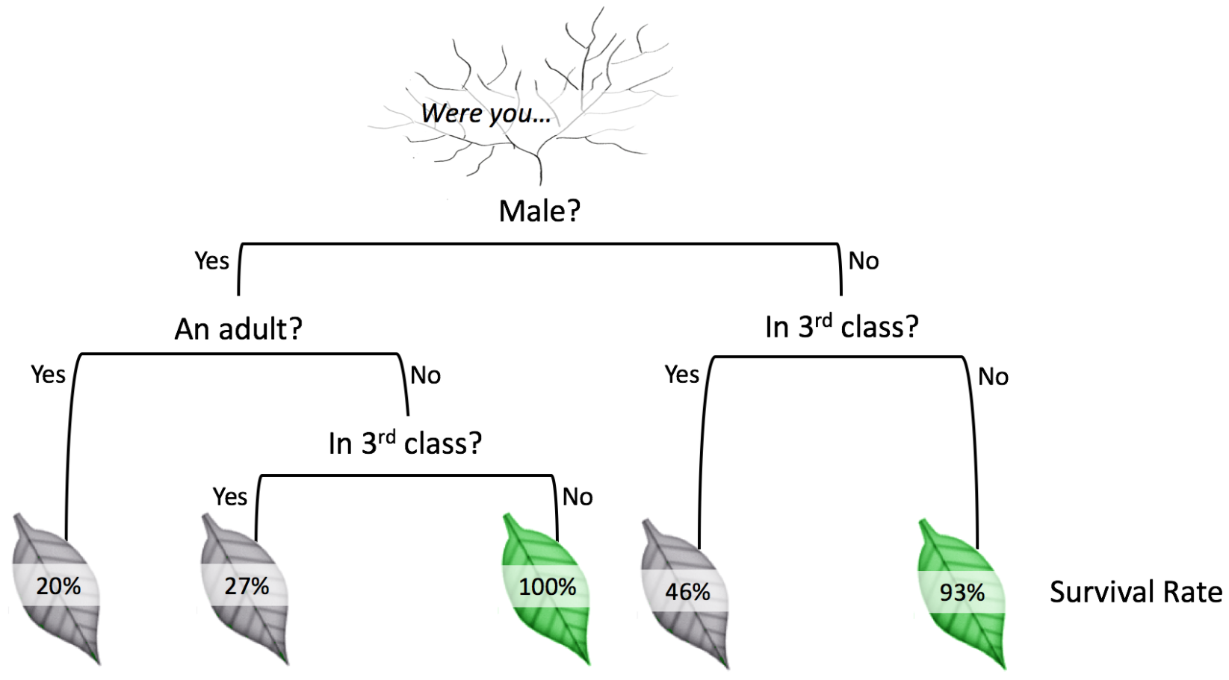

Model Technique
Model structure
Frequency sub-model: Gradient Boosting Machine (GBM) with Poisson likelihood as loss function
Severity sub-model: Gradient Boosting Machine (GBM) with Poisson likelihood as loss function
Tree-based Models
Decision Tree
Ensemble Tree
– Random Forest
– Gradient Boosting Machine (GBM)
Predict whether you’d survive the sinking of Titanic

Slide 16
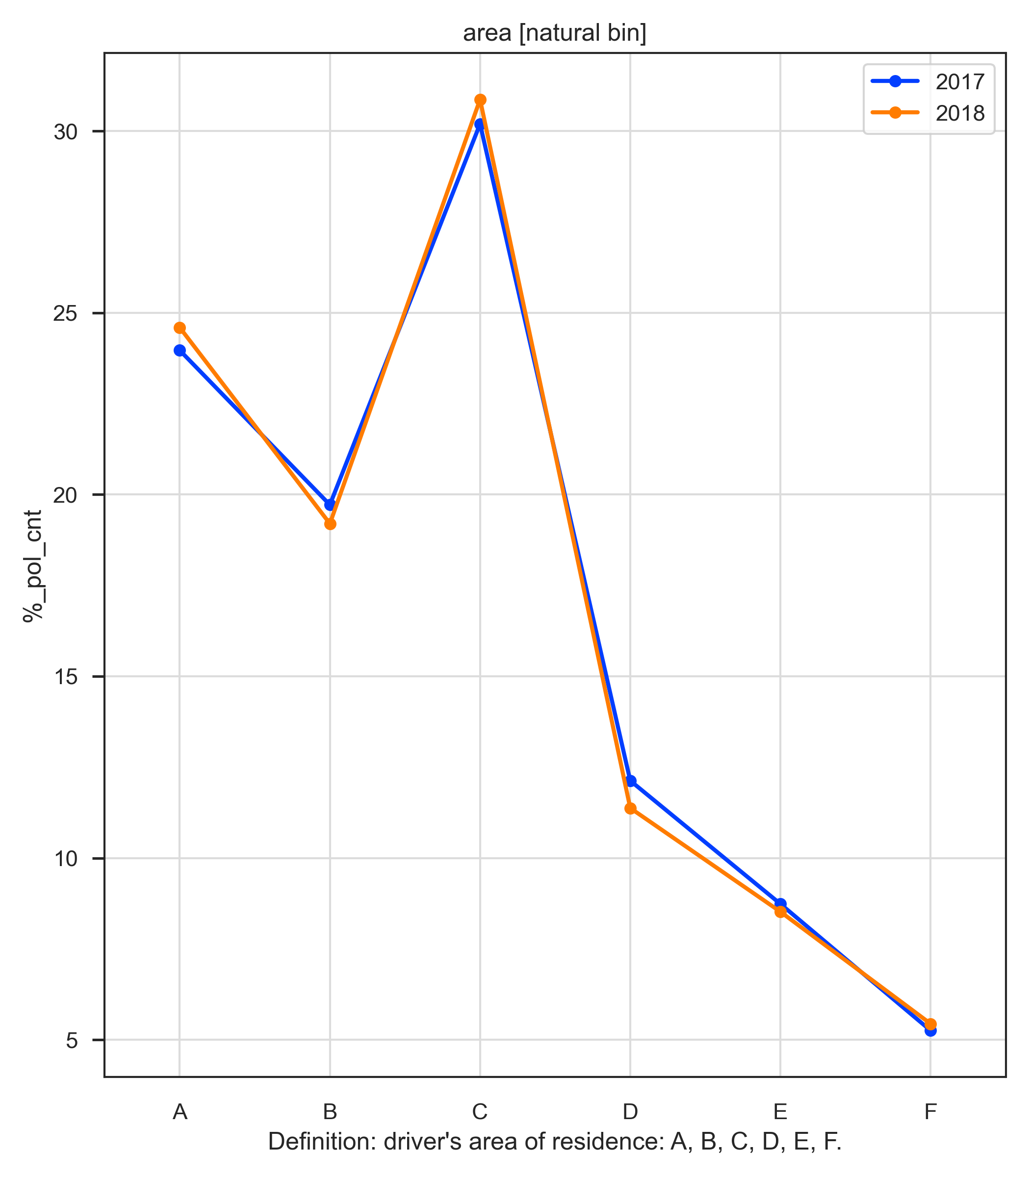
Data Exploration
Target variable analysis
Check the adequacy of using Poisson and Gamma distributions
Cap the heavy tailed claim amount target variable
Univariate analysis on predictors
Variable profiling
Stability check
Split data
Random split 2017 samples into training and holdout data

Slide 17
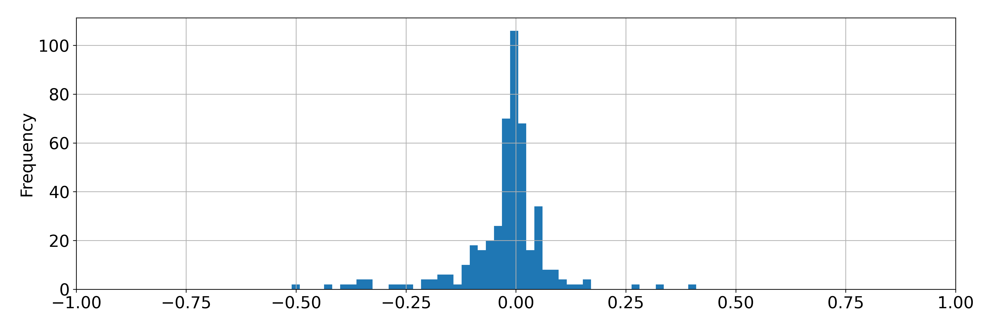
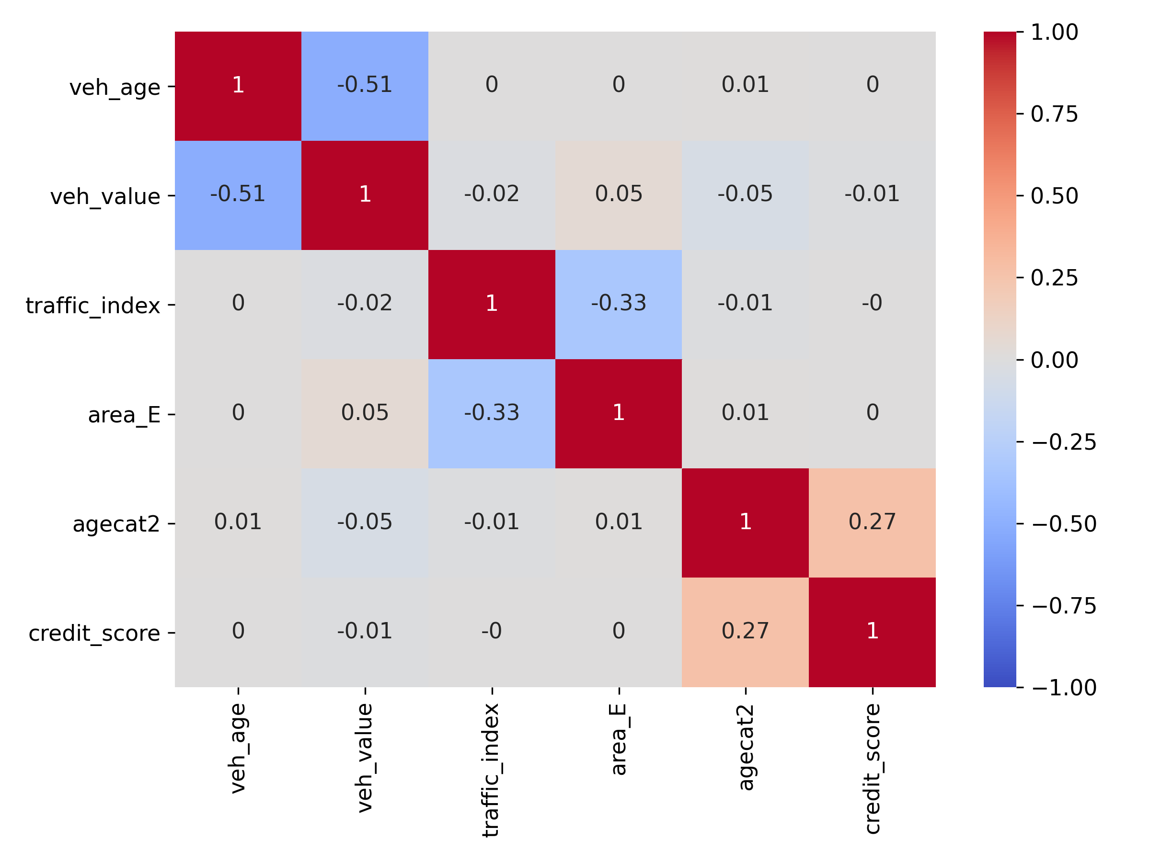
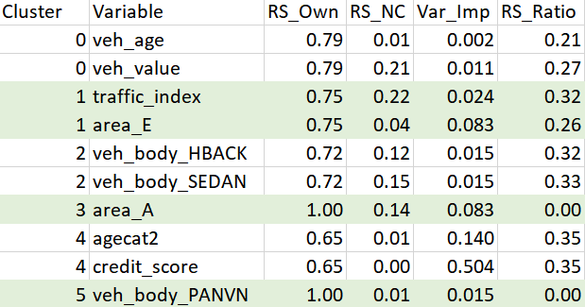
Data Exploration (Cont’d)
Variable reduction
Remove predictors that are purely noise or weak signals
Reduce collinearity among predictors
Cluster analysis

Slide 18
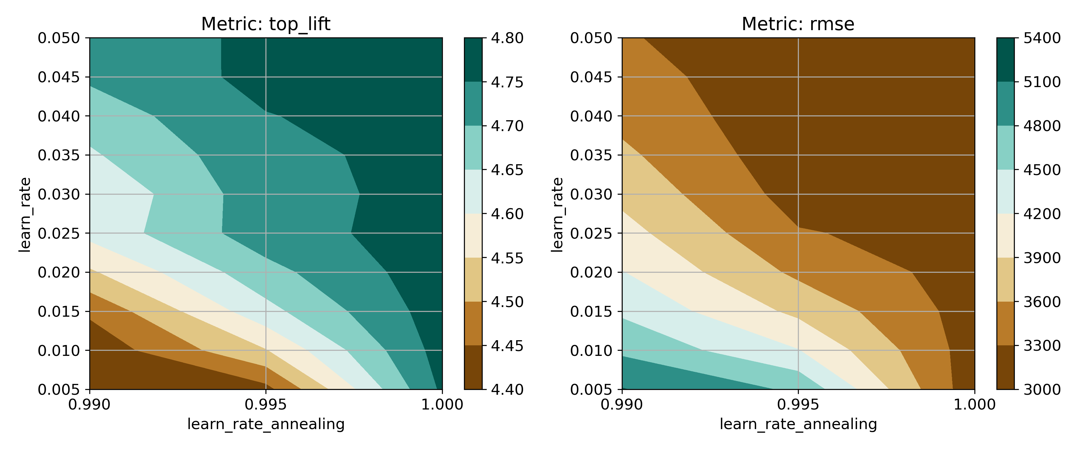
Model Selection
Hyper-parameter tuning
Focused on tuning tree specific hyper-parameters
Totally went through two rounds. 1st round on learn rate and learn rate annealing; 2nd round on max depth, min rows, and minimum split improvement.

Slide 19
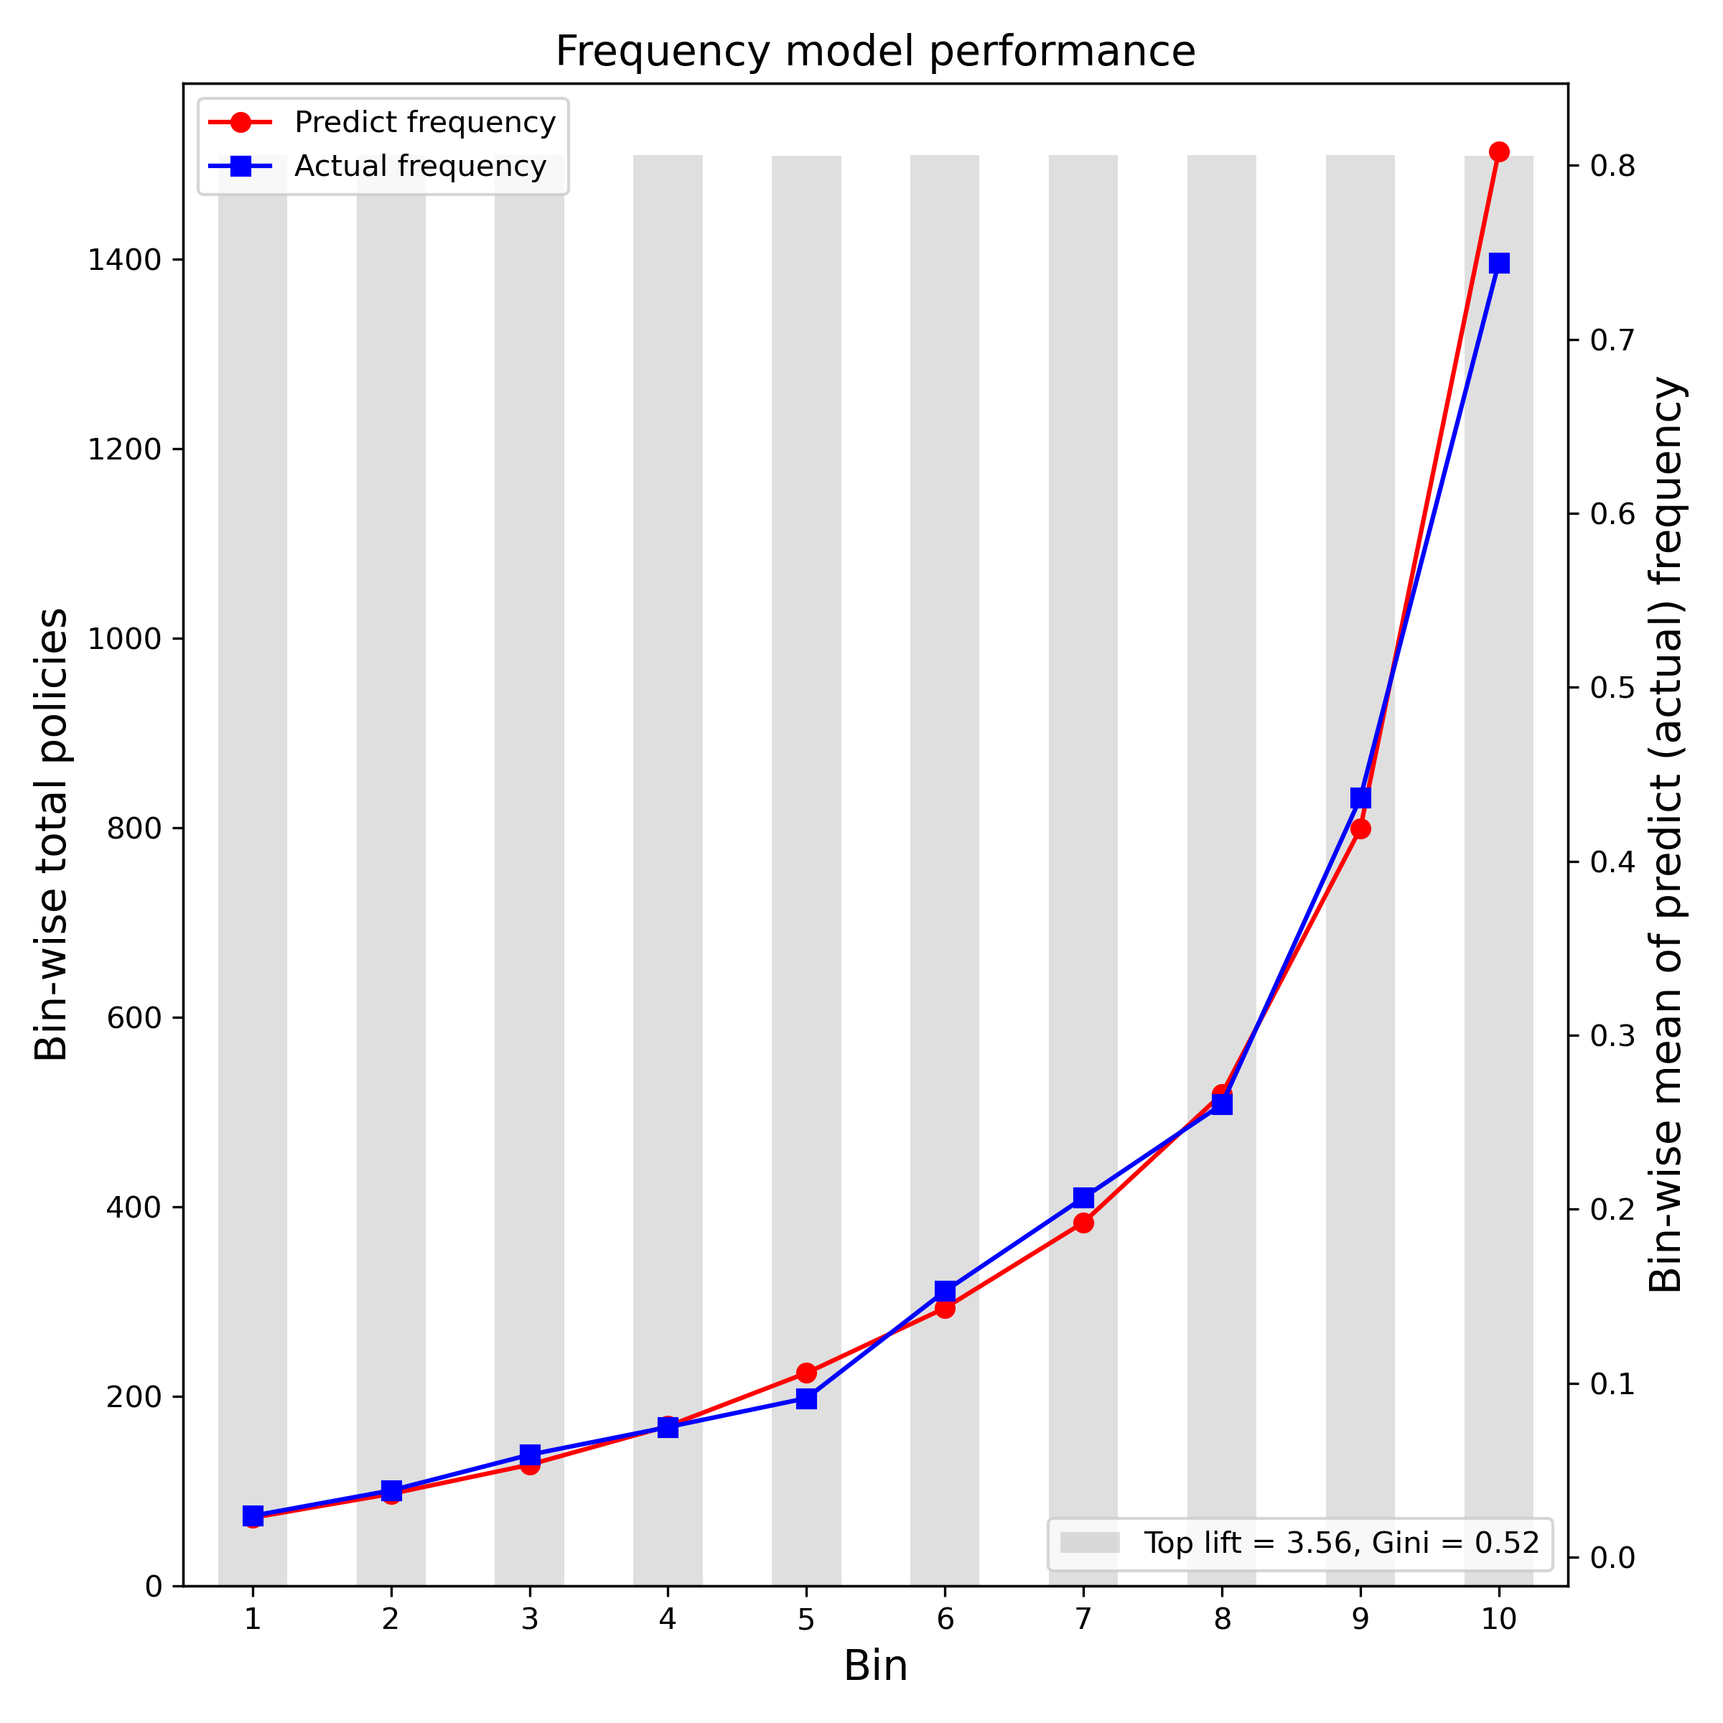
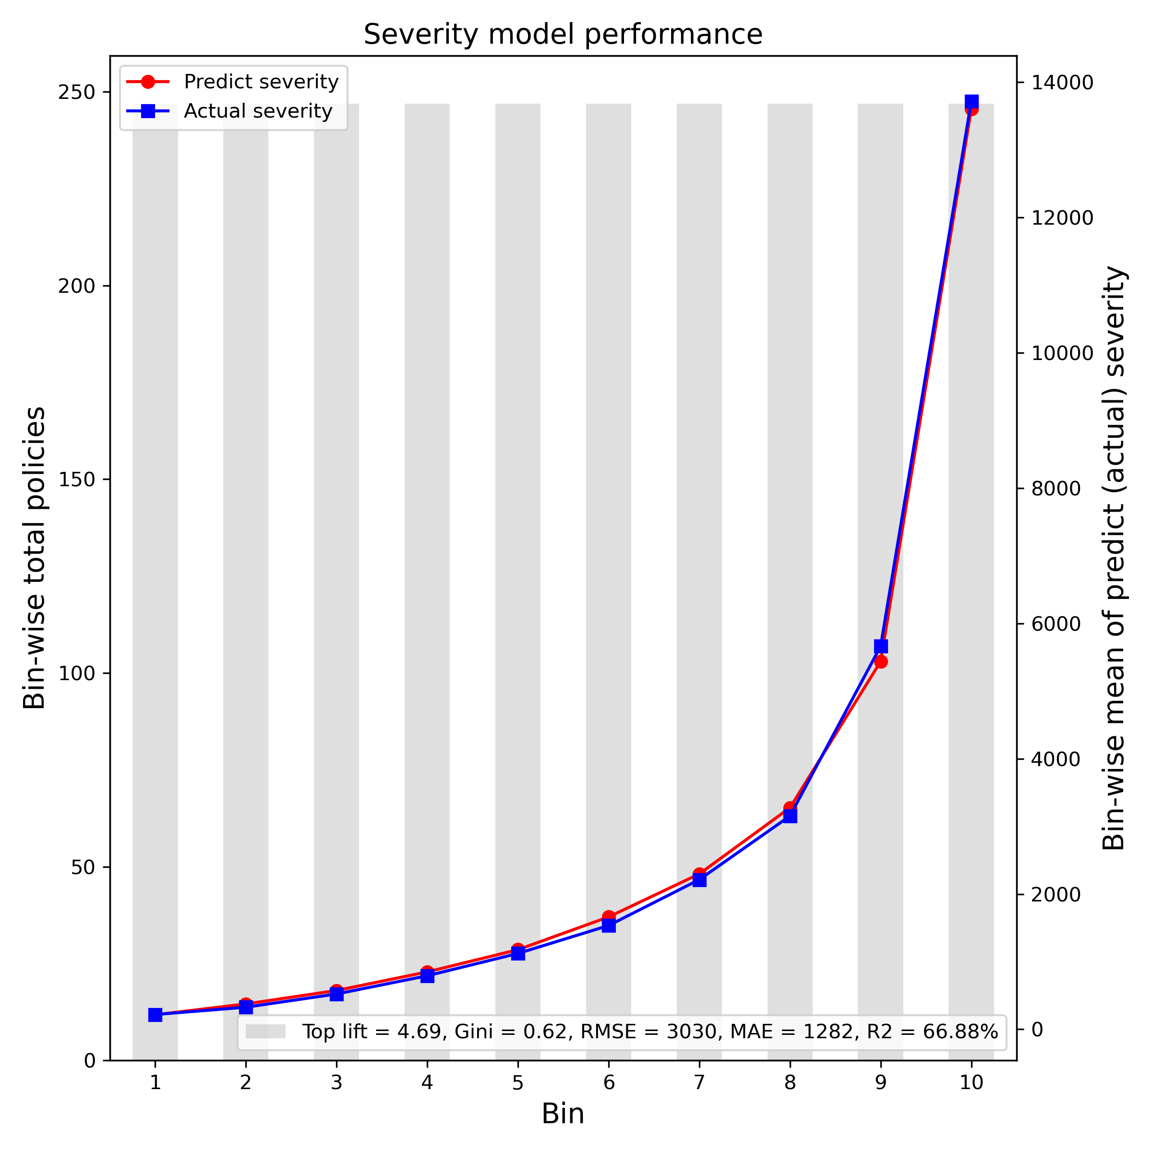
Model Selection (Cont’d)
Final models evaluation: performance on holdout sample (25% randomly selected 2017 samples)

Slide 20


Slide 21
Supplemental Material
Stability charts
Frequency and severity sub-models predict vs actual plots
Predict vs actual plots on combined prediction
Partial dependence plots on combined model
Model spec

Slide 22
Risk Group Summary and Marketing Campaign
Preferred Group
Sub-standard Group
Marketing Campaign
Excellent, good, and fair credit score;
Date of birth between 1970 – 1989;
Female;
Vehicle value lower than $15000;
Vehicle body type: HBACK, SEDAN, STNWG;
Areas other than C.
Very bad credit score;
Vehicle is in the youngest age group;
Date of birth before 1950 or after 1990;
Vehicle value higher than $25000;
Vehicle body type: COUPE, HDTOP, TRUCH, etc.;
Area C.
Supplying educational opportunities for the customers in the sub-standard group; with the focus on young and old drivers; Giving gifts if they complete the program.
Providing Driving trackers to customers. Driving assessment and comments to help drivers to aware and improve their driving behaviors.
Advertising low premium charge to attract new customers (specially to give low premium to preferred group); Cooperating with underwriters on carrying out the detailed promotion based on the predicted loss.
Providing loyalty discount reward for customers in preferred group when they renew their policies.

