Slide 1

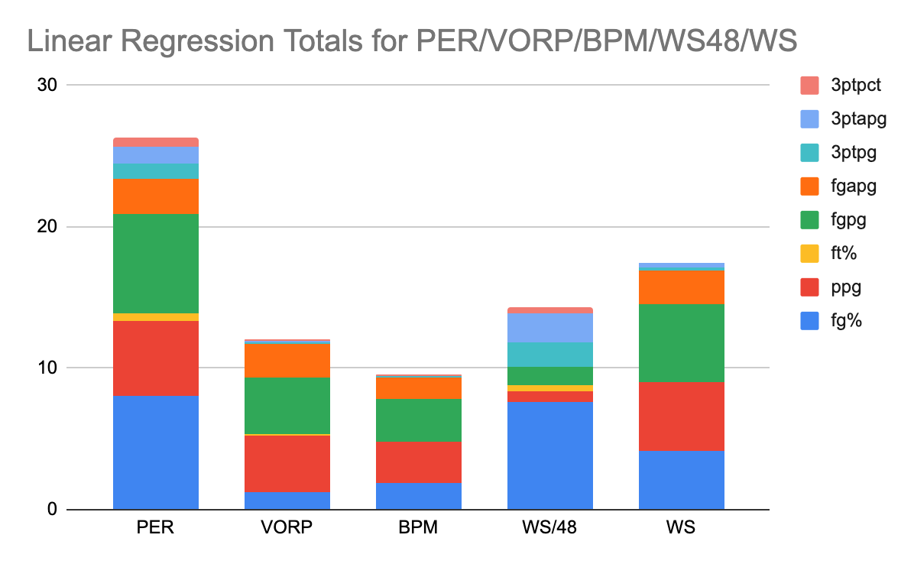
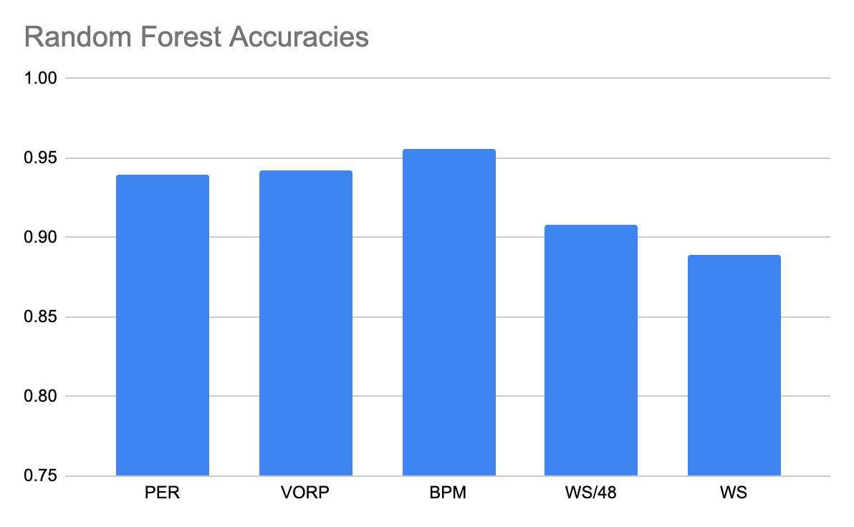
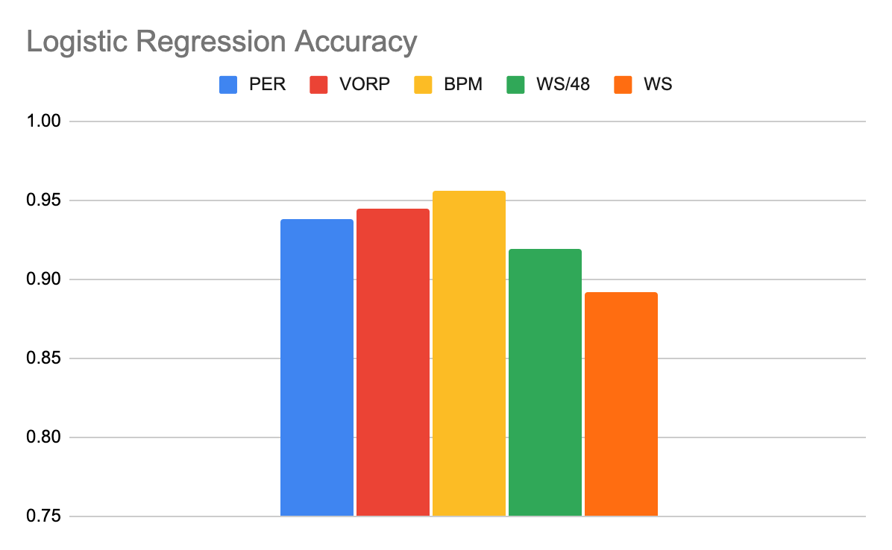
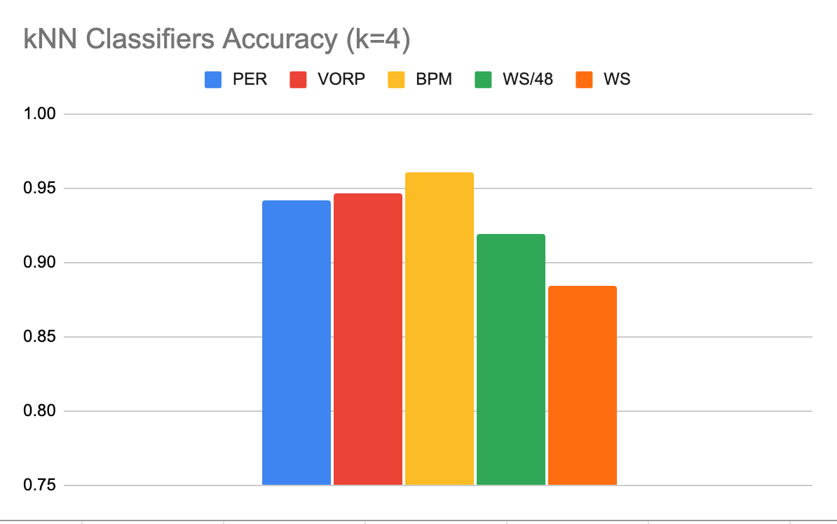
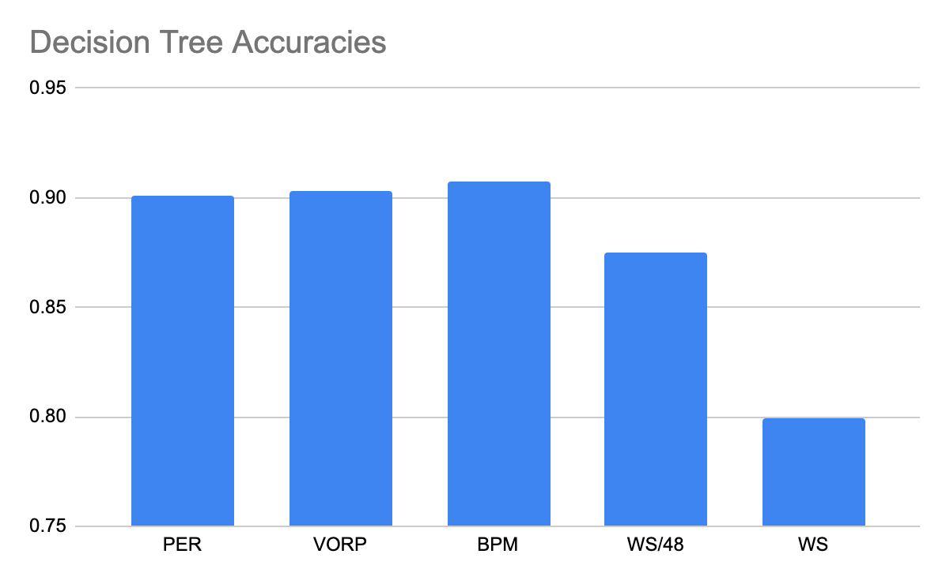
Identification of Trends that Predict NBA Player Success based on NCAA Statistics
Using Machine Learning Models
Max Englander
Department of Computer Science, The George Washington University
Abstract
Methodology
Results of Random Forest Models for each advanced statistic:
Ever since the NBA was created on November 1, 1946, franchises have been searching for the optimal way to draft players. From scouting reports to advanced analytics, front offices around the league have searched for a means to determine if a player when drafted will be successful. Unfortunately, there has not been a method found yet will definitively tell a team if the player they are drafting will become a star. This means that when a team invests in a player and uses an incredibly valuable draft pick on them, they are still relying on subjective means which can often lead to missed opportunities and “busts”, which is a common term for a player that has underperformed expectations after being drafted. In this project, numerous machine learning models were used along with NCAA and NBA statistics to determine which statistics from college are the best at determining if a player will become a successful NBA player. These models include decision trees, random forests, k-nearest neighbor classifiers, logistic regression classifiers, and linear regression. By comparing and contrasting data drawn from all these different models, this project will show what college statistics NBA front offices can use when trying to determine who they should draft.
To begin, first all the data for each player needed to be scraped, organized, and cleaned. An algorithm [1] was modified and updated to scrape data from both basketball-reference.com [2] and sports-reference.com/cbb [3]. This algorithm iterated through every NBA player listed on basketball-reference and proceeded to find the corresponding page for their college career on sports-reference, appending all the data into a single dictionary and then added it onto a single data frame. The data from their NBA careers included both basic and advanced statistics, while the data from their college careers only included basic stats (points per game, field goal percentage, free throw percentage, field goals per game, field goal attempts per game, three pointers per game, three-point attempts per game, three-point percentage). This resulted in a massive collection of player data, with many rows missing certain statistics. To clean the data, all rows that were missing any statistics were removed from the data frame, reducing the size of the dataset from 5200 to 1700. Once the data was ready for use, it was run through a series of machine learning models. These models included linear regression, logistic regression, k-nearest neighbors, decision trees, and random forests. For the linear regression model, each individual college statistic was fitted to each advanced NBA statistic. This resulted in models for each possible pairing (40 total models). Then each score was calculated for each model to see the goodness-of-fit for each pairing. Next, logistic regression was used on each advanced statistic. The x-values for each model were all the college statistics and the y-values were classifiers for each model based on boundaries created for each advanced NBA statistic. The boundary for PER was 18.0 (20% above the average 15.0), for VORP it was 20 (VORP is a cumulative statistic, so it is biased towards players with longer careers), for BPM it was 2.0 (BPM is averaged out for a player’s career), for win shares per 48 minutes it was 0.13 (the top 250 players in NBA history have at least win shares per 48 of 0.13), and for win shares it was 40 (a successful player should have added around 40 wins for their career). These boundaries classified players into two categories based on if they were above or below those marks, is an all-star and is not an all-star. Once these classifier columns were created, logistic regression using the college statistics and the classified columns was run for each advanced NBA statistic. The same process was done for the k-nearest neighbor models, decision tree models, and random forest models. Both the college statistics and advanced statistic classifier columns were split into training and testing groups to analyze how accurate the models were at predicting whether a player was going to be an all-star based on their college stats.
Results of Logistic Regression Models for each advanced statistic:
Conclusion
The goal of this project was to try and figure out what college statistics are the best indicators of future NBA success. To determine this, the advanced stats that had the highest correlations to each individual collegiate stat needed to be ordered. By examining the linear regression chart, it is clear that points per game, field goals per game, and field goal percentage each consistently showed the highest correlations among each advanced statistic. Furthermore, by observing the accuracies among the classifier models, a clear pattern emerges. BPM, VORP, and PER all had the highest accuracy scores among the models when predicting NBA success. This means that the statistics that correlated the highest with those advanced NBA statistics would best predict for NBA success. Among PER, VORP, and BPM, points per game, field goal percentage, field goals per game, and field goal attempts per game were correlated the highest. Free throw percentage, three-point percentage, three-point attempts per game, and three-point makes per game were correlate the lowest. Therefore, this project can conclude that based on the resulting data from various machine learning models, that points per game, field goal percentage, field goals per game, and field goal attempts per game are the best indicators of future NBA success due to the consistency displayed across all models. NBA scouts and executives should pay most attention to these statistics when evaluating players and deciding who they should draft over others.
Introduction
Before analyzing statistics, first the definition for a “successful” NBA player needed to be established. To do this, 5 advanced NBA statistics were picked for their relevance and general trustworthiness. First, PER, or player efficiency rating, was selected as one of the parameters for “success.” PER was created by John Hollinger and attempts to summarize a player’s entire contribution on the court into a single number. It uses information such as field goals, free throws, 3-pointers for positive weight and missed shots, turnovers, and fouls for negative weight. The league average for PER is 15.0. Next, VORP, or value-over-replacement-player was selected as it is a box score estimate of the points per 100 possessions that a player contributes above a replacement player (which is -2.0) on an average team and distributed over an 82 game season. So, if a player had a career VORP of 4.0, they added about 4 more points per 100 possessions over their career than a replacement player. BPM (box plus-minus) was also selected, as it takes box score statistics from an individual and team level and tries to estimate the player’s performance relative to an average player. Lastly, win shares and win shares per 48 minutes were used. A win share is a statistic assigned to a player based on their offense, defense, and playing team, while win shares per 48 minutes is the amount of win shares a player has per 48 minutes (which is the same amount of minutes in an NBA game–so win shares per 48 minutes is an aggregate for how many win shares a player has for each individual game). Each win share is worth 1/3 of a team win, so a team that wins 30 games has 90 wins shares to distribute among its roster. Along with these advanced statistics, college stats such as points per game, field goal percentage, free throw percentage, and a few more relevant stats were used to find correlation between college and NBA performance. There were cutoffs selected for each advanced NBA statistic (PER, VORP, BPM, WS/48, WS) and those cutoffs determined if a player is considered a star level player. The goal of this research was to see what statistic correlated the most strongly with each advanced statistic and also which advanced statistic most strongly correlated with NBA success.
Results of kNN Classifier Models for each advanced statistic:
Results
Results of Linear Regression Models sums for each advanced statistic:
College/Adv. Statistic Correlation | PER | VORP | BPM | WS/48 | WS
fg% | 8.089073685 | 1.213090067 | 1.92760131 | 7.61798358 | 4.134581046
ppg | 5.304960332 | 4.051428105 | 2.840017093 | 0.7363701232 | 4.886646744
ft% | 0.4613632452 | 0.05396753754 | 0.002940907209 | 0.4386524705 | 0.02854199665
fgpg | 7.057509688 | 4.006216714 | 3.11481784 | 1.280863806 | 5.530563771
fgapg | 2.432794323 | 2.353887707 | 1.488030845 | 0.006726884853 | 2.32083044
3ptpg | 1.138890465 | 0.1235929337 | 0.04877248284 | 1.724797331 | 0.2197402823
3ptapg | 1.18579528 | 0.08433409491 | 0.03757208288 | 2.068480086 | 0.3516575941
3ptpct | 0.6800742534 | 0.18159943 | 0.05861281954 | 0.4300265933 | 0.0003826003773
Results of Decision Tree Models for each advanced statistic:
References
[1] bgp12 (2020) nbancaacomparisons dataget.py (Version 1.0) [Source code] https://data.world/bgp12/nbancaacomparisons
[2] Sports Reference LLC "(NBA Players)." Basketball-Reference.com - Basketball Statistics and History. https://www.basketball-reference.com/. (4/23/22)
[3] [2] Sports Reference LLC "(NCAA Players)." Sports-Reference.com - Basketball Statistics and History. https://www.sports-reference.com/cbb. (4/23/22)

