Slide 1
Tara/GEM Exploratory Analysis
Ashley Babjac
Updated: 01/17/22

Slide 2
Main Idea
It would be a major scientific finding to identify features of microbial genomes that are associated with that genome belonging to an uncultured organism
However, there is major phylogenetic bias in the organisms that are uncultured. All 200+ microbial phyla contain uncultured species, but most phyla do not contain cultured species.
Metabolism is strongly correlated to taxonomy, so therefore there’s a strong correlation between whether a species has been cultured and what its genome contains that probably isn’t related to whether it has been cultured
So: is there a way to control for phylogeny, when selecting features that distinguish between cultured and uncultured microbes?

Slide 3
Phase 1: TARA preliminary analysis

Slide 4
Background
Tara is a global scale project with the goal of studying ocean Microorganisms from the gene to the community level.
Starting in 2008, Tara Oceans collected seawater samples within the epipelagic layer, both from the surface water and the deep chlorophyll maximum (DCM) layers, as well as the mesopelagic zone.
These samples have been sequenced and compiled over the last couple of years into a comprehensive dataset.

Slide 5
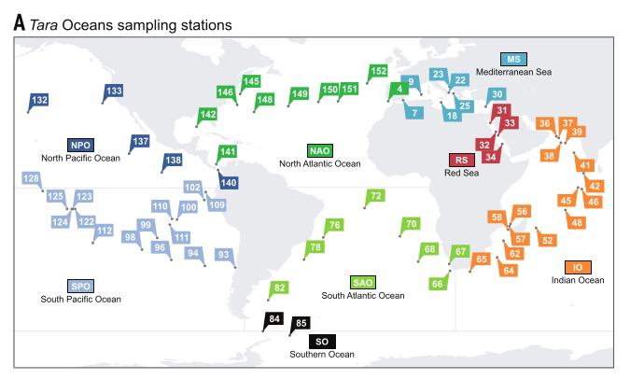
Background

Slide 6
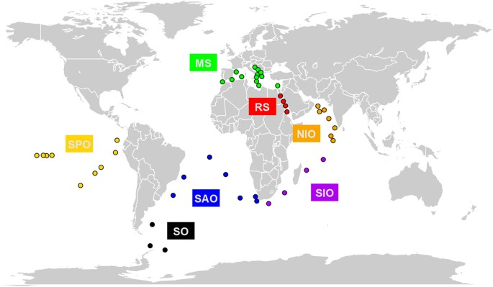
Background
Have labels for 9 ocean regions:
RS (Red Sea)
SO (Southern Ocean)
NAT (North Atlantic)
SAT (South Atlantic)
IO (Indian Ocean)
NP (North Pacific)
SP (South Pacific)
AO (Arctic Ocean)
MS (Mediterranean Sea)

Slide 7
Understanding the data
The dataset I work with specifically is comprised of 124 sites taken from different parts of the ocean
For each site there are:
Vectors of abundances for each organism per site
A set of metadata features (depth, pressure, latitude, longitude, etc.)
The organisms are classified by KO, genus, species, etc.
Multiple organisms can have the same KO
There are roughly a half million samples which condenses down to about 10,000 KO’s

Slide 8
Example of the data
 | latitude | longitude | depth | (more metadata)... | organism1_abundance | organism2_abundance | ... | organismN_abundance
Site 1 | coor1 | coor1 | 15.1 | ... | 0 | 1 | ... | 5
Site 2 | coor2 | coor2 | 1.5 | ... | 4 | 2 | ... | 3
... | ... | ... | ... | ... | ... | ... | ... | ...
... | ... | ... | ... | ... | ... | ... | ... | ...
... | ... | ... | ... | ... | ... | ... | ... | ...
Site N | coor3 | coor3 | 20.6 | ... | 0 | 0 | ... | 0

Slide 9
Current goals
Short term: Can we find “interesting” features associated with clusters of KO’s based on their abundances?
Short term: What KO’s are indicative of particular regions (i.e. can the KO predict the site)?
Long term: Is there a way to control for phylogeny? If so, can we control for phylogeny when selecting features that distinguish between cultured and uncultured microbes?

Slide 10
Initial Pass: Unsupervised clusters
Basically, going to cluster things based on their abundances (i.e. omitting the metadata)
Methods:
Condense down and sum abundance vectors by KO (i.e. if they have the same KO they have the same molecular function and we will treat them the same)
Normalize abundance vectors across sites
Compute a distance matrix using Bray-Curtis statistic
Calculate linkages using Ward’s distance metric
Use CH-index to determine optimal cutoff for cut_tree() and split the dendrogram into N clusters

Slide 11
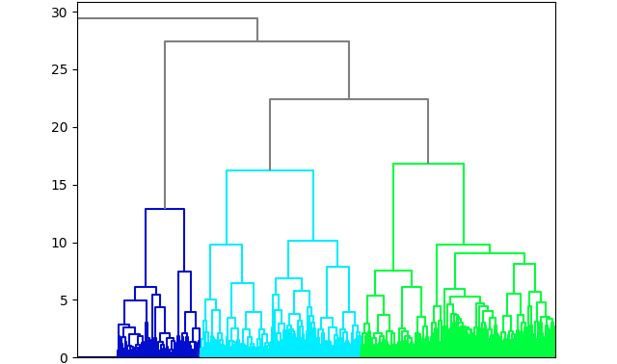
Unsupervised Clusters using condensed KO
Ward’s Distance
Sample KO

Slide 12
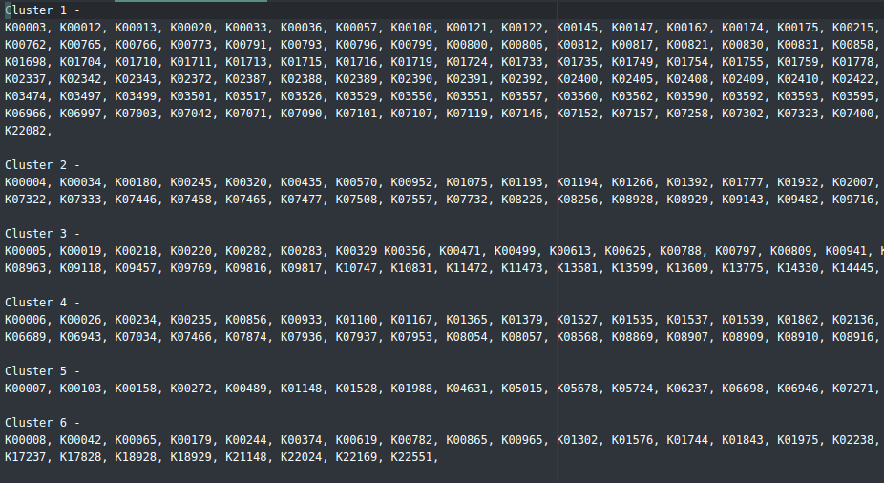
Example Output

Slide 13
Summarizing the Clusters
I ended up with 123 clusters each with roughly 50-300 elements.
I summarized different elements of the metadata on the clusters (i.e. depth, pressure, etc.) and in general saw differences in the averages for the metadata across clusters.
This implies that organisms (and KO’s) with similar abundance profiles show up in sites that have similar metadata characteristics.

Slide 14
Second Pass: SVM
Used standard SVM in Python
For each of the 9 ocean regions we used features (Abundances condensed by KO and metadata) per site to predict the ocean region
SVM is binary so the labels were either it belonged to a site (1) or it did not (0)
70% training and 30% holdout (randomly sampled)
Looked at metrics:
Accuracy - Ratio of the correctly classified data to the total amount of classifications
Precision - What proportion of positive identifications was actually correct?
Recall - What proportion of actual positives was identified correctly?

Slide 15
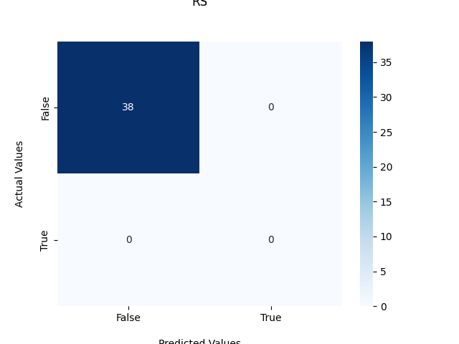
Results: RS
Accuracy: 1.0
Precision: N/A
Recall: N/A

Slide 16

Results: SO
Accuracy: 1.0
Precision: 1.0
Recall: 1.0

Slide 17
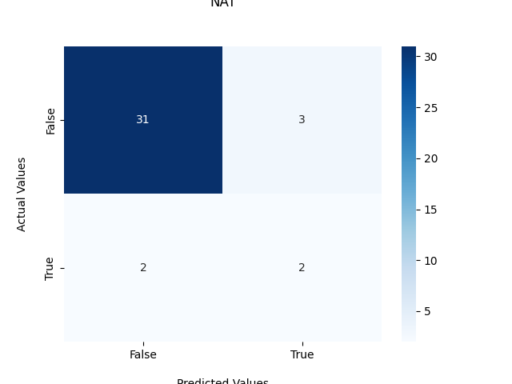
Results: NAT
Accuracy: 0.868421052631579
Precision: 0.4
Recall: 0.5

Slide 18

Results: IO
Accuracy: 1.0
Precision: 1.0
Recall: 1.0

Slide 19
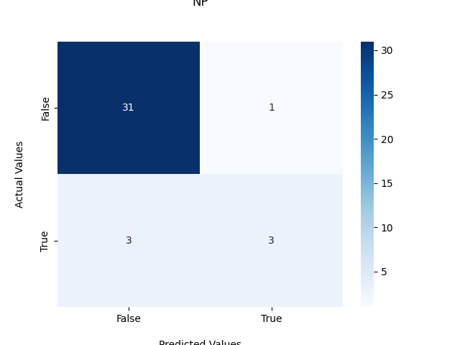
Results: NP
Accuracy: 0.8947368421052632
Precision: 0.75
Recall: 0.5

Slide 20
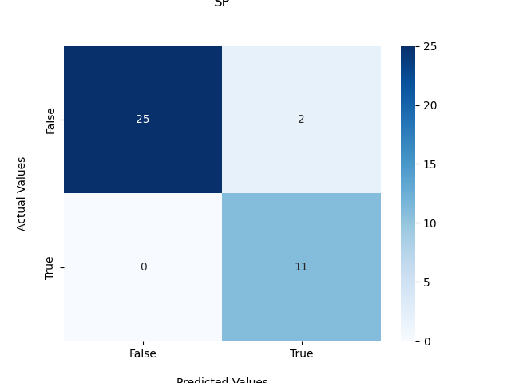
Results: SP
Accuracy: 0.9473684210526315
Precision: 0.8461538461538461
Recall: 1.0

Slide 21
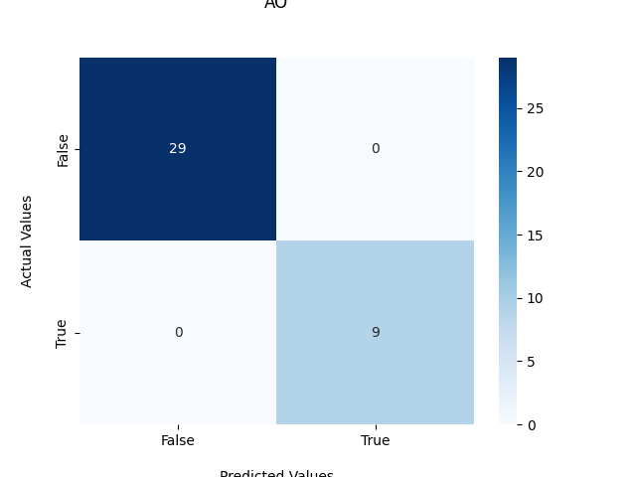
Results: AO
Accuracy: 1.0
Precision: 1.0
Recall: 1.0

Slide 22

Results: SAT
Accuracy: 1.0
Precision: 1.0
Recall: 1.0

Slide 23

Results: MS
Accuracy: 0.9473684210526315
Precision: 0.0
Recall: N/A

Slide 24
Second Pass: Cont
Added in PCA to reduce number of features
Able to reduce down to 4 features and account for 99% of variability
Re-ran same SVM analysis with reduced PCA features
Notes:
Add PCA plot

Slide 25
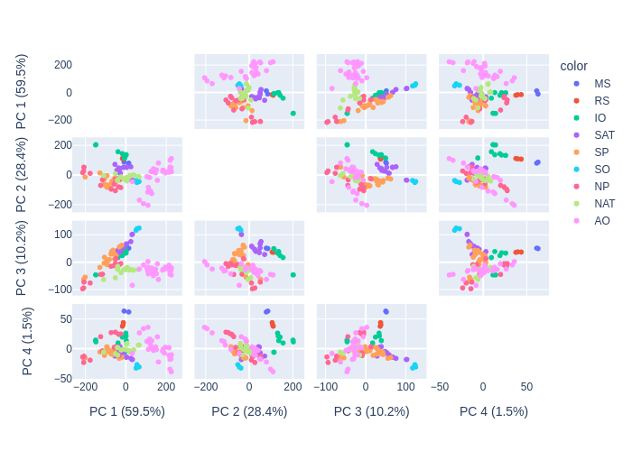
PCA Plot n=4 (99.6% of variability)

Slide 26
Results: RS (+PCA)
Accuracy: 1.0
Precision: N/A
Recall: N/A

Slide 27
Results: SO (+PCA)
Accuracy: 1.0
Precision: 1.0
Recall: 1.0

Slide 28

Results: NAT (+PCA)
Accuracy: 0.8947368421052632
Precision: N/A
Recall: 0.0

Slide 29
Results: IO (+PCA)
Accuracy: 1.0
Precision: 1.0
Recall: 1.0

Slide 30

Results: NP (+PCA)
Accuracy: 0.8157894736842105
Precision: 0.3333333333333333
Recall: 0.16666666666666666

Slide 31

Results: SP (+PCA)
Accuracy: 0.9210526315789473
Precision: 1.0
Recall: 0.7272727272727273

Slide 32
Results: AO (+PCA)
Accuracy: 1.0
Precision: 1.0
Recall: 1.0

Slide 33

Results: SAT (+PCA)
Accuracy: 0.9210526315789473
Precision: 0.6
Recall: 0.75

Slide 34
Results: MS (+PCA)
Accuracy: 0.9473684210526315
Precision: 0.0
Recall: N/A

Slide 35
Fixing the Imbalance Problem
The labels for this are highly unbalanced due to small number of samples across 9 regions
Fix this by oversampling using SMOTE (Synthetic Minority Over-Sampling Technique)

Slide 36
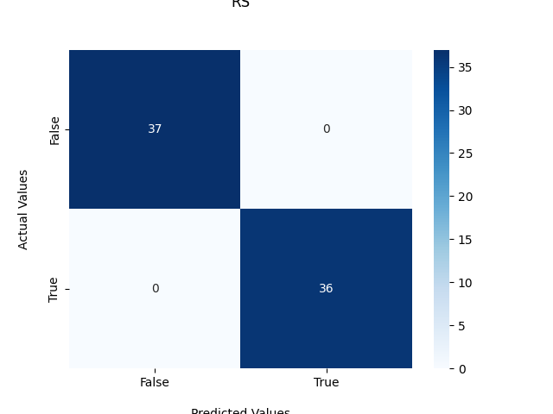
Results: RS (+PCA+SMOTE)
Accuracy: 1.0
Precision: 1.0
Recall: 1.0

Slide 37

Results: SO (+PCA+SMOTE)
Accuracy: 1.0
Precision: 1.0
Recall: 1.0

Slide 38
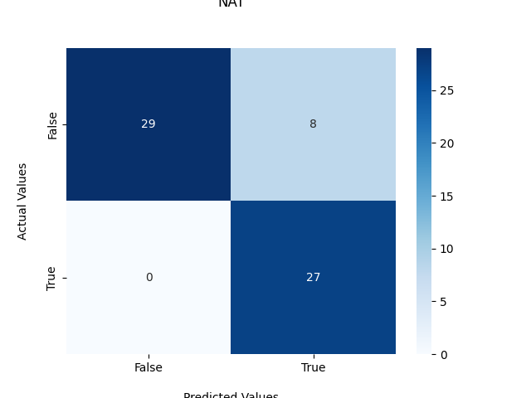
Results: NAT (+PCA+SMOTE)
Accuracy: 0.875
Precision: 0.7714285714285715
Recall: 1.0

Slide 39
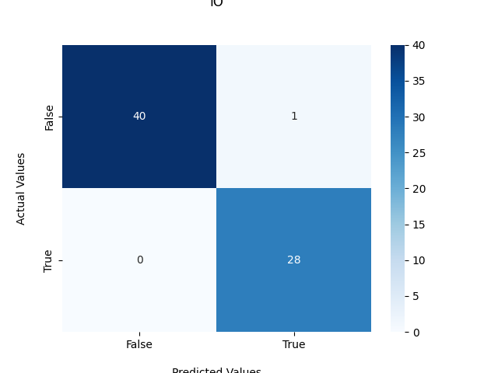
Results: IO (+PCA+SMOTE)
Accuracy: 0.9855072463768116
Precision: 0.9655172413793104
Recall: 1.0

Slide 40
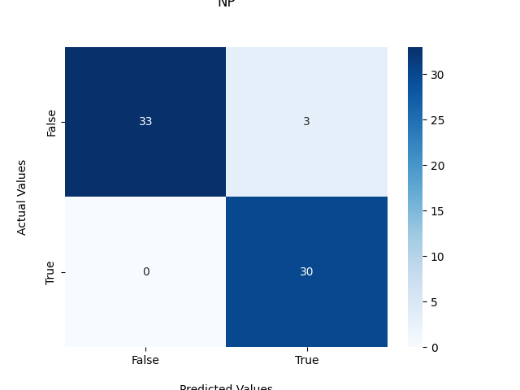
Results: NP (+PCA+SMOTE)
Accuracy: 0.9545454545454546
Precision: 0.9090909090909091
Recall: 1.0

Slide 41
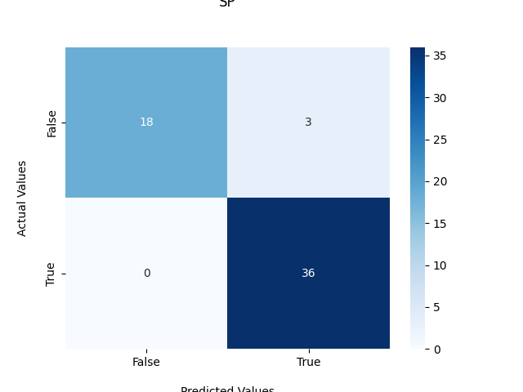
Results: SP (+PCA+SMOTE)
Accuracy: 0.9473684210526315
Precision: 0.9230769230769231
Recall: 1.0

Slide 42
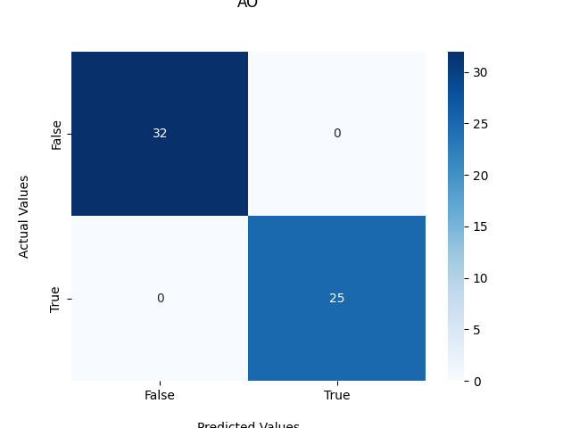
Results: AO (+PCA+SMOTE)
Accuracy: 1.0
Precision: 1.0
Recall: 1.0

Slide 43
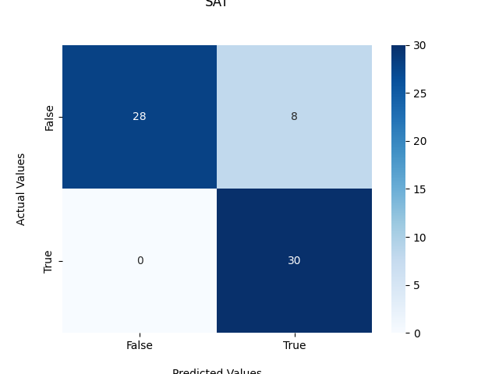
Results: SAT (+PCA+SMOTE)
Accuracy: 0.8787878787878788
Precision: 0.7894736842105263
Recall: 1.0

Slide 44
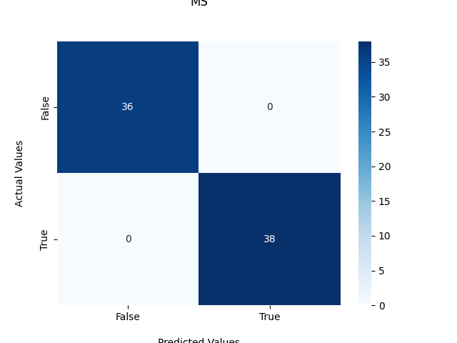
Results: MS (+PCA+SMOTE)
Accuracy: 1.0
Precision: 1.0
Recall: 1.0

Slide 45
Conclusions
We are able to use the abundances/metadata to accurately predict the ocean region
PCA does “represent” 99.6% of variability but it is noisy
Predictions using SVM suffer slightly from the loss in information
Balanced data seems to have roughly the same prediction power

Slide 46
Comparing: Autoencoders
Ran a standard autoencoder model on the TARA feature set
Pipe encoder “features” through SVM to compare with PCA
Autoencoder currently reduces down to 10 layers - need to experiment with other combinations and dimensions

Slide 47
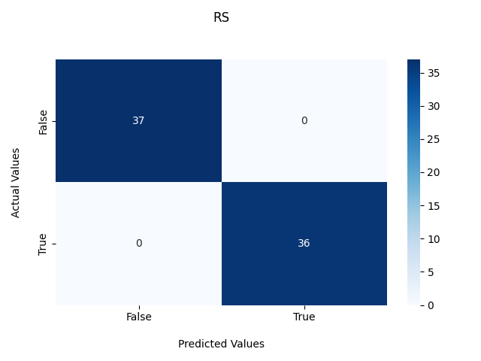
Results: RS (+AE+SMOTE)
Accuracy: 1.0
Precision: 1.0
Recall: 1.0

Slide 48

Results: SO (+AE+SMOTE)
Accuracy: 1.0
Precision: 1.0
Recall: 1.0

Slide 49
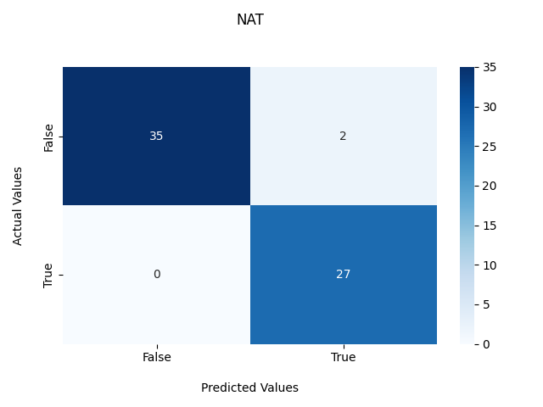
Results: NAT (+AE+SMOTE)
Accuracy: 0.96875
Precision: 0.9310344827586207
Recall: 1.0

Slide 50
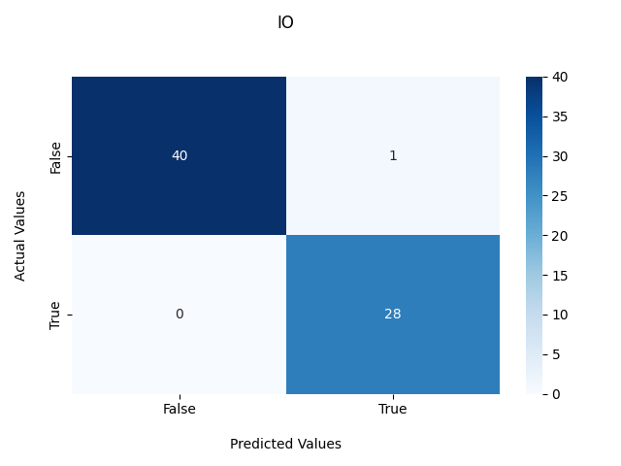
Results: IO (+AE+SMOTE)
Accuracy: 0.9855072463768116
Precision: 0.9655172413793104
Recall: 1.0

Slide 51
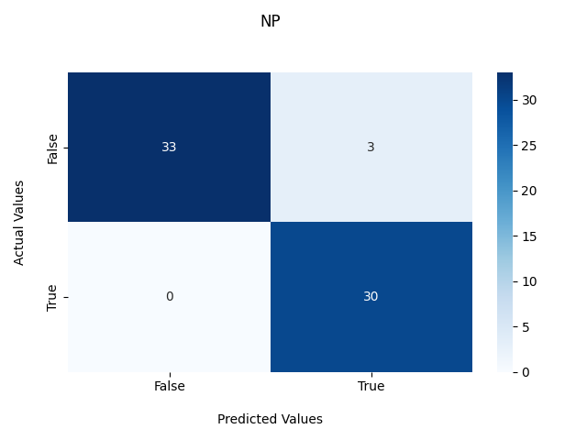
Results: NP (+AE+SMOTE)
Accuracy: 0.9545454545454546
Precision: 0.9090909090909091
Recall: 1.0

Slide 52
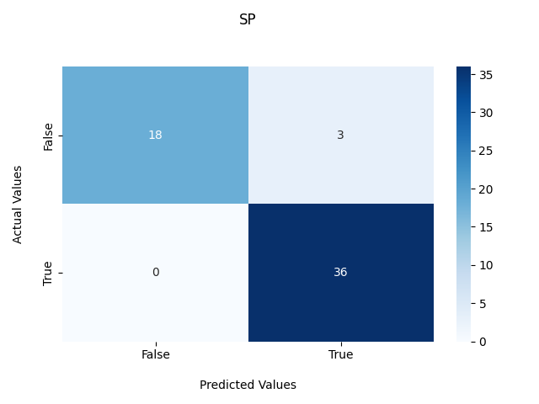
Results: SP (+AE+SMOTE)
Accuracy: 0.9473684210526315
Precision: 0.9230769230769231
Recall: 1.0

Slide 53

Results: AO (+AE+SMOTE)
Accuracy: 1.0
Precision: 1.0
Recall: 1.0

Slide 54

Results: SAT (+AE+SMOTE)
Accuracy: 0.9696969696969697
Precision: 0.9375
Recall: 1.0

Slide 55
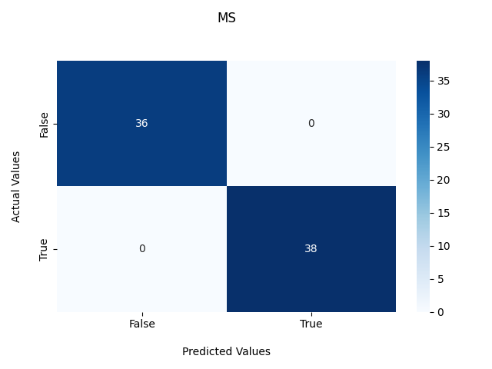
Results: MS (+AE+SMOTE)
Accuracy: 1.0
Precision: 1.0
Recall: 1.0

Slide 56
Phase 2: Using GEM for cultured/uncultured prediction

Slide 57
Understanding the data
Three data files
GEM metadata
Annotation features - fine resolution COG abundances in genomes (4318 features)
Pathway features - coarse grained COG abundances in genomes (i.e. higher biochemical pathways) (71 features)
Total number of samples = 52,515

Slide 58
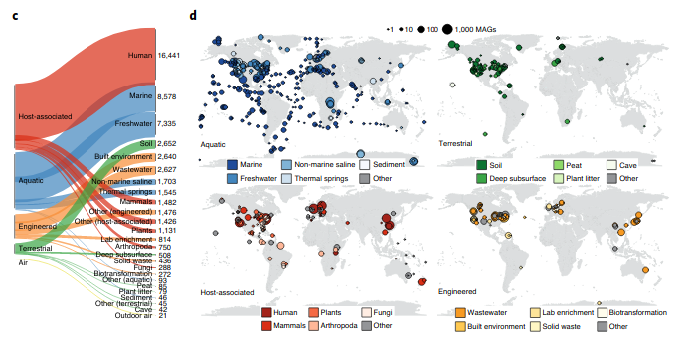
GEM mapping

Slide 59
Performing PCA
First performed PCA on all 52,515 samples using just metadata/pathway features
100% of variability explained by 1 PCA
This was fishy to me so I am investigating…
I think there is probably a bug with this
Also performed PCA on full feature set (including annotation features)
This timed out so I decided to proceed with just the metadata + pathway (roughly 120) features

Slide 60
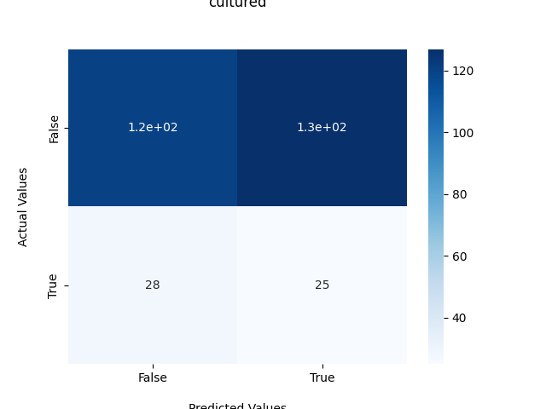
Initial pass with PCA+SVM
Could not use full dataset (timed out)
Used metadata+pathway features for a small subset (1000 samples)
Did not do very well - predicted basically 50/50
5000 samples also timed out

Slide 61
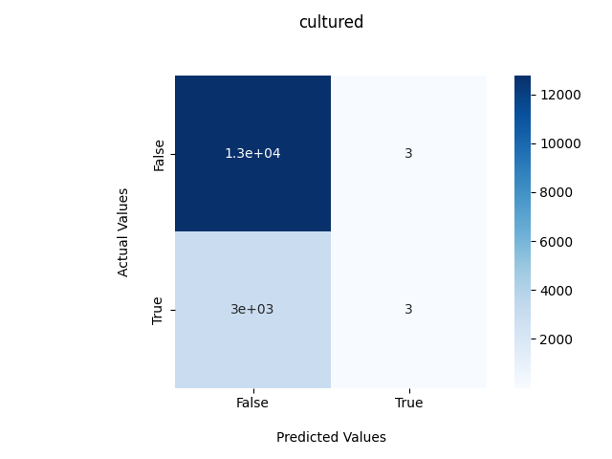
Initial pass with AE+SVM
Used standard AE with 10 layers in embedding
Accuracy: 0.8105998095842589
Precision: 0.5
Recall: 0.0010053619302949062
Seems to predict everything as positive

Slide 62
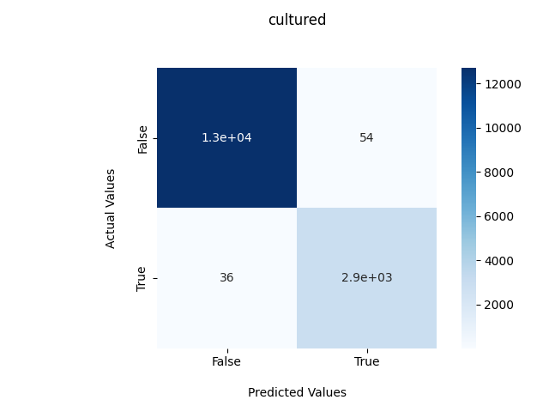
AE+SVM (manually tuned)
Again standard AE, this time with 100 layers and some other parameters changed
Accuracy: 0.9942875277689622
Precision: 0.9820119920053297
Recall: 0.9879356568364611
Predicts pretty well on holdout

Slide 63
Attempting to reduce information between cultured/uncultured
Cultured and uncultured features may contain some “shared” information
We want to factor out this information
Current method:
For each family:
Calculate the average per feature for the uncultured organisms
Subtract the average from the cultured organisms
I call this “vectorizing”

Slide 64
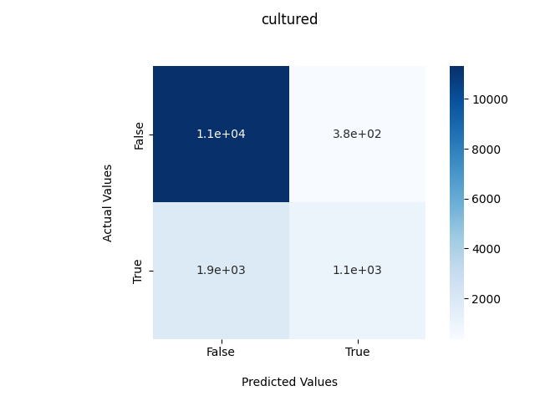
Initial pass with AE+SVM on vectorized data
Used standard AE with 10 layers in embedding
Accuracy: 0.847143345877523
Precision: 0.7356002775850105
Recall: 0.36388602814967386
Does better given same parameters than not having vectorization

Slide 65

AE+SVM (manually tuned) on vectorized data
Again standard AE, this time with 100 layers and some other parameters changed
Accuracy: 0.9934998289428669
Precision: 0.9893871961656967
Recall: 0.9783344617467841
This does roughly the same as non-vectorized data

Slide 66
Next Steps:
Continue investigating the bug in the PCA
This will act like a “baseline” to compare to
Working on using hyperparameter tuning to more efficiently choose a “best” model
Was attempting grid search but I don’t know if an exhaustive approach will actually be needed
Suggestions?
Talk to Dr. Steen about ways I can improve the way I am handling cultured/uncultured

Slide 67
Challenges
Autoencoders work really well for prediction but do not allow interpretation of the results very easily
One of the goals of this work is to determine what factors play a role in a microbe being cultured/uncultured

