Slide 1
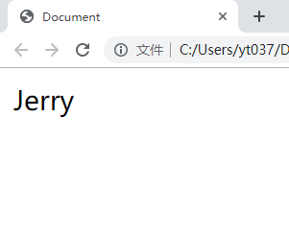
数据响应式
Object.defineProperty
var obj = {};
obj.name = "Jerry";

Slide 2
依赖收集
依赖
Dep1 deps = [watcher1,watcher3]
Watcher1
key = name1
<p>{{name1}}</p> <p>{{name2}}</p>
<p>{{name1}}</p>
收集
Watcher2
key = name2
Dep2 deps = [watcher2]
Watcher3
key = name1

Slide 3
Vue初始化流程
扩展$mount
实现$mount
初始化全局API
初始化
plateforms/web/entry-runtime-with-compiler
plateforms/web/runtime/index
core/index
core/instance/
index
compileToFunctions()
mountComponent()
Vue.set
Vue.delete
Vue.nextTick
initUse(Vue)
initMixin(Vue)
initExtend(Vue)
function Vue (..) {}
initMixin(Vue)
stateMixin(Vue)
eventsMixin(Vue)
lifecycleMixin(Vue)
renderMixin(Vue)

Slide 4
Vue数据响应原理
data
observe
Observer
walk/observeArray
view
data
getter setter
depend
render
update
notify
$mount()
Dep
addDep
Watcher
addSub
update

Slide 5
虚拟DOM的概念
events
JS操作
虚拟DOM
DOM
reactive
patch

Slide 6
Vue模板编译
渲染函数
模板
render(h) {
return h('div', [
h('h1', 'title'),
h('p', 'some content')
])
}
<div>
<h1>title</h1>
<p>some content</p>
</div>
编译

