Slide 1
Activity-based modelling for exposure assessment
Meng Lu
Utrecht University

Slide 2
Exposure for activity information-available situations (SPALDIA).
-> Activity schedule and probability -> Sample a schedule
-> Correspond to a person’s geographical locations and relate to air pollution maps
identified (e.g. with known home, work, activity locations)
predicted (e.g. activity location is close to home)
simulated (e.g. unknown work locations).
-> Exposure assessment
Exposure for information-sparse situations (SCN and EPIC-NL).
-> Relationships between occupation and socioeconomic to the activity patterns -> classify patterns -> clustering activities.

Slide 3
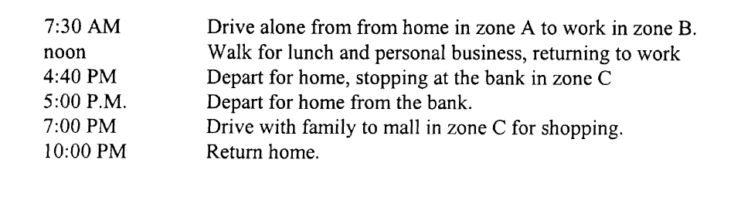
Activity schedule
Econometric models, which impute personal day activities (Bowman 2000)
P(schedule) = P(pattern)P(tours|pattern)
a hypothetical schedule:

Slide 4
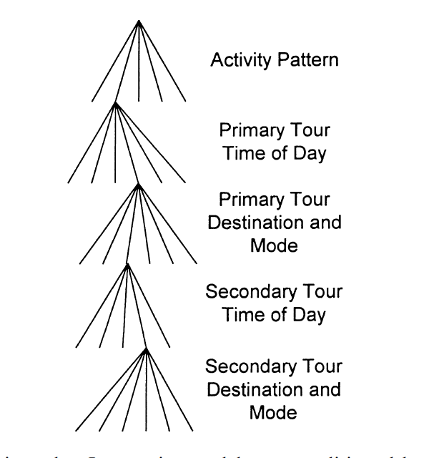
P(schedule) = P(pattern)P(tours|pattern)
Pattern: a function of the attributes of all its available tour alternatives.
Tour: has a base point that a person will start the trip from and return to, it can consists subtours, e.g. break at work. The tour model is hierarchical:
A tour has a tour type: defined by the number, purpose and sequence of activity stops on the tour. For example: (1) home -> work -> home, (2) home -> school -> home -> additional activity.
Secondary tour:
constrained_activity = [“home”, ‘’work’’, “work related”, “shopping”]
unconstrained_activity= [“sports”]
Probability of tours:
All the tours are assigned a priority. The tour contains highest priority activity will be given the highest priority (highest probability)
A primary activity: = [“home”, ‘’work’’, “work related”]
Activity priority: {“home”:0.6, “work”:0.3, “work related”:0.05, “shopping”:0.05, “sports”: 0.05}
Figure 1

Slide 5
Pattern
characterised by the
primary activity,
the type of tour for the day’s primary activity,
the number and purpose of secondary tours.
the pattern can be classified based on the socioeconomic groups.

Slide 6
Pattern
Pattern = {
[fulltime_worker:
primary_activity = “work”,
type_of_tour = “home2work2home”
number_purpose_secondary_activity = 1_unconstrained],
[student:
primary_activity = “school”,
type_of_tour = “home2school2home2activity2activity”,
number_purpose_secondary_activity = 2_unconstrained]
}

Slide 7
Primary and secondary tours
The secondary tour is conditioned on the primary tour
P(tours|pattern) = p(primary tours|pattern)p(secondary tours|pattern)
P(tour) = p(timming)p(mode, destination|timing)

Slide 8
Example
#Assume a person A is a student and 80% he will follow the student pattern.
Pattern_ = Pattern[“student”]
P(pattern) = 80% # defined from spaldia
Tour_type, tour_primary, tour_secondary = retrieve_from (Pattern_)
P(primary_tour|pattern) = f(activity_priority, tourtype, timming, mode)
P(secondary_tour|pattern) = f(activity_priority, tourtype, timming, mode)
P(tours|pattern) = p(primary tours|pattern)p(secondary tours|pattern)
#P(tour) = p(timming)p(mode, destination|timing)
P(schedule) = P(pattern)P(tours|pattern)
Note: timming from route (OSM).
Open transport map

Slide 9
SPALDIA Data and process defined/ predicted/ simulated from data
Data
Days per week of cycling, vehicles, walking.
Primary commuting tools to work, if public transport, the time needed to the public transportation.
How many hours per day and days per week at work place.
10pm – 6 am activity (one hour somewhere?)
Occupation (outdoor, indoor)
Work location, home location.
Process:
Define the primary activity
Predict probability for each activity, tour, time, to calculate P(schedule)
Sample schedule, retrieve space-time locations and calculate exposure.
Classify patterns from socioeconomical variables

