Slide 1
Tidal landscape classification -- P classes
Meng Lu

Slide 2
P1 plaat laag energetisch
P1a1 'Laag energetische vlakke plaat, zand',
P1a1 'Laag energetische vlakke plaat, zand (< 8% lutum)',
P1a1 'Laag energetische plaat met laag golvend relief (H < 0,25m, L = 10-25m)',
P1a2 'Laag energetische vlakke plaat, slibrijk zand (> 8% lutum)',
P1a1 : sand
P1a2: silt
P1a1: low energy sand
P1a2: low energy silt
P2c: high vlak
P2b: megaripple
P2c plaat hoog vlak
P2c 'Hoog energetische vlakke plaat',
P2c 'Geisoleerde schelpenrug op (meestal) hoog energetische plaat',
P2c 'Geisoleerde zandrug op (meestal) hoog energetische plaat',
P2c 'Geisoleerde schelpen- of zandrug op energetische slik langs dijk',
P2b Plaat megaribbel
P2b 'Hoog energetische plaat met onregelmatige 3-dimensionale megaribbels (H > 0,25m)',
P2b 'Hoog energetische plaat met onregelmatige 2-dimensionale megaribbels (H > 0,25m)',
P2b 'Hoog energetische plaat met megaribbels (H > 0,25m) 3-dimensionaal',
P2b 'Hoog energetische plaat met megaribbels (H > 0,25m) 2-dimensionaal',
P2b 'Hoog energetische plaat gegolfd relief (H < 0,25m, L >25m)'

Slide 3
Method
OBIA + XGBoost
XGBoost: Boosting trees with complexity control
Key parameters:
Classifier: gbmtrees
Objective: softmax
Trees: 1500
Learning rate: 0.002
Maximum depth: 6

Slide 4
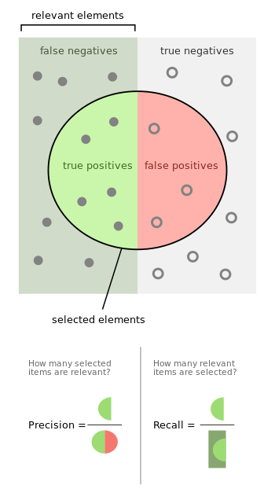
Accuracy metrics
Precision: tp / (tp + fp): the fraction of relevant instances among the retrieved instances.
Recall: tp / (tp + fn): the fraction of the total amount of relevant instances that were actually retrieved.
Accuracy: (tp+fp)/all
Tp: true positives
Tn: true negatives
Fp: false positives
Fn: false negatives

Slide 5
P classes: accuracy metrics
precision: tp / (tp + fp)
recall: tp / (tp + fn)
 | Precision | Recall
P1a1 low energy sand | 0.45 | 0.51
P1a2 low energy silt | 0.53 | 0.57
P2c high vlak | 0.55 | 0.27
P2b megaripple | 0.64 | 0.77
Overall | 54.44% | 54.65%
Accuracy: 54.65%
Tp: true positives
Fp: false positives
Fn: false negatives
P1a1: low energy sand
P1a2: low energy silt
P2c: high vlak
P2b: megaripple

Slide 6
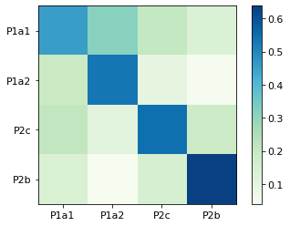
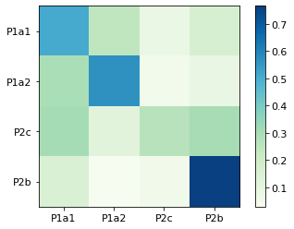
P classes: confusion matrix
Normalised by all the predicted truth
Diagonal: precision
Normalised by all the truth
Diagonal: recall

Slide 7
P classes: original confusion matrix
p1a1 p1a2 p2c p2b
P1a1 [1914, 929, 287, 627]
p1a2 [ 815, 1552, 135, 224]
P2c. [ 886, 325, 762, 876]
P2b. [ 601, 117, 211, 3042]
P1a1: low energy sand
P1a2: low energy silt
P2c: high vlak
P2b: megaripple

Slide 8
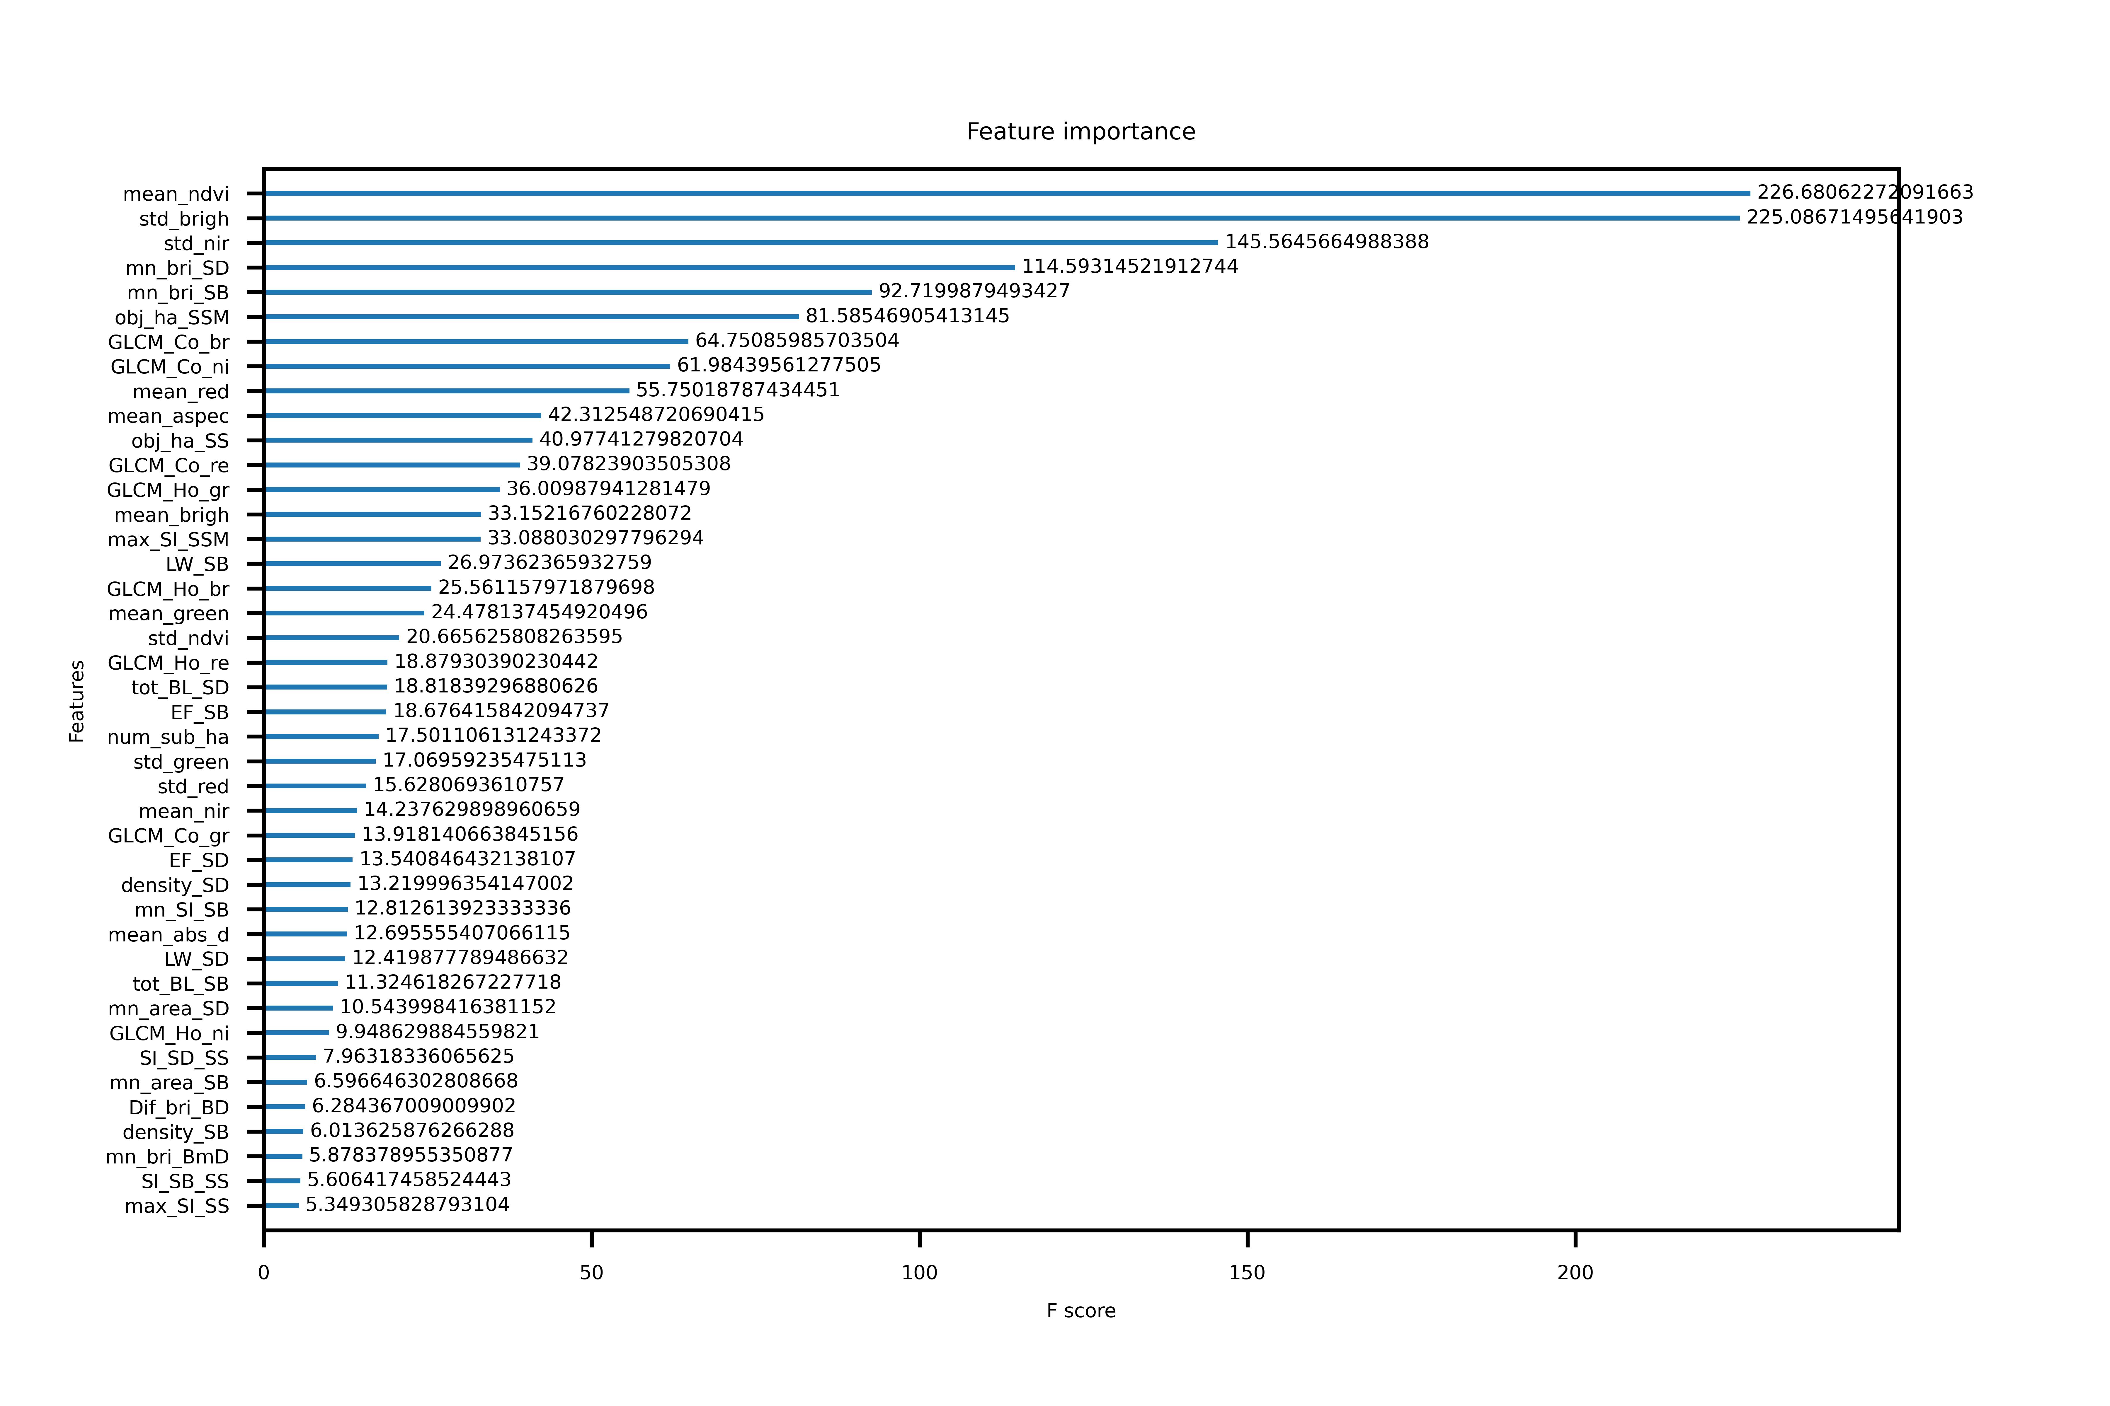

Slide 10
P1 classes: accuracy metrics
precision: tp / (tp + fp)
recall: tp / (tp + fn)
 | Precision | Recall
P1a1 low energy sand | 0.85 | 0.44
P1a2 low energy silt | 0.62 | 0.73
Overall | 72.76% | 65.16%
Accuracy: 65.16%
Tp: true positives
Fp: false positives
Fn: false negatives
P1a1: low energy sand
P1a2: low energy silt
P2c: high vlak
P2b: megaripple

Slide 11
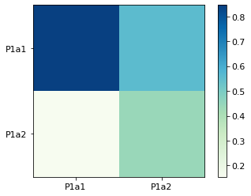
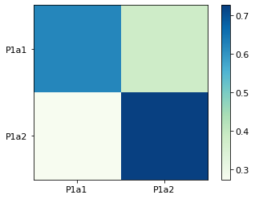
P1 classes: confusion matrix
Normalised by all the predicted truth
Diagonal: precision
Normalised by all the truth
Diagonal: recall

Slide 12
P1 classes: original confusion matrix
p1a1 p1a2
P1a1 5455, 3332,
p1a2 995, 2636
P1a1: low energy sand
P1a2: low energy silt

Slide 13
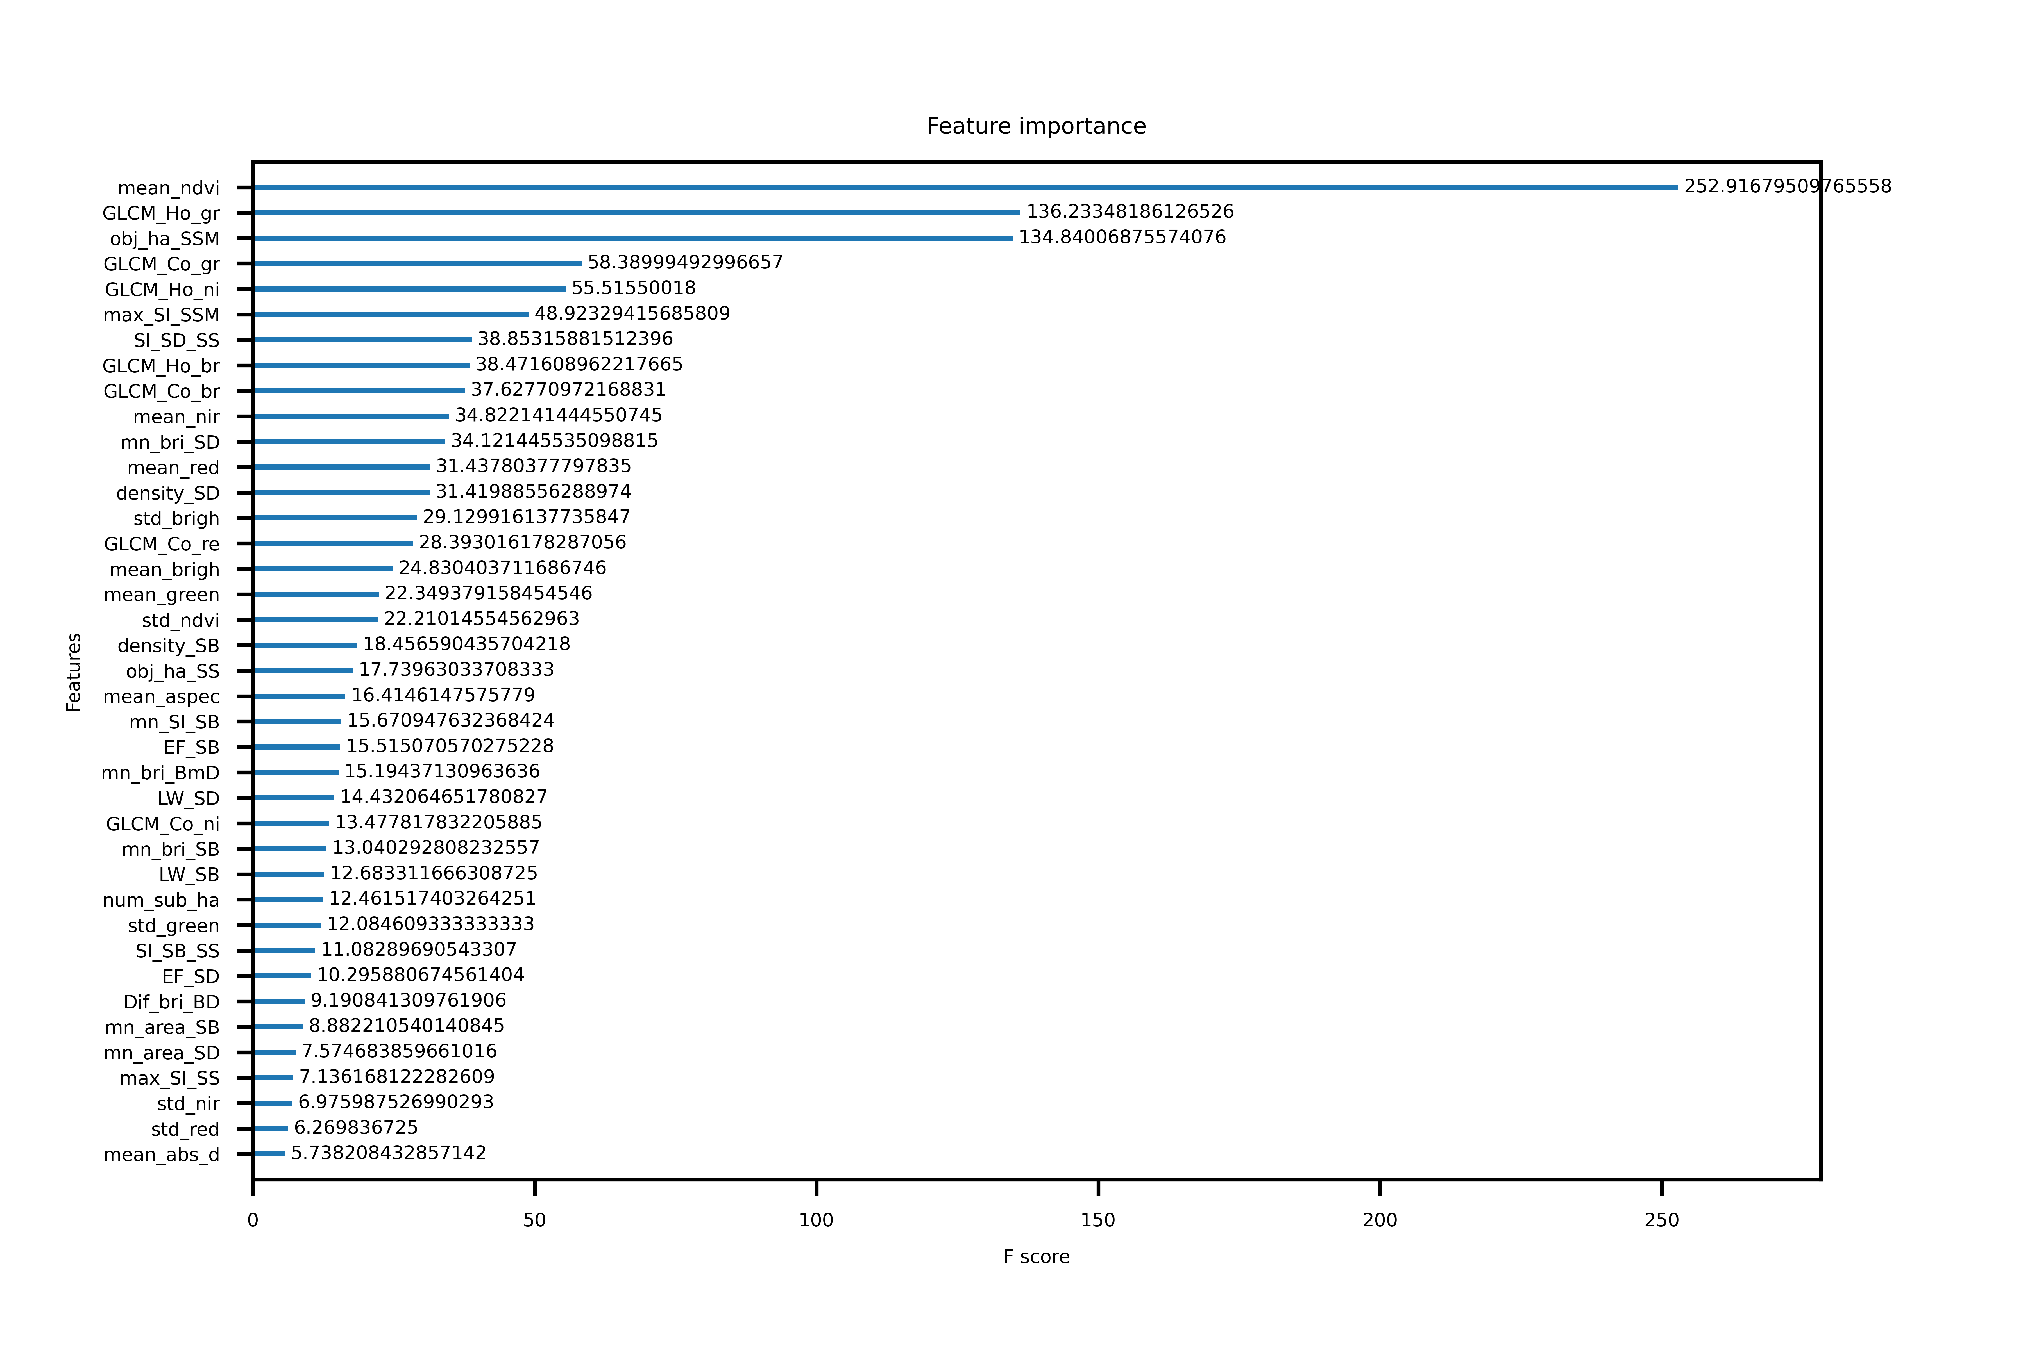

Slide 15
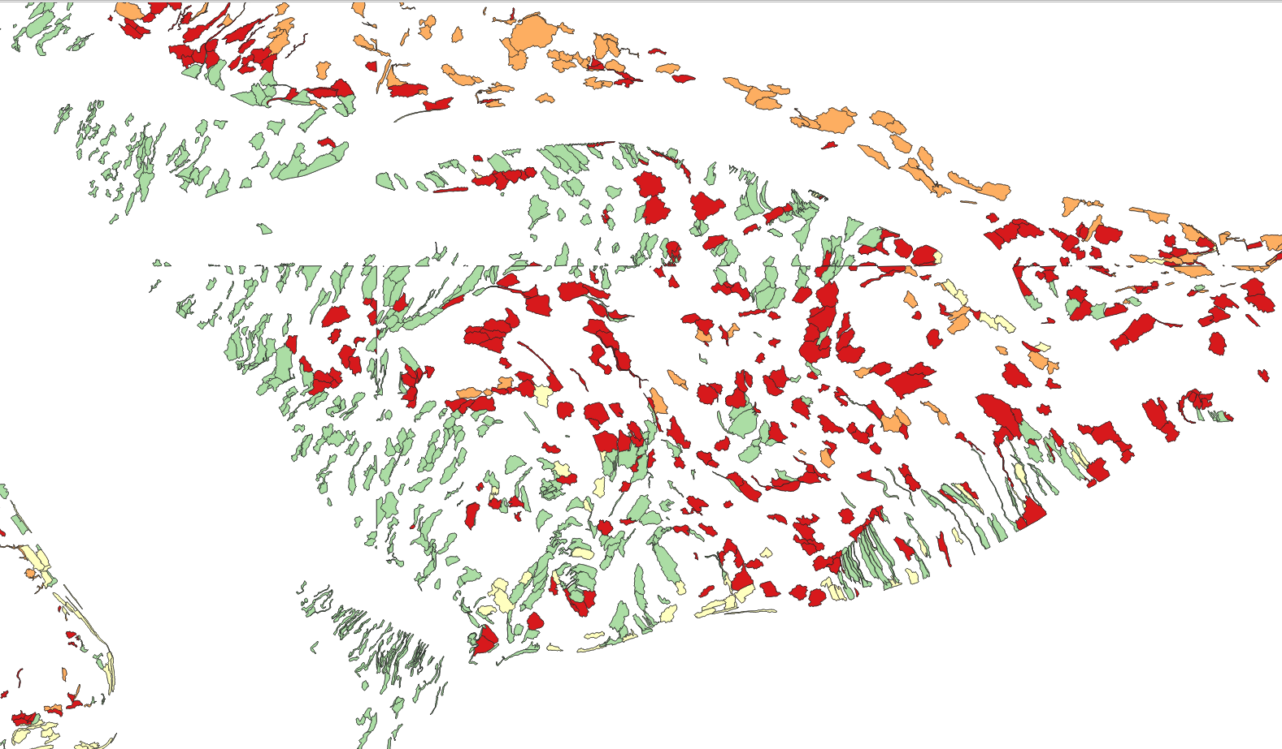
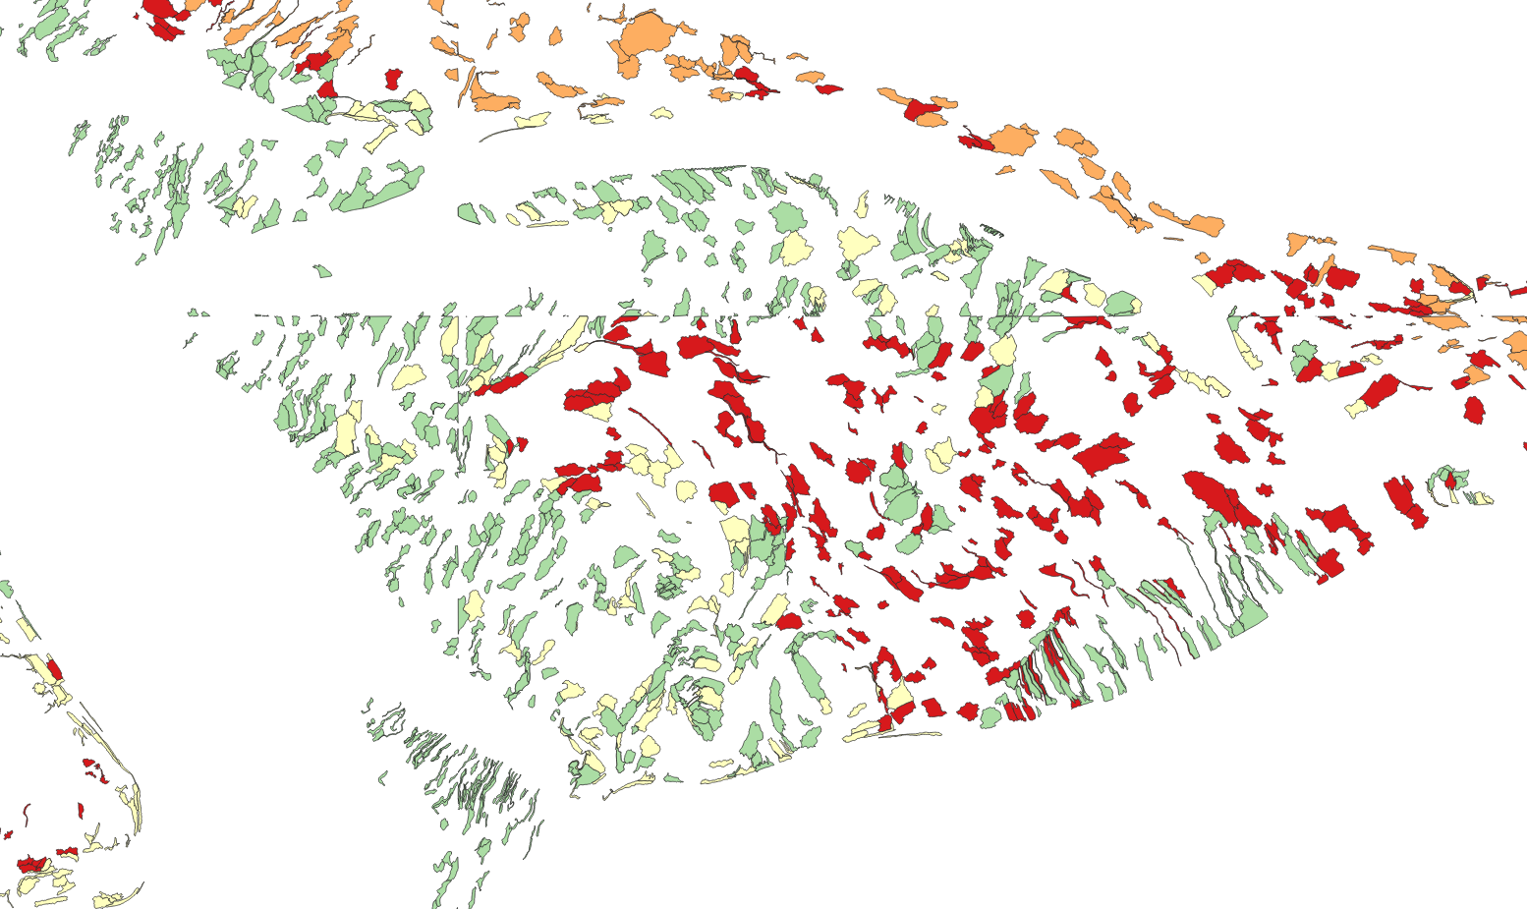

Predicted
P1a1: low energy sand
P1a2: low energy silt
P2c: high vlak
P2b: megaripple
Ground truth

