Slide 1
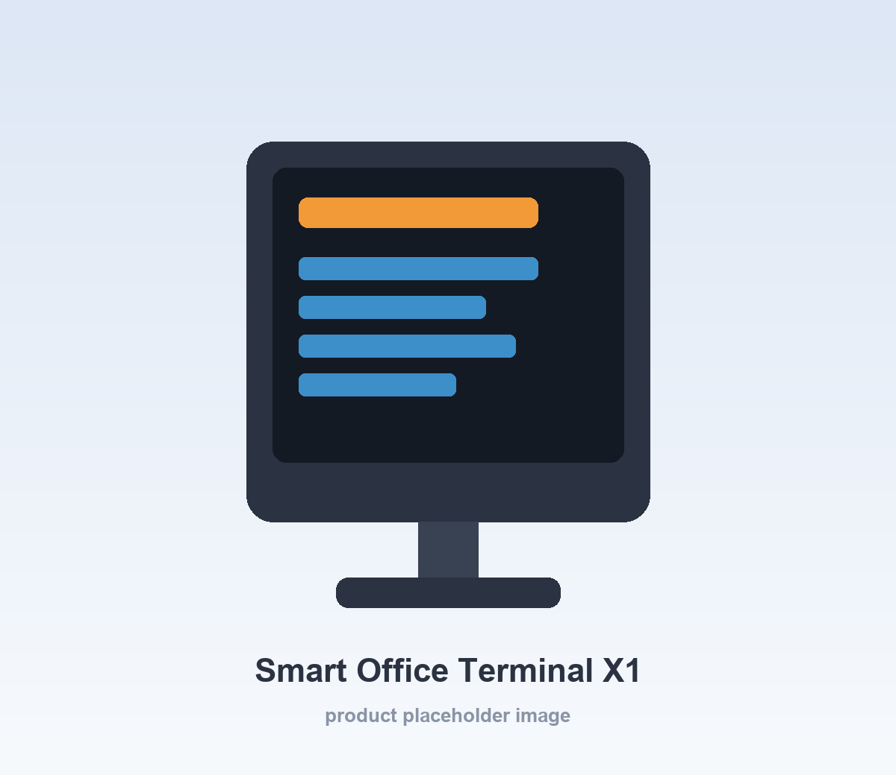
September 2026 Sales Report
East China Regional Performance
September 2026
Example Technology Co., Ltd.

Slide 2
Key Business Metrics
Report: September 2026 Sales Report
SALES
GROWTH
ORDERS
CUSTOMERS
¥12,580,000
+18.5%
12,580
3,280
Total reported sales: ¥12,580,000 year to date.
Metric | Value A | Value B
Summary | ¥12,580,000 | Growth +18.5% YoY

Slide 3
Product Showcase
Smart Office Terminal X1
A next-generation smart terminal designed for enterprise office scenarios.
Price
¥2,580
Month-over-month growth
+23.6%
September 2026 Sales Report

Slide 4

Workspace Asset Test
{{image:missing_image}}

